Slide 1
Car Segmentation Final Project Presentation
By
Piter Garcia

Slide 2
ROCHESTER INSTITUTE OF TECHNOLOGY
ABSTRACT
In this project, we explore the detection of car and circles in a basic gray scale images.
This work is based in detection of cars and its tires.
The car and circle detection process used is based on:
pixel direction concept of Cannyn non-maximum suppression process for contour tracing described by Neubeck and Gool.

Slide 3
Topics of Interest:
Objective
Introduction
Approach
Strategies
Implementation
Practical Problems and Solutions
Goal
Conclusion
Question

Slide 4
OBJECTIVE
Detection and recognition of shapes such as cars and tires.
Evaluate edge segments to determine the desired shape.
I use the edge threshold property of Canny edge detection.
Test my algorithm on different images of cars.
The main objective is to describe the techniques and approaches taken towards car segmentation system.

Slide 5
INTRODUCTION
Extracting the edges from an image simplifies the analysis of the image by:
dramatically reducing the amount of data to be processed
preserving useful information about the boundaries.
The edge extracted image is used by many algorithms such as:
the Circular Hough transform
the Linear Square method to further extract shape information in an image.
The aim of this project is to develop an explanation of the imaging system used in:
capturing the data to get the shape of cars and circles
discuss the challenges imposed by the dataset
apply some algorithms such as mixture of Gaussians, Canny edge detection, and HSB
Analyze the difficulties encountered in handling this data to identify the potential car and tire shapes.

Slide 6
APPROACH
Main approaches are:
Extracting roads from the image.
Implement Hough transform and Canny edge detection.
Another algorithm that turned out more efficient for car segmentation is HSB.
Convolution and non-maximum suppression combination.
Canny Edge Detection:
The algorithm uses a multi-stage process to detect a wide range of edges in images.
The stages used in this project are:
Image smoothing. This is done to reduce the noise in the image.
Calculating edge strength and edge direction.
Directional non-maximum suppression to obtain thin edges across the image.
Invoking threshold with hysteresis to obtain only the valid edges in an image.

Slide 7

Block diagram of the Stages of the Canny Edge Detector.
A block diagram of the Canny edge detection algorithm is shown above.
The input to the detector can be either a color image or a grayscale image.
The output is an image containing only those edges that have been detected.

Slide 8

Image Smoothing:
First stage of the Canny edge detection.
Pixel values of the input image are convolved
Reduce the noise within an image
Gaussian filter.
It is a discrete version of the 2-dimensional function shown below.
σ is the standard deviation of the Gaussian filter:
Describes the narrowness of the peaked function
x and y are spatial coordinates.

Slide 9
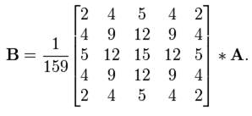
An example of the conversion of a 2-dimensional 5x5 discrete Gaussian filter function is shown in the above equation.
The function is obtained for σ = 1.4
Substituting integer values for x and y and re-normalizing.
A is the 2-dimensional array of input pixel values and B is an output image.
The process of smoothing an image using an M x M block filter yields:
Each pixel value to be a weighted average of the surrounding pixel values
The pixel value at the center weighted much more strongly than nearby points.
suppress noise and get a continuous edge contour in the non-max suppression process.
The output obtained is a blurred intermediate image
Next block is calculated with this output to get strength and direction of the edges.

Slide 10
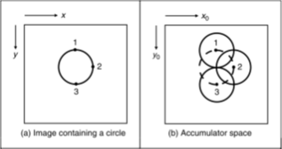

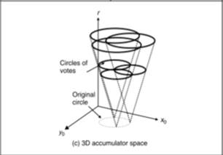
Extraction of Shapes
Algorithms used are:
Linear Square Method
Hough Transform
- HT was successful detecting circles in noisy environments.
Circular Hough Transform
The Canny edge detector forms the input to extract the circle using the circular Hough transform.
This figure shows three circles defined by three edge points labeled 1, 2 and 3:
- These circles are defined for a given radius value
- Each edge point defines a circle for the other values of the radius
- All edge points map to a cone of votes in the accumulator space

Slide 11
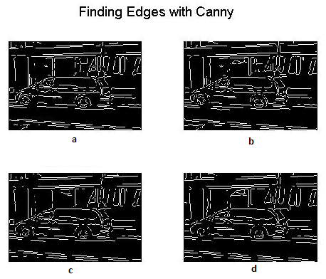
IMPLEMENTATION
Analyze my algorithm's performance
with the given approaches:
The Canny edge detection
uses thresholding with hysteresis
with two values, T1 and T2.
selecting which points belong to
edges and which do not.
Edges detected by:
(a) 0.1 times the default threshold
(b) 0.2 times the default threshold
(c) 0.5 times the default threshold
(d) 0.9 times the threshold value
Only pixel directions are used to validate the edges in this case. Thus, the issue of finding the right threshold for every image is solved.

Slide 12
Sensitivity to Illumination
Some factors that affect the results of the edge detection are:
shade
texture
illumination, and so on
In these figures, the goal of the edge detector is to:
Discard the edges created by shades, textures and illuminations
Give the edge segments for only the strong boundaries
The figures to the left are examples of its implementation:
The intensity of the original image is decreased
The illustration of dependency of the Canny edge detector
The proposed algorithm caused this change in intensity

Slide 13
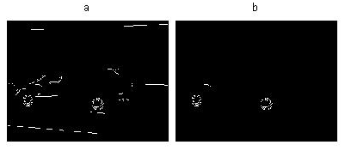
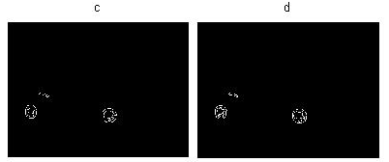
Images (a) through (d) are Canny edge
detector results with different threshold
values.
Notice that:
The reduction in edges is detected.
Images (e) & (f) are not much different and still have enough info to detect a circle.
These two images detected similar edges using the different thresholds, 0.8 and 0.9.
The number of edges detected in (f) has decreased, but still the algorithm used get a similar response as the response in (e).

Slide 14
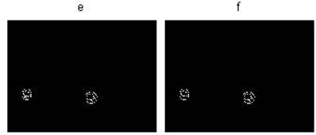
In this case:
illumination does affect my algorithm
the sensitivity to illumination is less when compared to the Canny edge detector
it uses the rate of change of pixel values
we use the edge direction, which is derived by comparing the pixel values.

Slide 15
Some of the disadvantages of the implemented algorithms are:
Quantization errors:
An appropriate size of accumulator array is difficult to choose.
Difficulties with noise
The advantage and weakness of my algorithms is that:
They connect edge points across the image to some form of parametric curve.
Good phantom circles could also be detected with a reasonably large voting array.

Slide 16
Thresholding:
Eliminates spurious points and non-edge pixels from results of non-maximum suppression.
Good smoothing, calculating edge strength and edge pixel, and the non-maximum suppression stage, to obtain thin edges in the image.
Two threshold values, T1 (high) and T2 (low), for the edge strength of the pixel of the img.
Edge strength which is greater than T1 is considered as a definite edge.
Edge strength which is less than T2 is set to zero.
The pixel with edge strength between T1 and T2 is considered if there is a path from this pixel to a pixel with edge strength above T1.
The path must be entirely through pixels with edge strength of at least T2.
This process reduces the probability of streaking.
As the edge strength is dependent on the intensity of the pixel of the image, thresholds T1 and T2 also depend on the intensity of the pixel of the image.
The thresholds T1 and T2 are calculated by the Canny edge detectors using adaptive algorithms.
All the edges in an image are detected using the Canny edge detection.

Slide 17
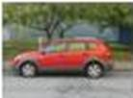
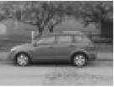

GOAL
In this project, only two three-dimensional
color spaces are investigated
RGB
HSV

Slide 18
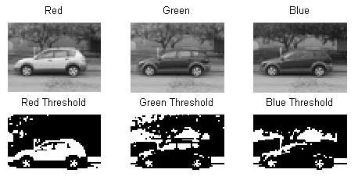
Existing color-based general-purpose image retrieval systems roughly fall into three categories depending on the signature extraction approach used:
histogram
color layout
region-based search

Slide 19
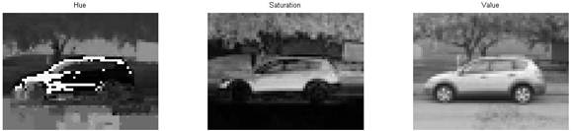
Histogram search characterizes an image by:
its color distribution
histogram
drawback of a global histogram representation is that information about:
object location
shape
texture is discarded.

Slide 20
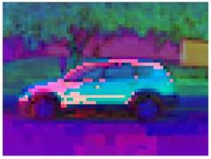
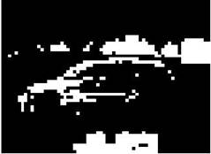
This project showes that images retrieved by using the global color histogram may not be semantically related, even though they share similar color distribution in some results.

Slide 21
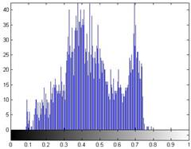
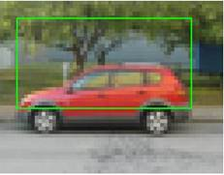
Histogram-based retrievals in HSV showed better performance than in RGB color space.
The histogram Intersection-based image retrieval in HSV color space was found to be most desirable than the Canny edge detection algorithm.

Slide 22
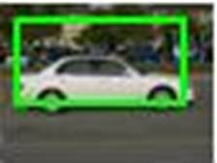
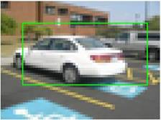
The pictures are the result of the HSB algorithm:
successfully worked detecting the car in pictures assigned
drew a box around the car’s shape.

Slide 23
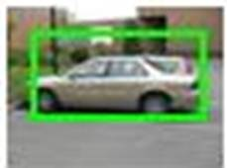
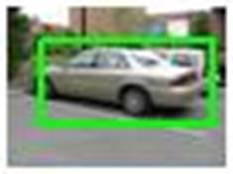
Same approach was used with canny edge detector :
the result was not as successful at the HSB algorithm.
The reasons why:
recognizing cars only on the basis of pixels values
not recognizing cars on color intensities.
HSB algorithm works better recognizing a car in an image.
Boxes around the car do not come out as perfect as desired:
there is a reflection of light present in some images.
reflection brings noise, causing problems in image recognition

Slide 24
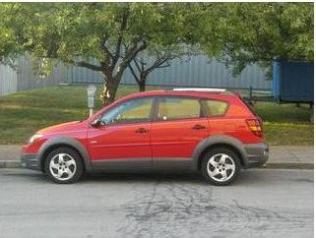
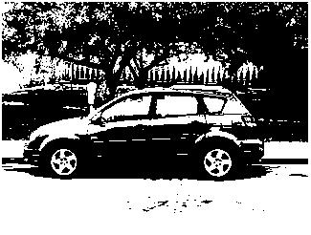
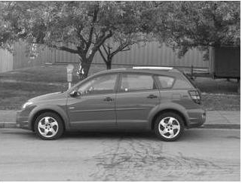
RGB and HSB histogram-based image retrieval methods in two color spaces are exhaustively compared by providing graphs for each image class and for all test images.

Slide 25
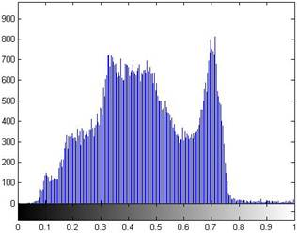
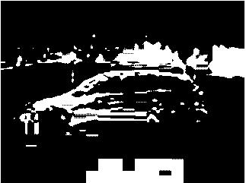
In this section of the project:
two different algorithms were combined
obtain the shape of the cars along with the shape of the tires

Slide 26
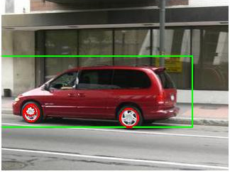
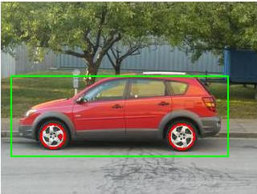
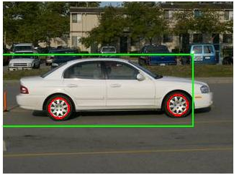
This image retrieval system was built with the:
canny edge recognition
HSB
This is a similar process to the previous code.
This algorithm identifies a car shape
along with the car’s tires.

Slide 27
CONCLUSION
A threshold invariant algorithm has been proposed:
uses a modification of the Canny edge detector.
The algorithm has been tested on a group of 10 images.
reduced sensitivity to changes in image intensity.
One on the most challenging tasks in this project was:
the car extraction in images.
A solution to this problem was:
provide an algorithm that can be used to find any shape.
classify image accordingly to described shapes.

Slide 28
Techniques used Hough Transform:
used to identify circular objects in low-contrast noisy images.
Highly dependent converting gray-scale images to bin images
Using edge detection techniques such as Canny:
find irregular instances of objects
predefined set of shapes by a voting procedure.
In general, histogram-based retrievals in HSV color space showed better performance than in RGB color space since it showed higher precision values for the same recall values.

