Slide 1
Scene Classification
Update 2
Piter Garcia Karina Damico Pauline Martial

Slide 2
Karina:
Gabor descriptor

Slide 3
Gabor descriptor
Load the image - compute 384 feature vector, which is combined from little histograms (8 bin by each filter)
Compute average histogram for each category
Load test images and compare each image with the average histograms
- find minimum distance (histogram intersection) - classify
Results: Very bad - 70% error, running time 53 minutes - Garbage approach
Reason: Probably because Gabor filters have two side - real and imaginary - imaginary part was ignored, histograms were similar
How to resolve? - Superimpose the layers

Slide 4
Gabor descriptor
Superimpose gabor-filtered images to generalize histogram
fv = []
For each quarter of the image
for each filter in the filter bank (12 filters)
- filter input
superimpose resulted 12 layers
calculate histogram h
fv = [fv h]
Repeat algorithm above for each image in the category
Calculated averaged histogram for each category
Load test image, run algorithm, compare with average histograms of
categories
Choose min difference - classify

Slide 5
Gabor descriptor
Advantages: can reduce feature vector by choosing 20 bins for each quarter (instead 8*12 beans) - total 80 - feature vector
Runtime: 37 minutes!!! for whole dataset.
Try to downsize the image - gives adequate results with 0.5
Thought about professor's idea - is it equivalent to downsampling?
Could I just downsample the image using Gaussian pyramid?

Slide 6
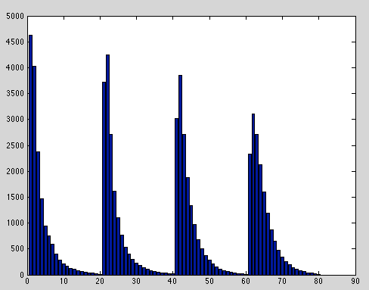
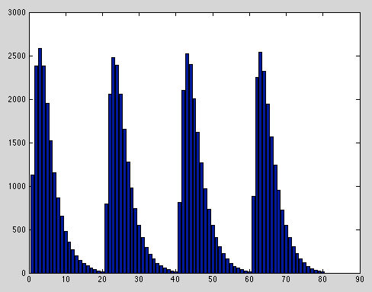
Gabor descriptor
Tall building Forest

Slide 7
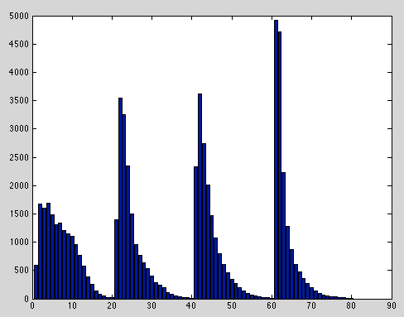
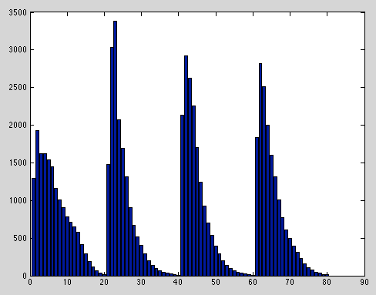
Gabor descriptor
Highway Coast

Slide 8
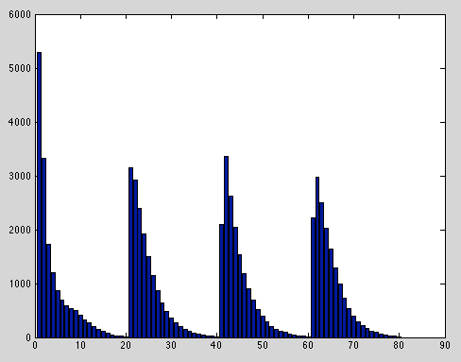
Gabor descriptor
Mountain
Scale is important here - thus must measure distance. Results for Euclidian distance:
Scale 0.5
Accuracy: 63% (80 fv)
Test for 32 bins per image quarter (128).
Accuracy: 63% - exactly the same; time - the same

Slide 9

Gabor descriptor
Correlation between categories:
Other test:
For the whole image - not breaking it in 4 sectors:
Accuracy: 53%
 | Coast | Forest | Mountain | Highway | TallBuilding
Coast | 1
Forest | - 0.015 | 1
Mountain | 0.0098 | -0.0083 | 1
Highway | 0.0376 | 0.0375 | 0.0313 | 1
TallBuilding | -0.000078 | 0.000034 | 0.000092 | 0.000008 | 1

Slide 10
Gabor descriptor
Results are so so... Better idea!?
Preserving more spatial information: don't use histogram, calculate value on each 'bin' of superimposed gaborfiltered image 'manually'.
Split the image in 32 bins manually and calculated sum of pixels
(32*4=128 feature vector)
Accuracy: 43%
Time: 27 min

Slide 11
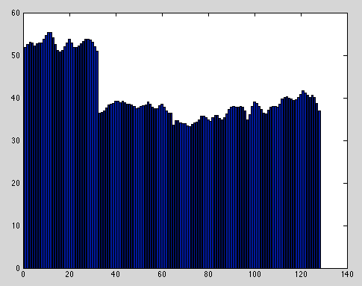
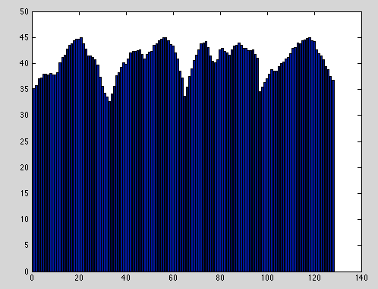
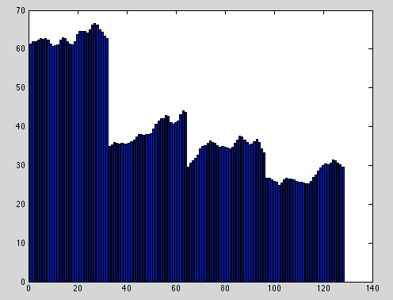
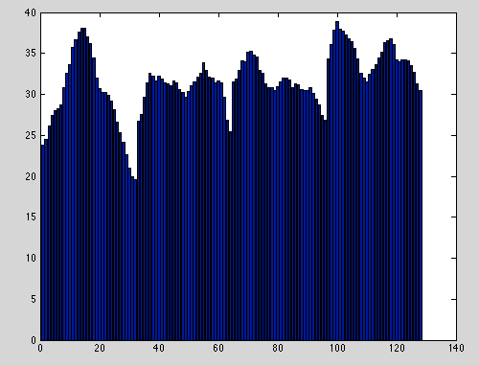
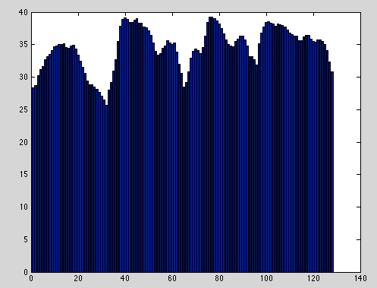
Gabor descriptor
coast
Forest
Highway
Tall building
Mountain

Slide 12
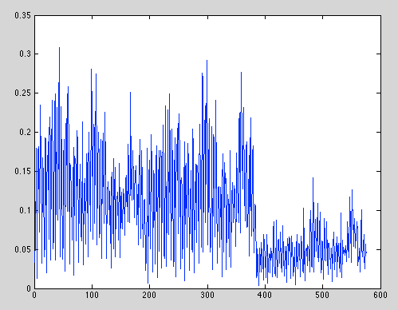
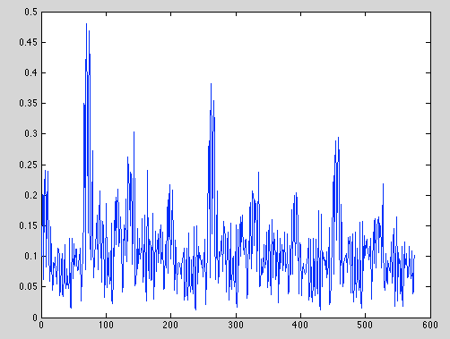
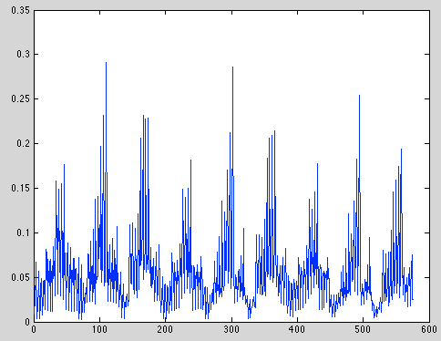
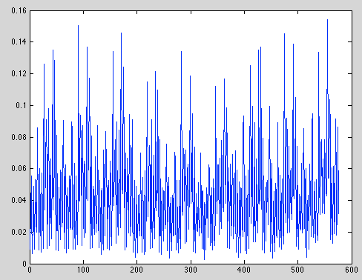
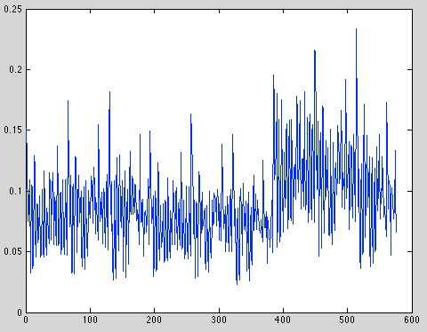
Gabor descriptor
Histogram and averaged method didn't work very well
Tried classic GIST Gabor - use normalized color images
mountain
tall building
coast
highway
forest
Next stage will keep trying GIST to get better accuracy than 63%

Slide 13
Gabor descriptor
Question: Gabor feat doesn't work well with histogram intersection method, Euclidian distance doesn't work well with CENTRIST histograms. We compare with averaged category histograms only
What's the point to look for better measure technique if it won't be used with hybrid?
Should try neural network for the next stage?

Slide 14
Pauline:
CENTRIST
descriptor

Slide 15
CENTRIST descriptor
Tests with different parameters:
Size of training set
Downsize factor
Image division
Distance calculation
Histogram number of bins

Slide 16
CENTRIST descriptor
Partial training data set: 1/3 of training images
Computation with downsize: 10 times
Total computation time: 18
Total number of misclassifications: 91/150
Computation with downsize: 4 times
Total computation time: 110
Total number of misclassifications: 93/150
Not same classifications but no improvement.

Slide 17
CENTRIST descriptor
Partial training data set
4 lines
.125 downsize
Quadratic Method
Total computation time: 27
Total number of misclassifications: 89/150
Histogram Intersection Method
Total computation time: 27
Total number of misclassifications: 45/150

Slide 18
CENTRIST descriptor
Whole training data set
4 lines
.125 downsize
Quadratic Method
Total computation time: 50
Total number of misclassifications: 87/150
Histogram Intersection Method
Total computation time: 50
Total number of misclassifications: 34/150

Slide 19
CENTRIST descriptor
Whole training data set
.125 downsize
Histogram Intersection Method
Total computation time: 48
Total number of misclassifications: 108/150
Quadratic Method
Total computation time: 49
Total number of misclassifications: 120/150
4 lines / 4 columns

Slide 20
CENTRIST descriptor
Whole training data set 4 lines Histogram Intersection Method
0.0625 downsize
Total computation time: 14
Total number of misclassifications: 52/150
0.125 downsize
Total computation time: 50
Total number of misclassifications: 34/150
0.25 downsize
Total computation time: 200
Total number of misclassifications: 37/150

Slide 21
CENTRIST descriptor
0.125 downsize 4 lines Histogram Intersection Method
All computation times = 50+/-1
10 bins histograms: 55/150 misclassifications
20 bins histograms: 34/150 misclassifications
40 bins histograms: 30/150 misclassifications
70 bins histograms: 28/150 misclassifications
100 bins histograms: 27/150 misclassifications
150 bins histograms: 24/150 misclassifications
200 bins histograms: 24/150 misclassifications

Slide 22
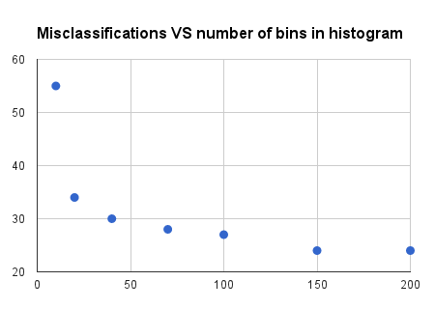
CENTRIST descriptor

Slide 23
CENTRIST descriptor
Best performance:
0.125 downsize
4 lines
Histogram Intersection Method
40 bins histograms = best compromise
Best result:
30/150 misclassifications
i.e. 80% successful classification

Slide 24
Piter:
Color histogram
descriptor

Slide 25
Project Progress Update - Week 2
%% Feature Extraction
%% Stat Comparision
%% Inter-class feature comparison
%% Intra-class comparison
%% Inter-class seperation comparison
%% Classification Comparison
%% Train / Verficiation Data Seperation
%% Avg Intersection Feature
%% Feature Creation
%% Dimension Reduction
%% Train SVM
%% Test SVM

