Slide 1
Scene Classification
Update 3
Karina Damico
Pauline Martial
Piter Garcia

Slide 2
Karina:
Gabor descriptor

Slide 3
Gabor descriptor
Test on 4 line histogram methods [2] - 1x128 feature vector:
Create training input matrix: 128 x 345
Create target matrix: 5 x 345 (5 categories, 345 samples)
Create NN with Matlab NN toolbox
Split those training images into: training (70%), validation (15%), testing (15%)
As vector has length 128 - thus, 128 input vectors
Number of hidden nodes: 70 (worked ok)
Number of output neurons: 5

Slide 4
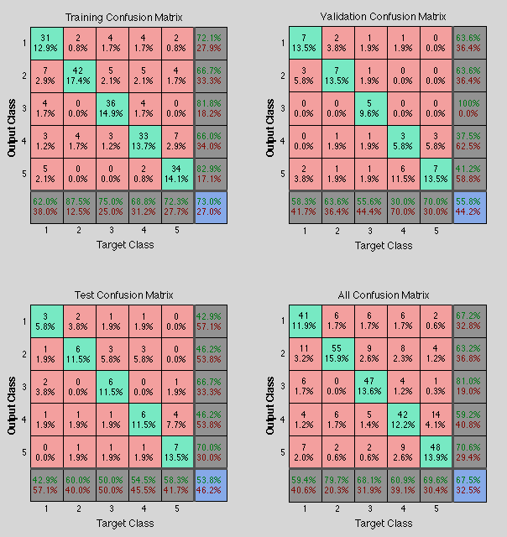
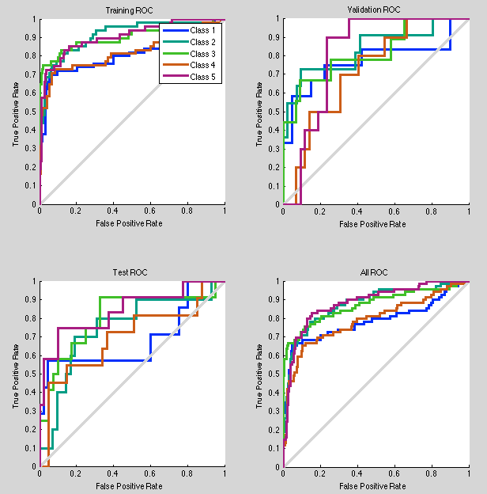
Gabor descriptor
Test on 4 line hist method: trained - 67% accuracy for testing portion

Slide 5
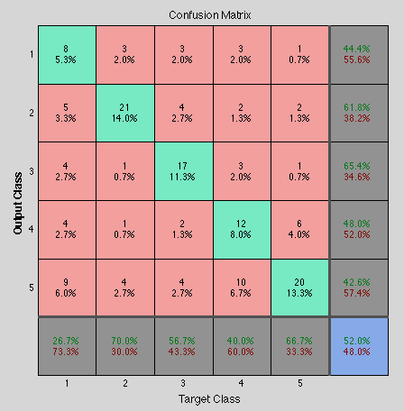
Gabor descriptor
Testing on 150 test images:
Number of misclassification: 72/150 - 52% accuracy
Where confusion happened - everywhere (more or less)
 | Coast | Forest | Highway | Mountain | Tall Building
Coast
Forest | 8
Highway | 7 | 5
Mountain | 7 | 3 | 5
Tall Building | 10 | 6 | 5 | 16
BAD!!!

Slide 6
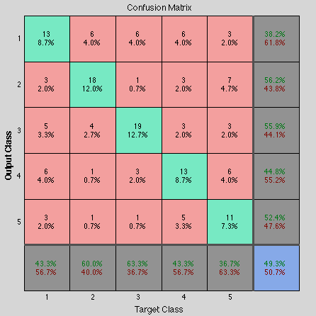
Gabor descriptor
Test on 4 line manual collon method:
Testing on 150 test images:
Number of misclassification: 76/150 - 50% accuracy
Where confusion happened - everywhere again (more or less)
BAD!!!

Slide 7
Gabor descriptor
GIST: as someone could remember from previous Update - 1 x 576 feature vector.
But I found a nice article describing how someone applied gabor on colored image, that needs to be preprocessed first, so:
1) Whitening the image (through difference of image and real part of double Fourier Transformed Image) - use fft2()
2) Local contrast normalization (normalization is done by dividing by the local luminance variance)
3) When calculating Gabor for colored - need to reshape, so that one column is one images output
Network is modified: 576 input nodes, 300 hidden layers

Slide 8
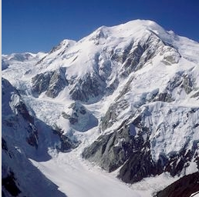
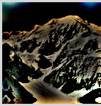
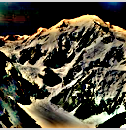
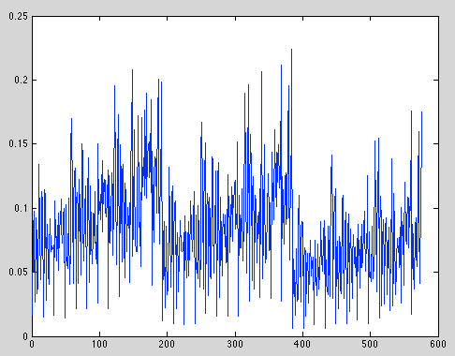
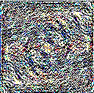
Gabor descriptor

Slide 9
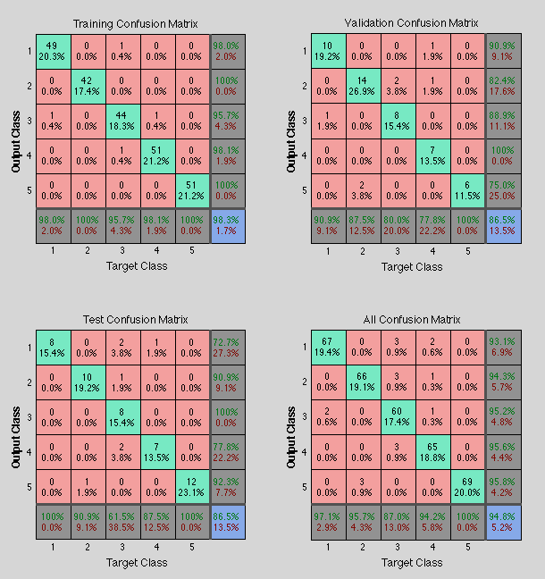
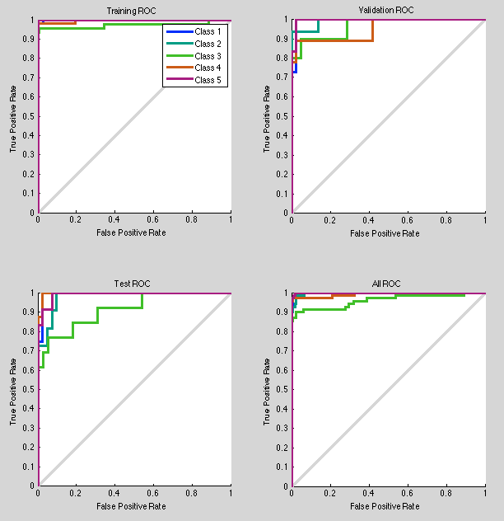
Gabor descriptor
94% accuracy for training and validation!!!
OMG! Looks nice!!! :D

Slide 10
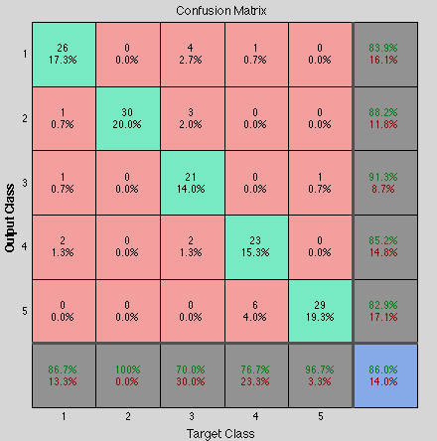
Gabor descriptor
Results of Running the trained Network on the test set (150 images).
86% - accuracy with "Gabor GIST gray scale no more" features
Forest - 100% correctly classified.
Tall Building - 96.6% correctly classified.
Which class was the most problematic one? - highway

Slide 11
Gabor descriptor
I'm very happy with results.
Next stage - will need to get all the features of my teammates - normalize and scale them,and then run through network.
Decided to use MLP instead of RBF, as the training time wasn't an issue even with 300 hidden layers, and MLP has nicer implementation in MATLAB - easier to configure and get fancy plots!

Slide 12
Pauline:
CENTRIST
descriptor

Slide 13
CENTRIST descriptor
Voting algorithm:
CT Gabor GIST
: high confidence (3)
: medium confidence (2)
: low confidence (1)
vote
vote
vote

Slide 14
CENTRIST descriptor
Random training/testing images:
3 | 2 | 6 | 1 | 7 | 4 | 5
< 5?
1 | 1 | 0 | 1 | 1 | 1 | 0
Testing images
Training images

Slide 15
CENTRIST descriptor
Total number of misclassifications: 80/100 = 80%
Detail: Number of errors
coast 15
forest: 23
mountain: 10
highway: 16
tall building: 16
Total number of misclassifications: 37/50 = 74%
Detail: Number of errors
coast 06
forest: 11
mountain: 04
highway: 07
tall building: 09

Slide 16
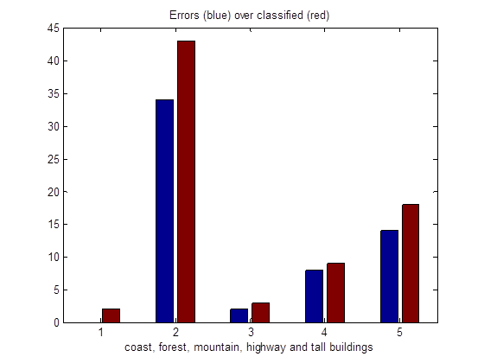
CENTRIST descriptor
Total number of misclassifications: 58/75 = 77%
Detail: Number of errors
coast 00/02
forest: 34/43
mountain: 02/03
highway: 08/09
tall building: 14/18

Slide 17
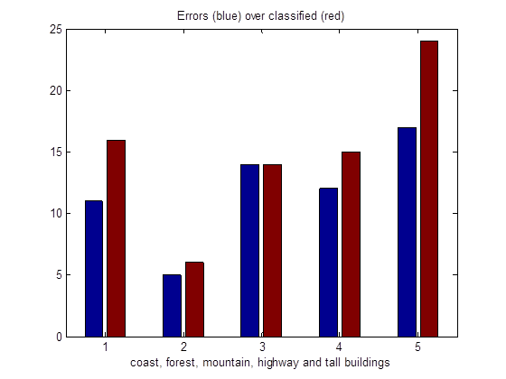
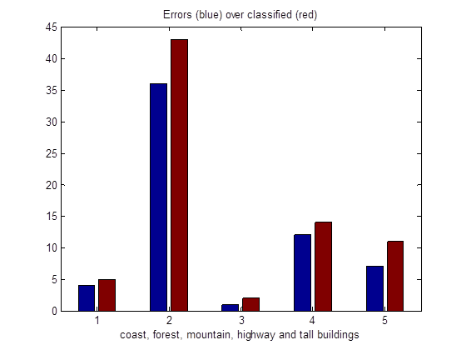
CENTRIST descriptor
If 3 disagree, priority to...
CENTRIST
70% errors
GIST
Gabor

Slide 18
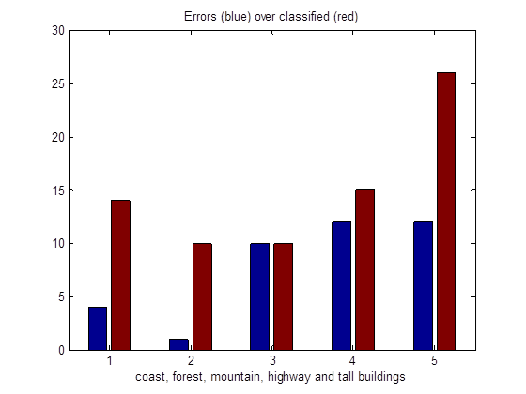
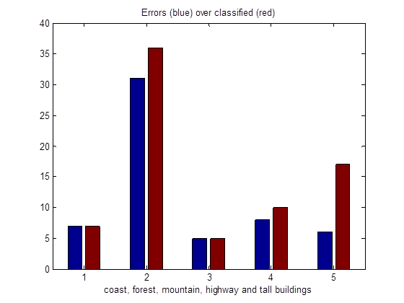
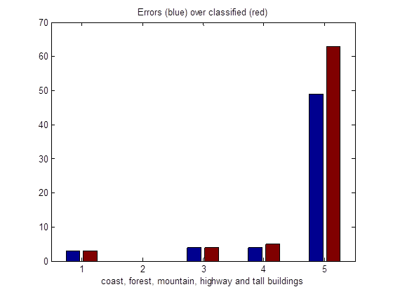
CENTRIST descriptor
Oh! Let's try to order feature vectors and image names in the same order...!
50% errors
CENTRIST
GIST
Gabor

Slide 19
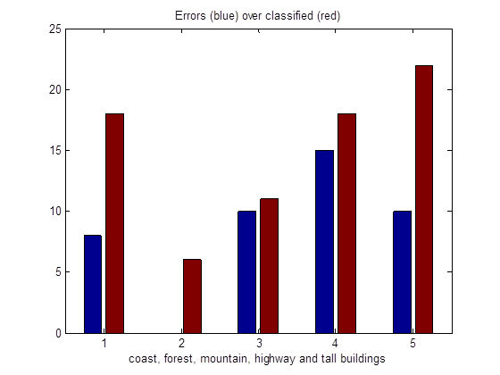
CENTRIST descriptor
Performance so far: around 55%
GIST and CENTRIST:
histogram intersection
GABOR: Euclidian distance
Default category decided by CT features if 3 methods disagree

Slide 20
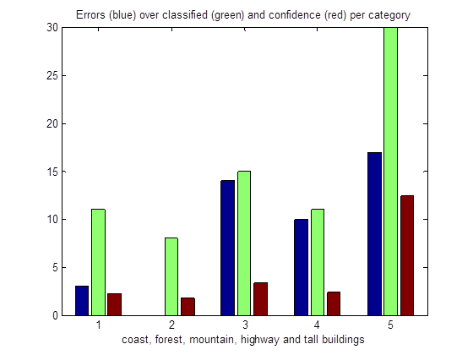
CENTRIST descriptor
Confidence = arbitrary number
Good performance
High confidence

Slide 21
Piter:
Color histogram
descriptor

Slide 22
On The List :
Feature Extraction
- Individually, combine and average color histograms for each class
Create a Set for Comparison Purpose
- Create a list of category of the average histograms of each class
Class feature comparison
- Individually Test and Compare classes
Classification Comparison
- Test and Compare all classes data
Average Intersection & Features Implementation
- Check for intersecting features among classes
Implement SVM

Slide 23
Feature Extraction
The Models, used for representing colors numerically, are as follow:
1 - RGB
2 - LAB
3 - HSV
4 - YCrCb
These methods or color spaces provide this descriptor with relevant information for classification purpose. The following test results will show the number of mis-classifications of each method with a 4 x 30 matrix of test images.

Slide 24
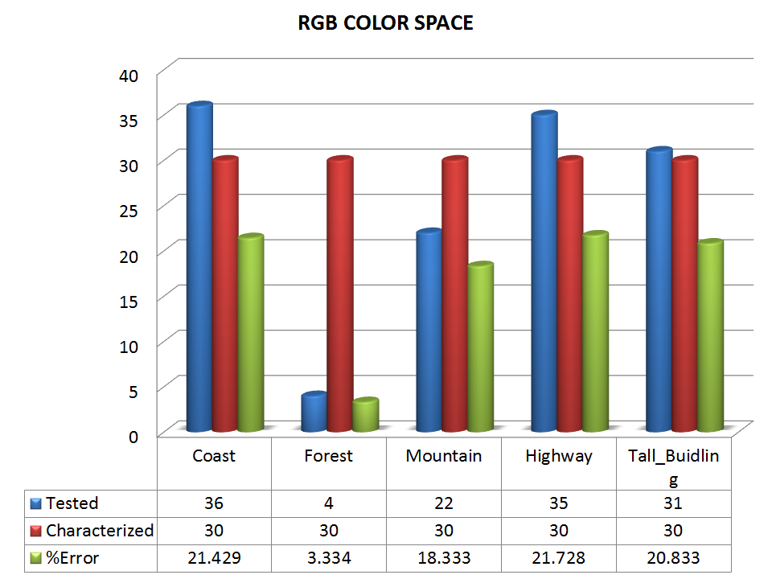

Slide 25
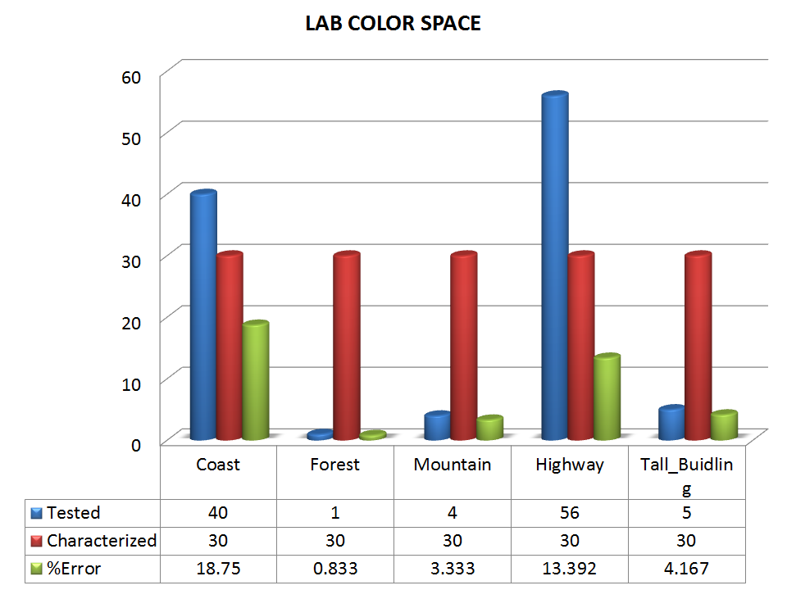

Slide 26
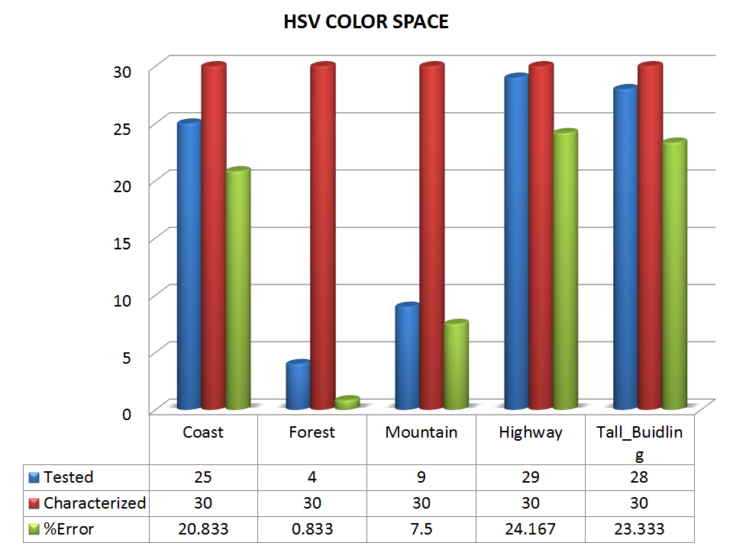

Slide 27
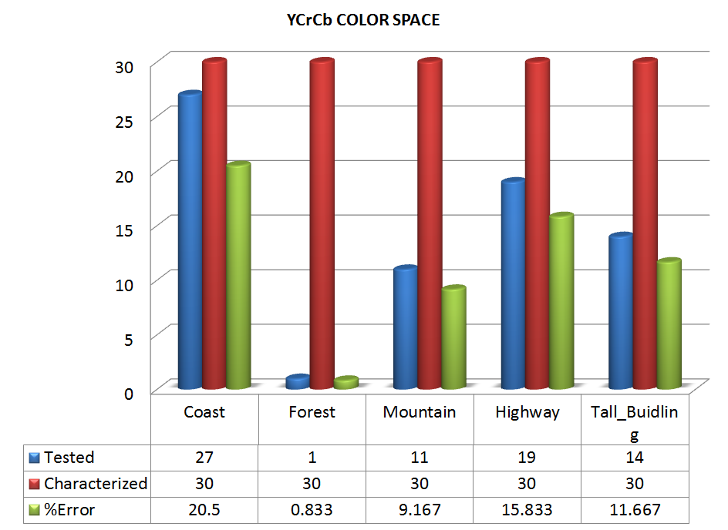

Slide 28
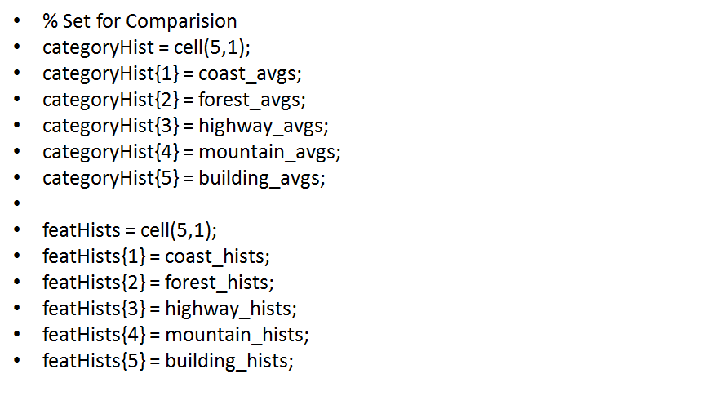
Creating Set & Comparing Classes

Slide 29
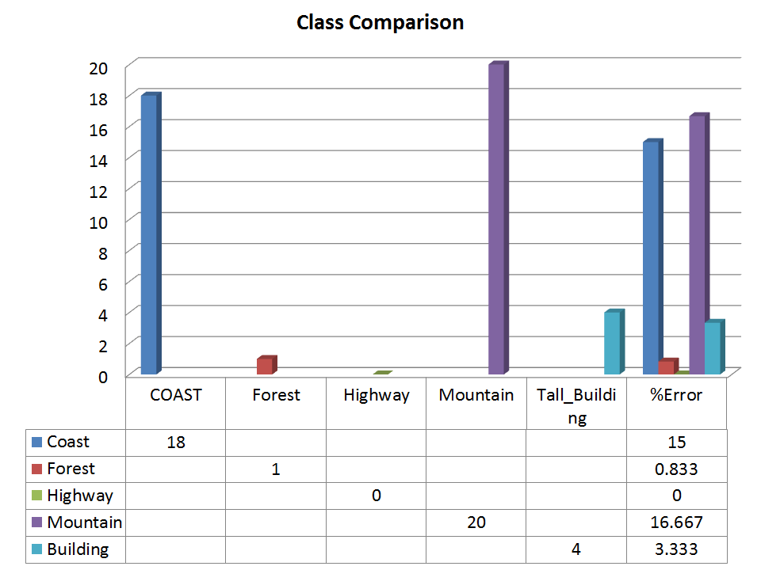

Slide 30
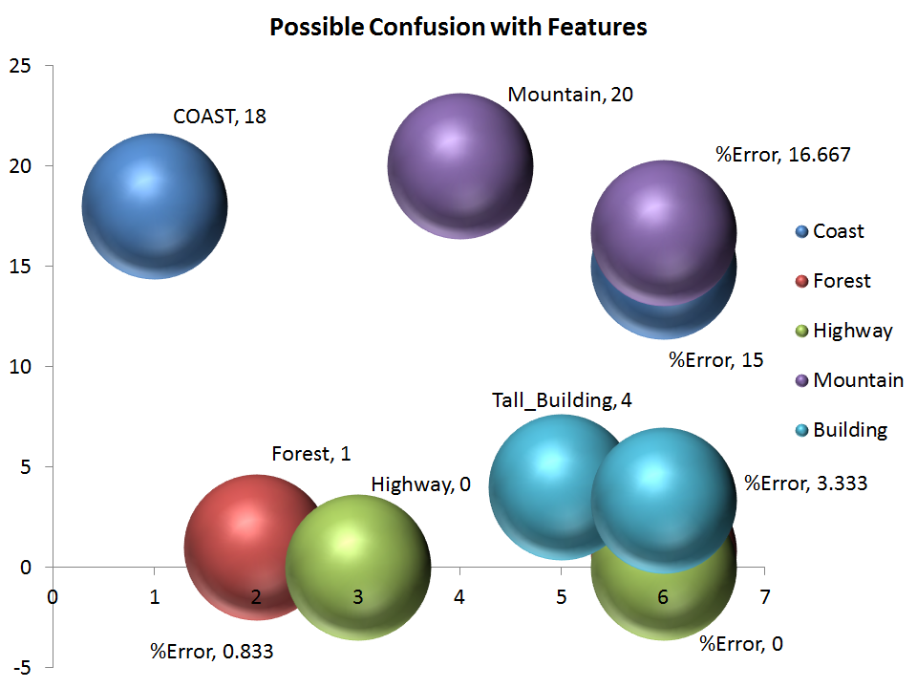

Slide 31
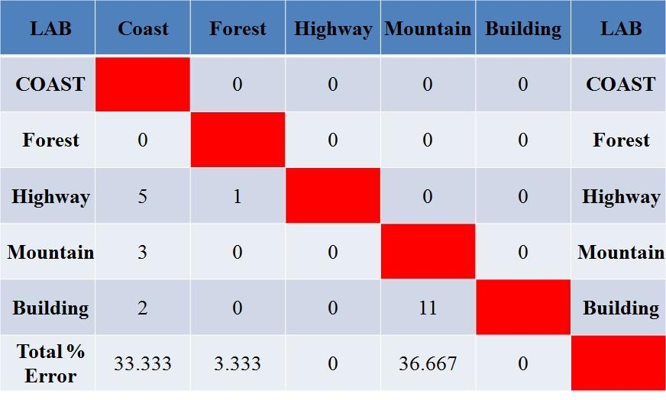
Average Intersection & Features Implementation

Slide 32
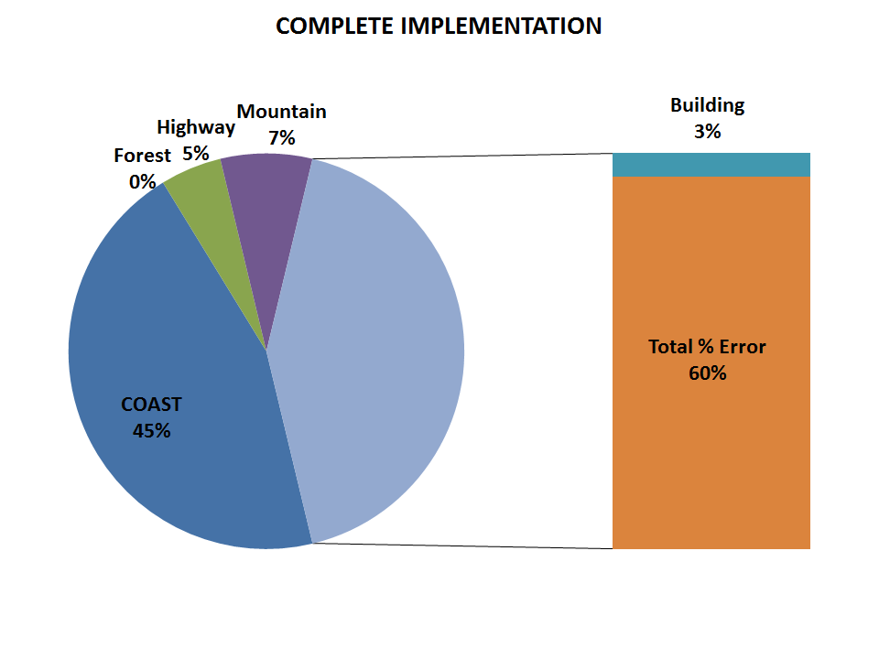

Slide 33
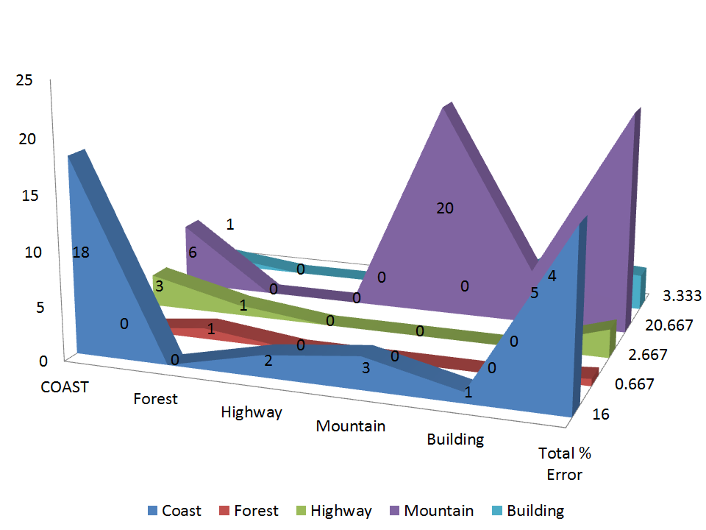

Slide 34
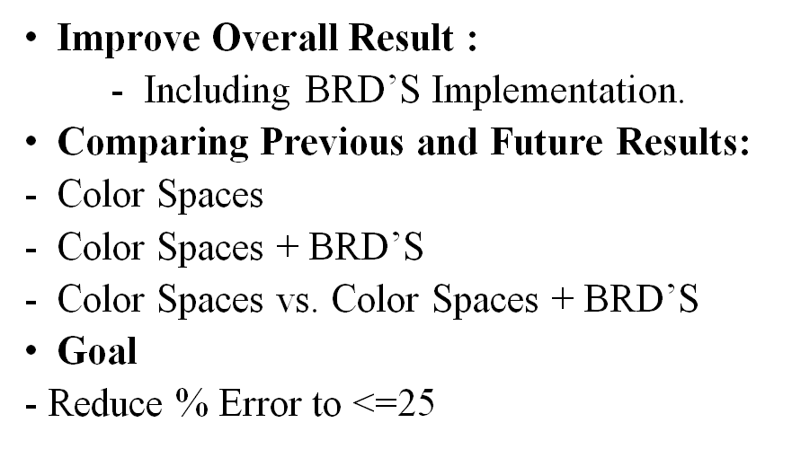
FINISHING UP

