Slide 1
Scene Classification
Update 4
Karina Damico
Pauline Martial
Piter Garcia

Slide 2
Karina and Pauline:
Gabor GIST + CENTRIST

Slide 3
Hybrid: Gabor GIST + CENTRIST
Visualize information of:
GIST feature vectors
CT feature vectors

Slide 4
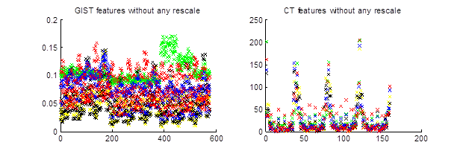
Hybrid: Gabor GIST + CENTRIST
Very different scales!

Slide 5
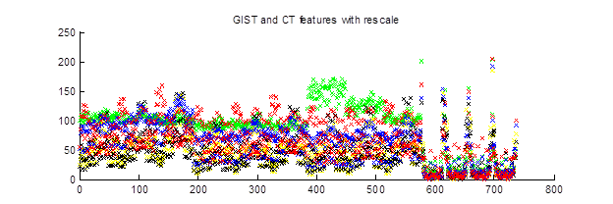
Hybrid: Gabor GIST + CENTRIST
How to scale?
Stretch Gabor GIST through CENTRIST scale
NN classifier rescales => absolute scale irrelevant
relative scale important
Find max and min of Centrist values: [a, b]
Scale Gabor into CENTRIST [a, b] range: A = (b-a)*Gabor + a

Slide 6
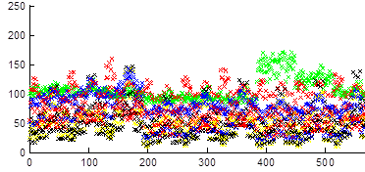
Hybrid: Gabor GIST + CENTRIST
GIST feature vector:
coast
forest
highway
mountain
tall building

Slide 7
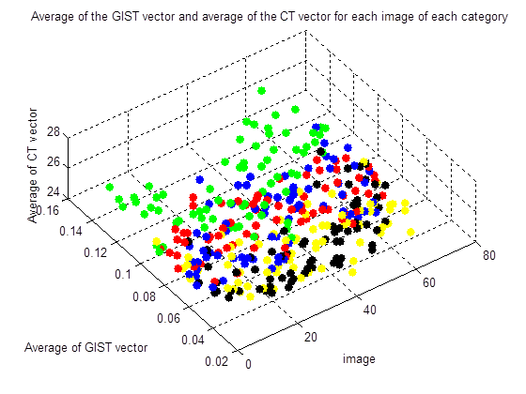
Hybrid: Gabor GIST + CENTRIST
coast
forest
highway
mountain
tall building

Slide 8
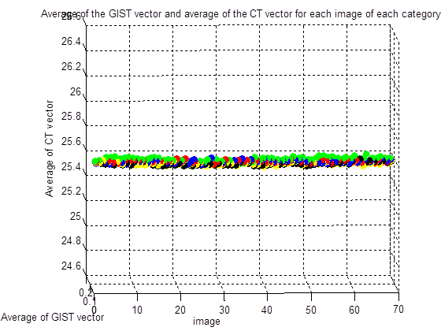
Hybrid: Gabor GIST + CENTRIST

Slide 9


CENTRIST descriptor
Constraints between neighbors => homogeneity introduced

Slide 10
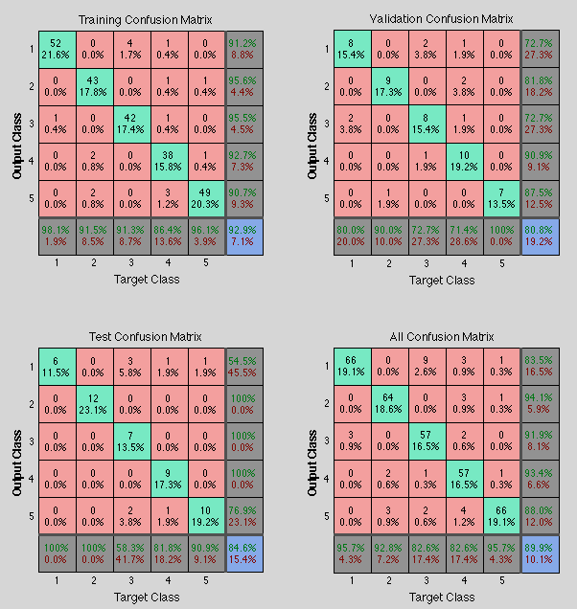
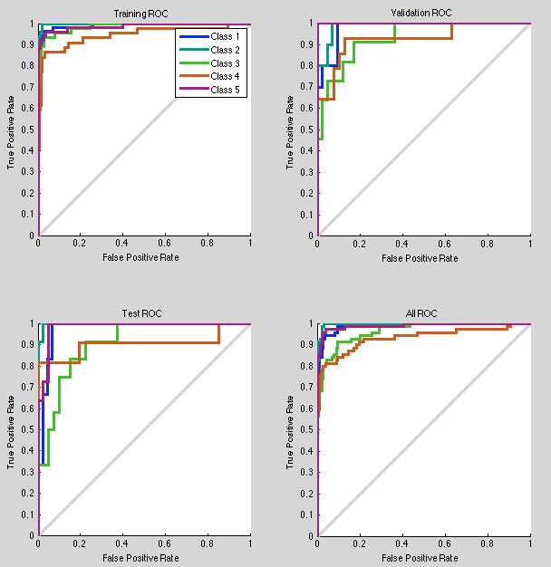
CENTRIST descriptor
Pure CENTRIST results through the network:

Slide 11
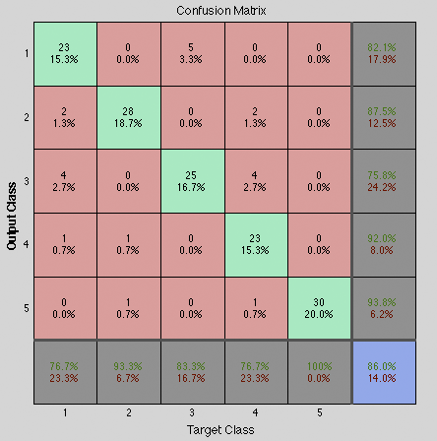
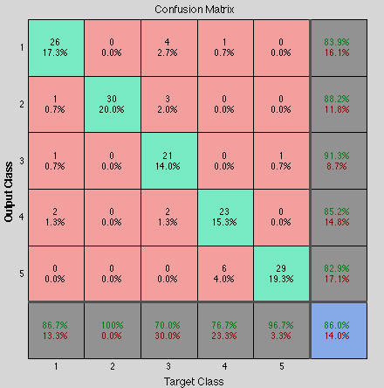
CENTRIST vs Gabor descriptor
Gabor GIST
CENTRIST

Slide 12
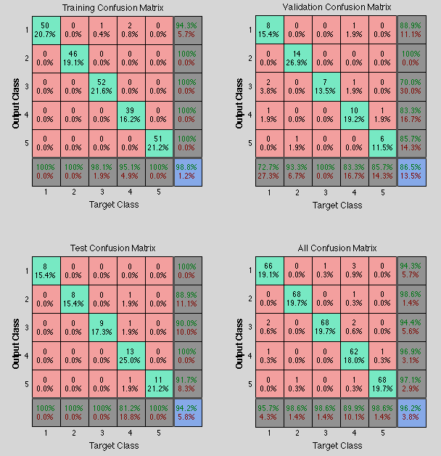
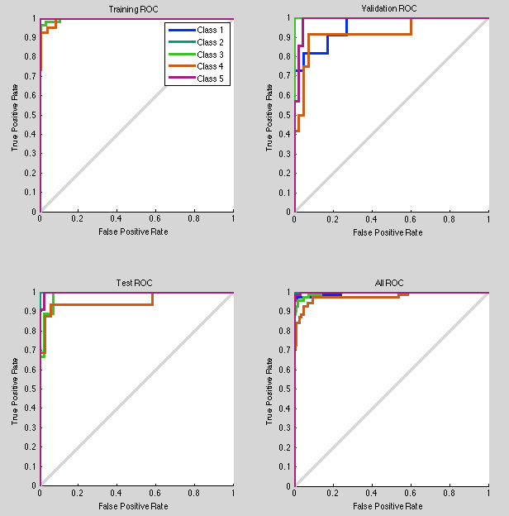
Hybrid: Gabor GIST + CENTRIST
736 inputs => 200 hidden nodes => 5 outputs

Slide 13
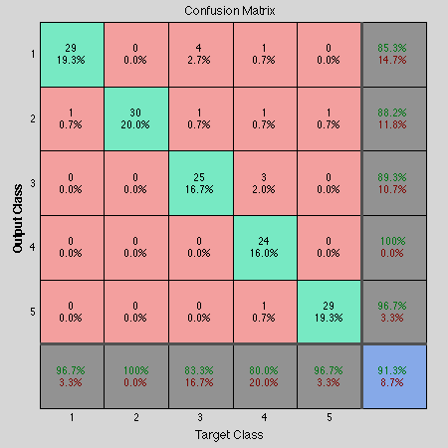
Hybrid: Gabor GIST + CENTRIST
91.3 % accuracy on 150 testing images dataset..
I have a feeling that it can be boost to 93 or so just by playing with number of hidden neurons and retrain it more and more
Coast and highway got improved comparably with Gabor

Slide 14
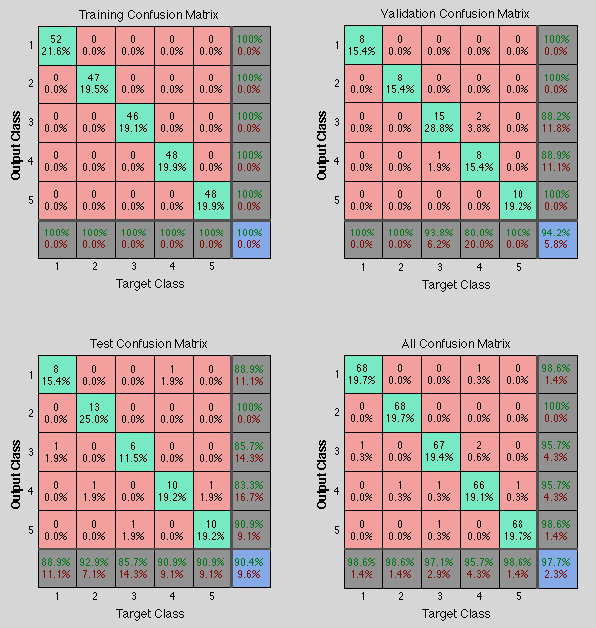
Hybrid: Gabor GIST + CENTRIST
250 hidden nodes, worse training results, BUT turned to be better overall

Slide 15

Hybrid: Gabor GIST + CENTRIST
Hybrid: Gabor GIST + CENTRIST
93.3 % accuracy on 150 testing images dataset
Improved Mountain and Tall building, but misclassified one coast comparably with 200 nodes.
Now: 100% accuracy for Forest and Tall building

Slide 16
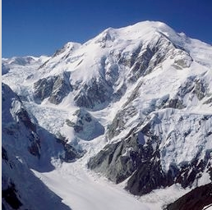
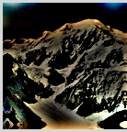
Gabor descriptor (addition)
About whitening:
Purpose: whitening is simply a process for removing pairwise, linear correlations => remove noisy details
How: through designing a filter in the frequency domain that will flatten the spectrum of a natural image (on average)
- design the amplitude spectrum of the filter so that it rises linearly with frequency, to compensate for the 1/f amplitude spectrum of natural images [define a grid of frequency coordinate]
- convolution in the space domain = multiplication in the frequency domain, => multiply the spectrum of the image with the spectrum of the filter and take the inverse fft2
Just check this if interested:
http://redwood.berkeley.edu/bruno/npb261b/lab2/lab2.html

Slide 17
Piter:
Color histogram
descriptor

Slide 18
COLOR HISTOGRAM descriptor

