Slide 1
EET 418 Microprocessor Interface & Control
Chapter 8, 9, 11
Combining C/C++ with Assembly Language
- Chapter 8 Page 224-225, Example
CPU – INTEL 8088 Microprocessor - 40 Pins, Address Bus, Data Bus, Control Bus, Section 9.1
CPU 8088 Input/Out Instructions - Section 11.1, Examples
Programmable Peripheral Interface Chip - 8255 I/O Programming - 40 Pins, Mode 0, Port A, B.C, Control (Byte) Word Register, Section 11.4, Examples
Lab 25 Key Board Simulator

Slide 2
8.1: Combining C with Assembly
Although Assembly language is the fastest language available for a given CPU, it cannot be run on different CPUs.
  A portable language is needed.
Today, a large portion of programs written for all computers are in the C/C++ language.
  A universal programming language that it can be run
  on any CPU architecture with little or no modification
    It is simply recompiled for that CPU.
  Combining C & Assembly takes advantage of C/C++'s portability and Assembly's speed.

Slide 3
8.1: Combining C with Assembly
There are two ways to mix C/C++ and Assembly.
  One is simply to insert the Assembly code in C programs.
    Commonly referred to as in-line assembly.
  The second method is to make the C/C++ language
  call an external Assembly language procedure.

Slide 4
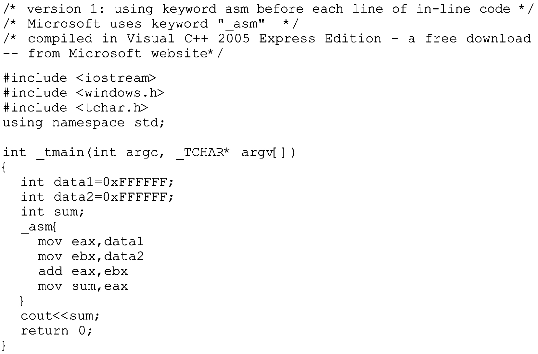
Inserting x86 assembly code into Visual C++ programs – inlining
Note that in Microsoft, not all interrupts may be supported in
the latest versions of Visual C++.
Each line must end in a semicolon or newline, and any comments must be in the correct form for C.

Slide 5
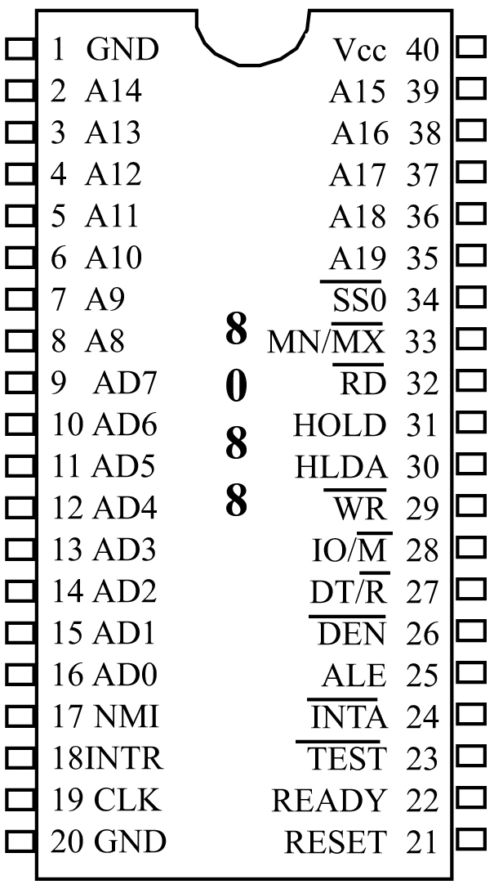
9.1: 8088 MICROPROCESSOR
  Due to chip packaging limitations in the 1970s, there was great effort to use the minimum number of pins
  for external connections.
    Intel multiplexed address & data buses, using the same pins to carry two sets of information: address & data.
  Pins 9-16 (AD0–AD7) are used for
  both data and addresses in 8088.
    AD stands for "address/data.”
  The ALE (address latch enable) pin signals whether the information on pins AD0–AD7 is address or data.
Fig. 9-1a 8088 in minimum mode

Slide 6
9.1: 8088 MICROPROCESSOR
  When 8088 sends out an address,
  it activates (sets high) the ALE, to indicate the information on pins
  AD0–AD7 is the address (A0–A7).
    This information must be latched, then pins AD0–AD7 are used to carry data.
  When data is to be sent out or in, ALE is low, which indicates that
  AD0–AD7 will be used as data
  buses (D0–D7).
  The process of separating address and data from pins AD0–AD7 is
  called demultiplexing.
Fig. 9-1a 8088 in minimum mode

Slide 7
9.1: 8088 MICROPROCESSOR address bus
  8088 has 20 address pins (A0–A19), allowing it to address a maximum of one megabyte of memory (2²⁰ = 1M).
    To demultiplex address signals, a latch must be used to grab the addresses.
  Widely used is the 74LS373 IC, also 74LS573, a 74LS373 variation.
    AD0 to AD7 go to the 74LS373 latch, providing the 8-bit address A0–A7.
    A8–A15 come directly from the microprocessor (pins 2–8 & pin 39).
  The last 4 bits of the address come from A16–A19, pin numbers 35–38.
Fig. 9-1a 8088 in minimum mode

Slide 8
9.1: 8088 MICROPROCESSOR other pins
  Pins 24–32 have different functions depending on whether 8088 is in minimum or maximum mode.
    In maximum mode, 8088 needs supporting chips to generate the
    control signals.
Fig. 9-1a 8088 in minimum mode

Slide 9
9.1: 8088 MICROPROCESSOR other pins
MN/MX (minimum/maximum) - minimum mode is selected by connecting MN/MX (pin number 33) directly to +5 V.
  Maximum mode is selected by grounding this pin.
NMI (nonmaskable interrupt) - an edge-triggered (low to high) input signal to the processor that will make the microprocessor jump to the interrupt vector table after it finishes the current instruction.
  Cannot be masked by software.
CLOCK - an input signal, connected to the 8284 clock generator.

Slide 10
9.1: 8088 MICROPROCESSOR other pins
INTR (interrupt request) - an active-high level-triggered input signal continuously monitored by
the microprocessor for an external interrupt.
  This pin & INTA are connected to the 8259 interrupt controller chip.
READY - an input signal, used to insert a wait state for slower memories and I/O.
  It inserts wait states when it is low.
TEST - in maximum mode, an input from the 8087 math coprocessor to coordinate communications.
  Not used In minimum mode.

Slide 11
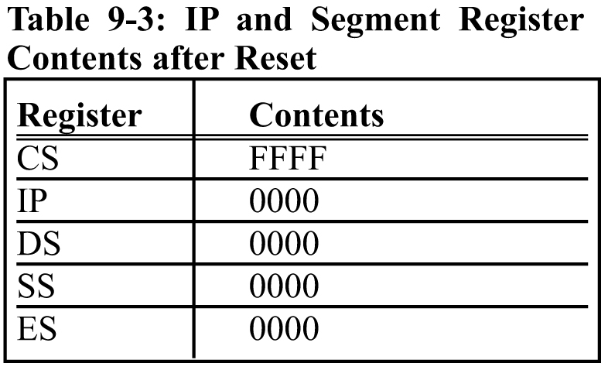
9.1: 8088 MICROPROCESSOR other pins
RESET - terminates present activities of the processor when a high is applied to the RESET input pin.
A presence of high will force the microprocessor to stop all activity and set the major registers to the values shown at right.

Slide 12
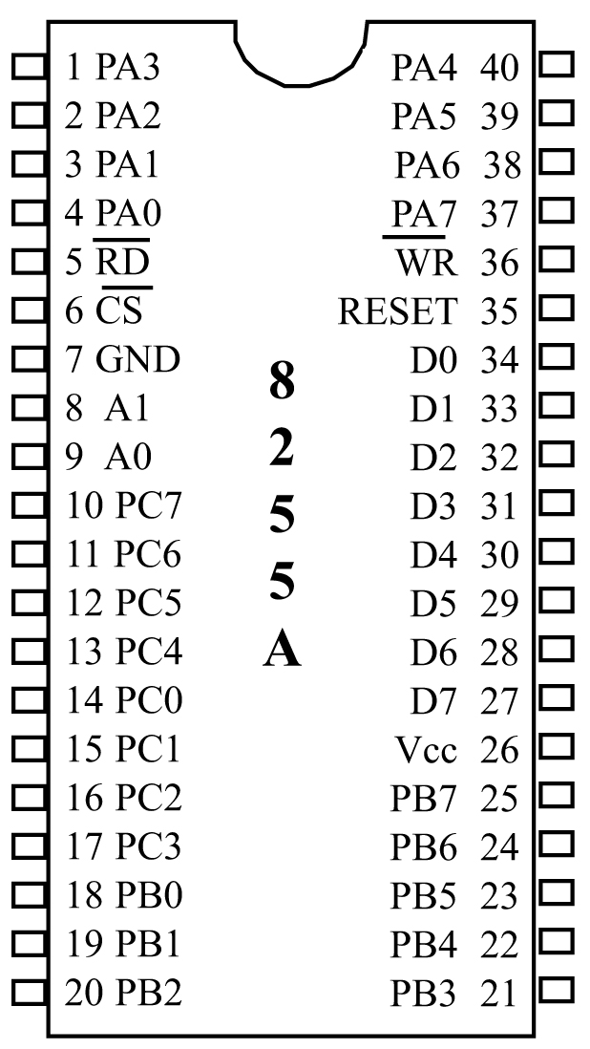
11.4: PROGRAMMING & INTERFACING THE 8255
The 8255 is a widely used
40-pin, DIP I/O chip.
  It has three separately accessible
  programmed ports, A, B & C.
  Each port can be programmed
  to be input or output.
  Ports can also be changed
  dynamically.
Port A (PA0–PA7)
Port B (PB0–PB7)
Port C (PC0–PC7)
These 8-bit ports can
be all input or all output.
Figure 11-11 8255 PPI Chip

Slide 13
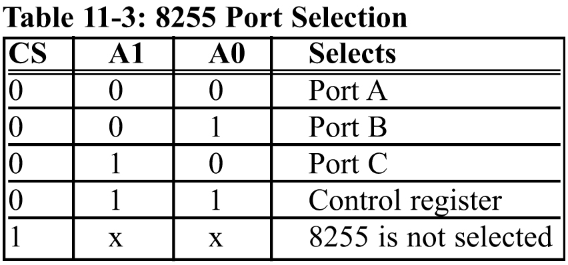
11.4: PROGRAMMING & INTERFACING THE 8255
A0, A1, and CS
  CS (chip select) selects the entire chip.
  Address pins A0 and A1 select the specific port
  within the 8255.
These three pins are used to access ports A, B, C, or the control register.
The control register must be programmed to select the operation mode of the three ports A, B, and C.

Slide 14
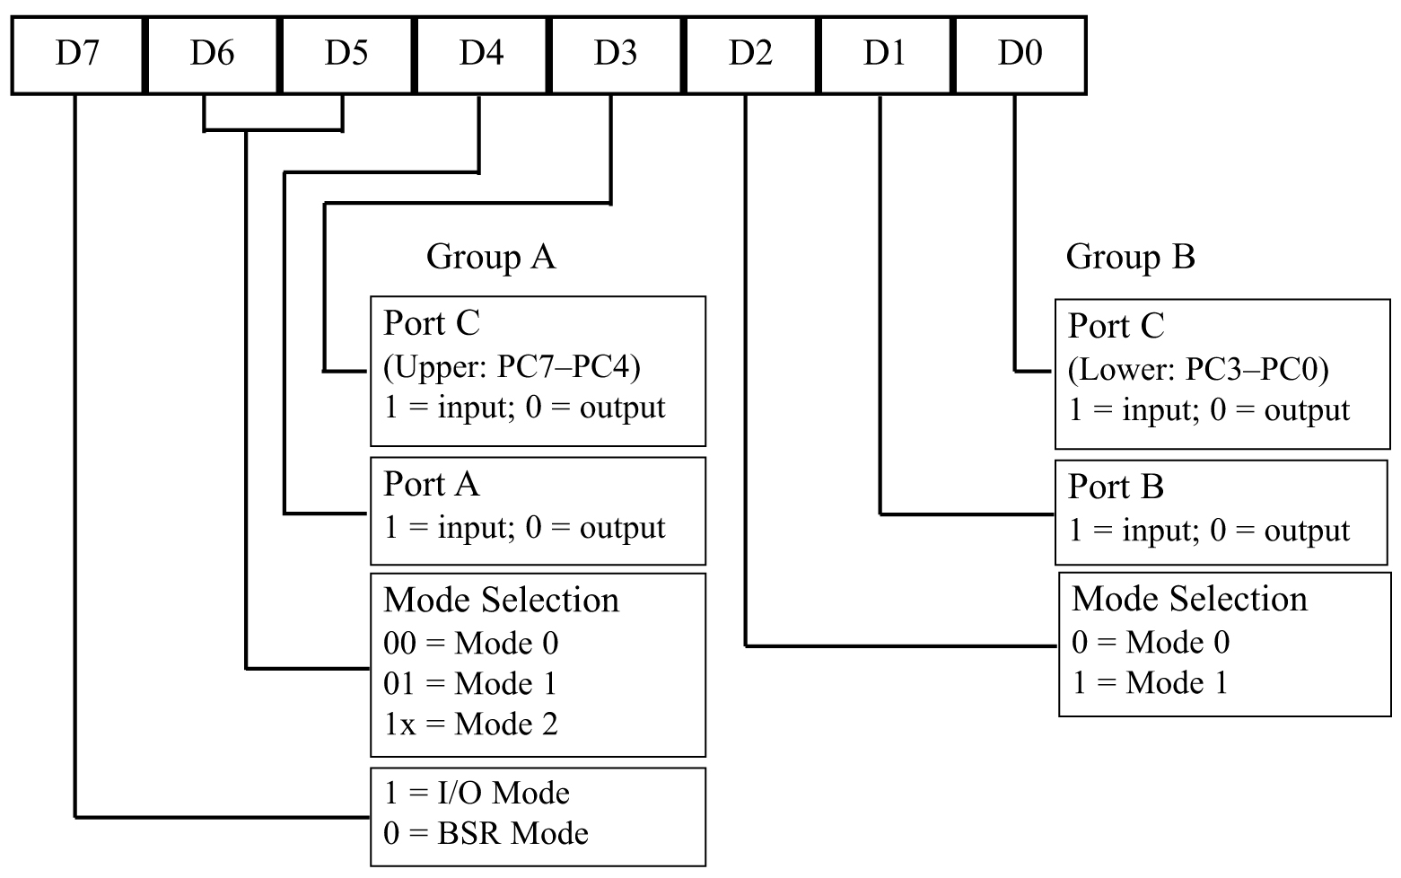
11.4: PROGRAMMING & INTERFACING THE 8255 mode selection of the 8255A
8255 ports can be programmed in various modes.
  The simple I/O mode, Mode 0, is most widely used.
Any of the ports
A, B, CL & CU
are programmable
as input or output.
All bits are out
or all are in.
No control of
individual bits
Figure 11-12 8255 Control
Word Format (I/O Mode)

Slide 15
Job 25 – Keyboard Simulator
A 64 key Keyboard is shown in lab notes Page 25. Assume there is a key (switch) at each intersection. Use 8255 Port A as Output, Port B as Input. Write a subroutine that identifies the key that was pressed. A moving “zero” is the output on Port A and if a switch is closed, a “zero” is applied to the particular bit on the Port B register. Let the subroutine initialize the ports so that we don’t have to write a calling program. Output all ones and a zero that moves along. Port B is interrogated each time to see if a zero has been found. Save Port A Output in register BH and Port B Input in the BL register. To test your program, check the four corners of the Keyboard Simulator

