Slide 1

Keyboard Simulator & Encoder → Job 25, 26, 27
Barcode Reader → Job 51, 52, 53, 54, 55

Slide 2

Read Class notes (pages 107-129) on Barcode
There are different types of Barcode Symbologies like Code 39, Code 128, Codabar, UPC, and 12of5.
Each Barcode has Black Bars and White Spaces called Elements.
For example Code 39 has 5 bars and 4 spaces making a total of 9 elements.
Code 39
Code 39 is the de facto standard for most industries.
Of the 9 elements for each character, 3 are wide and 6 are narrow making Code 39 a 2-width code (like Binary)
Code 39 encodes 44 different alphabet (A-Z), numeric (0-9), and 8 graphic characters as shown in Class notes page 112.

Slide 4
Barcode Wand
Refer Page 114 B for Wand Dimensions and Configurations
Follow the preferred orientation to scan the Barcode for *CODE* from left to right.
As the barcode wand hit a black-to-white or white-to-black edge, it saves the count value of each element. Then resets the counter and waits to hit another edge.
Wider the element the more count it takes. For example each scanned character you will get 3 larger (3 -1’s) and 6 smaller (6-0’s) counts.

Slide 5
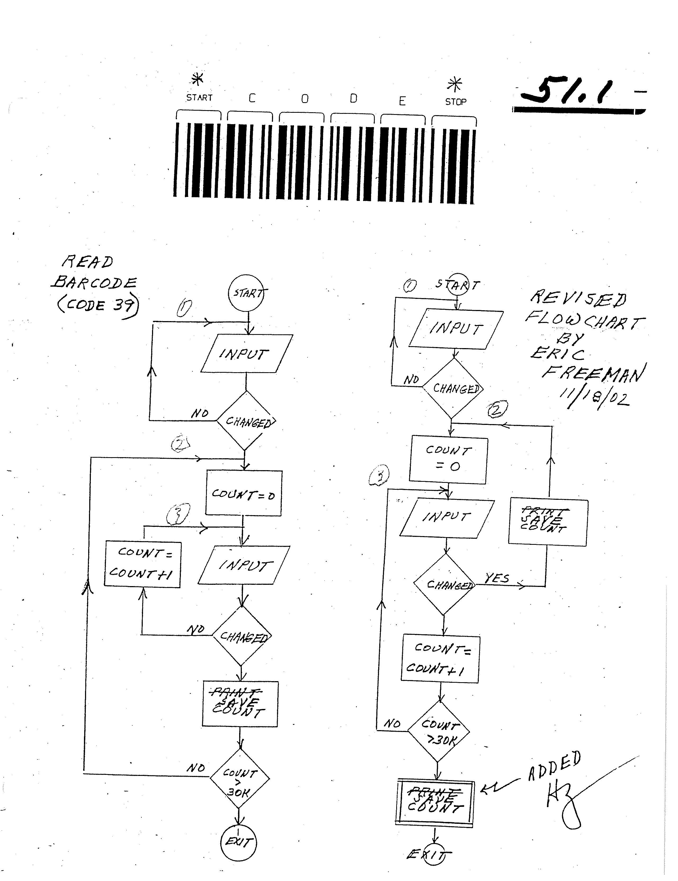

Slide 6
Example
*CODE* Start C O D E Stop
9 x 6 = 54 elements (6 characters with each 9 elements)
Start → * → 010010100 (9 elements, 6- 0’s, 3 -1’s) → 094H → 148D
C → C → 101001000 (9 elements, 6- 0’s, 3 -1’s) → 148H → 328D
O → O → 100010010 (9 elements, 6- 0’s, 3 -1’s) → 112H → 274D
D → D → 000011000 (9 elements, 6- 0’s, 3 -1’s) → 019H → 25D
E → E → 100011000 (9 elements, 6- 0’s, 3 -1’s) → 118H → 280D
Stop → * → 010010100 (9 elements, 6- 0’s, 3 -1’s) → 094H → 148D

Slide 7

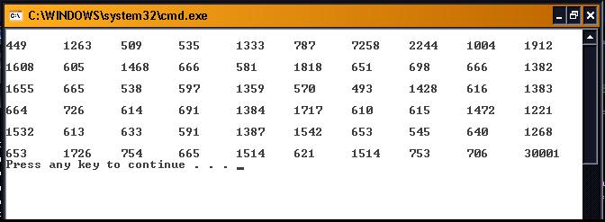
Job 51 Objective: Learn how the barcode wand reads the black bars and white spaces for different sets of characters. Study the flow chart in the lab notes Page 51.1. and write a program to find the count value of each barcode symbols in the lab notes.
Note: We don’t care the count value for the space in between each character. They are the inter symbol counts at every 10th location.

Slide 8
#include <stdio.h>
#include "mdedriverdll.h"
int main()
{
unsigned int PrtAin1=0,PrtAin2=0,Count=0,Lines[1000],x=0;
MDEOpenDriver(); //This opens the driver
MDEOpenLPTPort(0x378); //MDEOpenLPTPort(int baseaddress), baseaddress= 378h
MDEConfigPort(0x378, 0x10); //This sends control word, 0x10 = Port A input
while((PrtAin1=PrtAin2=(MDEInPA(0x378) & 1))==0);
//To test the input change check the change in LSB
//printf("\n1 1: %i 2: %i\n",PrtAin1,PrtAin2);

Slide 9
while(Count <= 30000)
{
Count=0;
while((PrtAin1==PrtAin2) && (Count <= 30000))
{
PrtAin2=MDEInPA(0x378);
PrtAin2=PrtAin2 & 1;//Store the LSB to see the change in Input
Count++;
}// end inner while
PrtAin1=PrtAin2;
Lines[x++]=Count;
}//end outer while
} // end main

Slide 10
Count=0;
int g;
while(Count<x){ printf("\n");
for (g=0;g<10;g++) {
printf("%i\t",Lines[Count]);
Count++;
}}
MDECloseDriver(); // this closes the driver
return(0);

Slide 11

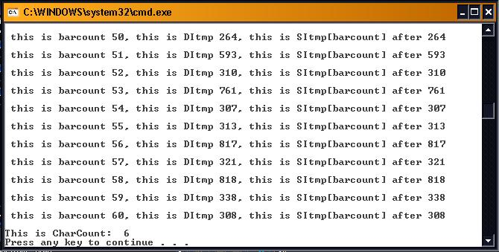
Job 52 Objective: Learn the process of translating bar codes into alphanumeric characters. In this exercise, extend the Job 51 that will convert the number of bars to number of characters.
Hint: Study the flow chart in the lab notes Page 51.1 and decide where to put another counter that counts bars. Then at the end divide that count by 10 to get the number of characters.

Slide 12

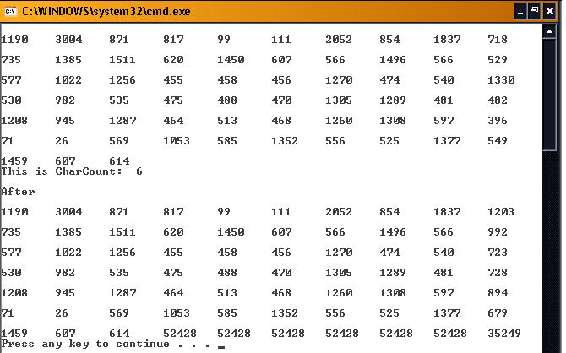
Objective: Extend Job 52 to learn the process of translating bar codes to calculate the average widths of bars and spaces of each character. Store the average width value of each character at every 10th location of the symbol counts. Use your calculator to check the average value of each character.

Slide 13

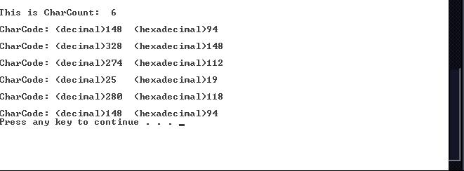
Objective: Extend Job 53 to obtain 9 elements (3-1’s and 6-0’s) Code 39 for each scanned character. Use the average count value from Job 53 and compare each count value to assign 1 or 0. Display Code 39 value in Hexadecimal and Decimal.

Slide 14

Objective: Extend Job 54 that reads the numeric codes (Hexadecimal value of each character)and returns the ASCII Code. Use the Code 39 look up table in your Lab notes Page 55.1 and Job 27 to display the scanned barcode. Verify the displayed ASCII code with the scanned barcode.
Code39_Patterns DW 121H, 61H,160H, 31H,130H, 70H, 25H,124H, 64H, 34H
DW 109H, 49H,148H, 19H,118H, 58H, 0DH,10CH, 4CH, 1CH
DW 103H, 43H,142H, 13H,112H, 52H, 07H,106H, 46H, 16H
DW 181H, 0C1H,1C0H,91H,190H, 0D0H,85H,184H, 0C4H,94H
DW 0A8H, 0A2H,08AH,2AH,0FFFH
; 1 to 0 ; A to J ; K to T ; U to * ; $ to %
Code39_Characters DB "1234567890ABCDEFGHIJKLMNO
PQRSTUVWXYZ-. *$/+%"

