Slide 1
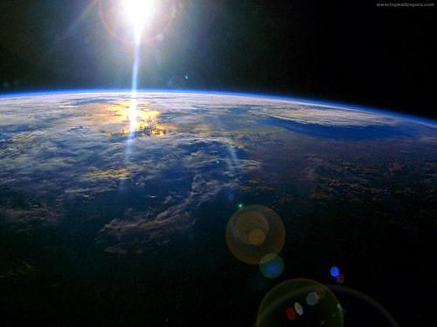
Greenhouse Effect
The greenhouse effect is a good thing as long as we don’t add gases to it.

Slide 2
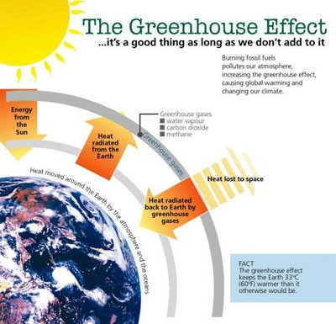

Slide 3
Greenhouse Effect
The greenhouse effect is the process in which the emission of infrared radiation by the atmosphere warms a planet's surface. The greenhouse effect was discovered by Joseph Fourier in 1824 and first investigated quantitatively by Svante Arrhenius in 1896.
The greenhouse effect is a naturally occurring phenomenon that is responsible for trapping heat near the earth's surface and keeping the planet warm. It is called the greenhouse effect because the way it works is similar to the way in which a green house functions.
When the sun's rays hit the Earth's atmosphere and the surface of the Earth, approximately 70 percent of the energy stays on the planet, absorbed by land, oceans, plants and other things. The other 30 percent is reflected into space by clouds, snow fields and other reflective surfaces. But even the 70 percent that gets through doesn't stay on earth forever (otherwise the Earth would become a blazing fireball).

Slide 4
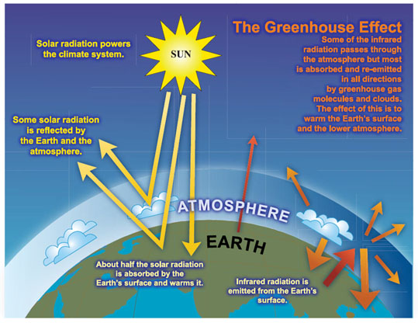

Slide 5
Greenhouse Effect
The greenhouse effect has been described by Ex-Vice President Al Gore as the potentially most dangerous environmental problem facing mankind, with consequences second only to nuclear war. The greenhouse effect can be visualized as follows: Imagine the Earth has been encircled by a giant glass sphere. The heat penetrates through the glass. Some of the heat is absorbed by the Earth and some is radiated back towards space. The radiated heat reaches the glass sphere and is prevented from dispersing any further. Similarly, the Earth is surrounded by a blanket of gas which traps energy in the atmosphere. This results in the overall warming of the atmosphere.

Slide 6
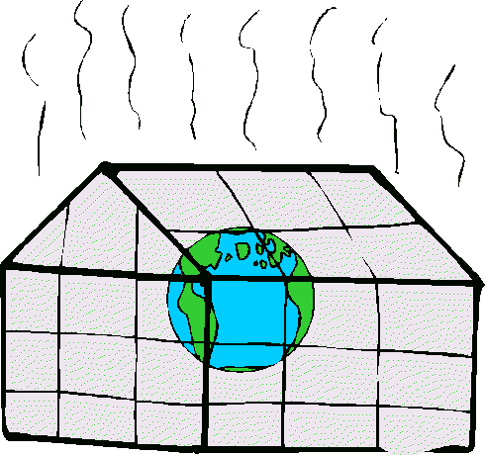
Greenhouse Effect

Slide 7
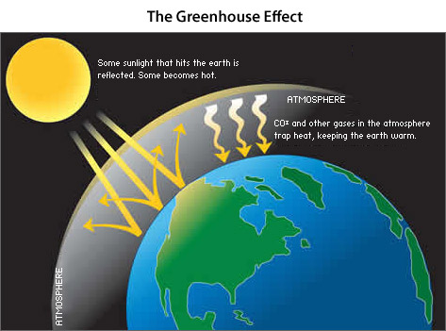
Greenhouse Effect

Slide 8
Greenhouse Effect
"For two hundred years we've been conquering nature. Now we're beating it up," stated by Francesca Lyman in her book “The Greenhouse Trap”, published by Beacon Press in Boston in the year 1990.
The greenhouse occurs naturally, but when humans put more greenhouse gases (carbon, methane, water vapor, and, nitrous oxide) and pollutants in the air the natural balance is off set. Since the beginning of industrialization, two hundred years ago, the gases have risen substantially, mainly from fossil fuels. This has produced a reduction in environmental quality and an increase in global warming.
The Earth's average surface temperature of 15 °C (59 °F) is about 33 °C (91.4 °F) warmer than it would be without the greenhouse effect. Then the greenhouse effect is a good thing as long as we don’t add gases to it.

Slide 9
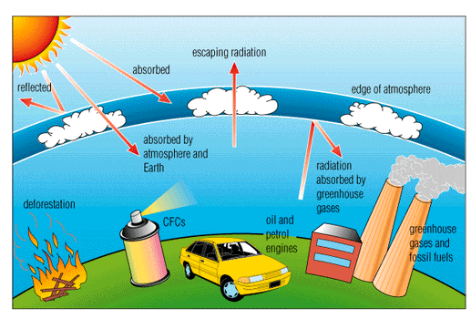
Greenhouse Effect

Slide 10
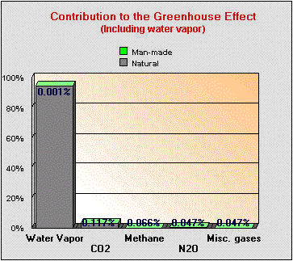
Greenhouse Effect

Slide 11
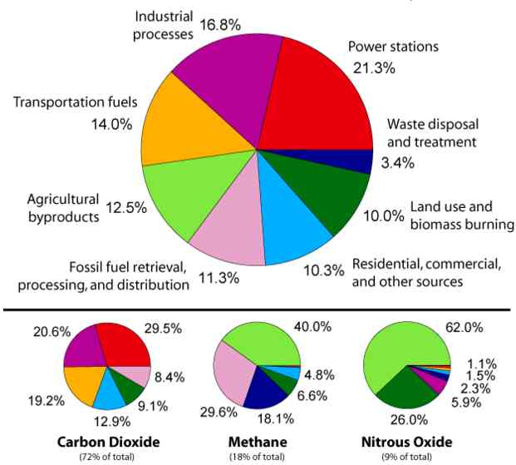
Greenhouse Effect

Slide 12
Greenhouse Effect
It is estimated that the Earth's average temperature has risen by five tenths to six tenths degrees Celsius since the 1880's because of emissions of greenhouse gases from human activity (America Online). Although, this temperature increase may not seem like much, over the years it will make a considerable difference in the way we live.
With further increases, the consequences of global warming could very well include the eradication of the entire ecosystems, increased frequency and intensity of storms, hurricanes, floods, and droughts. It could also cause melting of glaciers and polar ice which would cause rising sea levels resulting in the permanent flooding of vast areas of heavily populated lands and the creation of hundreds of millions of environmental refugees.

Slide 13
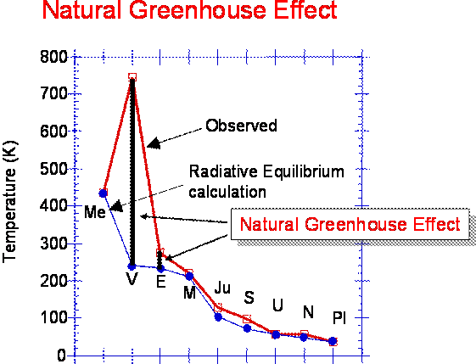
Greenhouse Effect

Slide 14
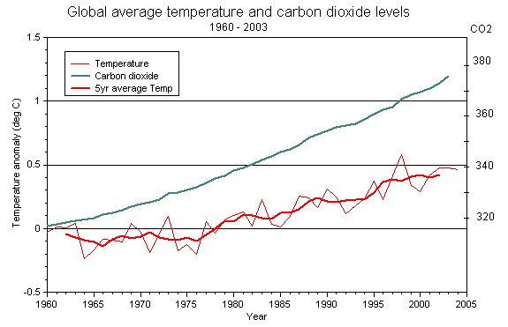

Slide 15
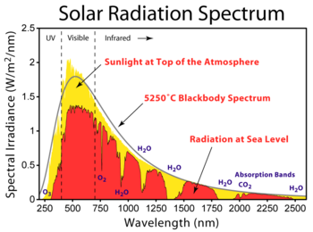
Greenhouse Effect

