Slide 1
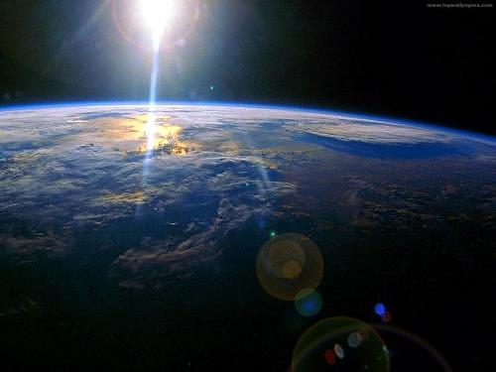


Greenhouse Effect
The greenhouse effect is a good thing as long as we don’t add gases to it.
BY: Wayfrel Puello

Slide 2
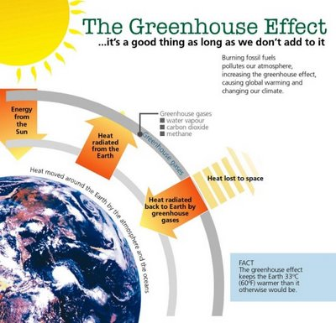

Slide 3
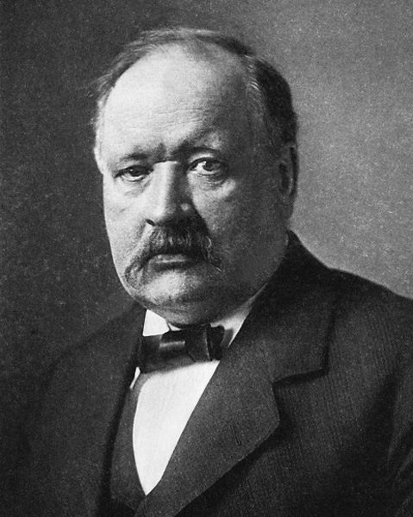
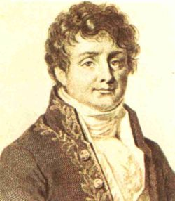
Greenhouse Effect
Discovered in 1824
by Joseph Fourier
First investigated in 1896 by Svante Arrhenius

Slide 4
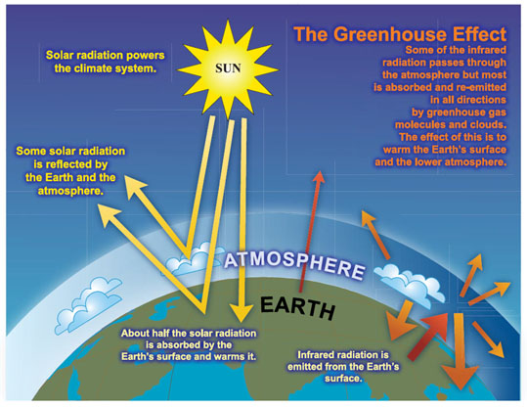

Slide 5
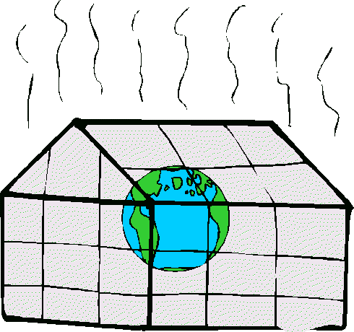
Greenhouse Effect

Slide 6
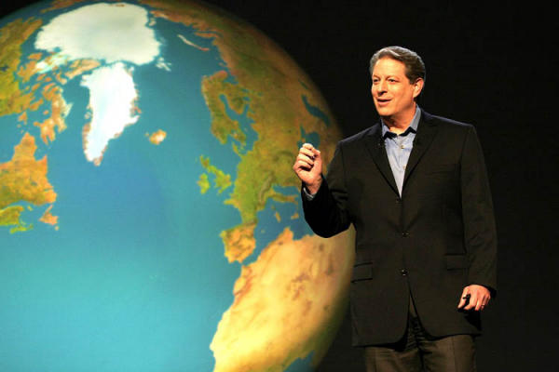

Greenhouse Effect
The greenhouse effect has been described by Ex-Vice President Al Gore as the potentially most dangerous environmental problem facing mankind, with consequences second only to nuclear war.

Slide 7
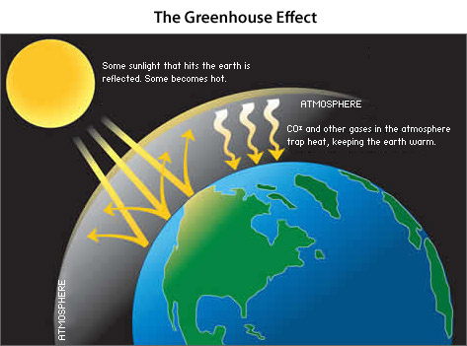
Greenhouse Effect

Slide 8
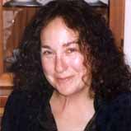
"For two hundred years we've been conquering nature. Now we're beating it up," stated by Francesca Lyman in her book “The Greenhouse Trap”, published by Beacon Press in Boston in the year 1990.
“The greenhouse occurs naturally, but when humans put more greenhouse gases (carbon, methane, water vapor, and, nitrous oxide) and pollutants in the air the natural balance is off set. Since the beginning of industrialization, two hundred years ago, the gases have risen substantially, mainly from fossil fuels. This has produced a reduction in environmental quality and an increase in global warming.”

Slide 9
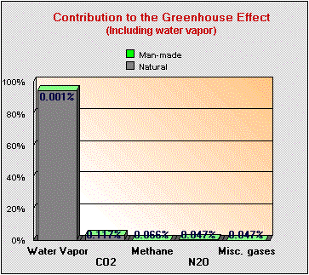
Greenhouse Effect

Slide 10
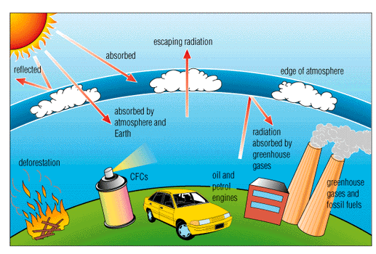
Greenhouse Effect

Slide 11
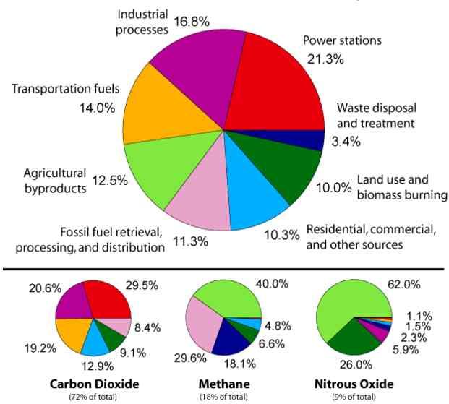
Greenhouse Effect

Slide 12
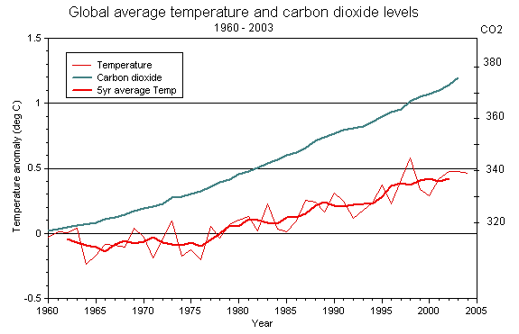
Earth's average surface temperature of 15 °C (59 °F) is about 33 °C (91.4 °F) warmer than it would be without the greenhouse effect.

Slide 13

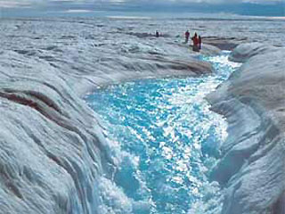
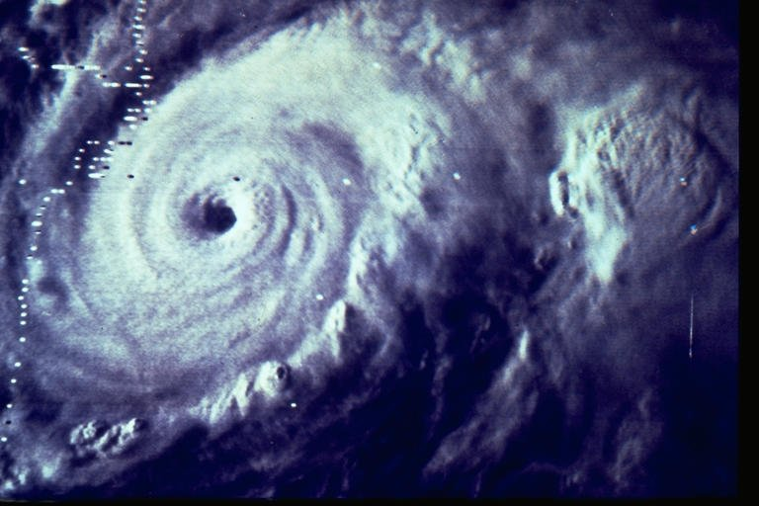
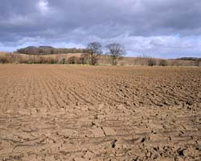
Greenhouse Effect
With further increases, the consequences of global warming could very well include the eradication of the entire ecosystems, increased frequency and intensity of storms, hurricanes, floods, and droughts. It could also cause melting of glaciers and polar ice which would cause rising sea levels resulting in the permanent flooding of vast areas of heavily populated lands and the creation of hundreds of millions of environmental refugees.

Slide 14
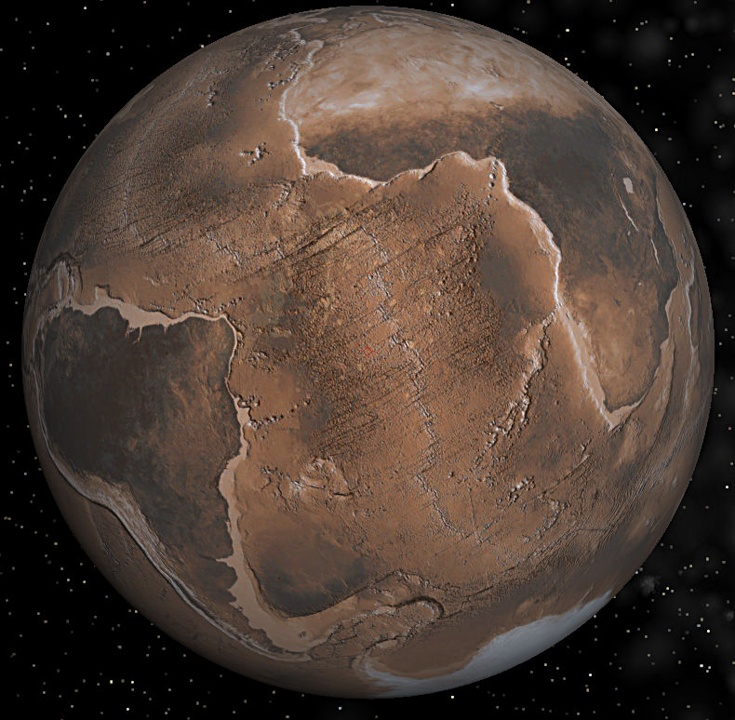
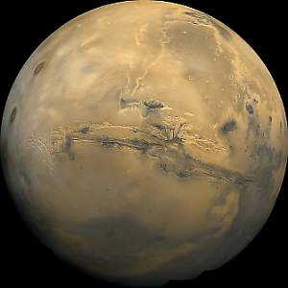
Greenhouse Effect
EARTH
MARS

Slide 15

Greenhouse Effect
The greenhouse effect is a good thing as long as we don’t add gases to it.
THE END
Think about it..

