Slide 1
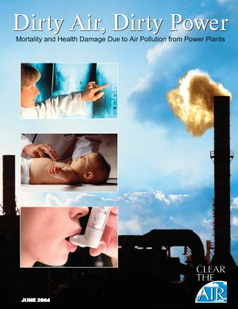
Effects of the Pollution
in our Planet
Adverse
AIR QUALITY
can kill many organisms including humans.

Slide 2
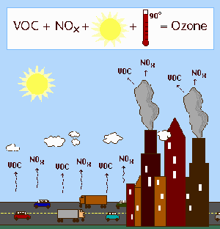

Slide 3
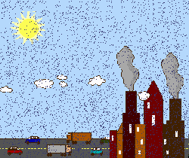

Slide 4
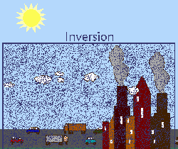

Slide 5
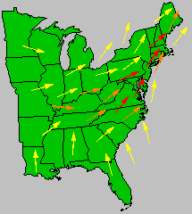

Slide 6
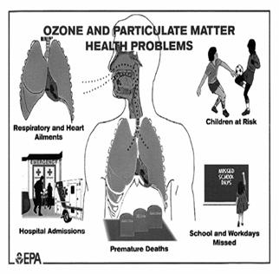
Ozone pollution can cause respiratory disease

Slide 7
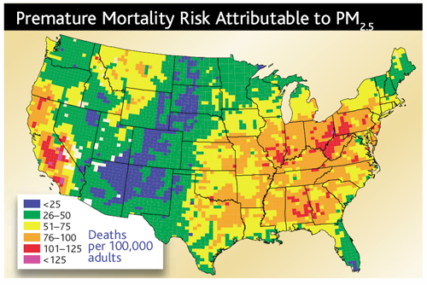

Slide 8
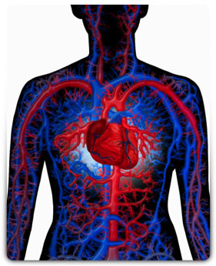
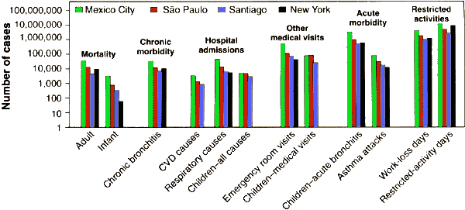
cardiovascular disease,

Slide 9
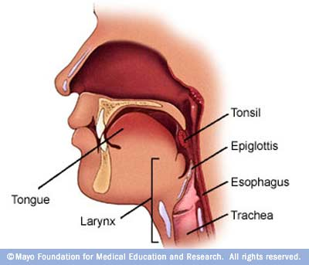
throat inflammation, chest pain, and congestion.

Slide 10


Slide 11


Slide 12
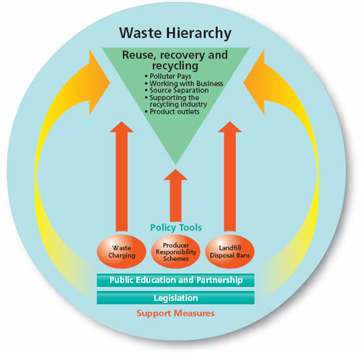
The three Rs

Slide 13


Slide 14
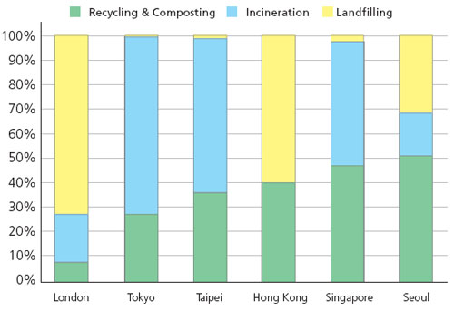

Slide 15


