Slide 1

DATA WAREHOUSING

Slide 2
Materi Pengajaran
Introduction: Enterprise IT Architecture & Data Warehouse Concepts
Warehousing Strategy
Warehouse Management & Support Process
Data Warehouse Planning
Data Warehouse Implementation
Warehouse Schema Design
Warehouse Metadata
Warehouse Maintenance & Evolution

Slide 3
The Enterprise IT Architecture
The IT Architecture of an enterprise at a given time depends on three main factors :
  The business requirements of the enterprise ;
    constantly changing, and the changes are coming at an exponential rate.
    Business requirements, over the years, evolved from day-to-day clerical recording of transactions to the automation of business process.
  The available technology at that time ;
    Technology has advanced by delivering exponential increases in computing power and communication capabilities.
  The accumulated investments of the enterprise from earlier technology generations

Slide 4
The IT Professional’s Responsibility
Today, the IT professional continues to have a two-fold responsibility :
  Meet Business Requirement ;
    The IT pro. must ensure the Enterprise IT infrastructure properly supports a myriad set of requirements from different business users, each of whom has different and constantly changing needs.
  Take Advantage of Technology Advancements ;
    At the same time, the IT pro. must also constantly learn new buzzwords (e.g. OLTP, OLAP, Data Mining, Wireless Technology, Mobile Computing etc.) review new methodologies, evaluate new tools, and maintain ties with technology partners.

Slide 5
Business Perspective
From the Business Perspective, the requirements of enterprise fall into four categories :
  Operational
    Legacy System
    OLTP
    Active Database
    Operational Data Store
    Flash Monitoring and Reporting
    Workflow Management (Groupware)
  Decisional
    Decision Support Application
    Data Warehouse
  Informational
    Informational Web Scripts
    Informational Web Services
  Virtual Corporation
    Transactional Web Scripts
    Transactional Web Services

Slide 6
Data Warehousing Definition
Data Warehousing is a process not a product
It is a process for properly assembling and managing data from various sources for the purpose of answering business questions and making decisions that were not previously possible.
Source: NCR Corporation 1997

Slide 7
There are major differences between those applications which RUN the business and those that ANALYZE the business
Run The Business
Updated in Real Time
Current view of the data
Retrieval of discrete information (transaction oriented)
Complex databases schemas (optimized for performance)
Structured user access
Single context view of the data
Analyze The Business
Periodic data refreshing from “The Business” databases and external data sources
Time accumulation of data
Retrieval & analysis of vast amounts of data
Business oriented database schemas (optimized for flexibility and ease of use)
Flexible / user modifiable access
Integrated view of information

Slide 8
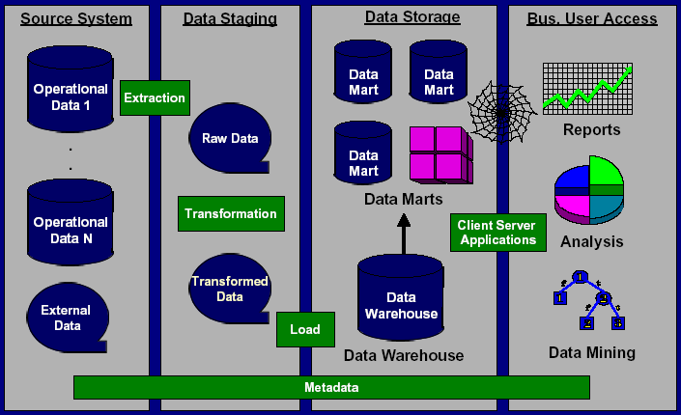
Logical Data Warehouse Architecture

Slide 9
Extraction, Transformation and Load (ETL) is a key component of the Data Warehouse
Data from the internal and external source system(s) is;
  Extracted from the operational sources
    Directly by a tool
    Indirectly through flat file transmission / dumps
  Cleansed & Transformed based on the Business Rules
    Edited, Reformatted & Standardized
    Aggregated, Reorganized, Partitioned
Loaded into the Data Warehouse

Slide 10
Extraction, Transformation and Load (ETL) is a key component of the Data Warehouse
ETL can be accomplished by writing custom code or through the purchase of an off-the-shelf ETL tool
  Writing custom code is time consuming and typically can not be reused in other areas of the platform
  Off-the-shelf ETL tools can be used to extract data from operational source systems to load the Data Warehouse or from the Data Warehouse itself, to load Data Marts
Unlike other components of the architecture, it is very difficult to replace an ETL tool once the Data Warehouse is up and running
  Cleansing and transformation logic is embedded in the code
  Off-the-shelf tools do not share metadata

Slide 11
Data Warehouse vs. Data Marts
Data Warehouse
Contains detailed and aggregated information for multiple subject areas
Sourced from the operational system(s) of record
Response time is measured in minutes, hours or days depending on the query
Access maybe limited to “power” users with in-depth knowledge of the data
Queries tend to be scheduled and monitored
Data Marts
Contains detailed or aggregated information for a single subject area OR aggregated information for multiple subject areas
Can be dependent or independent (not recommended) Marts
Response time is measured in seconds or minutes
Access is, in general, open to all users with a “need to know”
Queries tend to be ad-hoc in nature with little to no scheduling

Slide 12
Why separate Data Marts vs. creating additional aggregates within the Data Warehouse ?
Data Marts are created to meet the specialized needs of a subset of the Data Warehouse user community
Placing the Data Marts closer to the intended users reduces network traffic
Multiple complex queries against the detailed information in the Data Warehouse does not affect user response time on the Data Marts
Heavy query demands can be placed against the Data Marts without affecting the processing power of the Data Warehouse

Slide 13
There are four primary categories for data access
Canned Reports
  Basic (or standard) reports for well defined, well understood business questions
Ad-Hoc Queries
  Free form queries submitted against the data warehouse
On-Line Analytical Processing (OLAP)
  Interactive slicing and dicing of data by “dimensions” with the ability to “drill down” into lower levels of detail
  Variations of OLAP include
    Multi-Dimensional OLAP (MOLAP)
    Relational OLAP (ROLAP)
    Hybrid OLAP (HOLAP)
Data Mining
  The use of statistical algorithms that review the relationships among data elements to determine if any patterns exist
… each of which can be delivered to the end user through client server or the WEB technologies

Slide 14
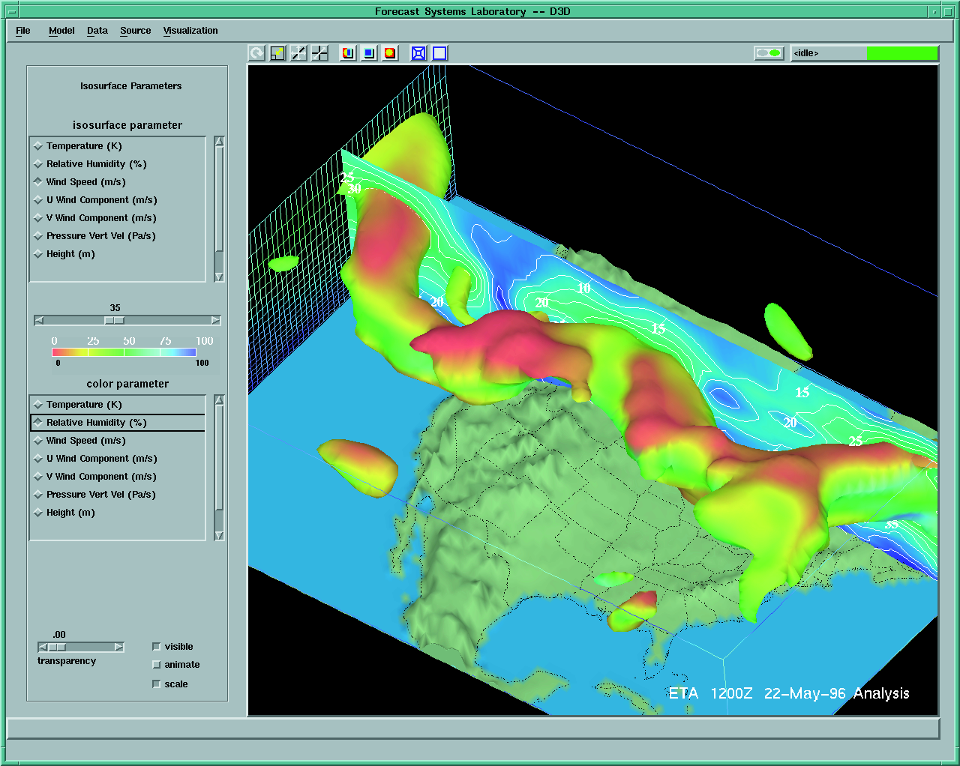
Multidimensional Visualization of Geospatial Data

Slide 15
Logical Data Warehouse Architecture

Slide 16
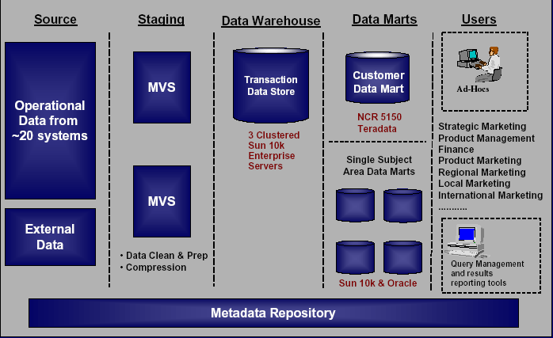
Technology for the Data Warehouse & Data Marts

Slide 17
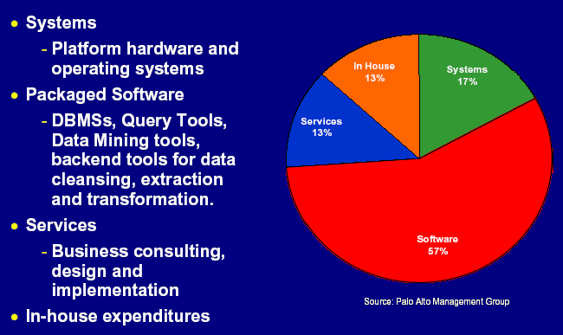
The Data Warehousing market is comprised of four categories; Systems, Packaged Software, Services, In-house Expenditures

Slide 18
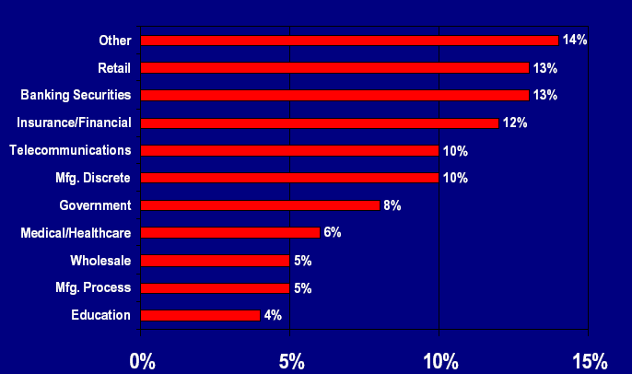
Data Warehouse Solutions Market by Industry Sector, Yr 2002

