Slide 1
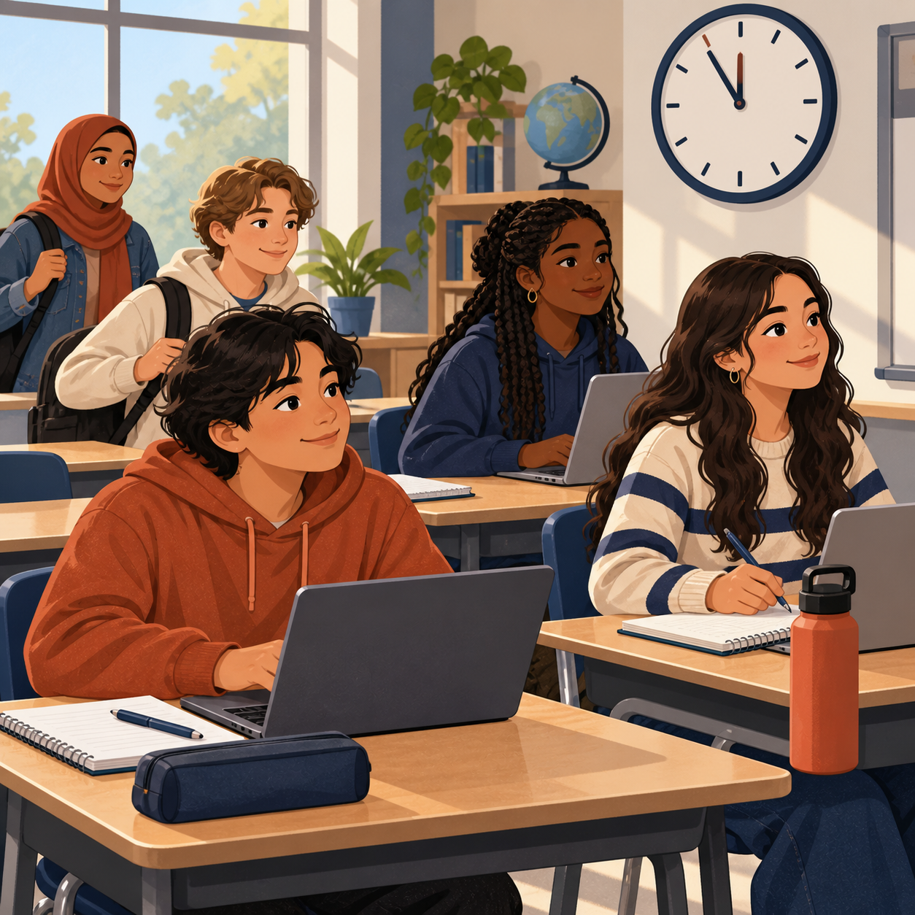

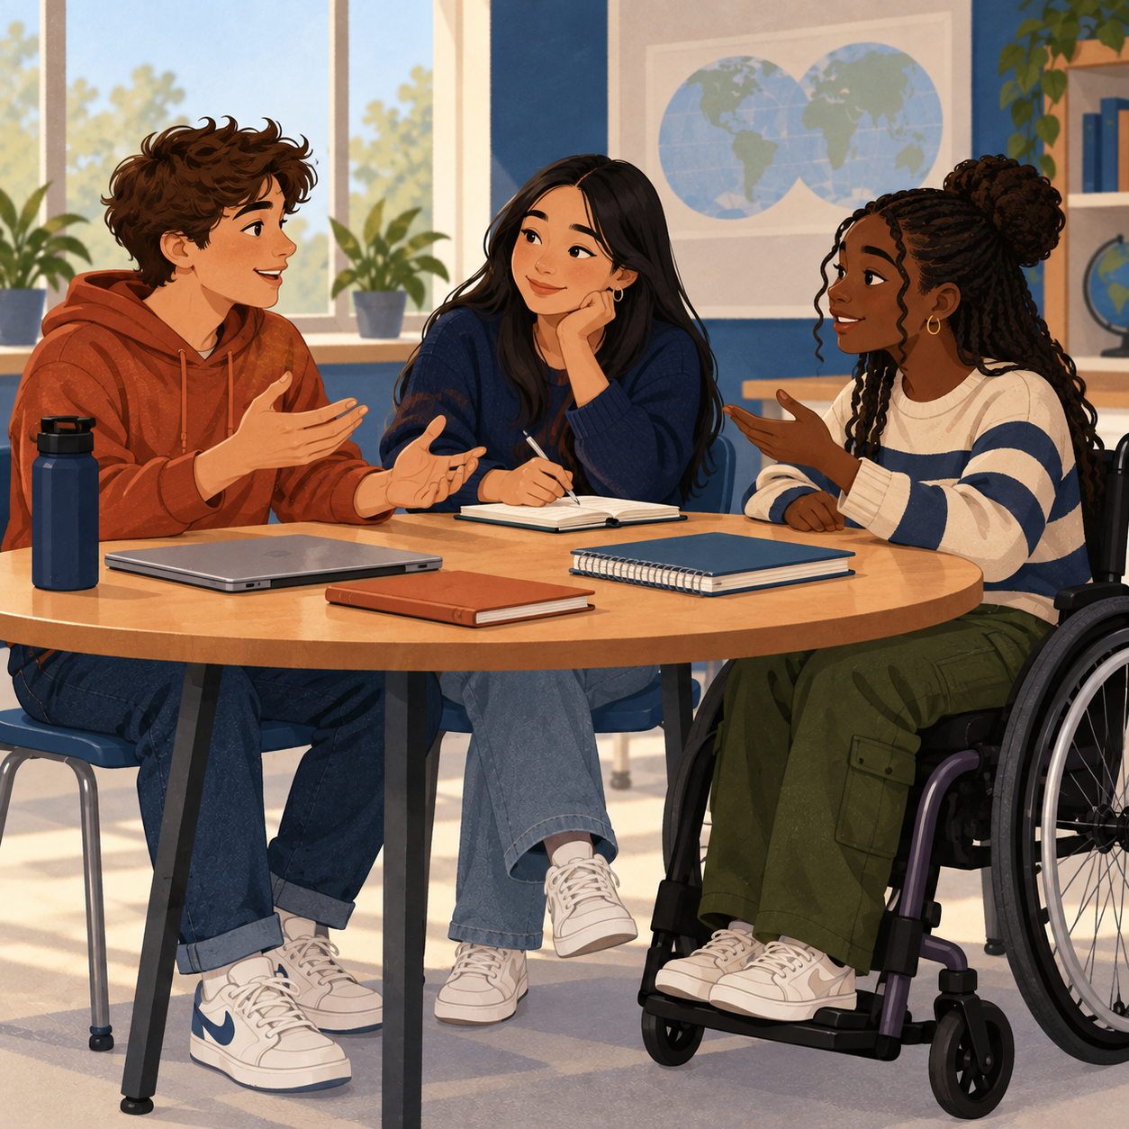
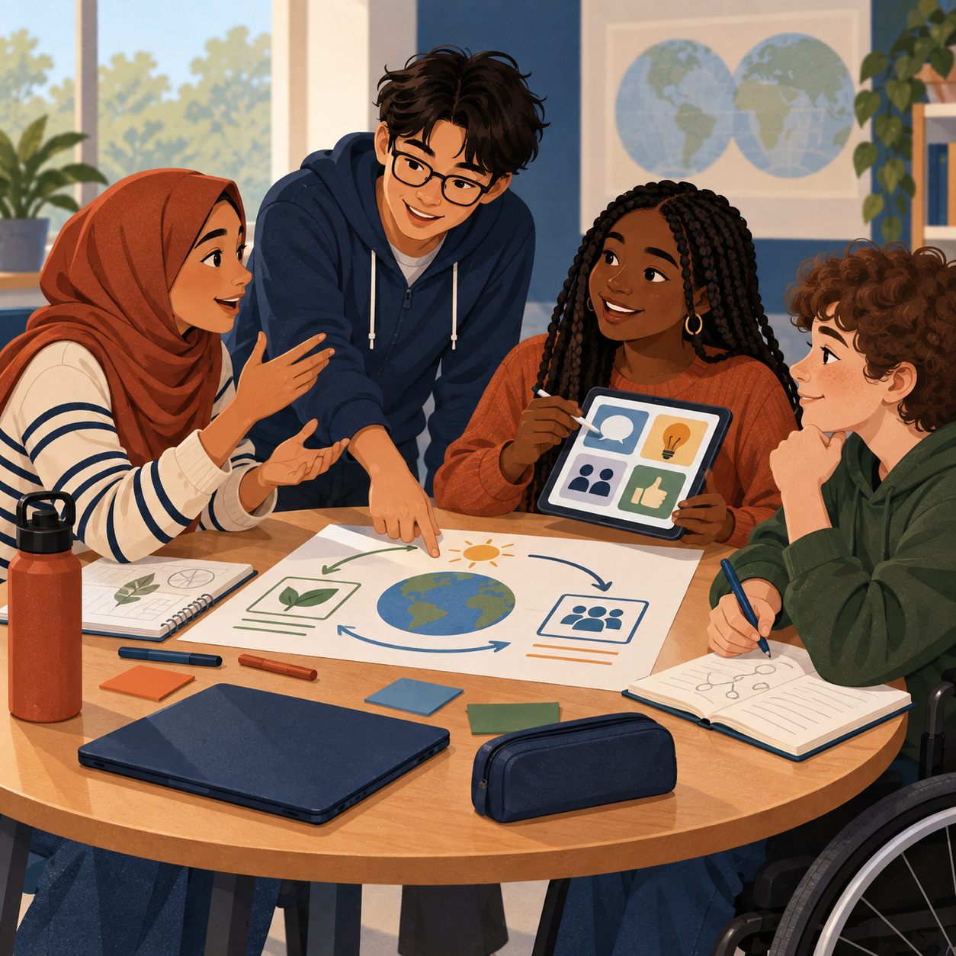
OUR SHARED COMMITMENT
BLOCK 5 CLASS NORMS
We created these norms together. Each picture and example shows what they can look like in class.
1
READY
Arrive prepared, on time, and ready to begin.
Student ideas: On time, accountable, prepared, dependable.
2
COMMUNICATE
Listen actively and speak clearly, kindly, and professionally.
Student ideas: Communication, customer service, respectful, transparent.
3
PRODUCTIVE
Stay focused, use your time well, and complete your work.
Student ideas: Productive, self-driven, focused, complete work on time.
4
TEAMWORK
Work well with others and adjust when challenges arise.
Student ideas: Teamwork, kind, flexible, problem-solver, work under pressure.
Chosen by the students of Block 5
Words, examples, and pictures offer different ways to understand our agreement.
Notes:
Sources: 09-11 Lecture_ Classroom Professionalism and Course Management transcript; Planning_ Course Scheduling and Curriculum Outline transcript; Block 4 brainstorm photograph supplied 2026-09-11. The four norm labels and supporting student-idea words come from the class discussion and photographed brainstorm, polished only for length and readability. UDL design choices: each norm appears as a word, a plain-language action example, a student-generated keyword line, and an inclusive visual vignette. The poster uses high contrast, large sans-serif type, consistent order, and descriptive image alt text. The handwritten source photo informed the content but is intentionally not displayed.

