Slide 1
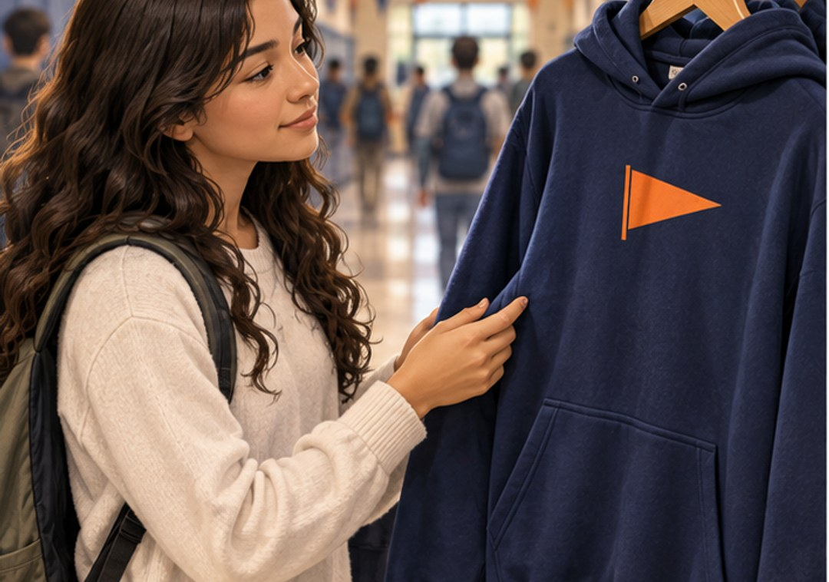
CHAPTER 1 · p. 3 · SBTE 2–3
A hoodie, a shop, and your choices
CHAPTER 1 LEARNING TARGETS
Differentiate business and marketing.
Explain marketing’s purpose.
Explain the marketing mix.
Which choice could make this product work better?
p. 3 · SBTE 2–3 Think quietly, then point, write, or explain. 1/29
Notes:
SOURCE: Chapter 1, printed p. 3 · SBTE 2–3; original SBTE deck remains content authority.
PITER SAYS: “Look at the picture. A hoodie, a shop, and your choices” Pause 10 seconds. Then connect one noticed detail to CHAPTER 1 LEARNING TARGETS. Read and explain the academic language.
CHECK: Which choice could make this product work better?
EXPECTED: Any supported customer-oriented choice. Invite a fictional example instead of asking students about their own purchases.
MISCONCEPTION / SOURCE DETAIL: Teacher guide to the full chapter. Use only the current section’s chunk; never present all slides in one lesson. Discussion prompts from SBTE 2 remain in notes: How might marketing affect a fictional purchase? What work do marketers do? How does marketing affect society? How are wants and needs considered?
STOP: After one explanation and the matched check, move to the assigned textbook heading. Allow approximately 60–90 seconds per selected concept screen; do not present the full library in one class. Protect the scheduled reading.
SBTE HANDOFF: “Can you connect this example to our notes?” SBTE gives a 20-second correction or collects whole-class responses while Piter teaches.
LESSON COMPARISON: Same concept, source reading, instructional time and check in both formats. Compare the access format, not more support time or easier questions. An alternative response mode preserves the explanation requirement.
TEACHER SOURCE EXAMPLES: Teacher guide to the full chapter. Use only the current section’s chunk; never present all slides in one lesson. Discussion prompts from SBTE 2 remain in notes: How might marketing affect a fictional purchase? What work do marketers do? How does marketing affect society? How are wants and needs considered?
ACCESS: Read the short directions and describe the relevant visual aloud. Offer pointing, fingers, a written letter, or a quiet spoken response. Do not require eye contact, public disclosure, a phone, or speed. Keep printed response options available. No flashing, animation, or audible countdown.
VISUAL SOURCE: Fictional generated illustrations; not actual students, school events, products, or prices. Repeated images intentionally preserve the scenario between prediction and academic explanation.

Slide 2

CHAPTER 1 · p. 4 · SBTE 4
What does the business actually do?
BUSINESS
Makes, sells, or provides products in exchange for money.
A product is something that can be bought or sold.
Point to a good or paid service a shop could offer.
p. 4 · SBTE 4 Think quietly, then point, write, or explain. 2/29
Notes:
SOURCE: Chapter 1, printed p. 4 · SBTE 4; original SBTE deck remains content authority.
PITER SAYS: “Look at the picture. What does the business actually do?” Pause 10 seconds. Then connect one noticed detail to BUSINESS. Read and explain the academic language.
CHECK: Point to a good or paid service a shop could offer.
EXPECTED: Food is a good; paid repair is a service. Both can be products.
MISCONCEPTION / SOURCE DETAIL: Business also means a particular company or organization; source examples include Amazon and Walmart.
STOP: After one explanation and the matched check, move to the assigned textbook heading. Allow approximately 60–90 seconds per selected concept screen; do not present the full library in one class. Protect the scheduled reading.
SBTE HANDOFF: “Can you connect this example to our notes?” SBTE gives a 20-second correction or collects whole-class responses while Piter teaches.
LESSON COMPARISON: Same concept, source reading, instructional time and check in both formats. Compare the access format, not more support time or easier questions. An alternative response mode preserves the explanation requirement.
TEACHER SOURCE EXAMPLES: Business also means a particular company or organization; source examples include Amazon and Walmart.
ACCESS: Read the short directions and describe the relevant visual aloud. Offer pointing, fingers, a written letter, or a quiet spoken response. Do not require eye contact, public disclosure, a phone, or speed. Keep printed response options available. No flashing, animation, or audible countdown.
VISUAL SOURCE: Fictional generated illustrations; not actual students, school events, products, or prices. Repeated images intentionally preserve the scenario between prediction and academic explanation.

Slide 3
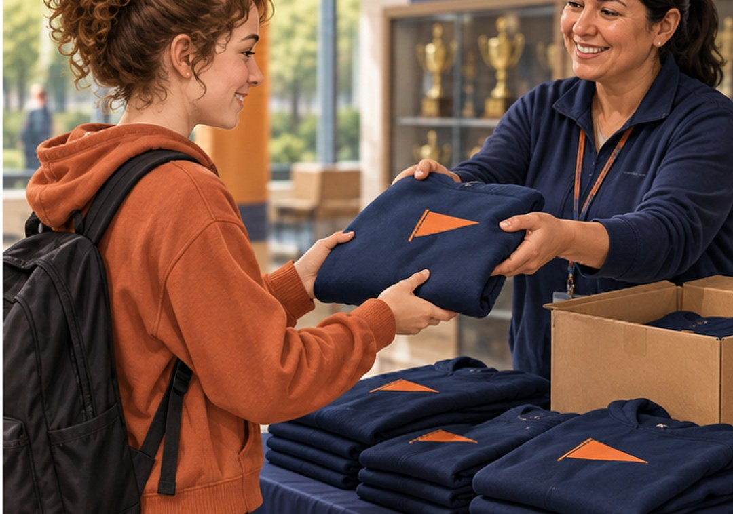
CHAPTER 1 · p. 4 · SBTE 4
How would customers find it?
MARKETING
Promoting, selling, and distributing a product or service.
A hoodie needs more than a design.
Name one marketing task beyond advertising.
p. 4 · SBTE 4 Think quietly, then point, write, or explain. 3/29
Notes:
SOURCE: Chapter 1, printed p. 4 · SBTE 4; original SBTE deck remains content authority.
PITER SAYS: “Look at the picture. How would customers find it?” Pause 10 seconds. Then connect one noticed detail to MARKETING. Read and explain the academic language.
CHECK: Name one marketing task beyond advertising.
EXPECTED: Selling or distribution.
MISCONCEPTION / SOURCE DETAIL: Describe the pickup scene; contrast making the hoodie with getting the finished product to the customer. Keep source definition alongside concrete example.
STOP: After one explanation and the matched check, move to the assigned textbook heading. Allow approximately 60–90 seconds per selected concept screen; do not present the full library in one class. Protect the scheduled reading.
SBTE HANDOFF: “Can you connect this example to our notes?” SBTE gives a 20-second correction or collects whole-class responses while Piter teaches.
LESSON COMPARISON: Same concept, source reading, instructional time and check in both formats. Compare the access format, not more support time or easier questions. An alternative response mode preserves the explanation requirement.
TEACHER SOURCE EXAMPLES: Describe the pickup scene; contrast making the hoodie with getting the finished product to the customer. Keep source definition alongside concrete example.
ACCESS: Read the short directions and describe the relevant visual aloud. Offer pointing, fingers, a written letter, or a quiet spoken response. Do not require eye contact, public disclosure, a phone, or speed. Keep printed response options available. No flashing, animation, or audible countdown.
VISUAL SOURCE: Fictional generated illustrations; not actual students, school events, products, or prices. Repeated images intentionally preserve the scenario between prediction and academic explanation.

Slide 4
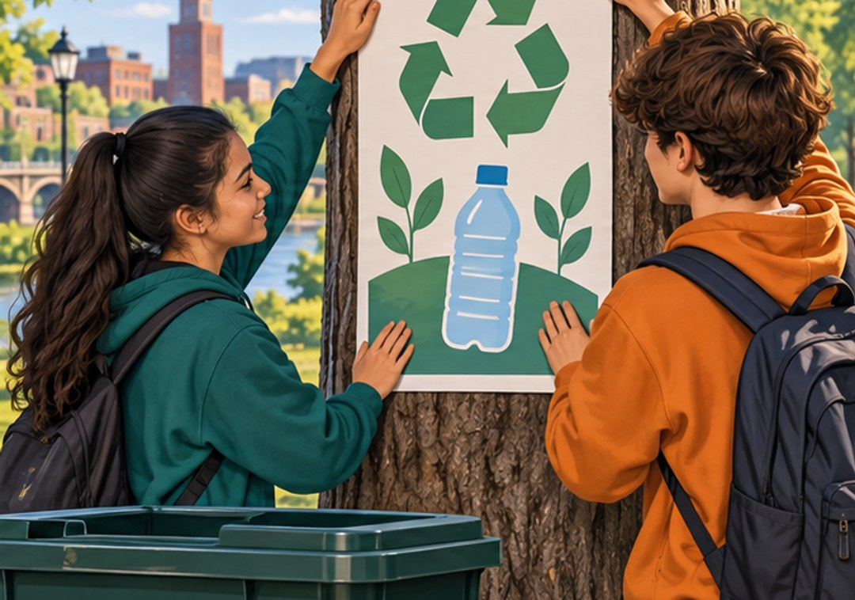
CHAPTER 1 · p. 4 · SBTE 4
An item, a task, or a message?
GOODS · SERVICES · IDEAS
Good: a tangible item for sale.
Service: a task performed for money.
Idea: a thought or opinion.
Classify the recycling MESSAGE, then its paper poster.
p. 4 · SBTE 4 Think quietly, then point, write, or explain. 4/29
Notes:
SOURCE: Chapter 1, printed p. 4 · SBTE 4; original SBTE deck remains content authority.
PITER SAYS: “Look at the picture. An item, a task, or a message?” Pause 10 seconds. Then connect one noticed detail to GOODS · SERVICES · IDEAS. Read and explain the academic language.
CHECK: Classify the recycling MESSAGE, then its paper poster.
EXPECTED: Message = idea; physical poster can be a good.
MISCONCEPTION / SOURCE DETAIL: Use all three market panels verbally: food, paid bicycle repair, community recycling idea. Source examples include food/clothing/furniture, car repair/financial advice/housecleaning, and voting or charitable giving.
STOP: After one explanation and the matched check, move to the assigned textbook heading. Allow approximately 60–90 seconds per selected concept screen; do not present the full library in one class. Protect the scheduled reading.
SBTE HANDOFF: “Can you connect this example to our notes?” SBTE gives a 20-second correction or collects whole-class responses while Piter teaches.
LESSON COMPARISON: Same concept, source reading, instructional time and check in both formats. Compare the access format, not more support time or easier questions. An alternative response mode preserves the explanation requirement.
TEACHER SOURCE EXAMPLES: Use all three market panels verbally: food, paid bicycle repair, community recycling idea. Source examples include food/clothing/furniture, car repair/financial advice/housecleaning, and voting or charitable giving.
ACCESS: Read the short directions and describe the relevant visual aloud. Offer pointing, fingers, a written letter, or a quiet spoken response. Do not require eye contact, public disclosure, a phone, or speed. Keep printed response options available. No flashing, animation, or audible countdown.
VISUAL SOURCE: Fictional generated illustrations; not actual students, school events, products, or prices. Repeated images intentionally preserve the scenario between prediction and academic explanation.

Slide 5

CHAPTER 1 · p. 5 · textbook support
Why can’t the event do everything?
ECONOMICS
Unlimited wants meet limited resources.
A fictional event has limited money, time, and space.
Name one trade-off without using your own finances.
p. 5 · textbook support Think quietly, then point, write, or explain. 5/29
Notes:
SOURCE: Chapter 1, printed p. 5 · textbook support; original SBTE deck remains content authority.
PITER SAYS: “Look at the picture. Why can’t the event do everything?” Pause 10 seconds. Then connect one noticed detail to ECONOMICS. Read and explain the academic language.
CHECK: Name one trade-off without using your own finances.
EXPECTED: For example spend on extra controllers versus seating.
MISCONCEPTION / SOURCE DETAIL: Economics studies decisions by individuals, businesses, governments, including production, consumption and transfer of wealth. Do not ask for personal financial information.
STOP: After one explanation and the matched check, move to the assigned textbook heading. Allow approximately 60–90 seconds per selected concept screen; do not present the full library in one class. Protect the scheduled reading.
SBTE HANDOFF: “Can you connect this example to our notes?” SBTE gives a 20-second correction or collects whole-class responses while Piter teaches.
LESSON COMPARISON: Same concept, source reading, instructional time and check in both formats. Compare the access format, not more support time or easier questions. An alternative response mode preserves the explanation requirement.
TEACHER SOURCE EXAMPLES: Economics studies decisions by individuals, businesses, governments, including production, consumption and transfer of wealth. Do not ask for personal financial information.
ACCESS: Read the short directions and describe the relevant visual aloud. Offer pointing, fingers, a written letter, or a quiet spoken response. Do not require eye contact, public disclosure, a phone, or speed. Keep printed response options available. No flashing, animation, or audible countdown.
VISUAL SOURCE: Fictional generated illustrations; not actual students, school events, products, or prices. Repeated images intentionally preserve the scenario between prediction and academic explanation.

Slide 6
CHAPTER 1 · p. 5 · textbook support
Selling $100 does not mean keeping $100
PROFIT AND NET WORTH
Profit = revenue − expenses
$100 − $70 = $30 profit
Net worth = assets − liabilities
Is a loan something the business owns or owes?
p. 5 · textbook support Think quietly, then point, write, or explain. 6/29
Notes:
SOURCE: Chapter 1, printed p. 5 · textbook support; original SBTE deck remains content authority.
PITER SAYS: “Look at the picture. Selling $100 does not mean keeping $100” Pause 10 seconds. Then connect one noticed detail to PROFIT AND NET WORTH. Read and explain the academic language.
CHECK: Is a loan something the business owns or owes?
EXPECTED: Owes: liability. Cash/equipment can be assets.
MISCONCEPTION / SOURCE DETAIL: All numbers fictional. Net worth is a stock of value; profit measures a period’s gain. Explain assets owned and liabilities owed. Do not conflate sales, cash, profit, and net worth.
STOP: After one explanation and the matched check, move to the assigned textbook heading. Allow approximately 60–90 seconds per selected concept screen; do not present the full library in one class. Protect the scheduled reading.
SBTE HANDOFF: “Can you connect this example to our notes?” SBTE gives a 20-second correction or collects whole-class responses while Piter teaches.
LESSON COMPARISON: Same concept, source reading, instructional time and check in both formats. Compare the access format, not more support time or easier questions. An alternative response mode preserves the explanation requirement.
TEACHER SOURCE EXAMPLES: All numbers fictional. Net worth is a stock of value; profit measures a period’s gain. Explain assets owned and liabilities owed. Do not conflate sales, cash, profit, and net worth.
ACCESS: Read the short directions and describe the relevant visual aloud. Offer pointing, fingers, a written letter, or a quiet spoken response. Do not require eye contact, public disclosure, a phone, or speed. Keep printed response options available. No flashing, animation, or audible countdown.
VISUAL SOURCE: Fictional generated illustrations; not actual students, school events, products, or prices. Repeated images intentionally preserve the scenario between prediction and academic explanation.

Slide 7
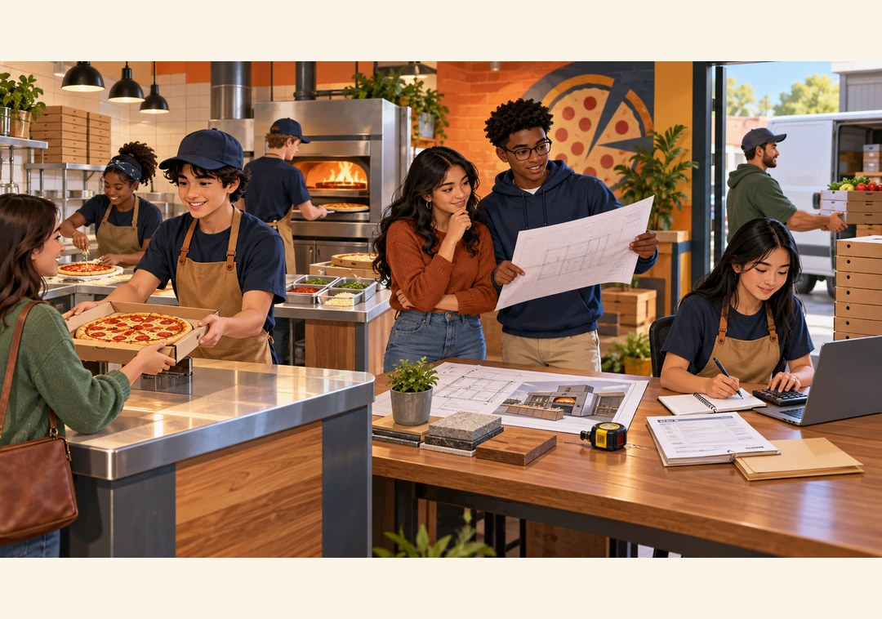
CHAPTER 1 · pp. 5–7 · SBTE 5–7
Same shop. Different kinds of work.
BUSINESS ACTIVITIES
Operational: daily work
Investing: build value over time
Financial: money in and out
Match making pizza, buying property, collecting payment.
pp. 5–7 · SBTE 5–7 Think quietly, then point, write, or explain. 7/29
Notes:
SOURCE: Chapter 1, printed pp. 5–7 · SBTE 5–7; original SBTE deck remains content authority.
PITER SAYS: “Look at the picture. Same shop. Different kinds of work.” Pause 10 seconds. Then connect one noticed detail to BUSINESS ACTIVITIES. Read and explain the academic language.
CHECK: Match making pizza, buying property, collecting payment.
EXPECTED: Operational; investing; financial.
MISCONCEPTION / SOURCE DETAIL: The source categories overlap. Focus on the scenario’s emphasis; do not claim every activity belongs exclusively to one category. Use source table Figure 1.2 for maintenance, buildings, loans, stock, sales and debts.
STOP: After one explanation and the matched check, move to the assigned textbook heading. Allow approximately 60–90 seconds per selected concept screen; do not present the full library in one class. Protect the scheduled reading.
SBTE HANDOFF: “Can you connect this example to our notes?” SBTE gives a 20-second correction or collects whole-class responses while Piter teaches.
LESSON COMPARISON: Same concept, source reading, instructional time and check in both formats. Compare the access format, not more support time or easier questions. An alternative response mode preserves the explanation requirement.
TEACHER SOURCE EXAMPLES: The source categories overlap. Focus on the scenario’s emphasis; do not claim every activity belongs exclusively to one category. Use source table Figure 1.2 for maintenance, buildings, loans, stock, sales and debts.
ACCESS: Read the short directions and describe the relevant visual aloud. Offer pointing, fingers, a written letter, or a quiet spoken response. Do not require eye contact, public disclosure, a phone, or speed. Keep printed response options available. No flashing, animation, or audible countdown.
VISUAL SOURCE: Fictional generated illustrations; not actual students, school events, products, or prices. Repeated images intentionally preserve the scenario between prediction and academic explanation.

Slide 8
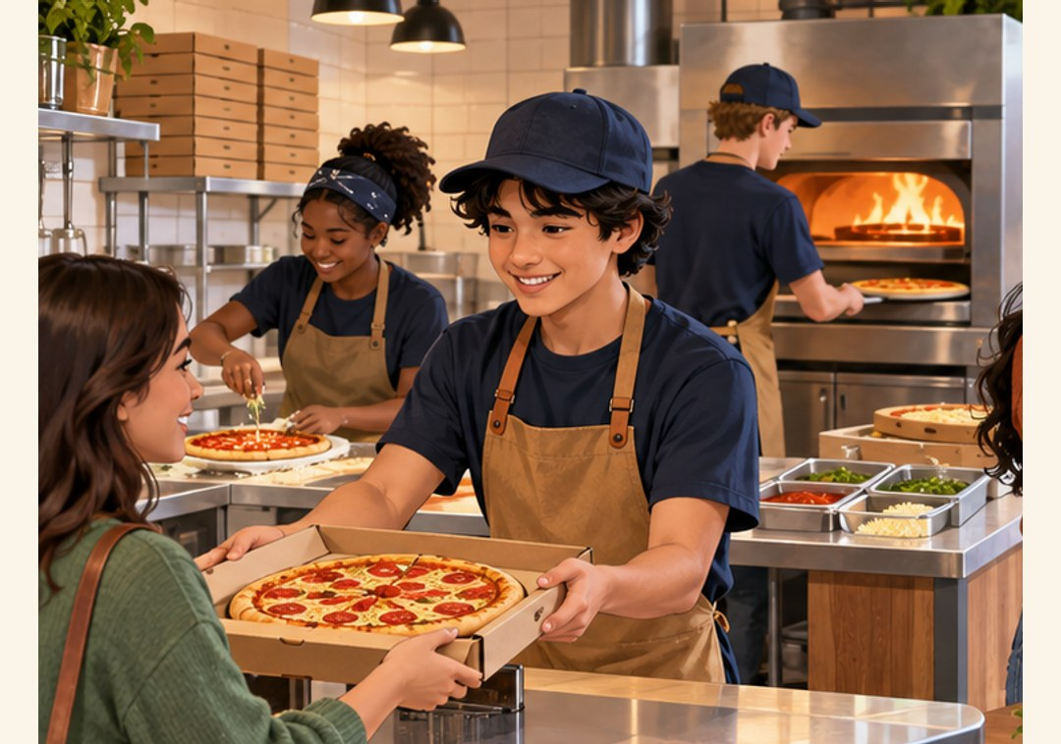
CHAPTER 1 · pp. 5–6 · SBTE 6
Who keeps the shop running today?
OPERATIONAL FUNCTIONS
Production makes products.
Marketing responds to demand.
Management directs work.
Finance handles daily money tasks.
Where would paying employees fit?
pp. 5–6 · SBTE 6 Think quietly, then point, write, or explain. 8/29
Notes:
SOURCE: Chapter 1, printed pp. 5–6 · SBTE 6; original SBTE deck remains content authority.
PITER SAYS: “Look at the picture. Who keeps the shop running today?” Pause 10 seconds. Then connect one noticed detail to OPERATIONAL FUNCTIONS. Read and explain the academic language.
CHECK: Where would paying employees fit?
EXPECTED: Finance within operational functions; also money movement.
MISCONCEPTION / SOURCE DETAIL: Retain source software-production example: developing software, hiring engineers, fixing bugs. Marketing includes competitor research, trends, social media. Management includes leading, supervising and planning.
STOP: After one explanation and the matched check, move to the assigned textbook heading. Allow approximately 60–90 seconds per selected concept screen; do not present the full library in one class. Protect the scheduled reading.
SBTE HANDOFF: “Can you connect this example to our notes?” SBTE gives a 20-second correction or collects whole-class responses while Piter teaches.
LESSON COMPARISON: Same concept, source reading, instructional time and check in both formats. Compare the access format, not more support time or easier questions. An alternative response mode preserves the explanation requirement.
TEACHER SOURCE EXAMPLES: Retain source software-production example: developing software, hiring engineers, fixing bugs. Marketing includes competitor research, trends, social media. Management includes leading, supervising and planning.
ACCESS: Read the short directions and describe the relevant visual aloud. Offer pointing, fingers, a written letter, or a quiet spoken response. Do not require eye contact, public disclosure, a phone, or speed. Keep printed response options available. No flashing, animation, or audible countdown.
VISUAL SOURCE: Fictional generated illustrations; not actual students, school events, products, or prices. Repeated images intentionally preserve the scenario between prediction and academic explanation.

Slide 9
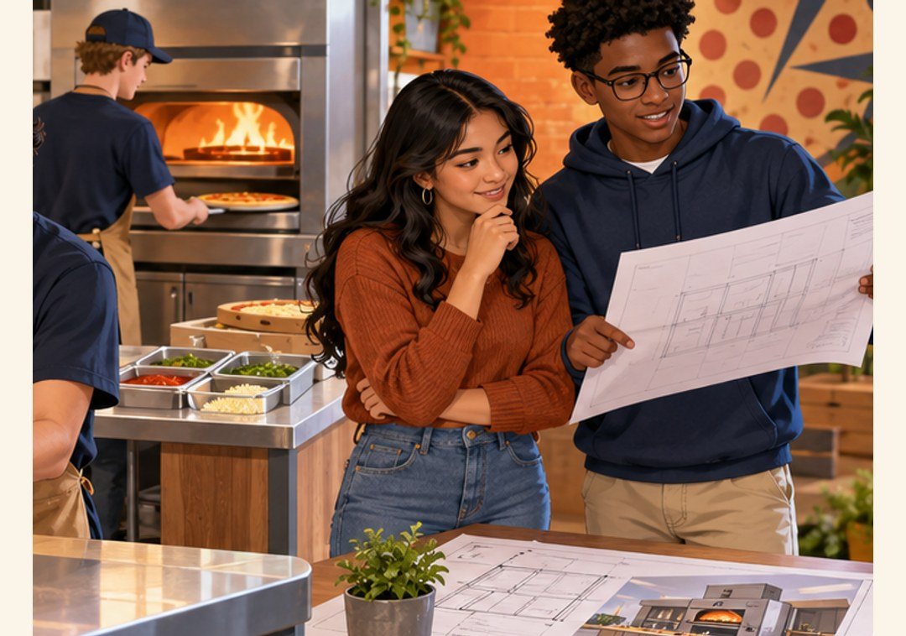
CHAPTER 1 · p. 6 · SBTE 7
What might help the shop grow?
INVESTING ACTIVITIES
Use money with the aim of building wealth over time.
Example: purchase a building.
Does an investment guarantee a gain?
p. 6 · SBTE 7 Think quietly, then point, write, or explain. 9/29
Notes:
SOURCE: Chapter 1, printed p. 6 · SBTE 7; original SBTE deck remains content authority.
PITER SAYS: “Look at the picture. What might help the shop grow?” Pause 10 seconds. Then connect one noticed detail to INVESTING ACTIVITIES. Read and explain the academic language.
CHECK: Does an investment guarantee a gain?
EXPECTED: No. Future benefit is an aim, not a guarantee.
MISCONCEPTION / SOURCE DETAIL: Preserve stocks, bonds, mutual funds and real estate as source examples; the text also discusses upgrades and advertisements as investments in future growth. Do not turn this into personal investment advice.
STOP: After one explanation and the matched check, move to the assigned textbook heading. Allow approximately 60–90 seconds per selected concept screen; do not present the full library in one class. Protect the scheduled reading.
SBTE HANDOFF: “Can you connect this example to our notes?” SBTE gives a 20-second correction or collects whole-class responses while Piter teaches.
LESSON COMPARISON: Same concept, source reading, instructional time and check in both formats. Compare the access format, not more support time or easier questions. An alternative response mode preserves the explanation requirement.
TEACHER SOURCE EXAMPLES: Preserve stocks, bonds, mutual funds and real estate as source examples; the text also discusses upgrades and advertisements as investments in future growth. Do not turn this into personal investment advice.
ACCESS: Read the short directions and describe the relevant visual aloud. Offer pointing, fingers, a written letter, or a quiet spoken response. Do not require eye contact, public disclosure, a phone, or speed. Keep printed response options available. No flashing, animation, or audible countdown.
VISUAL SOURCE: Fictional generated illustrations; not actual students, school events, products, or prices. Repeated images intentionally preserve the scenario between prediction and academic explanation.

Slide 10
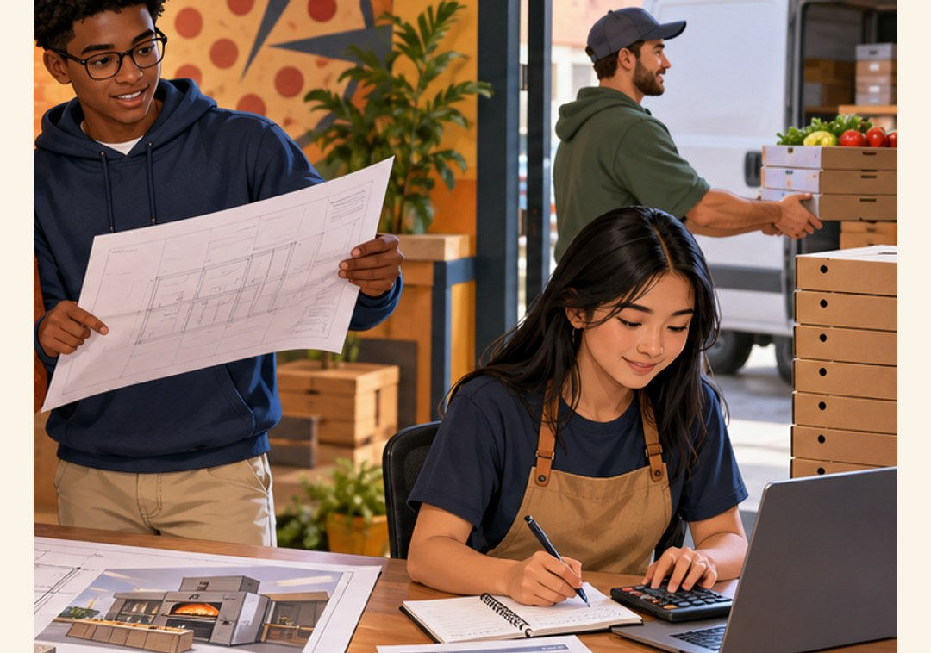
CHAPTER 1 · p. 7 · SBTE 7
Follow the money
FINANCIAL ACTIVITIES
Money comes in through sales.
Money goes out to suppliers or employees.
Name one input and one output for the pizza shop.
p. 7 · SBTE 7 Think quietly, then point, write, or explain. 10/29
Notes:
SOURCE: Chapter 1, printed p. 7 · SBTE 7; original SBTE deck remains content authority.
PITER SAYS: “Look at the picture. Follow the money” Pause 10 seconds. Then connect one noticed detail to FINANCIAL ACTIVITIES. Read and explain the academic language.
CHECK: Name one input and one output for the pizza shop.
EXPECTED: Customer payments in; wages or supplier payments out.
MISCONCEPTION / SOURCE DETAIL: Source pp. 6–7 and SBTE 6–7 overlap in financial terminology. Explain the emphasis without silently replacing it with an accounting cash-flow taxonomy.
STOP: After one explanation and the matched check, move to the assigned textbook heading. Allow approximately 60–90 seconds per selected concept screen; do not present the full library in one class. Protect the scheduled reading.
SBTE HANDOFF: “Can you connect this example to our notes?” SBTE gives a 20-second correction or collects whole-class responses while Piter teaches.
LESSON COMPARISON: Same concept, source reading, instructional time and check in both formats. Compare the access format, not more support time or easier questions. An alternative response mode preserves the explanation requirement.
TEACHER SOURCE EXAMPLES: Source pp. 6–7 and SBTE 6–7 overlap in financial terminology. Explain the emphasis without silently replacing it with an accounting cash-flow taxonomy.
ACCESS: Read the short directions and describe the relevant visual aloud. Offer pointing, fingers, a written letter, or a quiet spoken response. Do not require eye contact, public disclosure, a phone, or speed. Keep printed response options available. No flashing, animation, or audible countdown.
VISUAL SOURCE: Fictional generated illustrations; not actual students, school events, products, or prices. Repeated images intentionally preserve the scenario between prediction and academic explanation.

Slide 11
CHAPTER 1 · pp. 8–9 · SBTE 8
Who benefits besides the customer?
BUSINESSES AND SOCIETY
Provide products.
Create markets for exchange.
Support employment, wages, and taxes.
How could a neighborhood shop affect the community?
pp. 8–9 · SBTE 8 Think quietly, then point, write, or explain. 11/29
Notes:
SOURCE: Chapter 1, printed pp. 8–9 · SBTE 8; original SBTE deck remains content authority.
PITER SAYS: “Look at the picture. Who benefits besides the customer?” Pause 10 seconds. Then connect one noticed detail to BUSINESSES AND SOCIETY. Read and explain the academic language.
CHECK: How could a neighborhood shop affect the community?
EXPECTED: Products, jobs/wages, exchange opportunities, taxes funding public services.
MISCONCEPTION / SOURCE DETAIL: Read all three roles. Physical, virtual and specialty markets are source examples. Discuss benefits with conditions; no claims that all businesses benefit everyone equally. Keep social-welfare discussion source-focused and avoid asking about family circumstances.
STOP: After one explanation and the matched check, move to the assigned textbook heading. Allow approximately 60–90 seconds per selected concept screen; do not present the full library in one class. Protect the scheduled reading.
SBTE HANDOFF: “Can you connect this example to our notes?” SBTE gives a 20-second correction or collects whole-class responses while Piter teaches.
LESSON COMPARISON: Same concept, source reading, instructional time and check in both formats. Compare the access format, not more support time or easier questions. An alternative response mode preserves the explanation requirement.
TEACHER SOURCE EXAMPLES: Read all three roles. Physical, virtual and specialty markets are source examples. Discuss benefits with conditions; no claims that all businesses benefit everyone equally. Keep social-welfare discussion source-focused and avoid asking about family circumstances.
ACCESS: Read the short directions and describe the relevant visual aloud. Offer pointing, fingers, a written letter, or a quiet spoken response. Do not require eye contact, public disclosure, a phone, or speed. Keep printed response options available. No flashing, animation, or audible countdown.
VISUAL SOURCE: Fictional generated illustrations; not actual students, school events, products, or prices. Repeated images intentionally preserve the scenario between prediction and academic explanation.

Slide 12
CHAPTER 1 · p. 8 · SBTE 8 support
Warm clothing or this exact hoodie?
ECONOMIC NEEDS AND WANTS
Need: essential to survival.
Want: something desired.
Clothing can meet a need; a particular style can be a want.
Could the situation change what someone needs?
p. 8 · SBTE 8 support Think quietly, then point, write, or explain. 12/29
Notes:
SOURCE: Chapter 1, printed p. 8 · SBTE 8 support; original SBTE deck remains content authority.
PITER SAYS: “Look at the picture. Warm clothing or this exact hoodie?” Pause 10 seconds. Then connect one noticed detail to ECONOMIC NEEDS AND WANTS. Read and explain the academic language.
CHECK: Could the situation change what someone needs?
EXPECTED: Yes, context changes practical access needs; use the textbook economic distinction.
MISCONCEPTION / SOURCE DETAIL: Textbook classifies smartphone/internet as economic wants. Acknowledge that school participation may require digital access; do not imply students can simply complete digital work without it. Maintain academic definition and flag contextual tension.
STOP: After one explanation and the matched check, move to the assigned textbook heading. Allow approximately 60–90 seconds per selected concept screen; do not present the full library in one class. Protect the scheduled reading.
SBTE HANDOFF: “Can you connect this example to our notes?” SBTE gives a 20-second correction or collects whole-class responses while Piter teaches.
LESSON COMPARISON: Same concept, source reading, instructional time and check in both formats. Compare the access format, not more support time or easier questions. An alternative response mode preserves the explanation requirement.
TEACHER SOURCE EXAMPLES: Textbook classifies smartphone/internet as economic wants. Acknowledge that school participation may require digital access; do not imply students can simply complete digital work without it. Maintain academic definition and flag contextual tension.
ACCESS: Read the short directions and describe the relevant visual aloud. Offer pointing, fingers, a written letter, or a quiet spoken response. Do not require eye contact, public disclosure, a phone, or speed. Keep printed response options available. No flashing, animation, or audible countdown.
VISUAL SOURCE: Fictional generated illustrations; not actual students, school events, products, or prices. Repeated images intentionally preserve the scenario between prediction and academic explanation.

Slide 13
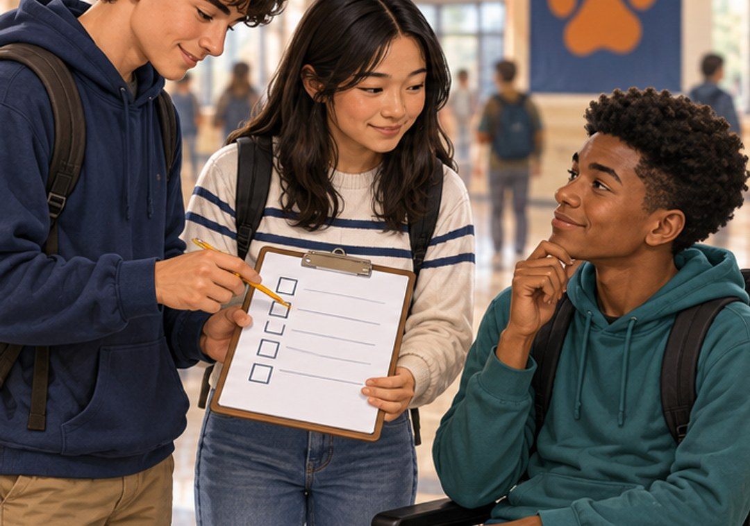
CHAPTER 1 · p. 10 · SBTE 9
Would YOUR favorite work for everyone?
PURPOSE OF MARKETING
Understand customer wants and needs.
Use research and evidence to deliver products that meet them.
What would you ask before making 200 hoodies?
p. 10 · SBTE 9 Think quietly, then point, write, or explain. 13/29
Notes:
SOURCE: Chapter 1, printed p. 10 · SBTE 9; original SBTE deck remains content authority.
PITER SAYS: “Look at the picture. Would YOUR favorite work for everyone?” Pause 10 seconds. Then connect one noticed detail to PURPOSE OF MARKETING. Read and explain the academic language.
CHECK: What would you ask before making 200 hoodies?
EXPECTED: Ask likely users about fit, comfort, intended use or preferred features.
MISCONCEPTION / SOURCE DETAIL: Customer-oriented decisions affect production, management and finance. Do not assume all teens want merchandise. Reference fictional scenario inspired by Sep. 17 announcements.
STOP: After one explanation and the matched check, move to the assigned textbook heading. Allow approximately 60–90 seconds per selected concept screen; do not present the full library in one class. Protect the scheduled reading.
SBTE HANDOFF: “Can you connect this example to our notes?” SBTE gives a 20-second correction or collects whole-class responses while Piter teaches.
LESSON COMPARISON: Same concept, source reading, instructional time and check in both formats. Compare the access format, not more support time or easier questions. An alternative response mode preserves the explanation requirement.
TEACHER SOURCE EXAMPLES: Customer-oriented decisions affect production, management and finance. Do not assume all teens want merchandise. Reference fictional scenario inspired by Sep. 17 announcements.
ACCESS: Read the short directions and describe the relevant visual aloud. Offer pointing, fingers, a written letter, or a quiet spoken response. Do not require eye contact, public disclosure, a phone, or speed. Keep printed response options available. No flashing, animation, or audible countdown.
VISUAL SOURCE: Fictional generated illustrations; not actual students, school events, products, or prices. Repeated images intentionally preserve the scenario between prediction and academic explanation.

Slide 14
CHAPTER 1 · pp. 10–11 · SBTE 9
Customer choice meets business reality
MARKETING CONCEPT
Customer needs
Company goals
Profits
A comfortable hoodie costs more to make. What must the shop consider?
pp. 10–11 · SBTE 9 Think quietly, then point, write, or explain. 14/29
Notes:
SOURCE: Chapter 1, printed pp. 10–11 · SBTE 9; original SBTE deck remains content authority.
PITER SAYS: “Look at the picture. Customer choice meets business reality” Pause 10 seconds. Then connect one noticed detail to MARKETING CONCEPT. Read and explain the academic language.
CHECK: A comfortable hoodie costs more to make. What must the shop consider?
EXPECTED: Customer value/needs, company goals and revenue minus expenses.
MISCONCEPTION / SOURCE DETAIL: Method of selling analyzes wants and needs and aims to satisfy them better than competitors. All three elements matter. Apply p. 9 Jack’s tortilla case after reading: customers, national expansion goals, distribution costs/profit. Preserve the case rather than replacing it with hoodies.
STOP: After one explanation and the matched check, move to the assigned textbook heading. Allow approximately 60–90 seconds per selected concept screen; do not present the full library in one class. Protect the scheduled reading.
SBTE HANDOFF: “Can you connect this example to our notes?” SBTE gives a 20-second correction or collects whole-class responses while Piter teaches.
LESSON COMPARISON: Same concept, source reading, instructional time and check in both formats. Compare the access format, not more support time or easier questions. An alternative response mode preserves the explanation requirement.
TEACHER SOURCE EXAMPLES: Method of selling analyzes wants and needs and aims to satisfy them better than competitors. All three elements matter. Apply p. 9 Jack’s tortilla case after reading: customers, national expansion goals, distribution costs/profit. Preserve the case rather than replacing it with hoodies.
ACCESS: Read the short directions and describe the relevant visual aloud. Offer pointing, fingers, a written letter, or a quiet spoken response. Do not require eye contact, public disclosure, a phone, or speed. Keep printed response options available. No flashing, animation, or audible countdown.
VISUAL SOURCE: Fictional generated illustrations; not actual students, school events, products, or prices. Repeated images intentionally preserve the scenario between prediction and academic explanation.

Slide 15
CHAPTER 1 · p. 10 · textbook support
30 out of 100 hoodie sales
MARKET SHARE
If one shop sells 30 of 100 hoodies in the defined market, its share is 30%.
If its sales rise, must its share rise too?
p. 10 · textbook support Think quietly, then point, write, or explain. 15/29
Notes:
SOURCE: Chapter 1, printed p. 10 · textbook support; original SBTE deck remains content authority.
PITER SAYS: “Look at the picture. 30 out of 100 hoodie sales” Pause 10 seconds. Then connect one noticed detail to MARKET SHARE. Read and explain the academic language.
CHECK: If its sales rise, must its share rise too?
EXPECTED: No. Total market sales may grow faster.
MISCONCEPTION / SOURCE DETAIL: Fictional units in the same period and defined market. Market share = company sales / total market sales ×100 using consistent measure. Source pie analogy can support explanation. Market share is not profit.
STOP: After one explanation and the matched check, move to the assigned textbook heading. Allow approximately 60–90 seconds per selected concept screen; do not present the full library in one class. Protect the scheduled reading.
SBTE HANDOFF: “Can you connect this example to our notes?” SBTE gives a 20-second correction or collects whole-class responses while Piter teaches.
LESSON COMPARISON: Same concept, source reading, instructional time and check in both formats. Compare the access format, not more support time or easier questions. An alternative response mode preserves the explanation requirement.
TEACHER SOURCE EXAMPLES: Fictional units in the same period and defined market. Market share = company sales / total market sales ×100 using consistent measure. Source pie analogy can support explanation. Market share is not profit.
ACCESS: Read the short directions and describe the relevant visual aloud. Offer pointing, fingers, a written letter, or a quiet spoken response. Do not require eye contact, public disclosure, a phone, or speed. Keep printed response options available. No flashing, animation, or audible countdown.
VISUAL SOURCE: Fictional generated illustrations; not actual students, school events, products, or prices. Repeated images intentionally preserve the scenario between prediction and academic explanation.

Slide 16
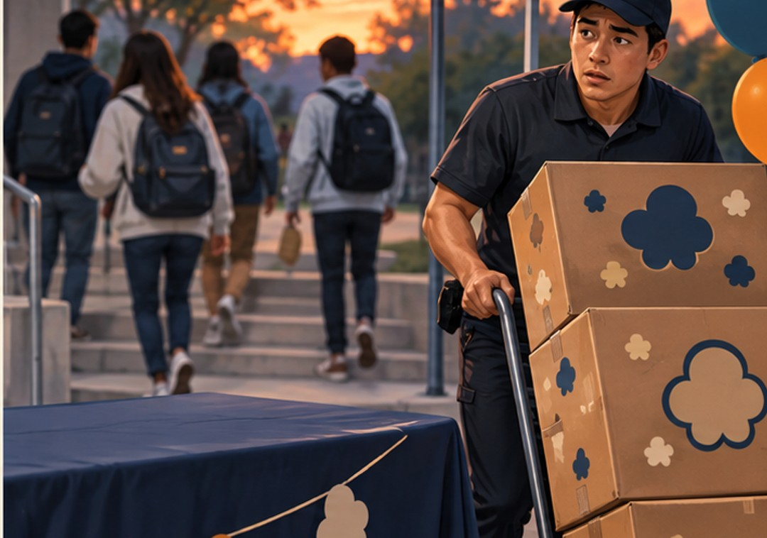
CHAPTER 1 · pp. 11–12 · SBTE 10
Which decision are we making?
MARKETING MIX: THE 4 Ps
Product: what customers receive
Promotion: how it is communicated
Price: what customers pay
Place: how it reaches them
A late delivery: which P needs attention?
pp. 11–12 · SBTE 10 Think quietly, then point, write, or explain. 16/29
Notes:
SOURCE: Chapter 1, printed pp. 11–12 · SBTE 10; original SBTE deck remains content authority.
PITER SAYS: “Look at the picture. Which decision are we making?” Pause 10 seconds. Then connect one noticed detail to MARKETING MIX: THE 4 Ps. Read and explain the academic language.
CHECK: A late delivery: which P needs attention?
EXPECTED: Place, especially timing/distribution.
MISCONCEPTION / SOURCE DETAIL: Preview map; the next screens unpack each P only as needed. Preserve all four; source order product, promotion, price, place.
STOP: After one explanation and the matched check, move to the assigned textbook heading. Allow approximately 60–90 seconds per selected concept screen; do not present the full library in one class. Protect the scheduled reading.
SBTE HANDOFF: “Can you connect this example to our notes?” SBTE gives a 20-second correction or collects whole-class responses while Piter teaches.
LESSON COMPARISON: Same concept, source reading, instructional time and check in both formats. Compare the access format, not more support time or easier questions. An alternative response mode preserves the explanation requirement.
TEACHER SOURCE EXAMPLES: Preview map; the next screens unpack each P only as needed. Preserve all four; source order product, promotion, price, place.
ACCESS: Read the short directions and describe the relevant visual aloud. Offer pointing, fingers, a written letter, or a quiet spoken response. Do not require eye contact, public disclosure, a phone, or speed. Keep printed response options available. No flashing, animation, or audible countdown.
VISUAL SOURCE: Fictional generated illustrations; not actual students, school events, products, or prices. Repeated images intentionally preserve the scenario between prediction and academic explanation.
SCENARIO UPDATE: Use the fictional school-event popcorn order to match Tuesday’s entry. A package feature is Product; the poster is Promotion; delivery timing is Place. Preserve all source definitions, reading and source examples.

Slide 17

CHAPTER 1 · p. 11 · SBTE 10
Which snack package would work better?
PRODUCT
Features of goods and services can change to meet customers’ wants and needs.
Name a feature, then the customer problem it could solve.
p. 11 · SBTE 10 Think quietly, then point, write, or explain. 17/29
Notes:
SOURCE: Chapter 1, printed p. 11 · SBTE 10; original SBTE deck remains content authority.
PITER SAYS: “Look at the picture. Soft fabric? Better resealable packaging?” Pause 10 seconds. Then connect one noticed detail to PRODUCT. Read and explain the academic language.
CHECK: Name a feature, then the customer problem it could solve.
EXPECTED: For example a secure pocket helps carry keys.
MISCONCEPTION / SOURCE DETAIL: Source includes changing components, color, shape, size and intended use. Comfort/access needs vary; do not prescribe one style for neurodivergent students.
STOP: After one explanation and the matched check, move to the assigned textbook heading. Allow approximately 60–90 seconds per selected concept screen; do not present the full library in one class. Protect the scheduled reading.
SBTE HANDOFF: “Can you connect this example to our notes?” SBTE gives a 20-second correction or collects whole-class responses while Piter teaches.
LESSON COMPARISON: Same concept, source reading, instructional time and check in both formats. Compare the access format, not more support time or easier questions. An alternative response mode preserves the explanation requirement.
TEACHER SOURCE EXAMPLES: Source includes changing components, color, shape, size and intended use. Comfort/access needs vary; do not prescribe one style for neurodivergent students.
ACCESS: Read the short directions and describe the relevant visual aloud. Offer pointing, fingers, a written letter, or a quiet spoken response. Do not require eye contact, public disclosure, a phone, or speed. Keep printed response options available. No flashing, animation, or audible countdown.
VISUAL SOURCE: Fictional generated illustrations; not actual students, school events, products, or prices. Repeated images intentionally preserve the scenario between prediction and academic explanation.
SCENARIO UPDATE: Use the fictional school-event popcorn order to match Tuesday’s entry. A package feature is Product; the poster is Promotion; delivery timing is Place. Preserve all source definitions, reading and source examples.

Slide 18

CHAPTER 1 · p. 11 · SBTE 10
How would anyone hear about it?
PROMOTION
Communication intended to interest customers.
Examples: an advertisement or a sales message.
How is the MESSAGE different from the snack?
p. 11 · SBTE 10 Think quietly, then point, write, or explain. 18/29
Notes:
SOURCE: Chapter 1, printed p. 11 · SBTE 10; original SBTE deck remains content authority.
PITER SAYS: “Look at the picture. How would anyone hear about it?” Pause 10 seconds. Then connect one noticed detail to PROMOTION. Read and explain the academic language.
CHECK: How is the MESSAGE different from the snack?
EXPECTED: Message communicates/persuades; snack is the product.
MISCONCEPTION / SOURCE DETAIL: Picture is a community-message analogy, not a snack ad. Keep source advertising, sales, markdowns, personal selling and time-sensitive email example. Return to the text’s example.
STOP: After one explanation and the matched check, move to the assigned textbook heading. Allow approximately 60–90 seconds per selected concept screen; do not present the full library in one class. Protect the scheduled reading.
SBTE HANDOFF: “Can you connect this example to our notes?” SBTE gives a 20-second correction or collects whole-class responses while Piter teaches.
LESSON COMPARISON: Same concept, source reading, instructional time and check in both formats. Compare the access format, not more support time or easier questions. An alternative response mode preserves the explanation requirement.
TEACHER SOURCE EXAMPLES: Picture is a community-message analogy, not a snack ad. Keep source advertising, sales, markdowns, personal selling and time-sensitive email example. Return to the text’s example.
ACCESS: Read the short directions and describe the relevant visual aloud. Offer pointing, fingers, a written letter, or a quiet spoken response. Do not require eye contact, public disclosure, a phone, or speed. Keep printed response options available. No flashing, animation, or audible countdown.
VISUAL SOURCE: Fictional generated illustrations; not actual students, school events, products, or prices. Repeated images intentionally preserve the scenario between prediction and academic explanation.
SCENARIO UPDATE: Use the fictional school-event popcorn order to match Tuesday’s entry. A package feature is Product; the poster is Promotion; delivery timing is Place. Preserve all source definitions, reading and source examples.

Slide 19
CHAPTER 1 · p. 12 · SBTE 10
The price has to work on both sides
PRICE
The amount charged for a good or service.
Consider customer value, costs, and competitors.
If a product sells below its cost, what happens?
p. 12 · SBTE 10 Think quietly, then point, write, or explain. 19/29
Notes:
SOURCE: Chapter 1, printed p. 12 · SBTE 10; original SBTE deck remains content authority.
PITER SAYS: “Look at the picture. The price has to work on both sides” Pause 10 seconds. Then connect one noticed detail to PRICE. Read and explain the academic language.
CHECK: If a product sells below its cost, what happens?
EXPECTED: It does not cover that cost; profits may fall or a loss results.
MISCONCEPTION / SOURCE DETAIL: No personal budgets collected. Fictional figures only. A business does not control all market conditions. Source: competitors and perceived value influence price.
STOP: After one explanation and the matched check, move to the assigned textbook heading. Allow approximately 60–90 seconds per selected concept screen; do not present the full library in one class. Protect the scheduled reading.
SBTE HANDOFF: “Can you connect this example to our notes?” SBTE gives a 20-second correction or collects whole-class responses while Piter teaches.
LESSON COMPARISON: Same concept, source reading, instructional time and check in both formats. Compare the access format, not more support time or easier questions. An alternative response mode preserves the explanation requirement.
TEACHER SOURCE EXAMPLES: No personal budgets collected. Fictional figures only. A business does not control all market conditions. Source: competitors and perceived value influence price.
ACCESS: Read the short directions and describe the relevant visual aloud. Offer pointing, fingers, a written letter, or a quiet spoken response. Do not require eye contact, public disclosure, a phone, or speed. Keep printed response options available. No flashing, animation, or audible countdown.
VISUAL SOURCE: Fictional generated illustrations; not actual students, school events, products, or prices. Repeated images intentionally preserve the scenario between prediction and academic explanation.

Slide 20
CHAPTER 1 · p. 12 · SBTE 10
The snack delivery misses the event
PLACE
The path from producer to customer.
Where, when, and how the product arrives matter.
Could online ordering still require a physical distribution plan?
p. 12 · SBTE 10 Think quietly, then point, write, or explain. 20/29
Notes:
SOURCE: Chapter 1, printed p. 12 · SBTE 10; original SBTE deck remains content authority.
PITER SAYS: “Look at the picture. It arrives after you need it” Pause 10 seconds. Then connect one noticed detail to PLACE. Read and explain the academic language.
CHECK: Could online ordering still require a physical distribution plan?
EXPECTED: Yes: supply, transport and pickup/delivery still matter.
MISCONCEPTION / SOURCE DETAIL: Retain textbook 24-hour delivery example and its consequence for satisfaction/reputation. Also preserve SFMOMA text-service reading as a historical textbook example, not a claim that service remains available.
STOP: After one explanation and the matched check, move to the assigned textbook heading. Allow approximately 60–90 seconds per selected concept screen; do not present the full library in one class. Protect the scheduled reading.
SBTE HANDOFF: “Can you connect this example to our notes?” SBTE gives a 20-second correction or collects whole-class responses while Piter teaches.
LESSON COMPARISON: Same concept, source reading, instructional time and check in both formats. Compare the access format, not more support time or easier questions. An alternative response mode preserves the explanation requirement.
TEACHER SOURCE EXAMPLES: Retain textbook 24-hour delivery example and its consequence for satisfaction/reputation. Also preserve SFMOMA text-service reading as a historical textbook example, not a claim that service remains available.
ACCESS: Read the short directions and describe the relevant visual aloud. Offer pointing, fingers, a written letter, or a quiet spoken response. Do not require eye contact, public disclosure, a phone, or speed. Keep printed response options available. No flashing, animation, or audible countdown.
VISUAL SOURCE: Fictional generated illustrations; not actual students, school events, products, or prices. Repeated images intentionally preserve the scenario between prediction and academic explanation.
SCENARIO UPDATE: Use the fictional school-event popcorn order to match Tuesday’s entry. A package feature is Product; the poster is Promotion; delivery timing is Place. Preserve all source definitions, reading and source examples.

Slide 21
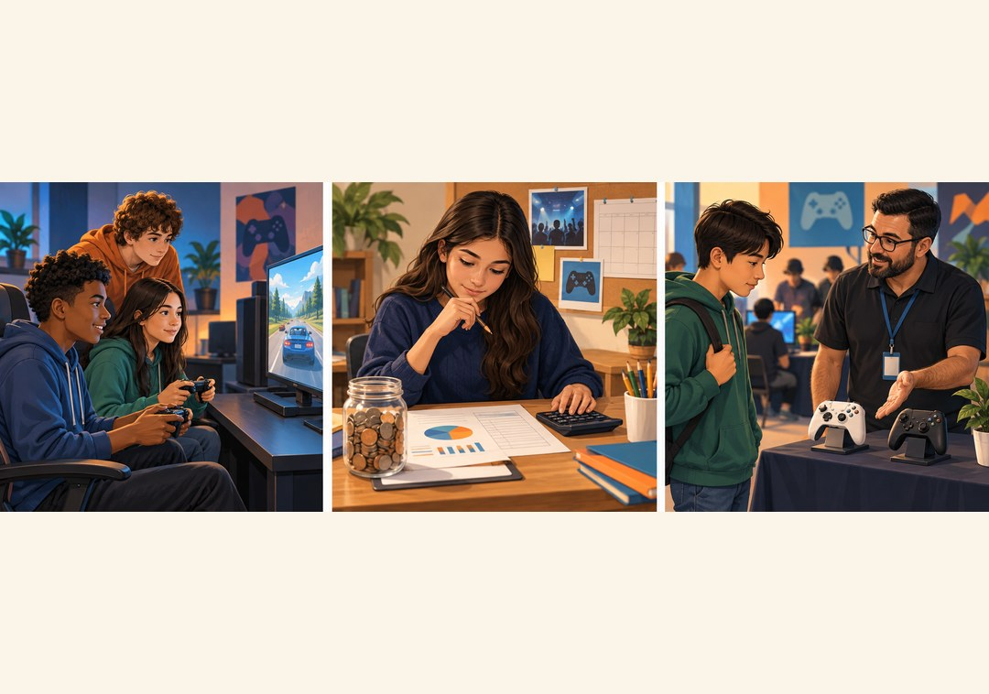
CHAPTER 1 · pp. 13–15 · SBTE 11
Seven jobs behind one offer
MARKETING FUNCTIONS
Channel management • MIM • Marketing planning
Pricing • Product/service management
Promotion • Selling
Which job learns what people want?
pp. 13–15 · SBTE 11 Think quietly, then point, write, or explain. 21/29
Notes:
SOURCE: Chapter 1, printed pp. 13–15 · SBTE 11; original SBTE deck remains content authority.
PITER SAYS: “Look at the picture. Seven jobs behind one offer” Pause 10 seconds. Then connect one noticed detail to MARKETING FUNCTIONS. Read and explain the academic language.
CHECK: Which job learns what people want?
EXPECTED: MIM/market research.
MISCONCEPTION / SOURCE DETAIL: Read full academic names aloud. Show this as an overview, not a memorization race. Each function supports customer needs, goals and profits. All seven receive their own screen.
STOP: After one explanation and the matched check, move to the assigned textbook heading. Allow approximately 60–90 seconds per selected concept screen; do not present the full library in one class. Protect the scheduled reading.
SBTE HANDOFF: “Can you connect this example to our notes?” SBTE gives a 20-second correction or collects whole-class responses while Piter teaches.
LESSON COMPARISON: Same concept, source reading, instructional time and check in both formats. Compare the access format, not more support time or easier questions. An alternative response mode preserves the explanation requirement.
TEACHER SOURCE EXAMPLES: Read full academic names aloud. Show this as an overview, not a memorization race. Each function supports customer needs, goals and profits. All seven receive their own screen.
ACCESS: Read the short directions and describe the relevant visual aloud. Offer pointing, fingers, a written letter, or a quiet spoken response. Do not require eye contact, public disclosure, a phone, or speed. Keep printed response options available. No flashing, animation, or audible countdown.
VISUAL SOURCE: Fictional generated illustrations; not actual students, school events, products, or prices. Repeated images intentionally preserve the scenario between prediction and academic explanation.

Slide 22

CHAPTER 1 · p. 13 · SBTE 12
The repaired bike needs a pickup plan
CHANNEL MANAGEMENT
Coordinate how, when, and where products travel from producers to customers.
Why does an inaccessible pickup time matter?
p. 13 · SBTE 12 Think quietly, then point, write, or explain. 22/29
Notes:
SOURCE: Chapter 1, printed p. 13 · SBTE 12; original SBTE deck remains content authority.
PITER SAYS: “Look at the picture. The product is ready. The route isn’t.” Pause 10 seconds. Then connect one noticed detail to CHANNEL MANAGEMENT. Read and explain the academic language.
CHECK: Why does an inaccessible pickup time matter?
EXPECTED: Customers cannot receive products when needed.
MISCONCEPTION / SOURCE DETAIL: Relate to place, suppliers, outlets and customer location. Figure 1.4 farm website/market stalls example remains required reading.
STOP: After one explanation and the matched check, move to the assigned textbook heading. Allow approximately 60–90 seconds per selected concept screen; do not present the full library in one class. Protect the scheduled reading.
SBTE HANDOFF: “Can you connect this example to our notes?” SBTE gives a 20-second correction or collects whole-class responses while Piter teaches.
LESSON COMPARISON: Same concept, source reading, instructional time and check in both formats. Compare the access format, not more support time or easier questions. An alternative response mode preserves the explanation requirement.
TEACHER SOURCE EXAMPLES: Relate to place, suppliers, outlets and customer location. Figure 1.4 farm website/market stalls example remains required reading.
ACCESS: Read the short directions and describe the relevant visual aloud. Offer pointing, fingers, a written letter, or a quiet spoken response. Do not require eye contact, public disclosure, a phone, or speed. Keep printed response options available. No flashing, animation, or audible countdown.
VISUAL SOURCE: Fictional generated illustrations; not actual students, school events, products, or prices. Repeated images intentionally preserve the scenario between prediction and academic explanation.
SCENARIO UPDATE: A fictional bicycle-repair business. Slide 22 concerns pickup/return arrangements, while slide 26 concerns improving service quality. Preserve the textbook examples in reading.

Slide 23

CHAPTER 1 · p. 13 · SBTE 12
Ask before assuming
MARKETING INFORMATION MANAGEMENT
Market research gathers qualitative and quantitative evidence.
Target market: the group a business focuses on selling to.
“Play, watch, or neither?” Why include all three?
p. 13 · SBTE 12 Think quietly, then point, write, or explain. 23/29
Notes:
SOURCE: Chapter 1, printed p. 13 · SBTE 12; original SBTE deck remains content authority.
PITER SAYS: “Look at the picture. Ask before assuming” Pause 10 seconds. Then connect one noticed detail to MARKETING INFORMATION MANAGEMENT. Read and explain the academic language.
CHECK: “Play, watch, or neither?” Why include all three?
EXPECTED: Avoids assuming universal interest; helps identify an audience.
MISCONCEPTION / SOURCE DETAIL: Include preferences, needs, competitors, and target grouping by age, behavior or geography as source content. A specific group is not everyone of that age. Figure 1.4 video-production/nonprofit example.
STOP: After one explanation and the matched check, move to the assigned textbook heading. Allow approximately 60–90 seconds per selected concept screen; do not present the full library in one class. Protect the scheduled reading.
SBTE HANDOFF: “Can you connect this example to our notes?” SBTE gives a 20-second correction or collects whole-class responses while Piter teaches.
LESSON COMPARISON: Same concept, source reading, instructional time and check in both formats. Compare the access format, not more support time or easier questions. An alternative response mode preserves the explanation requirement.
TEACHER SOURCE EXAMPLES: Include preferences, needs, competitors, and target grouping by age, behavior or geography as source content. A specific group is not everyone of that age. Figure 1.4 video-production/nonprofit example.
ACCESS: Read the short directions and describe the relevant visual aloud. Offer pointing, fingers, a written letter, or a quiet spoken response. Do not require eye contact, public disclosure, a phone, or speed. Keep printed response options available. No flashing, animation, or audible countdown.
VISUAL SOURCE: Fictional generated illustrations; not actual students, school events, products, or prices. Repeated images intentionally preserve the scenario between prediction and academic explanation.

Slide 24
CHAPTER 1 · pp. 13–14 · SBTE 12
How could the event pay its costs?
MARKETING PLANNING
Secure and allocate the funds to produce, market, and sell.
Equity: ownership investment
Debt: loans
Crowdfunding: many small contributions
Which funding route creates debt?
pp. 13–14 · SBTE 12 Think quietly, then point, write, or explain. 24/29
Notes:
SOURCE: Chapter 1, printed pp. 13–14 · SBTE 12; original SBTE deck remains content authority.
PITER SAYS: “Look at the picture. How could the event pay its costs?” Pause 10 seconds. Then connect one noticed detail to MARKETING PLANNING. Read and explain the academic language.
CHECK: Which funding route creates debt?
EXPECTED: Debt financing/loan.
MISCONCEPTION / SOURCE DETAIL: Do not substitute a generic calendar plan for this source’s emphasis on funding. Start-up capital, materials, expenses and production decisions matter. Figure 1.4 medical-device borrowing example.
STOP: After one explanation and the matched check, move to the assigned textbook heading. Allow approximately 60–90 seconds per selected concept screen; do not present the full library in one class. Protect the scheduled reading.
SBTE HANDOFF: “Can you connect this example to our notes?” SBTE gives a 20-second correction or collects whole-class responses while Piter teaches.
LESSON COMPARISON: Same concept, source reading, instructional time and check in both formats. Compare the access format, not more support time or easier questions. An alternative response mode preserves the explanation requirement.
TEACHER SOURCE EXAMPLES: Do not substitute a generic calendar plan for this source’s emphasis on funding. Start-up capital, materials, expenses and production decisions matter. Figure 1.4 medical-device borrowing example.
ACCESS: Read the short directions and describe the relevant visual aloud. Offer pointing, fingers, a written letter, or a quiet spoken response. Do not require eye contact, public disclosure, a phone, or speed. Keep printed response options available. No flashing, animation, or audible countdown.
VISUAL SOURCE: Fictional generated illustrations; not actual students, school events, products, or prices. Repeated images intentionally preserve the scenario between prediction and academic explanation.

Slide 25
CHAPTER 1 · p. 14 · SBTE 13
How much should it cost?
PRICING
Use customer evidence and market conditions to set a price that supports profit.
What is the difference between price and pricing?
p. 14 · SBTE 13 Think quietly, then point, write, or explain. 25/29
Notes:
SOURCE: Chapter 1, printed p. 14 · SBTE 13; original SBTE deck remains content authority.
PITER SAYS: “Look at the picture. How much should it cost?” Pause 10 seconds. Then connect one noticed detail to PRICING. Read and explain the academic language.
CHECK: What is the difference between price and pricing?
EXPECTED: Price is the amount; pricing is the decision process.
MISCONCEPTION / SOURCE DETAIL: Discuss too low to cover costs and too high for likely buyers. Figure 1.4 computer options example.
STOP: After one explanation and the matched check, move to the assigned textbook heading. Allow approximately 60–90 seconds per selected concept screen; do not present the full library in one class. Protect the scheduled reading.
SBTE HANDOFF: “Can you connect this example to our notes?” SBTE gives a 20-second correction or collects whole-class responses while Piter teaches.
LESSON COMPARISON: Same concept, source reading, instructional time and check in both formats. Compare the access format, not more support time or easier questions. An alternative response mode preserves the explanation requirement.
TEACHER SOURCE EXAMPLES: Discuss too low to cover costs and too high for likely buyers. Figure 1.4 computer options example.
ACCESS: Read the short directions and describe the relevant visual aloud. Offer pointing, fingers, a written letter, or a quiet spoken response. Do not require eye contact, public disclosure, a phone, or speed. Keep printed response options available. No flashing, animation, or audible countdown.
VISUAL SOURCE: Fictional generated illustrations; not actual students, school events, products, or prices. Repeated images intentionally preserve the scenario between prediction and academic explanation.

Slide 26

CHAPTER 1 · p. 14 · SBTE 13
Customers want a more reliable repair
PRODUCT AND SERVICE MANAGEMENT
Use customer problems and preferences to improve features or develop a solution.
What could change? How might the cost change?
p. 14 · SBTE 13 Think quietly, then point, write, or explain. 26/29
Notes:
SOURCE: Chapter 1, printed p. 14 · SBTE 13; original SBTE deck remains content authority.
PITER SAYS: “Look at the picture. People like it—except the unreliable repair” Pause 10 seconds. Then connect one noticed detail to PRODUCT AND SERVICE MANAGEMENT. Read and explain the academic language.
CHECK: What could change? How might the cost change?
EXPECTED: Change seam/material; added costs affect profitability.
MISCONCEPTION / SOURCE DETAIL: Offer different preferences without implying all users share sensitivities. Retain source Figure 1.4 nail-polish durability example.
STOP: After one explanation and the matched check, move to the assigned textbook heading. Allow approximately 60–90 seconds per selected concept screen; do not present the full library in one class. Protect the scheduled reading.
SBTE HANDOFF: “Can you connect this example to our notes?” SBTE gives a 20-second correction or collects whole-class responses while Piter teaches.
LESSON COMPARISON: Same concept, source reading, instructional time and check in both formats. Compare the access format, not more support time or easier questions. An alternative response mode preserves the explanation requirement.
TEACHER SOURCE EXAMPLES: Offer different preferences without implying all users share sensitivities. Retain source Figure 1.4 nail-polish durability example.
ACCESS: Read the short directions and describe the relevant visual aloud. Offer pointing, fingers, a written letter, or a quiet spoken response. Do not require eye contact, public disclosure, a phone, or speed. Keep printed response options available. No flashing, animation, or audible countdown.
VISUAL SOURCE: Fictional generated illustrations; not actual students, school events, products, or prices. Repeated images intentionally preserve the scenario between prediction and academic explanation.
SCENARIO UPDATE: A fictional bicycle-repair business. Slide 22 concerns pickup/return arrangements, while slide 26 concerns improving service quality. Preserve the textbook examples in reading.

Slide 27
CHAPTER 1 · p. 14 · SBTE 13
A message can change someone’s choice
PROMOTION
Send messages that influence purchasing.
Store design and advertisements can both communicate.
Which clue in an ad could appeal to its audience?
p. 14 · SBTE 13 Think quietly, then point, write, or explain. 27/29
Notes:
SOURCE: Chapter 1, printed p. 14 · SBTE 13; original SBTE deck remains content authority.
PITER SAYS: “Look at the picture. A message can change someone’s choice” Pause 10 seconds. Then connect one noticed detail to PROMOTION. Read and explain the academic language.
CHECK: Which clue in an ad could appeal to its audience?
EXPECTED: A relevant message, benefit, image or setting.
MISCONCEPTION / SOURCE DETAIL: Campaign image illustrates communication; distinguish the promotional act from the advertised product. Figure 1.4 food/social connection example.
STOP: After one explanation and the matched check, move to the assigned textbook heading. Allow approximately 60–90 seconds per selected concept screen; do not present the full library in one class. Protect the scheduled reading.
SBTE HANDOFF: “Can you connect this example to our notes?” SBTE gives a 20-second correction or collects whole-class responses while Piter teaches.
LESSON COMPARISON: Same concept, source reading, instructional time and check in both formats. Compare the access format, not more support time or easier questions. An alternative response mode preserves the explanation requirement.
TEACHER SOURCE EXAMPLES: Campaign image illustrates communication; distinguish the promotional act from the advertised product. Figure 1.4 food/social connection example.
ACCESS: Read the short directions and describe the relevant visual aloud. Offer pointing, fingers, a written letter, or a quiet spoken response. Do not require eye contact, public disclosure, a phone, or speed. Keep printed response options available. No flashing, animation, or audible countdown.
VISUAL SOURCE: Fictional generated illustrations; not actual students, school events, products, or prices. Repeated images intentionally preserve the scenario between prediction and academic explanation.

Slide 28
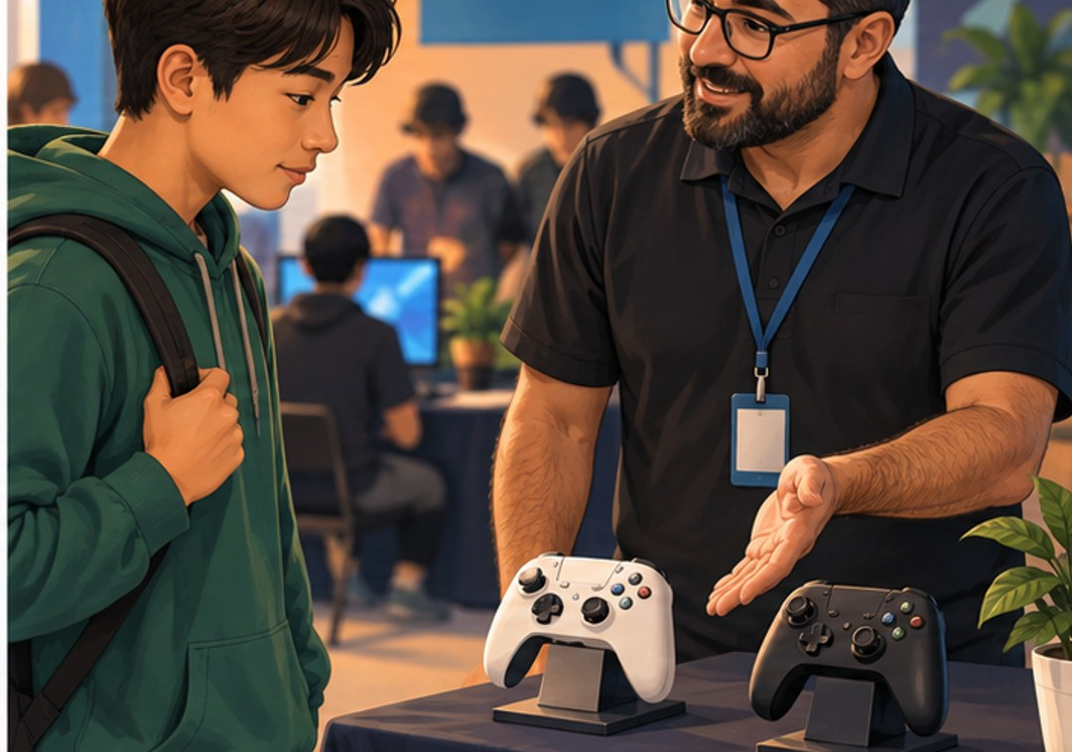
CHAPTER 1 · p. 14 · SBTE 13
“Which option would work for you?”
SELLING
Help match the product to the target customer at the right place, price, and time.
How could asking a question help a sale?
p. 14 · SBTE 13 Think quietly, then point, write, or explain. 28/29
Notes:
SOURCE: Chapter 1, printed p. 14 · SBTE 13; original SBTE deck remains content authority.
PITER SAYS: “Look at the picture. “Which option would work for you?”” Pause 10 seconds. Then connect one noticed detail to SELLING. Read and explain the academic language.
CHECK: How could asking a question help a sale?
EXPECTED: It reveals needs and helps a suitable recommendation.
MISCONCEPTION / SOURCE DETAIL: A customer-service mindset, relationships and feeling valued matter. Do not imply persuasion means pressure. Retain source pharmaceutical sample/sales presentation example in Figure 1.4.
STOP: After one explanation and the matched check, move to the assigned textbook heading. Allow approximately 60–90 seconds per selected concept screen; do not present the full library in one class. Protect the scheduled reading.
SBTE HANDOFF: “Can you connect this example to our notes?” SBTE gives a 20-second correction or collects whole-class responses while Piter teaches.
LESSON COMPARISON: Same concept, source reading, instructional time and check in both formats. Compare the access format, not more support time or easier questions. An alternative response mode preserves the explanation requirement.
TEACHER SOURCE EXAMPLES: A customer-service mindset, relationships and feeling valued matter. Do not imply persuasion means pressure. Retain source pharmaceutical sample/sales presentation example in Figure 1.4.
ACCESS: Read the short directions and describe the relevant visual aloud. Offer pointing, fingers, a written letter, or a quiet spoken response. Do not require eye contact, public disclosure, a phone, or speed. Keep printed response options available. No flashing, animation, or audible countdown.
VISUAL SOURCE: Fictional generated illustrations; not actual students, school events, products, or prices. Repeated images intentionally preserve the scenario between prediction and academic explanation.

Slide 29
CHAPTER 1 · pp. 15–16 · SBTE 14
Now prove the connection in the text
CHAPTER 1 APPLICATION
Choose one Figure 1.4 example.
Name its function.
Explain its link to needs, goals, or profits.
Example: farm pickup routes support customer access.
pp. 15–16 · SBTE 14 Think quietly, then point, write, or explain. 29/29
Notes:
SOURCE: Chapter 1, printed pp. 15–16 · SBTE 14; original SBTE deck remains content authority.
PITER SAYS: “Look at the picture. Now prove the connection in the text” Pause 10 seconds. Then connect one noticed detail to CHAPTER 1 APPLICATION. Read and explain the academic language.
CHECK: Example: farm pickup routes support customer access.
EXPECTED: Accurate function plus a supported marketing-concept relationship.
MISCONCEPTION / SOURCE DETAIL: Preserve source chapter review categories: Define Key Terms, Test Your Knowledge, Read and Write, Listen and Speak, Create and Design, Chapter Assessment. Use actual Teams assignment prompts; do not invent unseen questions. Record exact slide/page/paragraph reached by each section.
STOP: After one explanation and the matched check, move to the assigned textbook heading. Allow approximately 60–90 seconds per selected concept screen; do not present the full library in one class. Protect the scheduled reading.
SBTE HANDOFF: “Can you connect this example to our notes?” SBTE gives a 20-second correction or collects whole-class responses while Piter teaches.
LESSON COMPARISON: Same concept, source reading, instructional time and check in both formats. Compare the access format, not more support time or easier questions. An alternative response mode preserves the explanation requirement.
TEACHER SOURCE EXAMPLES: Preserve source chapter review categories: Define Key Terms, Test Your Knowledge, Read and Write, Listen and Speak, Create and Design, Chapter Assessment. Use actual Teams assignment prompts; do not invent unseen questions. Record exact slide/page/paragraph reached by each section.
ACCESS: Read the short directions and describe the relevant visual aloud. Offer pointing, fingers, a written letter, or a quiet spoken response. Do not require eye contact, public disclosure, a phone, or speed. Keep printed response options available. No flashing, animation, or audible countdown.
VISUAL SOURCE: Fictional generated illustrations; not actual students, school events, products, or prices. Repeated images intentionally preserve the scenario between prediction and academic explanation.

