Slide 1
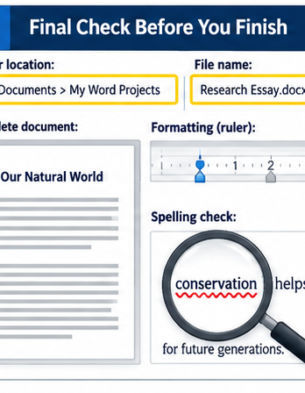
MONDAY ASSESSMENT REVIEW
Microsoft Word
Skills Check
Answer first. Then click to check the strategy.
7-minute review
Respond by voice, pointing, or fingers.
Notes:
Time: 30 seconds. Say: “This review uses new examples. Think first, then I will click to reveal the strategy. You can answer aloud, point, or use fingers.” Do not explain the assessment passage.

Slide 2
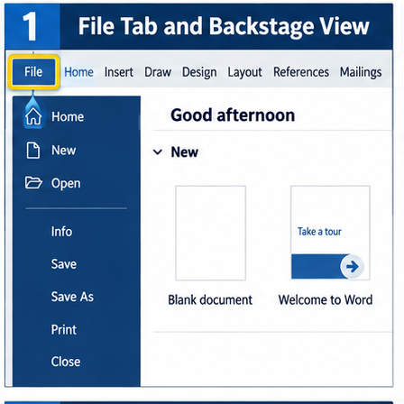
Find the command area
You need options for opening, saving, printing, and exporting.
Where do you go?
File opens Backstage View
Fast return: press Esc. Quick check: the Ribbon holds editing tools; File manages the document.
WORD LEVEL 1 REVIEW 2/8
Notes:
Time: 45–60 seconds. Ask for a point or one-word response before clicking. Click 1: reveal “File opens Backstage View.” Ask: “What lives on the Ribbon instead?” Click 2: reveal Esc and the distinction. Hard stop: “Good. File manages the document; the Ribbon changes its content.”

Slide 3
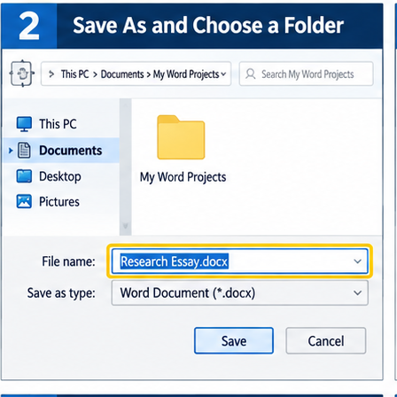
Save the right version
You opened yesterday’s file. Today’s work needs a new name.
Save or Save As?
Save As creates the new named version
Before saving, verify BOTH: the exact filename in angle brackets and the <My Word Projects> folder. Shortcut: Ctrl+Shift+S or F12.
WORD LEVEL 1 REVIEW 3/8
Notes:
Time: 55–70 seconds. Students show 1 for Save, 2 for Save As. Click 1 for answer. Ask: “What two details must you verify?” Click 2. Do not supply any assessment filename.

Slide 4
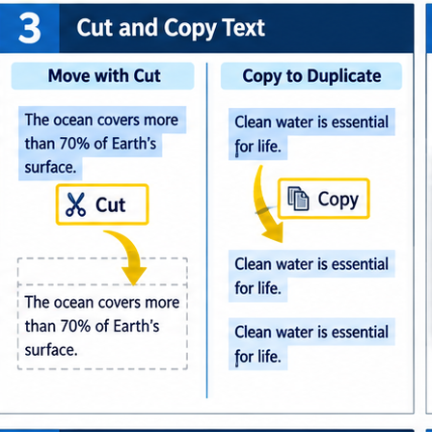
Move or repeat?
A. Move a paragraph to a new location.
B. Repeat one sentence somewhere else.
Which action fits each job?
Move = Cut + Paste Repeat = Copy + Paste
Windows shortcuts: Ctrl+X, Ctrl+C, Ctrl+V. Select only the exact text before using the command.
WORD LEVEL 1 REVIEW 4/8
Notes:
Time: 60–75 seconds. Ask students to cross arms for CUT/move and hold two fingers for COPY/repeat. Read A, then B. Click 1. Ask what must happen before either command. Click 2. Hard stop: “Move removes the original; repeat keeps it.”

Slide 5
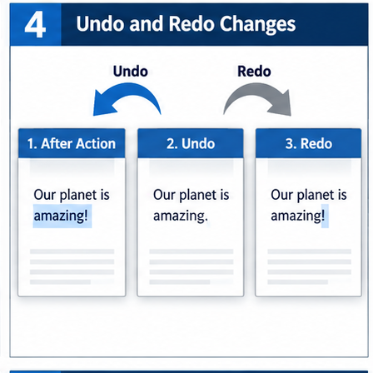
Recover from a mistake
You moved text, but it landed in the wrong place.
What is the fastest safe first move?
Undo reverses the last action
Ctrl+Z = Undo. Ctrl+Y = Redo on Windows. Redo restores an action you just undid.
WORD LEVEL 1 REVIEW 5/8
Notes:
Time: 45–60 seconds. Take one response before clicking. Click 1. Then ask: “What if Undo removed the correct action?” Click 2. Mention that deleting and retyping adds risk when Undo can recover the action.

Slide 6
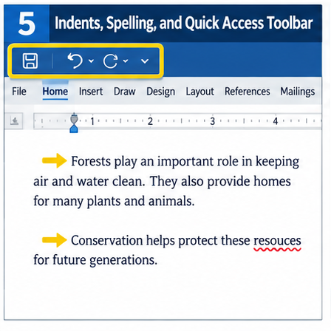
Paragraph setup and proofread
Your paragraphs need first-line indents, then a final language check.
What two tools help?
Tab at each paragraph start + Spelling and Grammar
Add Spelling and Grammar to the Quick Access Toolbar if requested. Check every change; do not accept suggestions automatically.
WORD LEVEL 1 REVIEW 6/8
Notes:
Time: 55–70 seconds. Students mime pressing one key for the indent. Click 1. Ask: “Where can a frequently used command stay visible?” Click 2. Emphasize that proofreading requires judgment.

Slide 7
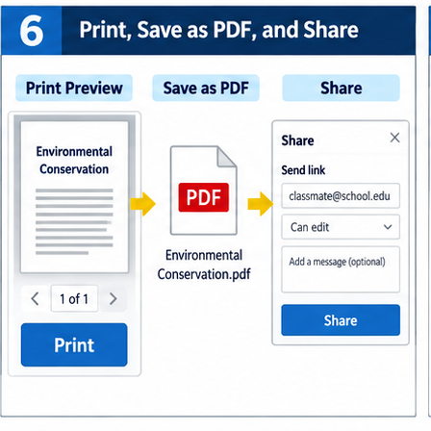
Preview, PDF, or Share?
1. Check how pages will look.
2. Create a non-editable copy.
3. Let a teacher access the document.
Name each pathway.
1 Print Preview 2 Save as PDF 3 Share
Ctrl+P opens preview. Create a PDF only when directed. Before sharing, check the recipient and permission.
WORD LEVEL 1 REVIEW 7/8
Notes:
Time: 70–90 seconds. Read one scenario at a time; students respond with the tool name. Click 1 after all three. Click 2 for safeguards. Do not print or share during the review.

Slide 8
30-second retrieval
Hold up the number that matches:
1 Move text 2 Repeat text
3 Recover an action 4 Preview pages
Cut Copy Undo Print Preview
Final check: correct folder, exact filename, complete text, clean formatting, proofread work.
WORD LEVEL 1 REVIEW 8/8
Notes:
Time: 45–60 seconds. Call four fresh scenarios in mixed order. Students hold up 1–4. Click 1 to reveal the mapped actions. Click 2 for the final test-day checklist. Close with: “Slow down at the save and selection steps; those two checks prevent most avoidable errors.”

