Slide 1

TUESDAY • CHAPTER 1
Business activities
and limited resources
By the end, you can sort an activity as operational, investing, or financial.
Files ready: Chapter 1 notes + textbook
Notes:
Before class: project this slide, open the Chapter 1 notes and textbook, and set a visible five-minute timer. Source: September 14 marketing transcripts and Chapter 1 pp. 4-7.

Slide 2
STEP 1 OF 6
⏱ 03:00
Entry setup
1
2
Open Chapter 1 notes
Open the textbook to page 4
Missing a file? Ask your partner first. Then raise your hand.
TODAY Open files | Think | Notes | Read | Model | Practice
Notes:
Say only: Open your Chapter 1 notes. Open the textbook to page 4. You have three minutes. If a file is missing, ask your partner and then raise your hand. Do not add more directions while students work.

Slide 3

STEP 2 OF 6
⏱ 05:00
Limited resources
You have $40 and two free hours
Choose one purchase or activity.
What must wait?
THINK 60 seconds
PARTNER 90 seconds
SHARE 3 answers
TODAY Open files | Think | Notes | Read | Model | Practice
Notes:
Exact script: You have $40 and two free hours. Choose one thing. Decide what must wait and why. Think for 60 seconds. Then tell your partner. I will take three answers. Start the timer and stop at five minutes.

Slide 4
STEP 2 OF 6
⏱ 02:00
Economics explains the choice
UNLIMITED WANTS
but
LIMITED RESOURCES
Economics studies how people and businesses make these choices.
TODAY Open files | Think | Notes | Read | Model | Practice
Notes:
Connect only three student answers. Name the limited resource in each answer: money, time, or availability. Then read the definition. Avoid repeating the student's full story.

Slide 5


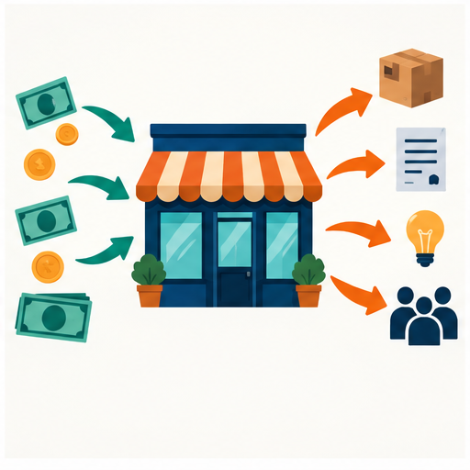
STEP 3 OF 6
⏱ 04:00
Three business activities
OPERATIONAL
INVESTING
FINANCIAL
Daily work
Money used to build value
Money entering or leaving
TODAY Open files | Think | Notes | Read | Model | Practice
Notes:
Teach the labels in under four minutes. Examples from the text: operational includes production, research, customer service, and hiring. Investing includes buildings, maintenance, stock, and advertising. Financial includes collecting sales money and paying debt, employees, or suppliers.

Slide 6
STEP 3 OF 6
⏱ 03:00
Operational functions
PRODUCTION
MARKETING
Creates goods or services
Studies demand and competition
MANAGEMENT
FINANCE
Leads employees and plans work
Handles daily money tasks
Quick check: Which function would fix a software bug?
TODAY Open files | Think | Notes | Read | Model | Practice
Notes:
Answer: production. Ask students to point to a quadrant, say the word, or write it. Source: Chapter 1 pp. 5-6. Keep this to three minutes.

Slide 7
STEP 4 OF 6
⏱ 15:00
Reading pages 3–7
PAGE
While we read
3–7
1. Follow the paragraph
2. Listen for a key term
3. Be ready when called
4. Ask when a sentence is unclear
Teacher and students share the reading
TODAY Open files | Think | Notes | Read | Model | Practice
Notes:
Call on one student per paragraph, but read a difficult paragraph yourself when fluency would block meaning. Pause only for business, product, marketing, economics, operational, investing, and financial. Keep the page range visible.

Slide 8

STEP 5 OF 6
⏱ 05:00
Terms to Know model
TERM
Economics
IN YOUR OWN WORDS
How people and businesses choose when they cannot have everything
EXAMPLE
A shop spends its limited money on supplies before decorations.
TODAY Open files | Think | Notes | Read | Model | Practice
Notes:
Model one entry. Show the location in the Terms to Know file. Students should use a meaningful image, a short definition in their own words, and one example. Confirm the SBTE's exact template fields before requiring anything beyond what the downloaded assignment shows.

Slide 9
STEP 6 OF 6
⏱ 06:00
Independent Terms to Know work
1
Open the Terms to Know file
2
Complete the next term in chapter order
3
Save in the Principles of Marketing folder
Need help? Partner first, then raise your hand.
TODAY Open files | Think | Notes | Read | Model | Practice
Notes:
Start a six-minute timer. Circulate. Check the folder, filename, and AutoSave if students edit in Microsoft 365. Do not fill silence with more instructions.

Slide 10
STEP 6 OF 6
⏱ 03:00
Activity sort
Show 1, 2, or 3 with your fingers
1 OPERATIONAL
2 INVESTING
3 FINANCIAL
A bakery buys a new oven.
A bakery pays its employees.
A bakery makes today’s bread.
TODAY Open files | Think | Notes | Read | Model | Practice
Notes:
Answers: new oven is investing, paying employees is financial, making bread is operational. Students may answer by pointing, fingers, speaking, or writing.

Slide 11
STEP 6 OF 6
⏱ 02:00
Exit check
One business activity I understand is ______.
My example is ______ because ______.
Say it • write it • point to your notes
TODAY Open files | Think | Notes | Read | Model | Practice
Notes:
Take two responses. Then record the final page, note slide, and Terms to Know entry completed by this class. That record controls Wednesday's starting point.

Slide 12
UPCOMING TARGETS
Chapter 1 timeline
SEP 22
Terms to Know due
SEP 23
Notes complete
SEP 24
Review due
SEP 25
Assessment planned
The September 25 schedule may change the assessment date.
Notes:
These dates come from the September 14 class transcripts. The SBTE noted that the September 25 shortened schedule may require a change. Confirm before presenting the assessment date as fixed.

