Slide 1
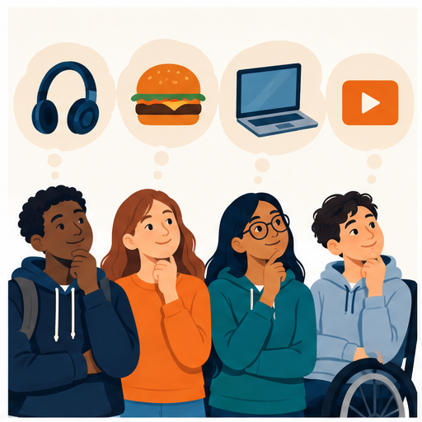
ICEBREAKER 1/4
You have $20. What do you choose?
Choose one
Food $8
Headphones $18
Save the $20
Think quietly for 30 seconds
Notes:
Say: You have twenty dollars. Choose food, headphones, or save the money. There is no single correct answer. Think quietly for thirty seconds.

Slide 2
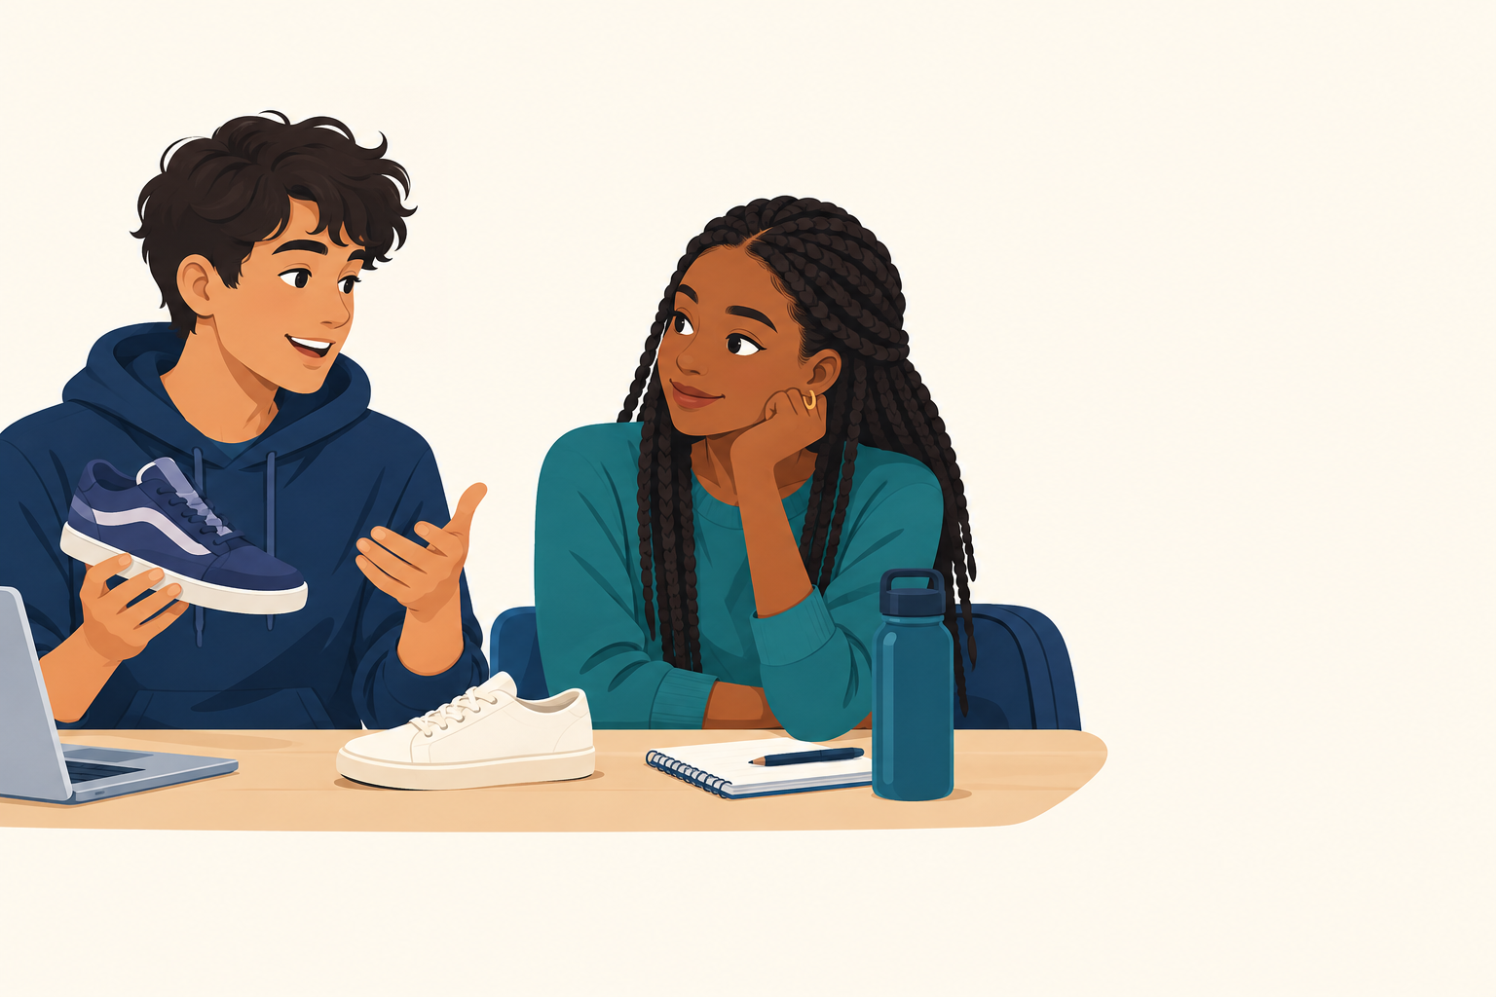
ICEBREAKER 2/4
Explain your choice to a partner
Use this sentence
I choose __________
because __________.
I give up __________.
Partner talk 2 minutes
Notes:
Say: Tell your partner what you chose, why you chose it, and what you cannot buy because of that choice. Example: I choose food because I need lunch. I give up the headphones.

Slide 3

ICEBREAKER 3/4
Three people will share
Listen for
1 Choice
2 Reason
3 What they gave up
Share-out 3 minutes
Notes:
Invite three answers. After each answer, restate the choice and tradeoff. Example: Maya chose headphones because music helps her focus. She gave up buying food today.

Slide 4
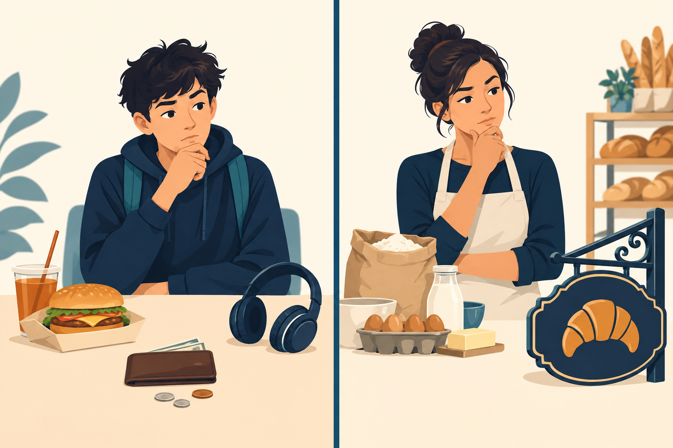
ICEBREAKER 4/4
How this connects to business
What limited the choice?
Example: I only had $20.
What did you give up?
Example: The headphones had to wait.
What would a business choose?
Example: A bakery buys ingredients before a new sign.
People and businesses choose how to use limited resources. That is economics.
Notes:
Wrap up: Both people and businesses have limited money, time, and materials. Every choice has a tradeoff. A bakery may spend money on ingredients now and delay a new sign. This is the same kind of decision you just made.

