Slide 1

ICEBREAKER 1/4
A bakery opens near school
Besides selling bread,
how could it help people?
Think of one idea
Think quietly 30 seconds
Notes:
Say: Imagine this bakery opened near our school. Besides selling bread, how could it help people in the neighborhood? Think of one idea. You may say it, write it, or point to an example on the next slide.
Sources: 09-15 Teaching placement — Eastridge · road 6_30 AM · target leave 2_15 PM-transcript.txt, September 15 classroom stopping point and pacing feedback; Chapter 1, pp. 8–9, Ways Businesses Contribute to Society.

Slide 2
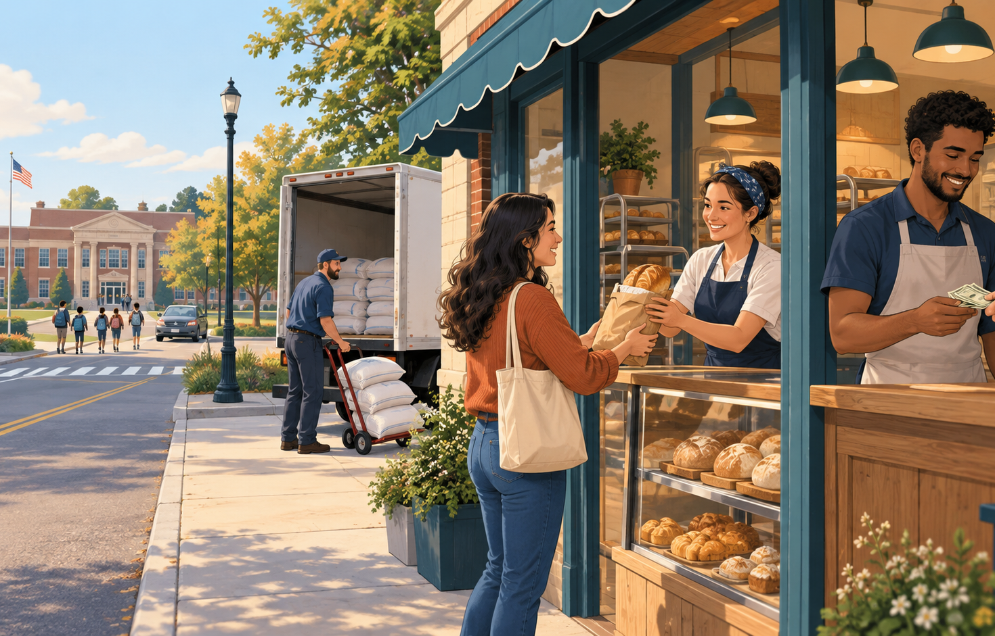
ICEBREAKER 2/4
Choose one way the bakery helps
A Gives people useful products
B Creates jobs and wages
C Buys from local suppliers
D Pays taxes for public services
Say it, point to it, or write it
Notes:
Say: Choose the strongest answer. There can be more than one correct answer. Example: B, because the bakery hires workers and pays them wages.
Sources: 09-15 Teaching placement — Eastridge · road 6_30 AM · target leave 2_15 PM-transcript.txt, September 15 classroom stopping point and pacing feedback; Chapter 1, pp. 8–9, Ways Businesses Contribute to Society.

Slide 3

ICEBREAKER 3/4
Explain your idea to a partner
Use this sentence
The bakery helps by
__________________.
This matters because
__________________.
Partner talk 90 seconds
Notes:
Say: Partner A speaks first, then Partner B. Example: The bakery helps by creating jobs. This matters because workers earn wages they can spend at other businesses. After ninety seconds, I will take three answers. If no one volunteers, I will call on someone.
Sources: 09-15 Teaching placement — Eastridge · road 6_30 AM · target leave 2_15 PM-transcript.txt, September 15 classroom stopping point and pacing feedback; Chapter 1, pp. 8–9, Ways Businesses Contribute to Society.

Slide 4

ICEBREAKER 4/4
Chapter 1: how businesses contribute
Provide products
Bread can meet a need or a want.
Create markets
The bakery buys flour and sells to customers.
Increase economic benefits
Jobs, wages, and taxes support the community.
Businesses help people by providing products, creating markets, and increasing economic benefits.
Notes:
Take three answers, then say: Chapter 1 names three roles. Businesses provide products, create markets, and increase economic benefits. We will finish yesterday's business activity table first, then read pages eight and nine. Keep the transition short so the class does not lose reading time.
Sources: 09-15 Teaching placement — Eastridge · road 6_30 AM · target leave 2_15 PM-transcript.txt, September 15 classroom stopping point and pacing feedback; Chapter 1, pp. 8–9, Ways Businesses Contribute to Society.

