Slide 1
LISTEN AND SPEAK RUBRIC
What your presentation shows
One assigned marketing function
1
PURPOSE
What does this function do for a business?
2
MARKETING CONCEPT
How does it connect a customer need or want with business goals and profit?
3
EXAMPLE
What would a business actually do?
1 / 5
Notes:
Source: original Chapter 1 Listen and Speak assignment and current rubric v2. The function is assigned in the September 28 class transcript.

Slide 2
THE SCHOOL’S 1–4 SCALE
A 3 is the target
4
Exceeds
Deeper connection or a new situation
3
Proficient
Accurate purpose, concept link, and specific example
More slides or decoration alone do not make a 4.
2 / 5
Notes:
Source: photographed EI Outcomes Rubric and local rubric v2. Three means expected proficiency; four reflects deeper understanding, independence, or transfer, not more work.

Slide 3
THE SCHOOL’S 1–4 SCALE
If the evidence is still growing
2
Developing
Part of the explanation is accurate, but a required link or example needs work.
1
Initial
You have started, but the required understanding is not clear yet.
Feedback tells you what to strengthen next.
3 / 5
Notes:
Source: local 1–4 rubric v2, aligned with photographed school EI Outcomes Rubric. Avoid making a score sound like a judgment of the student.

Slide 4
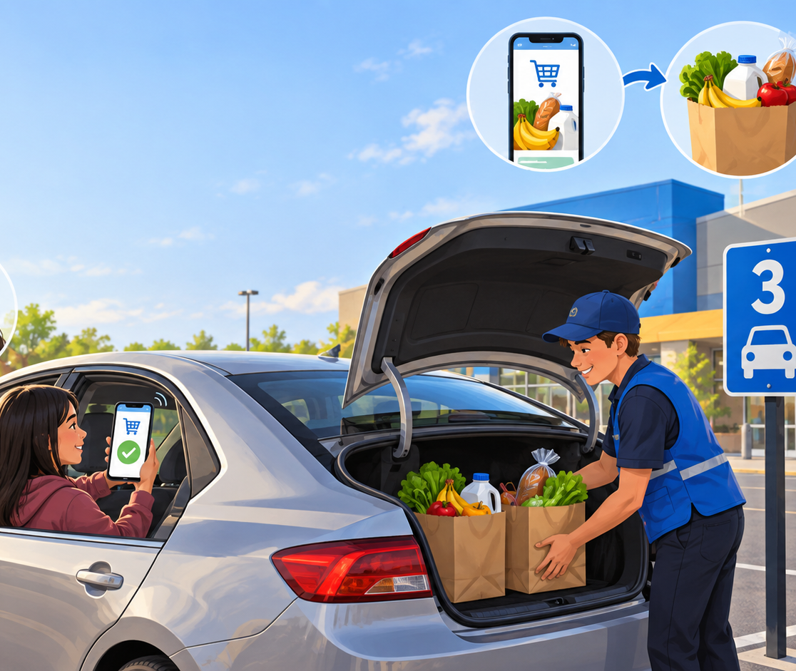
ONE CLASS EXAMPLE
What a proficient answer sounds like
Channel Management: grocery pickup
PURPOSE
The store decides how customers receive groceries.
CONCEPT
Pickup can serve a customer’s want for convenience while supporting sales and profit.
EXAMPLE
A customer orders online; a worker brings groceries to a pickup spot.
Where can you hear the purpose, concept link, and action?
4 / 5
Notes:
Illustrative teacher-created example grounded in Chapter 1 and prior class discussion of grocery pickup. The marketing concept link needs only a relevant need OR want. This example uses want. Do not treat this as a script students must copy.

Slide 5
HOW TO PREPARE
Supports help you show what you know
You may use notes, cue cards, a vocabulary bank, rehearsal, or a meaningful visual.
The learning target stays the same:
Explain the purpose. Connect it to the marketing concept. Give a specific example.
Clear explanation matters; accent, eye contact, and decoration are not the target.
5 / 5
Notes:
Source: local rubric v2 access-support language. Clarify with SBTE whether Clear Explanation is scored or feedback-only; this slide makes no claim about the final scoring method.

