Slide 1
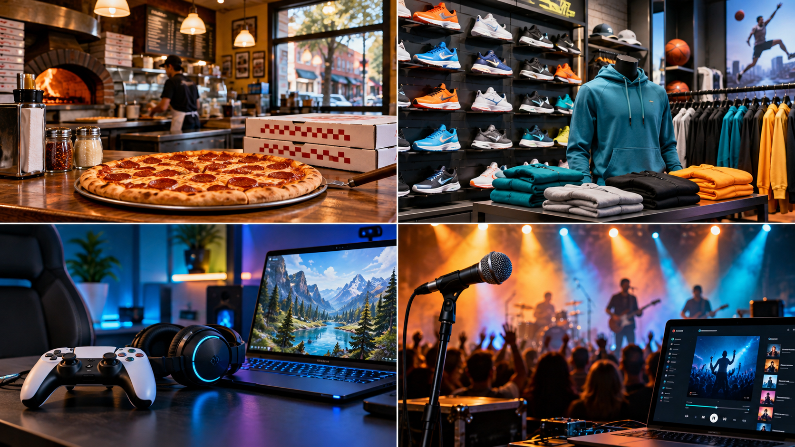
What makes you choose one brand over another?
LOOK FIRST • THINK OF ONE REASON
Notes:
Piter: Give students 15 silent seconds to look. Then ask for one-word reasons only: price, quality, convenience, style, popularity, delivery, etc.
Hard stop: 'Hold onto that reason. Your group will use it in a minute.'
SBTE discussion option: Replace the four industries with assigned industries if duplicate choices become a concern.
Transcript basis: 09-21 Marketing Fundamentals transcript lines 463-466 requests mixed groups and a ten-minute marketing-mix exercise.

Slide 2
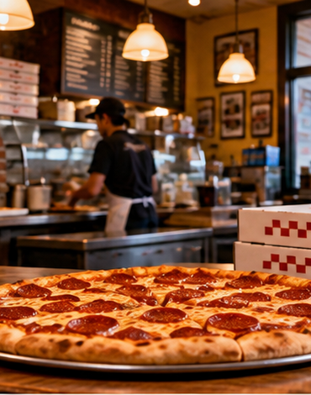
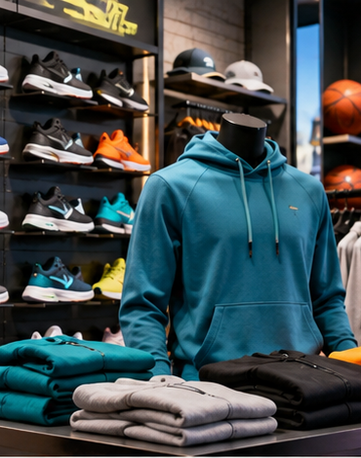


MARKETING MIX GROUP ACTIVITY
1 / 5 • 1 min
Choose an industry
FOOD
SPORTS + STYLE
GAMING + TECH
MUSIC + ENTERTAINMENT
Your group may choose another school-appropriate industry.
Notes:
Group formation: Use preassigned mixed groups of 3-4. Do not let students self-select.
Say: 'Choose one industry in 30 seconds. If you cannot agree, use the first option that gets two votes.'
Possible change for SBTE: Assign a different industry to each group to guarantee variety and save time.

Slide 3
BUILD YOUR EXAMPLE
2 / 5 • 2 min
Name one company and one product
INDUSTRY
What kind of business?
COMPANY
Which business in that industry?
PRODUCT
Which specific good or service?
Write the exact three choices before moving on.
Notes:
Give groups 90 seconds. Listen for a specific product, not only a company name.
Neutral prompt: 'Could a customer buy that exact item or service?'
Avoid supplying a company for them. The choice is part of the discussion.

Slide 4
DISCUSS ALL FOUR DECISIONS
3 / 5 • 6 min
Build the marketing mix
PRODUCT
What features or benefits make customers want it?
1
1
PRICE
What price seems fair, and why would customers pay it?
2
2
PLACE
Where and how can customers get it?
3
3
PROMOTION
How will the company get students' attention?
4
4
Everyone contributes one idea. Recorder keeps the strongest idea for each P.
Notes:
Discussion time: 6 minutes. Display or run a visible timer.
Roles for four: reader/timekeeper, recorder, reporter, participation checker. For groups of three, combine timekeeper and participation checker.
Circulate and ask only one prompt at a time. Watch for the common misconception that place means only a physical store; include online and distribution.
Content connection: The Four Ps follow the chapter discussion of product, price, place, and promotion in the 09-21 Business Fundamentals transcript around lines 48-60.

Slide 5
CHOOSE YOUR STRONGEST DECISIONS
4 / 5 • 2 min
Prepare a 30-second pitch
“We chose the __________ industry. Our company is __________, and our product is __________.”
ONE SMART CHOICE
ONE REASON
Explain the P your group discussed best.
Why would your target customer care?
Reporter speaks. Every group member should be ready for one follow-up question.
Notes:
Preparation time: 2 minutes. Share-out: 30 seconds per group.
Hard stop: 'Finish the sentence you are on. Reporters, eyes up.'
If time is short, hear two groups and collect the other groups' record sheets.

Slide 6
POSSIBLE NEXT LESSON
5 / 5 • 2 min
Save your group's choice
INDUSTRY
COMPANY
PRODUCT
Keep this example. We may turn it into a mini marketing plan.
Possible extension
A later lesson could add a target customer, compare competitors, improve each P, and build a one-slide pitch.
TODAY'S STOP: choices + discussion + short pitch
Notes:
Close: 'Today you built the starting point. A later lesson could turn the same choice into a fuller marketing plan.'
This extension reflects the user's recollection that the SBTE suggested the activity could become a later lesson. The transcript explicitly confirms the ten-minute exercise but does not preserve a more detailed extension description, so present this as a proposal for SBTE review.
SBTE decisions: keep student choice or assign industries; collect a paper record or verbal only; extend later into a mini marketing plan or stop after retrieval practice.

