Slide 1

ICEBREAKER 1/4
⏱ 3 MIN MAX
Three offerings from everyday life
Look for a good, a service, and an idea.
LOOK QUIETLY FOR 10 SECONDS FIND THREE DIFFERENT OFFERINGS
1/4
Notes:
0:00–0:15 | Say: ‘Look for three different things being offered. You do not need the business words yet.’
Source: Chapter 1, Introduction to Business and Marketing, B.E. Publishing, p. 4. Local source: /Users/pitergarcia/DataScience/Semester5/Semester3(UofR)/TeachingPlacement/second-placement/Chapter 1 Introduction to Business and Marketing.pdf
CLICK CUES: Whole scene first. Click once for the item/task/idea prompt. Give ten seconds to notice, then advance.

Slide 2
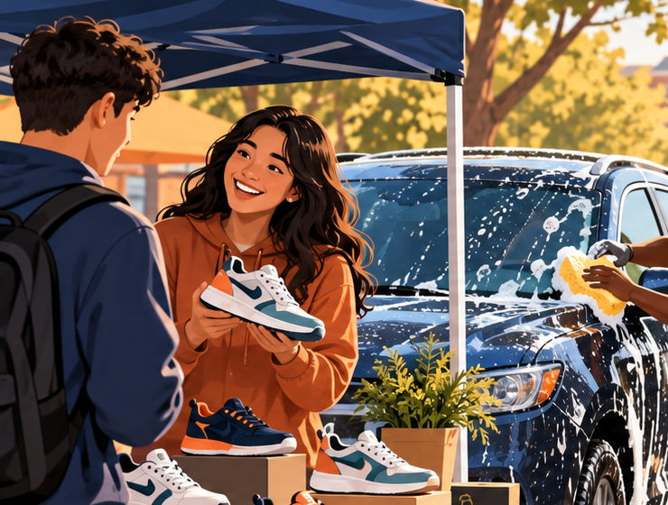


ICEBREAKER 2/4
⏱ 3 MIN MAX
Which picture shows a GOOD?
Show its number. Then listen for the next category.
GOOD = item to buy SERVICE = task done for someone IDEA = thought or opinion
1
3
2
POINT, WRITE, OR SAY: 1, 2, OR 3
2/4
Notes:
0:15–1:05 | Give 15 silent seconds. Then say: ‘I will show one picture at a time. Show 1, 2, or 3 when I name good, service, or idea.’ Students may point, write, or say the number.
Source: Chapter 1, Introduction to Business and Marketing, B.E. Publishing, p. 4. Local source: /Users/pitergarcia/DataScience/Semester5/Semester3(UofR)/TeachingPlacement/second-placement/Chapter 1 Introduction to Business and Marketing.pdf
CLICK CUES: Six clicks: picture 1, number 1, replace with picture 2, number 2, replace with picture 3, number 3. Ask for a good, service, or idea response while each picture is visible. Read the definition clues aloud as needed. Students can say, point to a clue, or write the category. Back revisits the previous picture. Advance only after all three responses.

Slide 3
ICEBREAKER 3/4
⏱ 3 MIN MAX
Check each picture
Name the offering, then explain the visual clue.
1
GOOD
2
SERVICE
3
IDEA
Sneakers are an item a customer can buy
A haircut is a task done for a customer
The poster shares a message or opinion
1 GOOD 2 SERVICE 3 IDEA
3/4
Notes:
1:05–1:50 | Reveal the order. Say: ‘Picture 1 is a good. Picture 2 is a service. Picture 3 shares an idea.’ Ask one student to name the clue that proves one answer.
Source: Chapter 1, Introduction to Business and Marketing, B.E. Publishing, p. 4. Local source: /Users/pitergarcia/DataScience/Semester5/Semester3(UofR)/TeachingPlacement/second-placement/Chapter 1 Introduction to Business and Marketing.pdf
CLICK CUES: Click for each picture, then its full-word explanation. The final click shows the numbered key. Keep the previously revealed rows visible for reference.

Slide 4
ICEBREAKER 4/4
⏱ 3 MIN MAX
One scene, three business words
Use the picture to connect business, marketing, and product.
BUSINESS
The shoe seller offers products for money.
MARKETING
The seller promotes and sells what customers may want.
PRODUCT
The sneakers are goods offered to customers.
One picture can show a business, marketing, and a product.
NEXT: Open page 4, then continue today’s Chapter 1 work.
4/4
Notes:
1:50–3:00 | Say the closer exactly. Then return to the Chapter 1 work. Keep the transition under 10 seconds.
Source: Chapter 1, Introduction to Business and Marketing, B.E. Publishing, p. 4. Local source: /Users/pitergarcia/DataScience/Semester5/Semester3(UofR)/TeachingPlacement/second-placement/Chapter 1 Introduction to Business and Marketing.pdf
CLICK CUES: Click first for the picture, then for business, marketing, product, and the closing connection. Keep earlier definitions visible.

