Slide 1
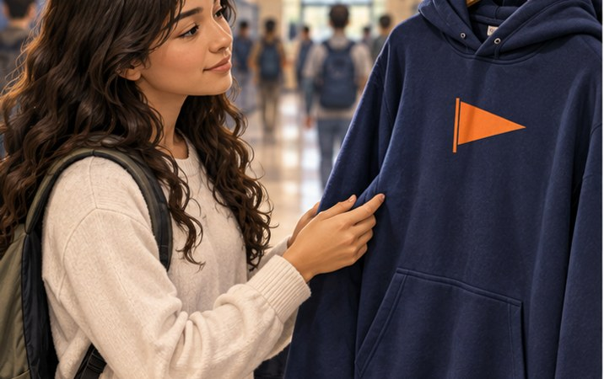
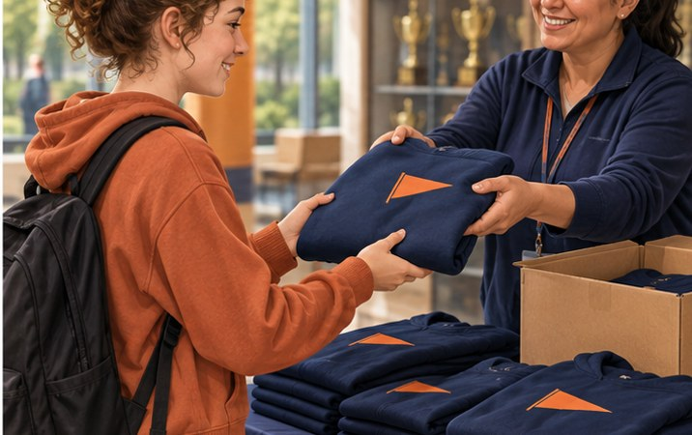
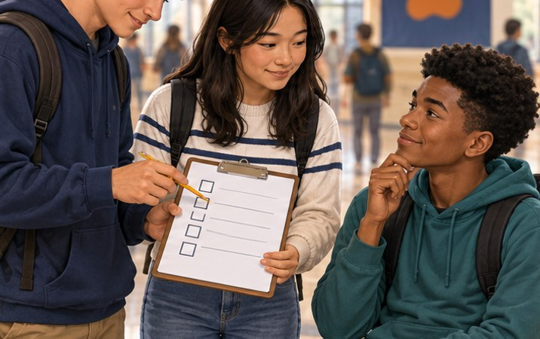
MONDAY · NOTICE AND CHOOSE
3:00 TOTAL
Would this hoodie work for everyone?
A fictional school-spirit shop is choosing its next hoodie.
What should the shop do FIRST?
A Pick our favorite
C Order a huge batch
B Ask likely buyers
LOOK 20s → CHOOSE 40s Point, show fingers, or write your choice.
pp. 10–11 · SBTE 9 “My choice is __ because __.” 1
Notes:
MONDAY, Sep. 21–25 2026. MAIN · only after pp. 7–9 / slide 8. SOURCE: Chapter 1 pp. 10–11 · SBTE 9. Printed textbook pages, not PDF viewer count. Total opener 3:00; 20s look, 40s choose, 50s check, 50s bridge, 20s buffer. Timer is teacher-controlled; on-slide times are static cues. Keep this fictional. The Sep. 17 announcements mention a school merchandise store and a freshman survey, but this is not an actual offer or event. If Friday reading is incomplete, use the Monday catch-up route at the END of this deck instead. Do not run both openers.
EXPECTED: B. Research customer wants and needs before committing to a product. Ask about fit, comfort, use, or style rather than personal income.
FOLLOW-UP 1 (optional, choose at most one): What could the shop ask about the hoodie?
FOLLOW-UP 2: How could that answer change what it sells?
HARD STOP: “We have our choice. Hold the extra examples; the reading gives us the model.”
TRANSITION: “Our hoodie choice gives us a reason to read page 10: how does the marketing concept guide the decision?”
SBTE: Take attendance during look/choose, scan participation discreetly, add one correction only if needed. Handoff: “Can you connect this to our notes?”
MATCHED CHECK: What must a business understand before deciding what to offer?
KEY: Customer wants and needs, together with company goals and profits.
PITER: Read the scenario once. Describe the three pictures. Give 20 seconds of quiet looking, then ask everyone for a response. Accept a private written choice. No partner transition.
ACCESS: Read the short directions and describe the relevant visual aloud. Offer pointing, fingers, a written letter, or a quiet spoken response. Do not require eye contact, public disclosure, a phone, or speed. Keep printed response options available. No flashing, animation, or audible countdown.
VISUAL SOURCE: Fictional generated illustrations; not actual students, school events, products, or prices. Repeated images intentionally preserve the scenario between prediction and academic explanation.

Slide 2
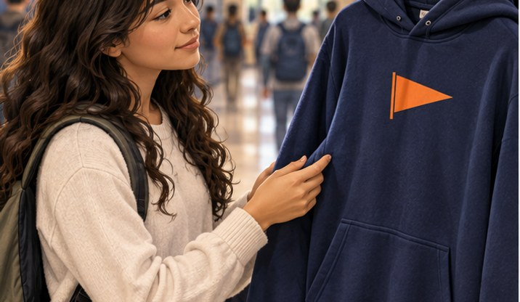
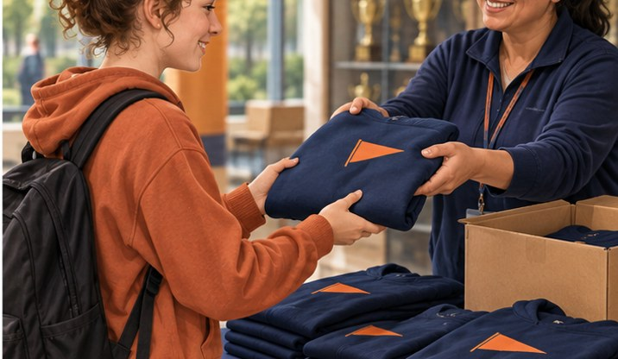
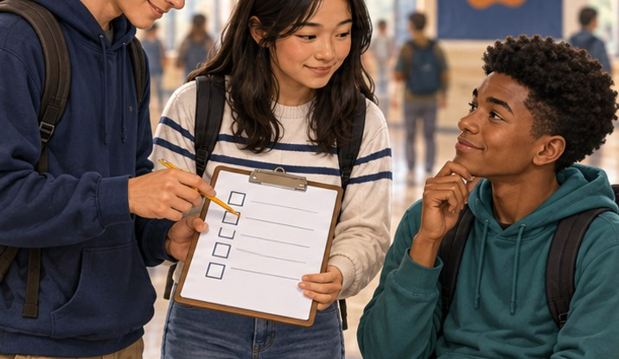
MONDAY · CHECK
CHECK · 0:50
B Ask likely buyers
MARKETING CONCEPT
Style and comfort
A product people want
Evidence from customers
Customer needs guide company goals and profit decisions.
pp. 10–11 · SBTE 9 Point to the clue that supports your answer. 2
Notes:
MONDAY, Sep. 21–25 2026. MAIN · only after pp. 7–9 / slide 8. SOURCE: Chapter 1 pp. 10–11 · SBTE 9. Printed textbook pages, not PDF viewer count. Total opener 3:00; 20s look, 40s choose, 50s check, 50s bridge, 20s buffer. Timer is teacher-controlled; on-slide times are static cues. Keep this fictional. The Sep. 17 announcements mention a school merchandise store and a freshman survey, but this is not an actual offer or event. If Friday reading is incomplete, use the Monday catch-up route at the END of this deck instead. Do not run both openers.
EXPECTED: B. Research customer wants and needs before committing to a product. Ask about fit, comfort, use, or style rather than personal income.
FOLLOW-UP 1 (optional, choose at most one): What could the shop ask about the hoodie?
FOLLOW-UP 2: How could that answer change what it sells?
HARD STOP: “We have our choice. Hold the extra examples; the reading gives us the model.”
TRANSITION: “Our hoodie choice gives us a reason to read page 10: how does the marketing concept guide the decision?”
SBTE: Take attendance during look/choose, scan participation discreetly, add one correction only if needed. Handoff: “Can you connect this to our notes?”
MATCHED CHECK: What must a business understand before deciding what to offer?
KEY: Customer wants and needs, together with company goals and profits.
PITER: Reveal and explain one visual clue. Use only one follow-up if time remains. Pointing alone shows selection; check explanation in the later matched lesson check.
ACCESS: Read the short directions and describe the relevant visual aloud. Offer pointing, fingers, a written letter, or a quiet spoken response. Do not require eye contact, public disclosure, a phone, or speed. Keep printed response options available. No flashing, animation, or audible countdown.
VISUAL SOURCE: Fictional generated illustrations; not actual students, school events, products, or prices. Repeated images intentionally preserve the scenario between prediction and academic explanation.

Slide 3

MONDAY · CONNECT
CONNECT · 0:50
Customer evidence helps a business choose.
Keep this example in mind as you read.
Open p. 10: “The Purpose of Marketing”
Find customer needs, company goals, and profits.
NEXT: Notes → required reading → vocabulary/application
pp. 10–11 · SBTE 9 Stop at 3:00 total. 3
Notes:
MONDAY, Sep. 21–25 2026. MAIN · only after pp. 7–9 / slide 8. SOURCE: Chapter 1 pp. 10–11 · SBTE 9. Printed textbook pages, not PDF viewer count. Total opener 3:00; 20s look, 40s choose, 50s check, 50s bridge, 20s buffer. Timer is teacher-controlled; on-slide times are static cues. Keep this fictional. The Sep. 17 announcements mention a school merchandise store and a freshman survey, but this is not an actual offer or event. If Friday reading is incomplete, use the Monday catch-up route at the END of this deck instead. Do not run both openers.
EXPECTED: B. Research customer wants and needs before committing to a product. Ask about fit, comfort, use, or style rather than personal income.
FOLLOW-UP 1 (optional, choose at most one): What could the shop ask about the hoodie?
FOLLOW-UP 2: How could that answer change what it sells?
HARD STOP: “We have our choice. Hold the extra examples; the reading gives us the model.”
TRANSITION: “Our hoodie choice gives us a reason to read page 10: how does the marketing concept guide the decision?”
SBTE: Take attendance during look/choose, scan participation discreetly, add one correction only if needed. Handoff: “Can you connect this to our notes?”
MATCHED CHECK: What must a business understand before deciding what to offer?
KEY: Customer wants and needs, together with company goals and profits.
PITER: Say the one-line closer. Students locate the named heading, not an unfamiliar page number alone. End the opener, then use the appropriate notes/readings.
ACCESS: Read the short directions and describe the relevant visual aloud. Offer pointing, fingers, a written letter, or a quiet spoken response. Do not require eye contact, public disclosure, a phone, or speed. Keep printed response options available. No flashing, animation, or audible countdown.
VISUAL SOURCE: Fictional generated illustrations; not actual students, school events, products, or prices. Repeated images intentionally preserve the scenario between prediction and academic explanation.

Slide 4
TUESDAY · NOTICE AND CHOOSE
3:00 TOTAL
Great hoodie. Wrong delivery day.
A fictional hoodie arrives AFTER the school event.
Which change fixes the problem?
A Change its design
C Fix pickup and delivery
B Ask about colors
LOOK 20s → CHOOSE 40s Point, show fingers, or write your choice.
pp. 11–12 · SBTE 10 “My choice is __ because __.” 4
Notes:
TUESDAY, Sep. 21–25 2026. PREVIEW · no prior 4 Ps knowledge needed. SOURCE: Chapter 1 pp. 11–12 · SBTE 10. Printed textbook pages, not PDF viewer count. Total opener 3:00; 20s look, 40s choose, 50s check, 50s bridge, 20s buffer. Timer is teacher-controlled; on-slide times are static cues. Preview through an everyday problem, then reveal the term. Do not quiz students on untaught P labels. Fictional delivery; no real school shipping promise. Terms to Know deadline is 9 AM today, not necessarily before this section meets.
EXPECTED: C. The missed event is a delivery/distribution problem. A better ad or new color would not fix the stated problem.
FOLLOW-UP 1 (optional, choose at most one): Could a great product still disappoint a customer? How?
FOLLOW-UP 2: Which detail tells you delivery is the issue?
HARD STOP: “Lock in your choice. Let’s name the concept and go to the reading.”
TRANSITION: “Keep that late hoodie in mind. Pages 11–12 explain all four decisions in the marketing mix.”
SBTE: Take attendance during look/choose, scan participation discreetly, add one correction only if needed. Handoff: “Can you connect this to our notes?”
MATCHED CHECK: A hoodie is advertised well but arrives too late. Which P needs attention, and why?
KEY: Place; distribution did not deliver it when needed.
PITER: Read the scenario once. Describe the three pictures. Give 20 seconds of quiet looking, then ask everyone for a response. Accept a private written choice. No partner transition.
ACCESS: Read the short directions and describe the relevant visual aloud. Offer pointing, fingers, a written letter, or a quiet spoken response. Do not require eye contact, public disclosure, a phone, or speed. Keep printed response options available. No flashing, animation, or audible countdown.
VISUAL SOURCE: Fictional generated illustrations; not actual students, school events, products, or prices. Repeated images intentionally preserve the scenario between prediction and academic explanation.

Slide 5
TUESDAY · CHECK
CHECK · 0:50
C Fix pickup and delivery
PLACE · ONE OF THE 4 Ps
PRODUCT: the hoodie
PLACE: the route to you
Research helps decisions
PLACE includes how, where, and when a product reaches you.
pp. 11–12 · SBTE 10 Point to the clue that supports your answer. 5
Notes:
TUESDAY, Sep. 21–25 2026. PREVIEW · no prior 4 Ps knowledge needed. SOURCE: Chapter 1 pp. 11–12 · SBTE 10. Printed textbook pages, not PDF viewer count. Total opener 3:00; 20s look, 40s choose, 50s check, 50s bridge, 20s buffer. Timer is teacher-controlled; on-slide times are static cues. Preview through an everyday problem, then reveal the term. Do not quiz students on untaught P labels. Fictional delivery; no real school shipping promise. Terms to Know deadline is 9 AM today, not necessarily before this section meets.
EXPECTED: C. The missed event is a delivery/distribution problem. A better ad or new color would not fix the stated problem.
FOLLOW-UP 1 (optional, choose at most one): Could a great product still disappoint a customer? How?
FOLLOW-UP 2: Which detail tells you delivery is the issue?
HARD STOP: “Lock in your choice. Let’s name the concept and go to the reading.”
TRANSITION: “Keep that late hoodie in mind. Pages 11–12 explain all four decisions in the marketing mix.”
SBTE: Take attendance during look/choose, scan participation discreetly, add one correction only if needed. Handoff: “Can you connect this to our notes?”
MATCHED CHECK: A hoodie is advertised well but arrives too late. Which P needs attention, and why?
KEY: Place; distribution did not deliver it when needed.
PITER: Reveal and explain one visual clue. Use only one follow-up if time remains. Pointing alone shows selection; check explanation in the later matched lesson check.
ACCESS: Read the short directions and describe the relevant visual aloud. Offer pointing, fingers, a written letter, or a quiet spoken response. Do not require eye contact, public disclosure, a phone, or speed. Keep printed response options available. No flashing, animation, or audible countdown.
VISUAL SOURCE: Fictional generated illustrations; not actual students, school events, products, or prices. Repeated images intentionally preserve the scenario between prediction and academic explanation.

Slide 6

TUESDAY · CONNECT
CONNECT · 0:50
A product has to reach its customer at the right time.
Keep this example in mind as you read.
Open pp. 11–12: “Marketing Mix”
Find product, promotion, price, and place.
NEXT: Notes → required reading → vocabulary/application
pp. 11–12 · SBTE 10 Stop at 3:00 total. 6
Notes:
TUESDAY, Sep. 21–25 2026. PREVIEW · no prior 4 Ps knowledge needed. SOURCE: Chapter 1 pp. 11–12 · SBTE 10. Printed textbook pages, not PDF viewer count. Total opener 3:00; 20s look, 40s choose, 50s check, 50s bridge, 20s buffer. Timer is teacher-controlled; on-slide times are static cues. Preview through an everyday problem, then reveal the term. Do not quiz students on untaught P labels. Fictional delivery; no real school shipping promise. Terms to Know deadline is 9 AM today, not necessarily before this section meets.
EXPECTED: C. The missed event is a delivery/distribution problem. A better ad or new color would not fix the stated problem.
FOLLOW-UP 1 (optional, choose at most one): Could a great product still disappoint a customer? How?
FOLLOW-UP 2: Which detail tells you delivery is the issue?
HARD STOP: “Lock in your choice. Let’s name the concept and go to the reading.”
TRANSITION: “Keep that late hoodie in mind. Pages 11–12 explain all four decisions in the marketing mix.”
SBTE: Take attendance during look/choose, scan participation discreetly, add one correction only if needed. Handoff: “Can you connect this to our notes?”
MATCHED CHECK: A hoodie is advertised well but arrives too late. Which P needs attention, and why?
KEY: Place; distribution did not deliver it when needed.
PITER: Say the one-line closer. Students locate the named heading, not an unfamiliar page number alone. End the opener, then use the appropriate notes/readings.
ACCESS: Read the short directions and describe the relevant visual aloud. Offer pointing, fingers, a written letter, or a quiet spoken response. Do not require eye contact, public disclosure, a phone, or speed. Keep printed response options available. No flashing, animation, or audible countdown.
VISUAL SOURCE: Fictional generated illustrations; not actual students, school events, products, or prices. Repeated images intentionally preserve the scenario between prediction and academic explanation.

Slide 7

WEDNESDAY · NOTICE AND CHOOSE
3:00 TOTAL
Would people actually come?
A fictional esports event wants players AND spectators.
Which question gives the most useful evidence?
A “Gaming is great, right?”
B “Play, watch, or neither?”
C “My favorite game wins?”
LOOK 20s → CHOOSE 40s Point, show fingers, or write your choice.
pp. 13–15 · SBTE 11–13 “My choice is __ because __.” 7
Notes:
WEDNESDAY, Sep. 21–25 2026. PREVIEW · research before an esports event. SOURCE: Chapter 1 pp. 13–15 · SBTE 11–13. Printed textbook pages, not PDF viewer count. Total opener 3:00; 20s look, 40s choose, 50s check, 50s bridge, 20s buffer. Timer is teacher-controlled; on-slide times are static cues. The Sep. 17 announcements mention esports, which supplies school context. This invented event is not a claim about school plans. No need to be a gamer. Apply the routine only once this section reaches marketing functions. Review deadline is 9 AM today.
EXPECTED: B. It permits several preferences rather than assuming everyone likes gaming. Responses are fictional, not collected personal data. MIM includes qualitative and quantitative evidence.
FOLLOW-UP 1 (optional, choose at most one): Why is “neither” a useful option?
FOLLOW-UP 2: How could the answer change the event?
HARD STOP: “One useful question is enough. Now find the academic name in the text.”
TRANSITION: “Page 13 names this work marketing information management; then we will read how all seven functions work together.”
SBTE: Take attendance during look/choose, scan participation discreetly, add one correction only if needed. Handoff: “Can you connect this to our notes?”
MATCHED CHECK: Which function gathers evidence about what customers want?
KEY: Marketing information management, also called market research.
PITER: Read the scenario once. Describe the three pictures. Give 20 seconds of quiet looking, then ask everyone for a response. Accept a private written choice. No partner transition.
ACCESS: Read the short directions and describe the relevant visual aloud. Offer pointing, fingers, a written letter, or a quiet spoken response. Do not require eye contact, public disclosure, a phone, or speed. Keep printed response options available. No flashing, animation, or audible countdown.
VISUAL SOURCE: Fictional generated illustrations; not actual students, school events, products, or prices. Repeated images intentionally preserve the scenario between prediction and academic explanation.

Slide 8

WEDNESDAY · CHECK
CHECK · 0:50
B Play, watch, or neither?
MARKETING INFORMATION MANAGEMENT
Players, spectators, and people who are not interested can all answer.
The answer helps identify the target market.
Market research gathers evidence about customers’ wants and needs.
pp. 13–15 · SBTE 11–13 Point to the clue that supports your answer. 8
Notes:
WEDNESDAY, Sep. 21–25 2026. PREVIEW · research before an esports event. SOURCE: Chapter 1 pp. 13–15 · SBTE 11–13. Printed textbook pages, not PDF viewer count. Total opener 3:00; 20s look, 40s choose, 50s check, 50s bridge, 20s buffer. Timer is teacher-controlled; on-slide times are static cues. The Sep. 17 announcements mention esports, which supplies school context. This invented event is not a claim about school plans. No need to be a gamer. Apply the routine only once this section reaches marketing functions. Review deadline is 9 AM today.
EXPECTED: B. It permits several preferences rather than assuming everyone likes gaming. Responses are fictional, not collected personal data. MIM includes qualitative and quantitative evidence.
FOLLOW-UP 1 (optional, choose at most one): Why is “neither” a useful option?
FOLLOW-UP 2: How could the answer change the event?
HARD STOP: “One useful question is enough. Now find the academic name in the text.”
TRANSITION: “Page 13 names this work marketing information management; then we will read how all seven functions work together.”
SBTE: Take attendance during look/choose, scan participation discreetly, add one correction only if needed. Handoff: “Can you connect this to our notes?”
MATCHED CHECK: Which function gathers evidence about what customers want?
KEY: Marketing information management, also called market research.
PITER: Reveal and explain one visual clue. Use only one follow-up if time remains. Pointing alone shows selection; check explanation in the later matched lesson check.
ACCESS: Read the short directions and describe the relevant visual aloud. Offer pointing, fingers, a written letter, or a quiet spoken response. Do not require eye contact, public disclosure, a phone, or speed. Keep printed response options available. No flashing, animation, or audible countdown.
VISUAL SOURCE: Fictional generated illustrations; not actual students, school events, products, or prices. Repeated images intentionally preserve the scenario between prediction and academic explanation.

Slide 9

WEDNESDAY · CONNECT
CONNECT · 0:50
Useful questions leave room for honest answers.
Keep this example in mind as you read.
Open p. 13: “Marketing Functions”
Find MIM and target market. Continue through p. 15.
NEXT: Notes → required reading → vocabulary/application
pp. 13–15 · SBTE 11–13 Stop at 3:00 total. 9
Notes:
WEDNESDAY, Sep. 21–25 2026. PREVIEW · research before an esports event. SOURCE: Chapter 1 pp. 13–15 · SBTE 11–13. Printed textbook pages, not PDF viewer count. Total opener 3:00; 20s look, 40s choose, 50s check, 50s bridge, 20s buffer. Timer is teacher-controlled; on-slide times are static cues. The Sep. 17 announcements mention esports, which supplies school context. This invented event is not a claim about school plans. No need to be a gamer. Apply the routine only once this section reaches marketing functions. Review deadline is 9 AM today.
EXPECTED: B. It permits several preferences rather than assuming everyone likes gaming. Responses are fictional, not collected personal data. MIM includes qualitative and quantitative evidence.
FOLLOW-UP 1 (optional, choose at most one): Why is “neither” a useful option?
FOLLOW-UP 2: How could the answer change the event?
HARD STOP: “One useful question is enough. Now find the academic name in the text.”
TRANSITION: “Page 13 names this work marketing information management; then we will read how all seven functions work together.”
SBTE: Take attendance during look/choose, scan participation discreetly, add one correction only if needed. Handoff: “Can you connect this to our notes?”
MATCHED CHECK: Which function gathers evidence about what customers want?
KEY: Marketing information management, also called market research.
PITER: Say the one-line closer. Students locate the named heading, not an unfamiliar page number alone. End the opener, then use the appropriate notes/readings.
ACCESS: Read the short directions and describe the relevant visual aloud. Offer pointing, fingers, a written letter, or a quiet spoken response. Do not require eye contact, public disclosure, a phone, or speed. Keep printed response options available. No flashing, animation, or audible countdown.
VISUAL SOURCE: Fictional generated illustrations; not actual students, school events, products, or prices. Repeated images intentionally preserve the scenario between prediction and academic explanation.

Slide 10
THURSDAY · NOTICE AND CHOOSE
3:00 TOTAL
The order is ready. Nobody can collect it.
The pickup table closes before customers can get there.
Which function should repair this first?
A Product/service management
C Channel management
B Marketing information management
LOOK 20s → CHOOSE 40s Point, show fingers, or write your choice.
pp. 13–15 · SBTE 12–13 “My choice is __ because __.” 10
Notes:
THURSDAY, Sep. 21–25 2026. APPLICATION · after the functions reading. SOURCE: Chapter 1 pp. 13–15 · SBTE 12–13. Printed textbook pages, not PDF viewer count. Total opener 3:00; 20s look, 40s choose, 50s check, 50s bridge, 20s buffer. Timer is teacher-controlled; on-slide times are static cues. If the section has not read the functions, use the plain-language choices A change the hoodie, B ask preferences, C fix pickup. Reveal channel management as a preview and finish the reading before independent application.
EXPECTED: C for the immediate distribution problem. MIM can reveal preferred pickup times and other functions support the repair; accept this distinction rather than claiming mutually exclusive categories.
FOLLOW-UP 1 (optional, choose at most one): How could research help choose a better pickup time?
FOLLOW-UP 2: Why wouldn’t a louder advertisement fix this alone?
HARD STOP: “We’ve identified the immediate repair. Save the other fixes for our application.”
TRANSITION: “Page 13 explains the distribution decisions; Figure 1.4 shows how they support customer needs.”
SBTE: Take attendance during look/choose, scan participation discreetly, add one correction only if needed. Handoff: “Can you connect this to our notes?”
MATCHED CHECK: How do channel management and place connect?
KEY: Channel management coordinates distribution; place is that path within the marketing mix.
PITER: Read the scenario once. Describe the three pictures. Give 20 seconds of quiet looking, then ask everyone for a response. Accept a private written choice. No partner transition.
ACCESS: Read the short directions and describe the relevant visual aloud. Offer pointing, fingers, a written letter, or a quiet spoken response. Do not require eye contact, public disclosure, a phone, or speed. Keep printed response options available. No flashing, animation, or audible countdown.
VISUAL SOURCE: Fictional generated illustrations; not actual students, school events, products, or prices. Repeated images intentionally preserve the scenario between prediction and academic explanation.

Slide 11
THURSDAY · CHECK
CHECK · 0:50
C Channel management
CHANNEL MANAGEMENT
A Improve the hoodie
C Fix how it reaches people
B Learn customer preferences
It coordinates how, when, and where products reach customers.
pp. 13–15 · SBTE 12–13 Point to the clue that supports your answer. 11
Notes:
THURSDAY, Sep. 21–25 2026. APPLICATION · after the functions reading. SOURCE: Chapter 1 pp. 13–15 · SBTE 12–13. Printed textbook pages, not PDF viewer count. Total opener 3:00; 20s look, 40s choose, 50s check, 50s bridge, 20s buffer. Timer is teacher-controlled; on-slide times are static cues. If the section has not read the functions, use the plain-language choices A change the hoodie, B ask preferences, C fix pickup. Reveal channel management as a preview and finish the reading before independent application.
EXPECTED: C for the immediate distribution problem. MIM can reveal preferred pickup times and other functions support the repair; accept this distinction rather than claiming mutually exclusive categories.
FOLLOW-UP 1 (optional, choose at most one): How could research help choose a better pickup time?
FOLLOW-UP 2: Why wouldn’t a louder advertisement fix this alone?
HARD STOP: “We’ve identified the immediate repair. Save the other fixes for our application.”
TRANSITION: “Page 13 explains the distribution decisions; Figure 1.4 shows how they support customer needs.”
SBTE: Take attendance during look/choose, scan participation discreetly, add one correction only if needed. Handoff: “Can you connect this to our notes?”
MATCHED CHECK: How do channel management and place connect?
KEY: Channel management coordinates distribution; place is that path within the marketing mix.
PITER: Reveal and explain one visual clue. Use only one follow-up if time remains. Pointing alone shows selection; check explanation in the later matched lesson check.
ACCESS: Read the short directions and describe the relevant visual aloud. Offer pointing, fingers, a written letter, or a quiet spoken response. Do not require eye contact, public disclosure, a phone, or speed. Keep printed response options available. No flashing, animation, or audible countdown.
VISUAL SOURCE: Fictional generated illustrations; not actual students, school events, products, or prices. Repeated images intentionally preserve the scenario between prediction and academic explanation.

Slide 12
THURSDAY · CONNECT
CONNECT · 0:50
Customer access is part of the product’s success.
Keep this example in mind as you read.
Open p. 13: “Channel Management”
Then use Figure 1.4 on p. 15 to explain the link.
NEXT: Notes → required reading → vocabulary/application
pp. 13–15 · SBTE 12–13 Stop at 3:00 total. 12
Notes:
THURSDAY, Sep. 21–25 2026. APPLICATION · after the functions reading. SOURCE: Chapter 1 pp. 13–15 · SBTE 12–13. Printed textbook pages, not PDF viewer count. Total opener 3:00; 20s look, 40s choose, 50s check, 50s bridge, 20s buffer. Timer is teacher-controlled; on-slide times are static cues. If the section has not read the functions, use the plain-language choices A change the hoodie, B ask preferences, C fix pickup. Reveal channel management as a preview and finish the reading before independent application.
EXPECTED: C for the immediate distribution problem. MIM can reveal preferred pickup times and other functions support the repair; accept this distinction rather than claiming mutually exclusive categories.
FOLLOW-UP 1 (optional, choose at most one): How could research help choose a better pickup time?
FOLLOW-UP 2: Why wouldn’t a louder advertisement fix this alone?
HARD STOP: “We’ve identified the immediate repair. Save the other fixes for our application.”
TRANSITION: “Page 13 explains the distribution decisions; Figure 1.4 shows how they support customer needs.”
SBTE: Take attendance during look/choose, scan participation discreetly, add one correction only if needed. Handoff: “Can you connect this to our notes?”
MATCHED CHECK: How do channel management and place connect?
KEY: Channel management coordinates distribution; place is that path within the marketing mix.
PITER: Say the one-line closer. Students locate the named heading, not an unfamiliar page number alone. End the opener, then use the appropriate notes/readings.
ACCESS: Read the short directions and describe the relevant visual aloud. Offer pointing, fingers, a written letter, or a quiet spoken response. Do not require eye contact, public disclosure, a phone, or speed. Keep printed response options available. No flashing, animation, or audible countdown.
VISUAL SOURCE: Fictional generated illustrations; not actual students, school events, products, or prices. Repeated images intentionally preserve the scenario between prediction and academic explanation.

Slide 13
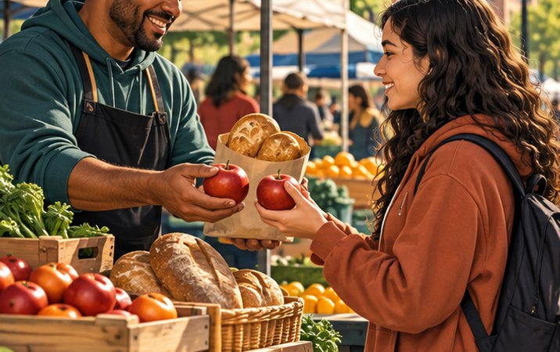
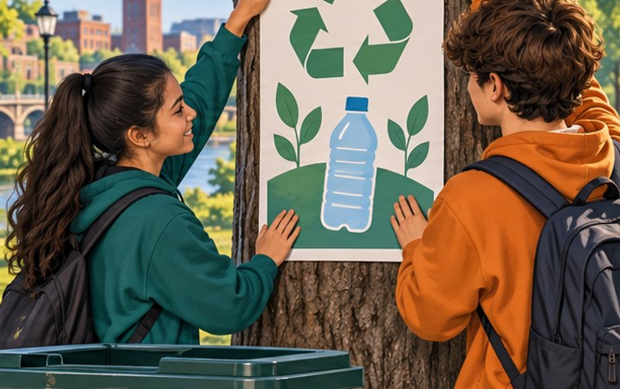
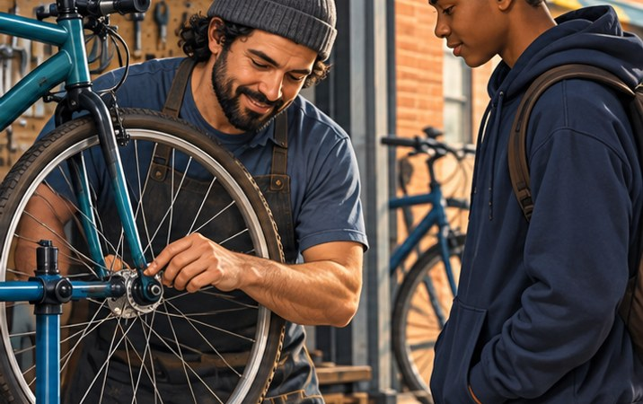
FRIDAY · NOTICE AND CHOOSE
3:00 TOTAL
Three scenes. Three different offerings.
Imagine a neighborhood market in Rochester. No visit needed.
Match G = good, S = service, I = idea.
1 Food to buy
3 “Recycle in our community”
2 A paid bicycle repair
LOOK 20s → CHOOSE 40s Point, show fingers, or write your choice.
p. 4; revisit pp. 10–15 · SBTE 4, 9–13 “My choice is __ because __.” 13
Notes:
FRIDAY, Sep. 21–25 2026. RETRIEVAL · private response. SOURCE: Chapter 1 p. 4; revisit pp. 10–15 · SBTE 4, 9–13. Printed textbook pages, not PDF viewer count. Total opener 3:00; 20s look, 40s choose, 50s check, 50s bridge, 20s buffer. Timer is teacher-controlled; on-slide times are static cues. Confirm the Sep. 25 assessment before use. If the SBTE needs a secure assessment start, omit the answer/reveal and follow-up entirely; do not coach assessed answers. Use the full routine on a review day. No new reading required before a test.
EXPECTED: Food is a good, paid repair is a service, the recycling message is an idea. The printed poster is also a good; we are classifying the message, not its paper.
FOLLOW-UP 1 (optional, choose at most one): If we classify the poster’s MESSAGE, what is it?
FOLLOW-UP 2: Which P or function could help the repair stall?
HARD STOP: “Pens down. Keep your response; we’re moving to today’s directions.”
TRANSITION: “These are the same Chapter 1 distinctions we will use in today’s review or assessment.”
SBTE: Take attendance during look/choose, scan participation discreetly, add one correction only if needed. Handoff: “Can you connect this to our notes?”
MATCHED CHECK: Give a correct offering category and one linked P or function.
KEY: For example: bike repair is a service; promotion communicates it, pricing sets its charge, and selling helps match it to a customer.
PITER: Read the scenario once. Describe the three pictures. Give 20 seconds of quiet looking, then ask everyone for a response. Accept a private written choice. No partner transition.
ACCESS: Read the short directions and describe the relevant visual aloud. Offer pointing, fingers, a written letter, or a quiet spoken response. Do not require eye contact, public disclosure, a phone, or speed. Keep printed response options available. No flashing, animation, or audible countdown.
VISUAL SOURCE: Fictional generated illustrations; not actual students, school events, products, or prices. Repeated images intentionally preserve the scenario between prediction and academic explanation.

Slide 14
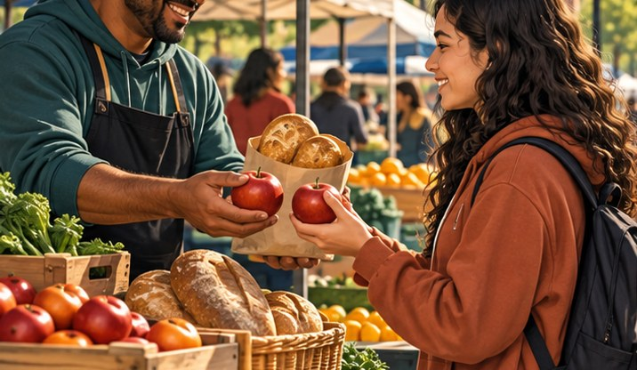
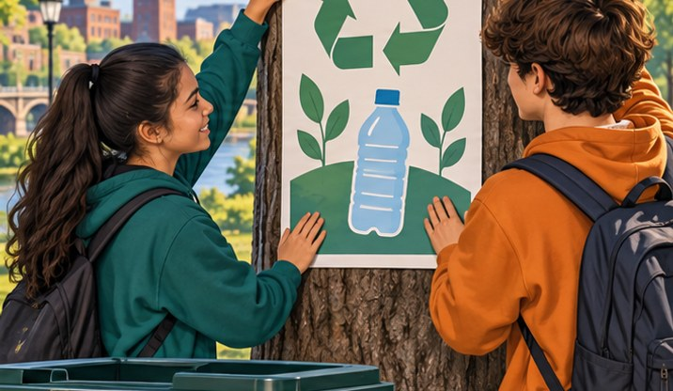
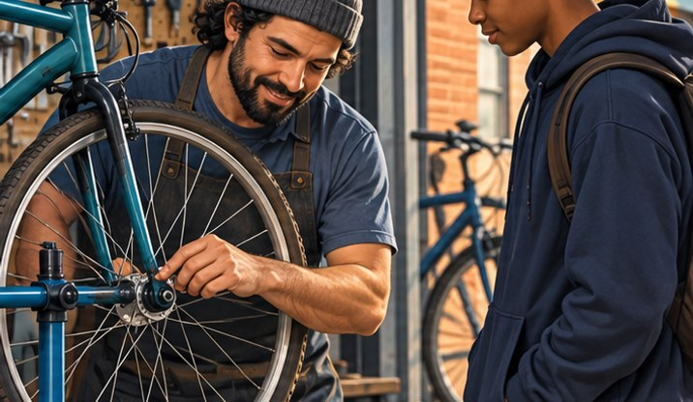
FRIDAY · CHECK
CHECK · 0:50
1 = G 2 = S 3 = I
GOOD · SERVICE · IDEA
G A tangible item
I A thought or opinion
S A task for payment
Good: tangible item. Service: paid task. Idea: thought or opinion.
p. 4; revisit pp. 10–15 · SBTE 4, 9–13 Point to the clue that supports your answer. 14
Notes:
FRIDAY, Sep. 21–25 2026. RETRIEVAL · private response. SOURCE: Chapter 1 p. 4; revisit pp. 10–15 · SBTE 4, 9–13. Printed textbook pages, not PDF viewer count. Total opener 3:00; 20s look, 40s choose, 50s check, 50s bridge, 20s buffer. Timer is teacher-controlled; on-slide times are static cues. Confirm the Sep. 25 assessment before use. If the SBTE needs a secure assessment start, omit the answer/reveal and follow-up entirely; do not coach assessed answers. Use the full routine on a review day. No new reading required before a test.
EXPECTED: Food is a good, paid repair is a service, the recycling message is an idea. The printed poster is also a good; we are classifying the message, not its paper.
FOLLOW-UP 1 (optional, choose at most one): If we classify the poster’s MESSAGE, what is it?
FOLLOW-UP 2: Which P or function could help the repair stall?
HARD STOP: “Pens down. Keep your response; we’re moving to today’s directions.”
TRANSITION: “These are the same Chapter 1 distinctions we will use in today’s review or assessment.”
SBTE: Take attendance during look/choose, scan participation discreetly, add one correction only if needed. Handoff: “Can you connect this to our notes?”
MATCHED CHECK: Give a correct offering category and one linked P or function.
KEY: For example: bike repair is a service; promotion communicates it, pricing sets its charge, and selling helps match it to a customer.
PITER: Reveal and explain one visual clue. Use only one follow-up if time remains. Pointing alone shows selection; check explanation in the later matched lesson check.
ACCESS: Read the short directions and describe the relevant visual aloud. Offer pointing, fingers, a written letter, or a quiet spoken response. Do not require eye contact, public disclosure, a phone, or speed. Keep printed response options available. No flashing, animation, or audible countdown.
VISUAL SOURCE: Fictional generated illustrations; not actual students, school events, products, or prices. Repeated images intentionally preserve the scenario between prediction and academic explanation.

Slide 15

FRIDAY · CONNECT
CONNECT · 0:50
Every offering needs an audience.
Keep this example in mind as you read.
Check p. 4, then follow today’s class agenda
Choose one scene. Name a P or function that could support it.
NEXT: Notes → required reading → vocabulary/application
p. 4; revisit pp. 10–15 · SBTE 4, 9–13 Stop at 3:00 total. 15
Notes:
FRIDAY, Sep. 21–25 2026. RETRIEVAL · private response. SOURCE: Chapter 1 p. 4; revisit pp. 10–15 · SBTE 4, 9–13. Printed textbook pages, not PDF viewer count. Total opener 3:00; 20s look, 40s choose, 50s check, 50s bridge, 20s buffer. Timer is teacher-controlled; on-slide times are static cues. Confirm the Sep. 25 assessment before use. If the SBTE needs a secure assessment start, omit the answer/reveal and follow-up entirely; do not coach assessed answers. Use the full routine on a review day. No new reading required before a test.
EXPECTED: Food is a good, paid repair is a service, the recycling message is an idea. The printed poster is also a good; we are classifying the message, not its paper.
FOLLOW-UP 1 (optional, choose at most one): If we classify the poster’s MESSAGE, what is it?
FOLLOW-UP 2: Which P or function could help the repair stall?
HARD STOP: “Pens down. Keep your response; we’re moving to today’s directions.”
TRANSITION: “These are the same Chapter 1 distinctions we will use in today’s review or assessment.”
SBTE: Take attendance during look/choose, scan participation discreetly, add one correction only if needed. Handoff: “Can you connect this to our notes?”
MATCHED CHECK: Give a correct offering category and one linked P or function.
KEY: For example: bike repair is a service; promotion communicates it, pricing sets its charge, and selling helps match it to a customer.
PITER: Say the one-line closer. Students locate the named heading, not an unfamiliar page number alone. End the opener, then use the appropriate notes/readings.
ACCESS: Read the short directions and describe the relevant visual aloud. Offer pointing, fingers, a written letter, or a quiet spoken response. Do not require eye contact, public disclosure, a phone, or speed. Keep printed response options available. No flashing, animation, or audible countdown.
VISUAL SOURCE: Fictional generated illustrations; not actual students, school events, products, or prices. Repeated images intentionally preserve the scenario between prediction and academic explanation.

Slide 16
MONDAY · NOTICE AND CHOOSE
3:00 TOTAL
More than a place to buy food?
Imagine a neighborhood market near school.
Which scenes show products for sale? Choose all that fit.
A Food stall
C Recycling message
B Paid bicycle repair
LOOK 20s → CHOOSE 40s Point, show fingers, or write your choice.
pp. 7–9 · SBTE 7–8 “My choice is __ because __.” 16
Notes:
MONDAY, Sep. 21–25 2026. CATCH-UP · use INSTEAD of main Monday route. SOURCE: Chapter 1 pp. 7–9 · SBTE 7–8. Printed textbook pages, not PDF viewer count. Total opener 3:00; 20s look, 40s choose, 50s check, 50s bridge, 20s buffer. Timer is teacher-controlled; on-slide times are static cues. Use this route if the actual section stop is before pp. 7–9/slide 8 completion. Do not advance this section just because the calendar says Monday. Financial activities may need a short note review before reading. Complete missing work first.
EXPECTED: A and B. The book includes goods and services as products. The recycling message need not be sold. Then identify wider contributions: jobs, wages, markets, and taxes. Do not infer every depicted worker’s pay.
FOLLOW-UP 1 (optional, choose at most one): How is a service also a product?
FOLLOW-UP 2: Who besides customers could benefit from the business?
HARD STOP: “Both goods and paid services count. Let’s use the reading to check the wider effects.”
TRANSITION: “Finish financial activities on page 7, then pages 8–9 explain how businesses affect their communities.”
SBTE: Take attendance during look/choose, scan participation discreetly, add one correction only if needed. Handoff: “Can you connect this to our notes?”
MATCHED CHECK: Name one contribution a business makes beyond its sale.
KEY: Employment/wages or taxes supporting public services; markets enabling exchange also accepted.
PITER: Read the scenario once. Describe the three pictures. Give 20 seconds of quiet looking, then ask everyone for a response. Accept a private written choice. No partner transition.
ACCESS: Read the short directions and describe the relevant visual aloud. Offer pointing, fingers, a written letter, or a quiet spoken response. Do not require eye contact, public disclosure, a phone, or speed. Keep printed response options available. No flashing, animation, or audible countdown.
VISUAL SOURCE: Fictional generated illustrations; not actual students, school events, products, or prices. Repeated images intentionally preserve the scenario between prediction and academic explanation.

Slide 17
MONDAY · CHECK
CHECK · 0:50
A and B show products for sale
BUSINESSES AND SOCIETY
A Goods meet needs/wants
C A community idea
B Services meet needs/wants
Businesses provide products, create markets, and support economic activity.
pp. 7–9 · SBTE 7–8 Point to the clue that supports your answer. 17
Notes:
MONDAY, Sep. 21–25 2026. CATCH-UP · use INSTEAD of main Monday route. SOURCE: Chapter 1 pp. 7–9 · SBTE 7–8. Printed textbook pages, not PDF viewer count. Total opener 3:00; 20s look, 40s choose, 50s check, 50s bridge, 20s buffer. Timer is teacher-controlled; on-slide times are static cues. Use this route if the actual section stop is before pp. 7–9/slide 8 completion. Do not advance this section just because the calendar says Monday. Financial activities may need a short note review before reading. Complete missing work first.
EXPECTED: A and B. The book includes goods and services as products. The recycling message need not be sold. Then identify wider contributions: jobs, wages, markets, and taxes. Do not infer every depicted worker’s pay.
FOLLOW-UP 1 (optional, choose at most one): How is a service also a product?
FOLLOW-UP 2: Who besides customers could benefit from the business?
HARD STOP: “Both goods and paid services count. Let’s use the reading to check the wider effects.”
TRANSITION: “Finish financial activities on page 7, then pages 8–9 explain how businesses affect their communities.”
SBTE: Take attendance during look/choose, scan participation discreetly, add one correction only if needed. Handoff: “Can you connect this to our notes?”
MATCHED CHECK: Name one contribution a business makes beyond its sale.
KEY: Employment/wages or taxes supporting public services; markets enabling exchange also accepted.
PITER: Reveal and explain one visual clue. Use only one follow-up if time remains. Pointing alone shows selection; check explanation in the later matched lesson check.
ACCESS: Read the short directions and describe the relevant visual aloud. Offer pointing, fingers, a written letter, or a quiet spoken response. Do not require eye contact, public disclosure, a phone, or speed. Keep printed response options available. No flashing, animation, or audible countdown.
VISUAL SOURCE: Fictional generated illustrations; not actual students, school events, products, or prices. Repeated images intentionally preserve the scenario between prediction and academic explanation.

Slide 18

MONDAY · CONNECT
CONNECT · 0:50
Businesses affect more than their customers.
Keep this example in mind as you read.
Resume p. 7; then read “Ways Businesses…” on pp. 8–9
Find products, markets, employment, and taxes.
NEXT: Notes → required reading → vocabulary/application
pp. 7–9 · SBTE 7–8 Stop at 3:00 total. 18
Notes:
MONDAY, Sep. 21–25 2026. CATCH-UP · use INSTEAD of main Monday route. SOURCE: Chapter 1 pp. 7–9 · SBTE 7–8. Printed textbook pages, not PDF viewer count. Total opener 3:00; 20s look, 40s choose, 50s check, 50s bridge, 20s buffer. Timer is teacher-controlled; on-slide times are static cues. Use this route if the actual section stop is before pp. 7–9/slide 8 completion. Do not advance this section just because the calendar says Monday. Financial activities may need a short note review before reading. Complete missing work first.
EXPECTED: A and B. The book includes goods and services as products. The recycling message need not be sold. Then identify wider contributions: jobs, wages, markets, and taxes. Do not infer every depicted worker’s pay.
FOLLOW-UP 1 (optional, choose at most one): How is a service also a product?
FOLLOW-UP 2: Who besides customers could benefit from the business?
HARD STOP: “Both goods and paid services count. Let’s use the reading to check the wider effects.”
TRANSITION: “Finish financial activities on page 7, then pages 8–9 explain how businesses affect their communities.”
SBTE: Take attendance during look/choose, scan participation discreetly, add one correction only if needed. Handoff: “Can you connect this to our notes?”
MATCHED CHECK: Name one contribution a business makes beyond its sale.
KEY: Employment/wages or taxes supporting public services; markets enabling exchange also accepted.
PITER: Say the one-line closer. Students locate the named heading, not an unfamiliar page number alone. End the opener, then use the appropriate notes/readings.
ACCESS: Read the short directions and describe the relevant visual aloud. Offer pointing, fingers, a written letter, or a quiet spoken response. Do not require eye contact, public disclosure, a phone, or speed. Keep printed response options available. No flashing, animation, or audible countdown.
VISUAL SOURCE: Fictional generated illustrations; not actual students, school events, products, or prices. Repeated images intentionally preserve the scenario between prediction and academic explanation.

