Slide 1
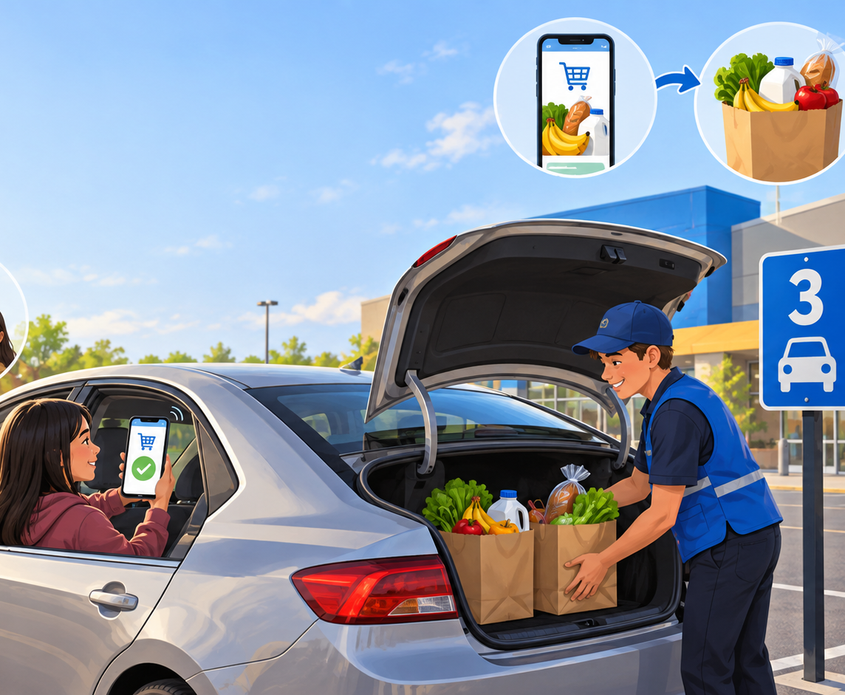
WEEK 1 RECAP · YOUR EXAMPLES
2 minutes
Marketing in the examples you gave us
Walmart pickup: a customer orders by phone, arrives at a pickup spot, and an employee loads the trunk.
With your group, point to two details in the image. What do those details help the business do for the customer?
POINT
JOT
TALK
Start with what you notice. Do not name a term yet.
Group roles: Reader names the detail. Connector says what it helps the customer do. Recorder writes two clues.
Notes:
Source: 09-23 transcript, student examples: Walmart phone ordering, pickup area, “pop your trunk,” convenience. Teacher move: plant feet at board, scan left-center-right, then say only the bold prompt. Wait 20 seconds before approaching groups. UDL: point, jot, or talk entry; group roles make the task predictable. Do not name functions yet.

Slide 2
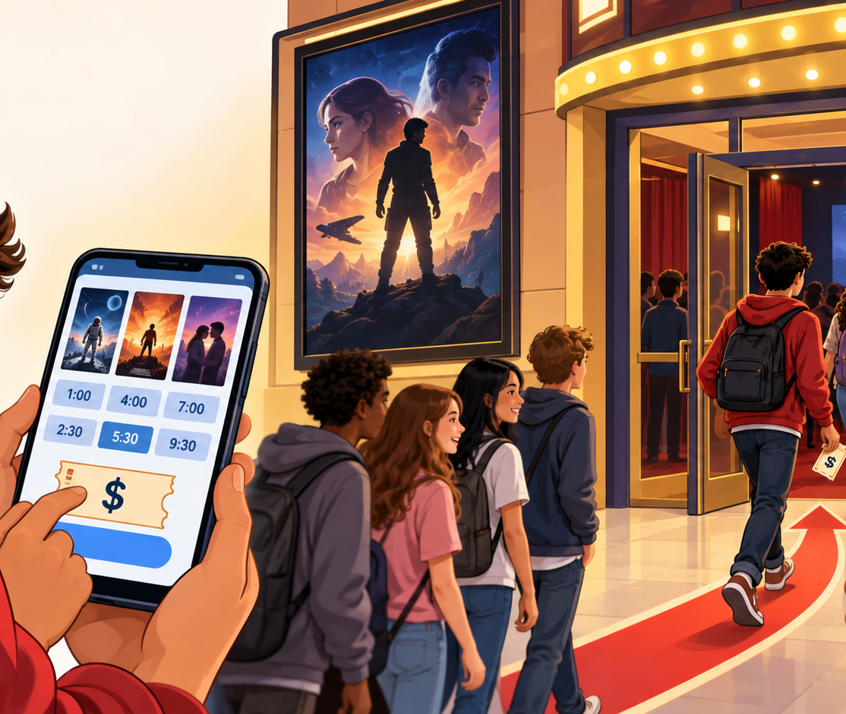
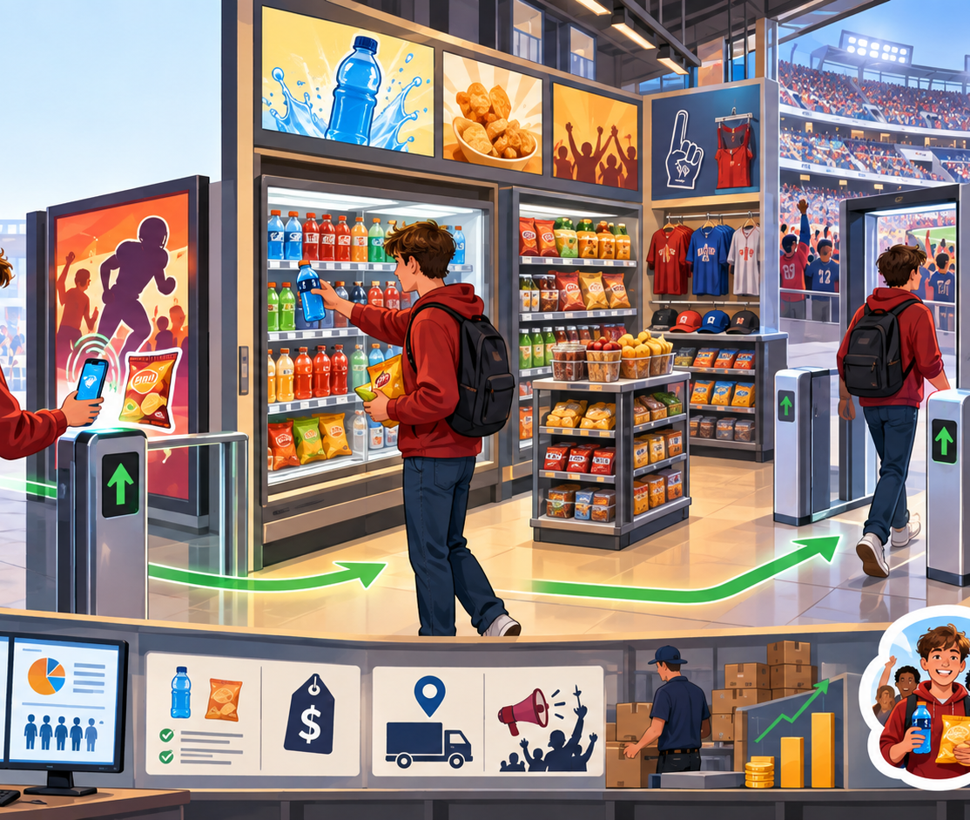
GROUP TASK · EVIDENCE, TERM, CUSTOMER
6 minutes
Choose one example
Your group must create one evidence sentence:
Movie showtimes OR stadium cashierless store
“We noticed ____. That could connect to ____ because it helps the customer ____.”
Word bank: product/service management · pricing · channel management · promotion · marketing information management · selling
Notes:
Source: 09-23 transcript. Student examples: movie theater showtimes and cashierless Blue Cross Arena style store. Exact definitions: channel management makes decisions about how, when, and where products travel; MIM gathers qualitative and quantitative data on wants and needs; product/service management uses feedback to adjust features; pricing considers cost and willingness/ability to buy; promotion sends messages; selling helps customers buy. Teacher move: point to only the word bank after groups have ideas. Assign groups: two terms maximum. Scan rather than pace. Say: “Use the picture as your evidence. You are allowed to be unsure between two terms.” UDL: shared sentence frame, word bank, team roles, private rehearsal before share.

Slide 3
SHARE + CONNECT · THE WEEK IN ONE EXPLANATION
4–6 minutes
The terms we are strengthening
Earlier this week
needs
wants
target market
market share
Marketing mix
product
price
place
promotion
Marketing concept
Satisfy customers’ needs and wants while making money.
Our team’s summary
“For ____, this business uses ____ to ____. That helps meet a customer need or want and helps the business make money.”
Share one sentence. Then listen for a different term another group used. Give a thumbs-up when you hear evidence that fits.
Notes:
Source: 09-23 transcript: “Satisfy the needs and wants of the customers to make money”; target markets are specific groups; market share is percentage of industry; Four Ps vocabulary. Share sequence: Call on one preselected/ready group. Ask class: “What evidence made that term fit?” Accept student language first, then connect to exact course term. Do not correct by replacing need with want or benefit. Close: “These examples show why marketers use the mix and the marketing functions: satisfy needs and wants while making money.” Teacher stance: one place near screen, scan as groups share. UDL: sentence frame, visual word chunks, oral or reader-selected sharing, and class signal response.

