Slide 1
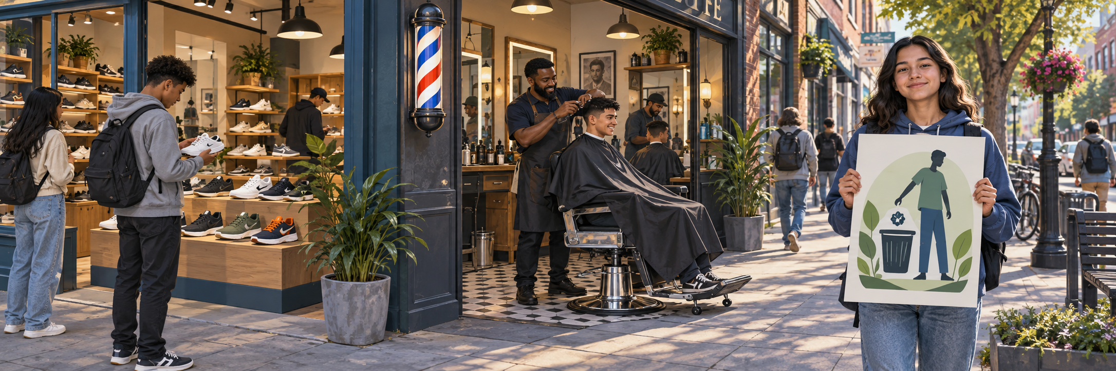
FRIDAY · NOTICE
3:00 TOTAL
What is being offered here?
A fictional neighborhood street. Look for three different offerings.
Notice the shoes, the haircut, and the message.
Chapter 1 p. 4; SBTE 4 LOOK QUIETLY · 20 seconds 1
Notes:
FRIDAY. Chapter 1 p. 4; SBTE 4. THREE-MINUTE MAXIMUM.
SEQUENCE: slide 13: whole scene, 20 seconds quiet noticing; slide 14: the same scene cropped into three details, 40 seconds choosing; slide 15: reveal after responses, 50 seconds checking and 50 seconds connecting to reading, 20 seconds buffer. No automatic countdown. Click-controlled appear/disappear effects.
SAY ON NOTICE: A fictional neighborhood street. Look for three different offerings. Notice the shoes, the haircut, and the message.
SAY ON CHOOSE: Which picture shows a GOOD? Read the three short labels once. Do not show the reveal before students respond.
FRIDAY SEPTEMBER 18: Retrieve goods, services, and ideas from Chapter 1 page 4. After this three-minute opener, resume the actual section stopping point and SBTE agenda. Do not skip outstanding reading or assume sections are aligned.
CLOSE: Different offerings. Different ways to meet a need.
READING TRANSITION: Check p. 4, then follow today’s class agenda. Resume the actual section stopping point, not the calendar alone.
ACCESS: Describe the scene without telling students the answer. Accept pointing, fingers, writing or a quiet response. No personal purchases, visits or financial disclosures required. SBTE takes attendance, scans responses and adds at most one clarification.
VISUAL SOURCE: Built-in image generation; fictional people and settings, not actual Eastridge students or facilities. Whole image first, exact source crops second, focused crop at reveal. Assets: ../assets/2026-09-21-to-25-visual-v3/whole-scenes/friday.png.
CLICK CUES: The whole scene and main question appear immediately. Give students a few seconds to notice. Click once for the supporting scenario text, then advance when ready.

Slide 2
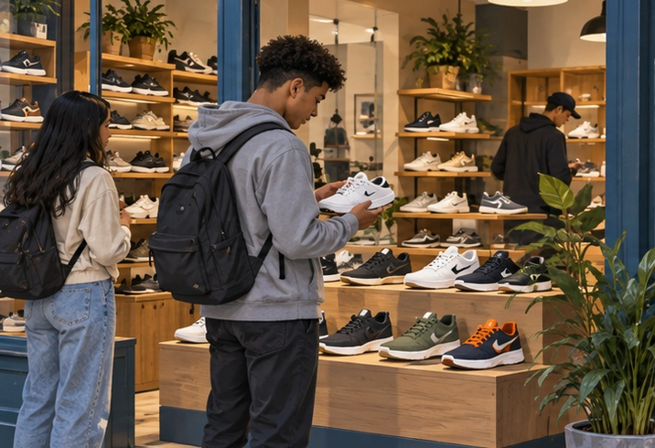
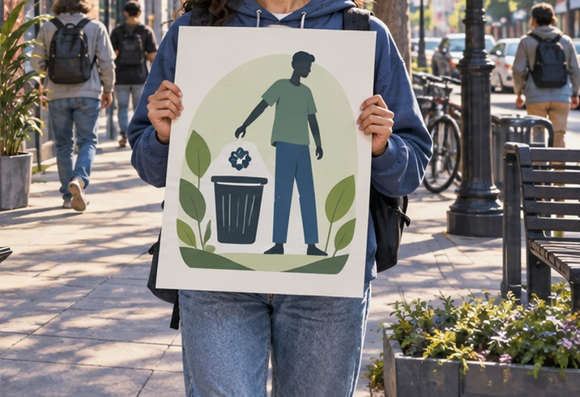
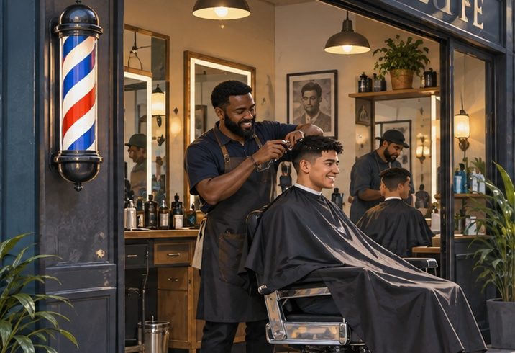
FRIDAY · CHOOSE
CHOOSE · 0:40
Which picture shows a GOOD?
Show its number. Then listen for the next category.
1 Sneakers for sale
3 “Keep our community clean”
2 A paid haircut
One question at a time. Point, show fingers, or write a number.
Chapter 1 p. 4 · SBTE 4 Point to the clue that supports your answer. 2
Notes:
FRIDAY. Chapter 1 p. 4; SBTE 4. THREE-MINUTE MAXIMUM.
SEQUENCE: slide 13: whole scene, 20 seconds quiet noticing; slide 14: the same scene cropped into three details, 40 seconds choosing; slide 15: reveal after responses, 50 seconds checking and 50 seconds connecting to reading, 20 seconds buffer. No automatic countdown. Click-controlled appear/disappear effects.
SAY ON NOTICE: A fictional neighborhood street. Look for three different offerings. Notice the shoes, the haircut, and the message.
SAY ON CHOOSE: Which picture shows a GOOD? Read the three short labels once. Do not show the reveal before students respond.
FRIDAY SEPTEMBER 18: Retrieve goods, services, and ideas from Chapter 1 page 4. After this three-minute opener, resume the actual section stopping point and SBTE agenda. Do not skip outstanding reading or assume sections are aligned.
CLOSE: Different offerings. Different ways to meet a need.
READING TRANSITION: Check p. 4, then follow today’s class agenda. Resume the actual section stopping point, not the calendar alone.
ACCESS: Describe the scene without telling students the answer. Accept pointing, fingers, writing or a quiet response. No personal purchases, visits or financial disclosures required. SBTE takes attendance, scans responses and adds at most one clarification.
VISUAL SOURCE: Built-in image generation; fictional people and settings, not actual Eastridge students or facilities. Whole image first, exact source crops second, focused crop at reveal. Assets: ../assets/2026-09-21-to-25-visual-v3/whole-scenes/friday.png.
CLICK CUES: Six clicks: picture 1, its label, replace with picture 2, its label, replace with picture 3, its label. Pause briefly on each picture. Invite a tentative choice as each appears; students may revise it. Read each label aloud. Use Back to revisit an earlier picture if needed. The next click advances to CHECK + CONNECT; do not advance until responses are collected.

Slide 3
FRIDAY · CHECK + CONNECT
REVEAL · 1:40
1 Good 2 Service 3 Idea
GOODS, SERVICES, AND IDEAS
Check p. 4, then follow today’s class agenda
Good: tangible item. Service: paid task. Idea: thought or opinion.
Different offerings. Different ways to meet a need.
Chapter 1 p. 4 · SBTE 4 Stop at 3:00 total. 3
Notes:
FRIDAY. Chapter 1 p. 4; SBTE 4. THREE-MINUTE MAXIMUM.
SEQUENCE: slide 13: whole scene, 20 seconds quiet noticing; slide 14: the same scene cropped into three details, 40 seconds choosing; slide 15: reveal after responses, 50 seconds checking and 50 seconds connecting to reading, 20 seconds buffer. No automatic countdown. Click-controlled appear/disappear effects.
SAY ON NOTICE: A fictional neighborhood street. Look for three different offerings. Notice the shoes, the haircut, and the message.
SAY ON CHOOSE: Which picture shows a GOOD? Read the three short labels once. Do not show the reveal before students respond.
FRIDAY SEPTEMBER 18: Retrieve goods, services, and ideas from Chapter 1 page 4. After this three-minute opener, resume the actual section stopping point and SBTE agenda. Do not skip outstanding reading or assume sections are aligned.
CLOSE: Different offerings. Different ways to meet a need.
READING TRANSITION: Check p. 4, then follow today’s class agenda. Resume the actual section stopping point, not the calendar alone.
ACCESS: Describe the scene without telling students the answer. Accept pointing, fingers, writing or a quiet response. No personal purchases, visits or financial disclosures required. SBTE takes attendance, scans responses and adds at most one clarification.
VISUAL SOURCE: Built-in image generation; fictional people and settings, not actual Eastridge students or facilities. Whole image first, exact source crops second, focused crop at reveal. Assets: ../assets/2026-09-21-to-25-visual-v3/whole-scenes/friday.png.
CLICK CUES: The focused image appears first. Click 1 reveals the answer and academic term. Click 2 reveals the reading cue and explanation. Click 3 reveals the one-line closer. Keep the full opener within three minutes.

