Slide 1
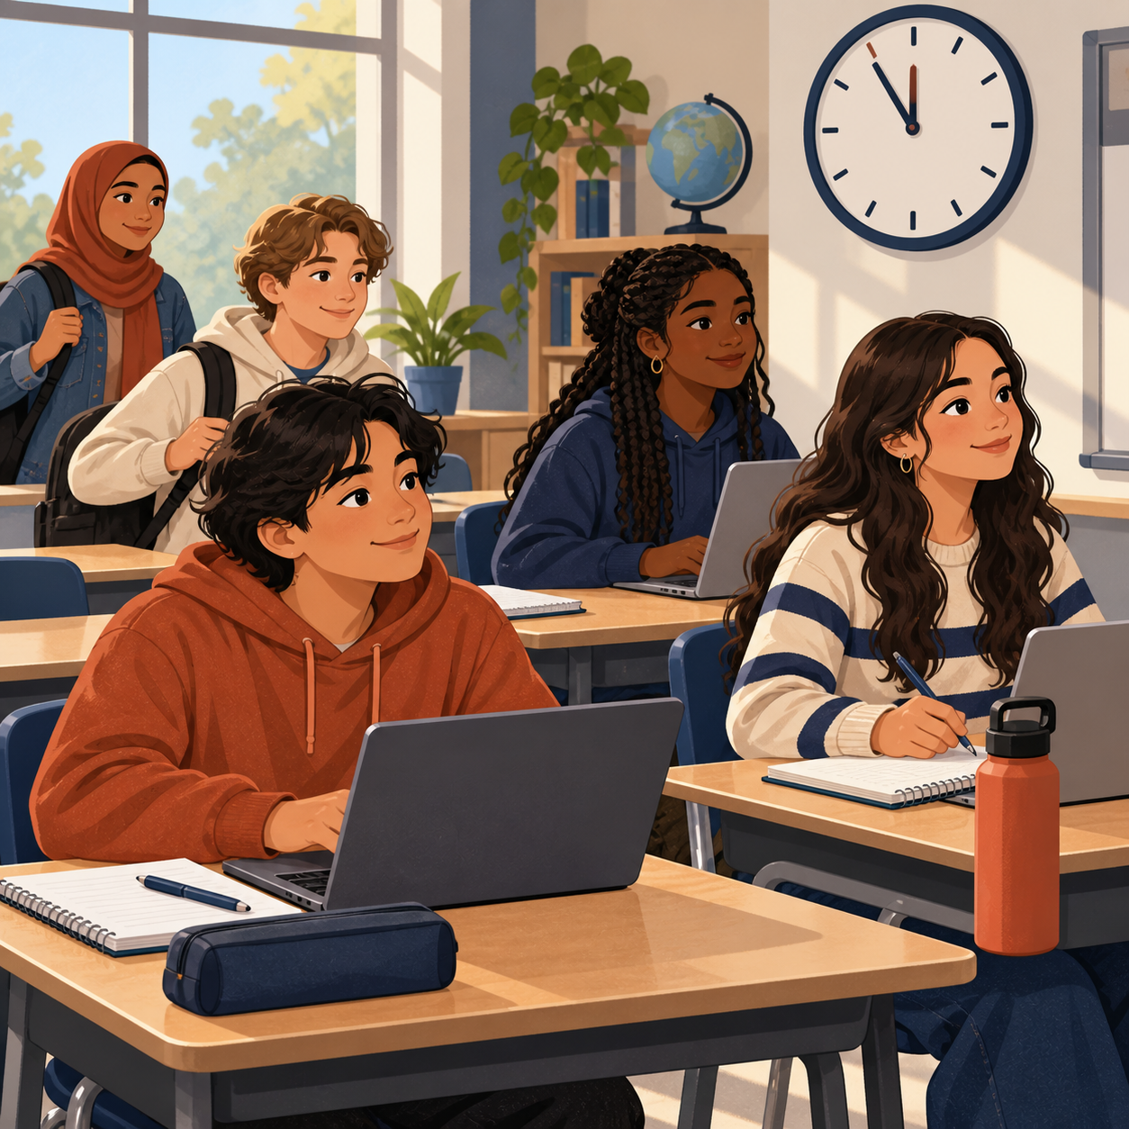

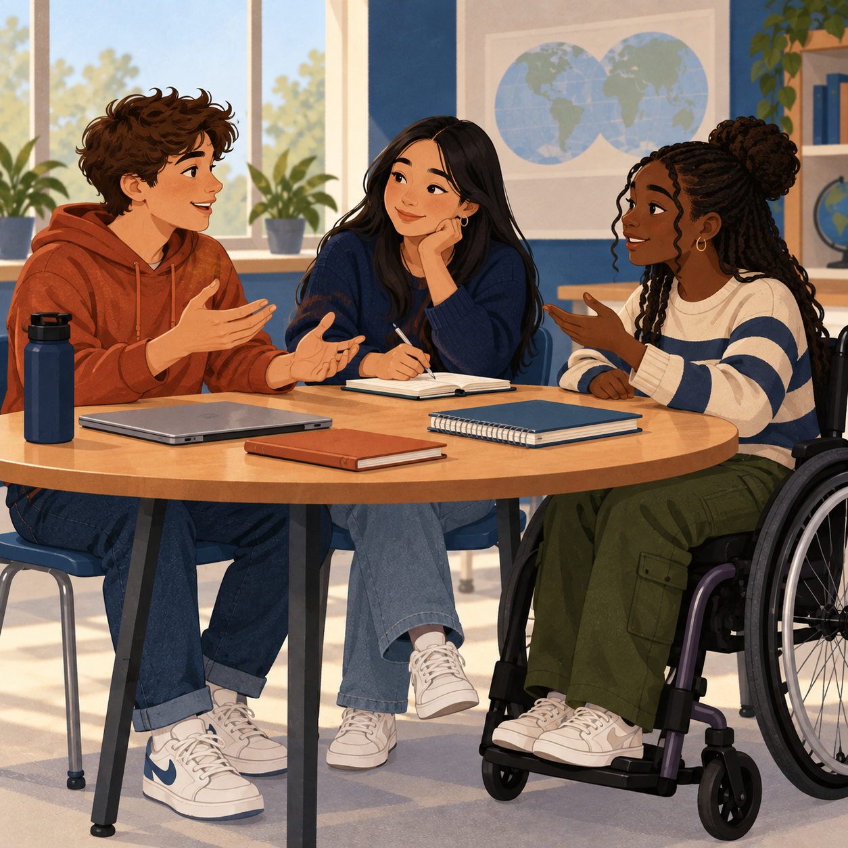
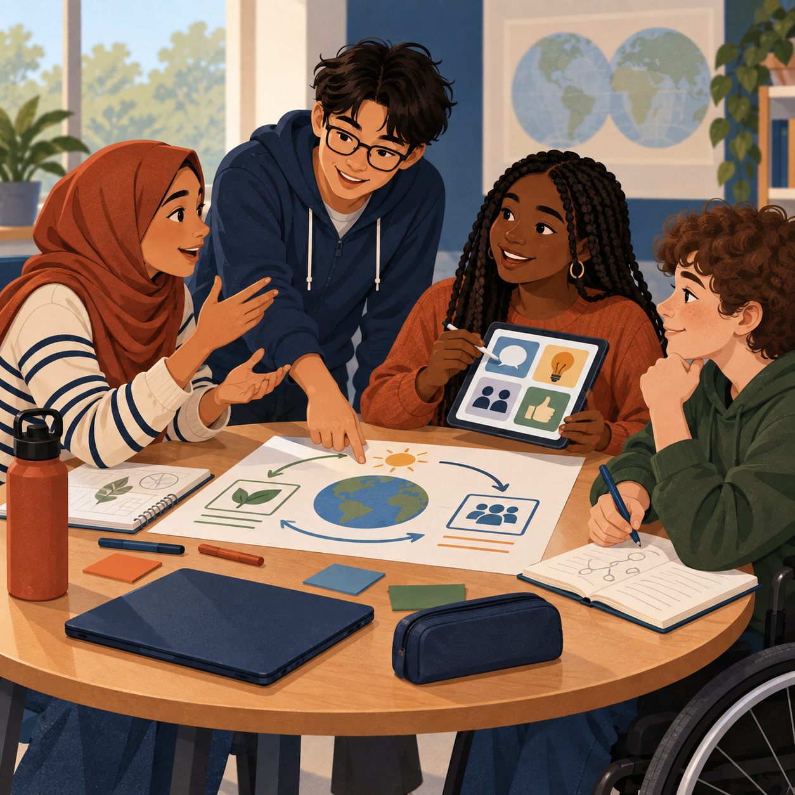
OUR SHARED COMMITMENT
BLOCK 4 CLASS NORMS
We created these norms together. Each picture and example shows what they can look like in class.
1
PUNCTUAL
Arrive on time with what you need to begin.
Student ideas: Organization, time management, discipline, reliability.
2
PRODUCTIVE
Stay focused and keep moving your work forward.
Student ideas: Willing to learn, problem-solver, independent, driven, initiative.
3
RESPECTFUL
Show patience and kindness in how you speak and act.
Student ideas: Emotional intelligence, patience, be nice, be respectful.
4
TEAMWORK & COMMUNICATION
Share ideas clearly and work toward a solution together.
Student ideas: Communication, teamwork, public speaking, bilingual, advocating.
Chosen by the students of Block 4
Words, examples, and pictures offer different ways to understand our agreement.
Notes:
Sources: 09-11 Lecture_ Classroom Professionalism and Course Management transcript; Planning_ Course Scheduling and Curriculum Outline transcript; Block 4 brainstorm photograph supplied 2026-09-11. The four norm labels and supporting student-idea words come from the class discussion and photographed brainstorm, polished only for length and readability. UDL design choices: each norm appears as a word, a plain-language action example, a student-generated keyword line, and an inclusive visual vignette. The poster uses high contrast, large sans-serif type, consistent order, and descriptive image alt text. The handwritten source photo informed the content but is intentionally not displayed.

