Slide 1
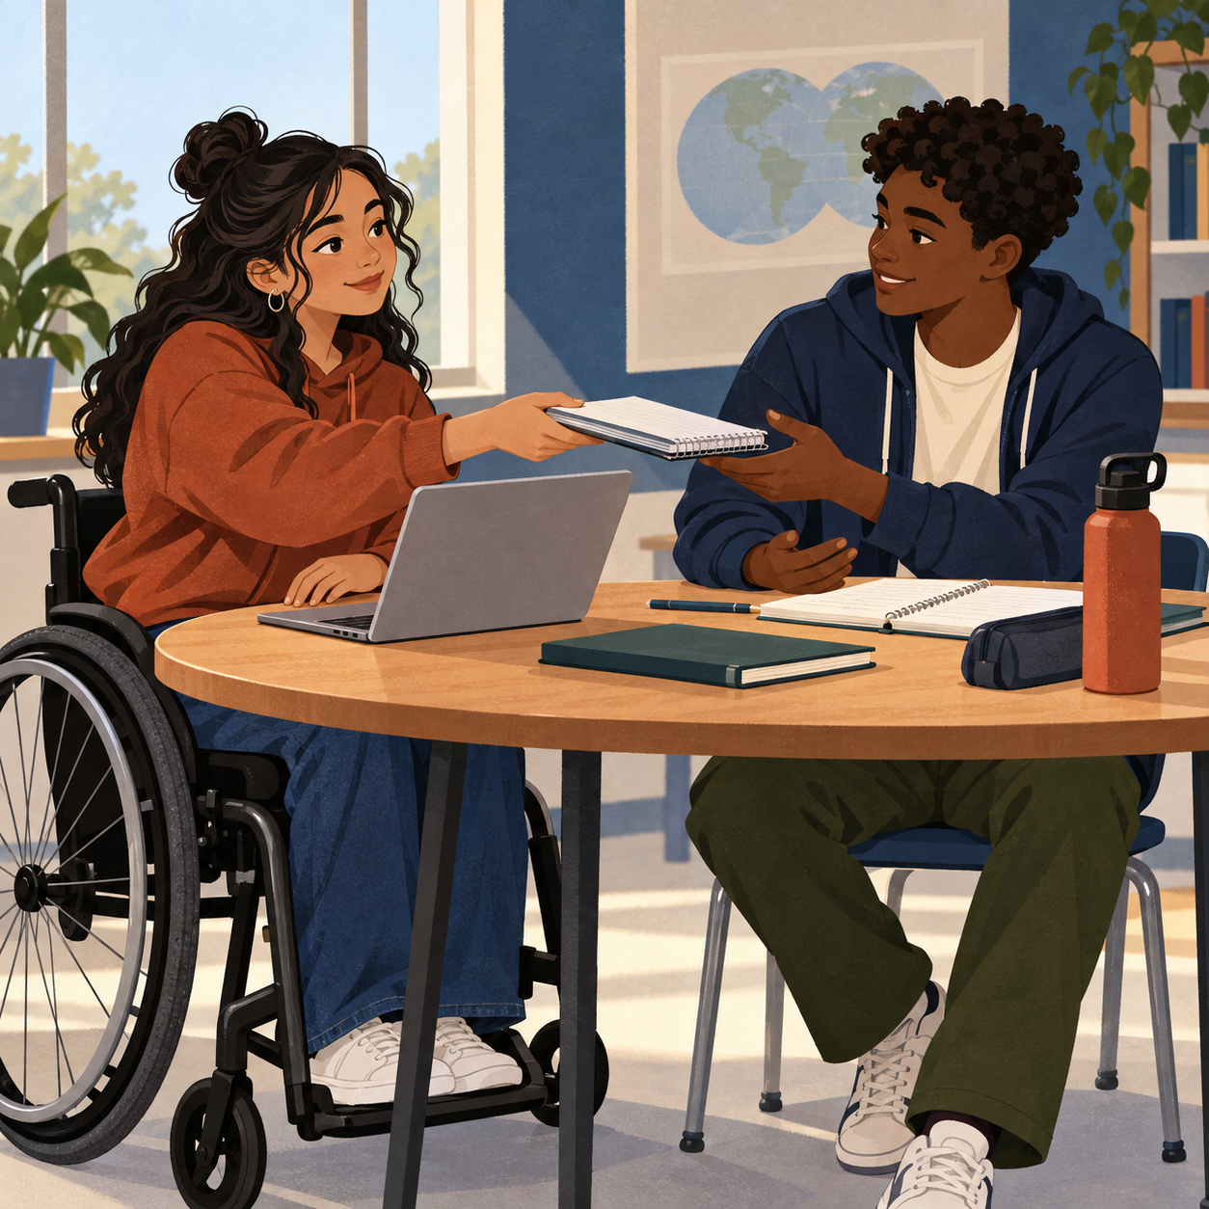
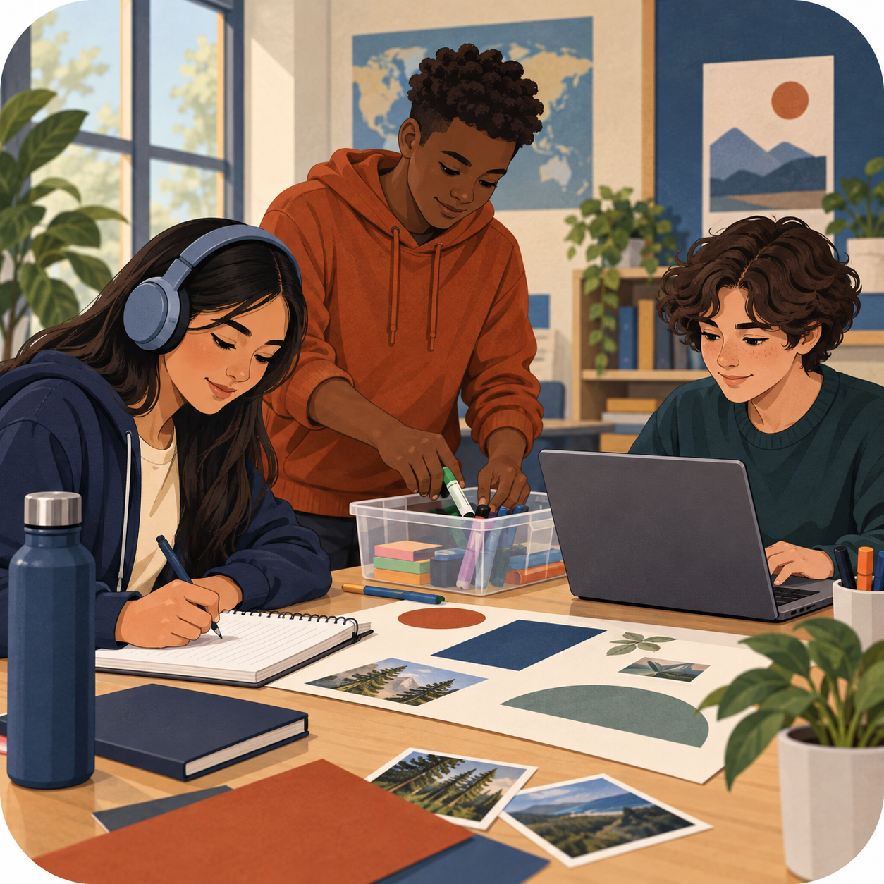
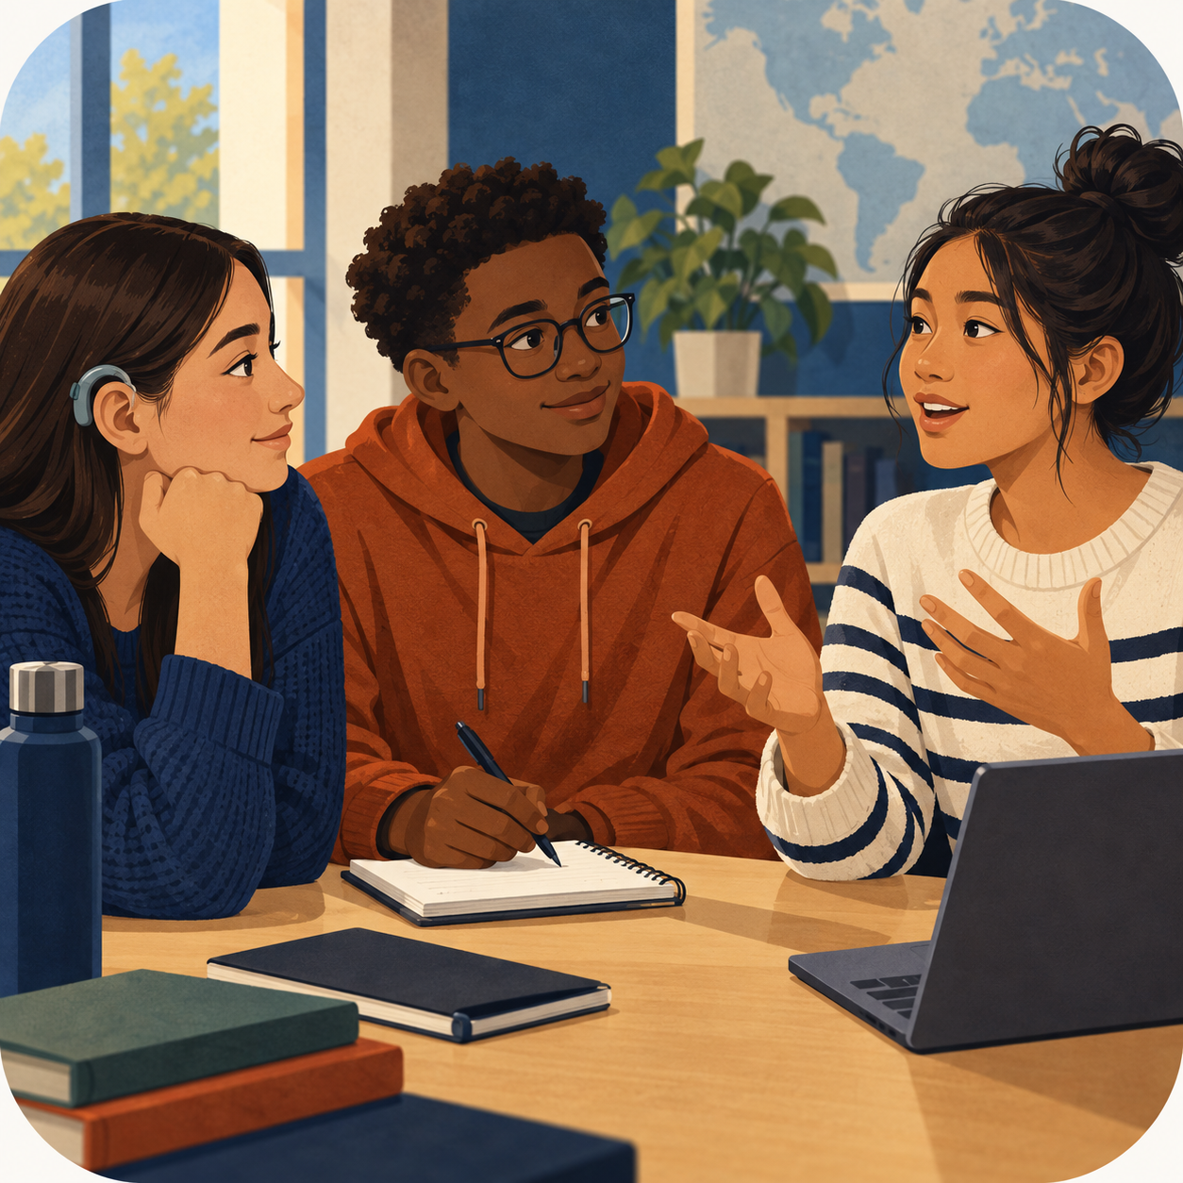
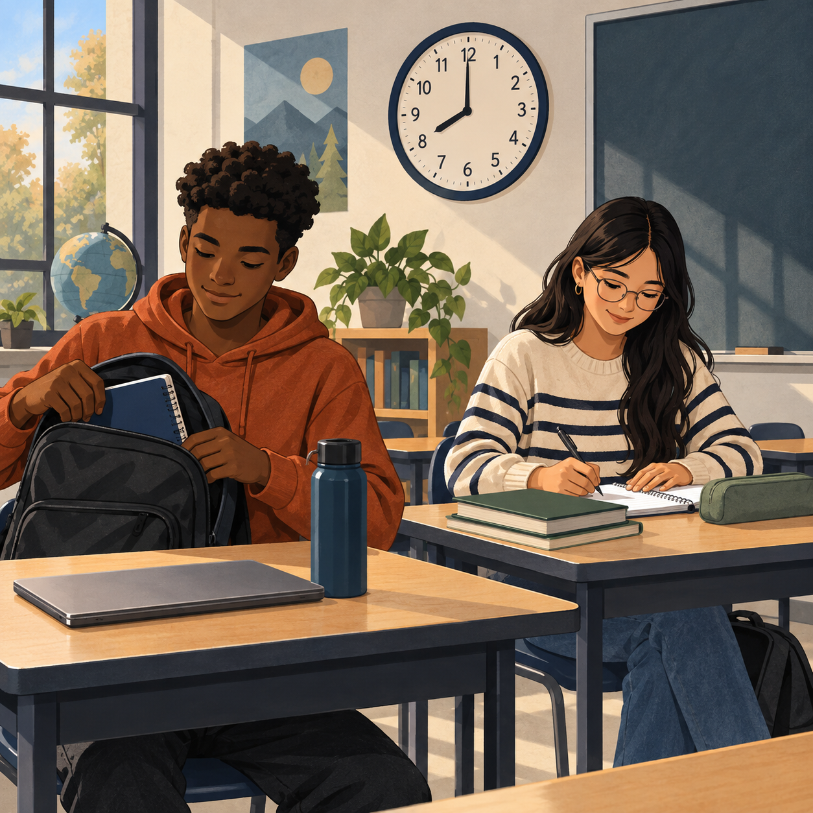
OUR SHARED COMMITMENT
BLOCK 1 CLASS NORMS
We created these norms together. Each picture and example shows what they can look like in class.
1
RESPECT
Treat people, ideas, and our shared space with care.
Student ideas: Being kind, self-control, advocate for self and others.
2
PRODUCTIVE
Use class time to do the work we agreed to do.
Student ideas: High effort, self-motivated, problem-solver, initiative.
3
ACTIVE LISTENING
Listen, participate, and respond to one another.
Student ideas: Communication, participation, teamwork, willingness to learn.
4
BE PUNCTUAL
Arrive ready and respect everyone’s time.
Student ideas: Time management, early or on time.
Chosen by the students of Block 1
Words, examples, and pictures offer different ways to understand our agreement.
Notes:
Sources: 09-11 Meeting_ School Opening, Classroom Norms, and Student Safety transcript, 01:25:19–01:30:47; Block 1 brainstorm photograph captured 2026-09-11. The four norm labels and supporting student-idea words come from the class discussion and photographed brainstorm, polished only for length and readability. UDL design choices: each norm appears as a word, a plain-language action example, a student-generated keyword line, and an inclusive visual vignette; the poster also uses high contrast, large sans-serif type, consistent order, and descriptive image alt text. The handwritten source photo informed the content but is intentionally not displayed.

