Slide 1

PRACTICAL MARKETING | PAGE 7
1 / 8 1 min
Phones, feedback, and access
SEND ME SFMOMA
Visitors text an emoji or phrase and receive a matching artwork.
NOTICE
What does the visitor do?
What becomes easier or more engaging?
Read, listen, or use the screen summary.
Quiet think time first. No personal disclosure is required.
Notes:
UDL representation: students may read page 7, listen to the teacher summary, or use the visible summary. Give 15 seconds of quiet processing before partner talk. Ask: What does the visitor do with the phone? What becomes easier? Source: Practical Marketing, p. 7.

Slide 2
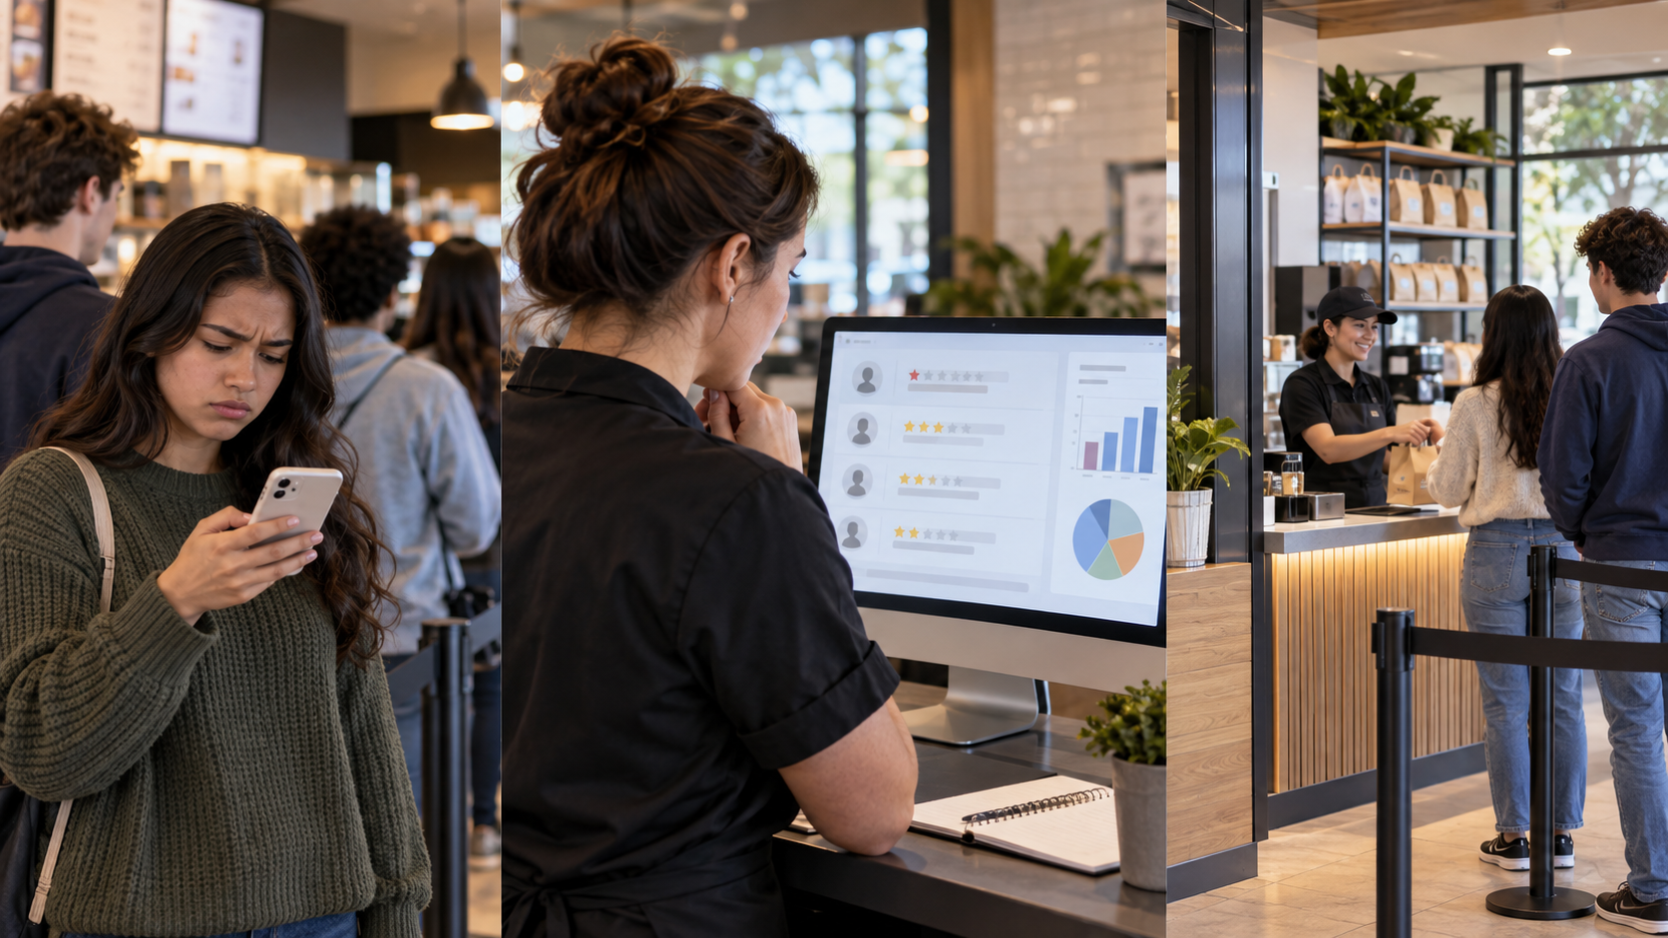
WORKED MODEL
A complete connection
PHONE USE
Visitors text an emoji and receive artwork that matches their interest.
1 Information management
The museum learns what visitors request.
2 Product/service management
The museum improves the digital experience.
Improvement: let visitors save favorites and revisit them later.
Listen for the pattern: phone use, customer need, two functions, one improvement.
Notes:
UDL representation and explicit instruction: model the finished response before independent work. Point to each part as you say it. Ask students to show one finger for phone use, two fingers for the two functions, and a thumb when they hear the improvement.

Slide 3
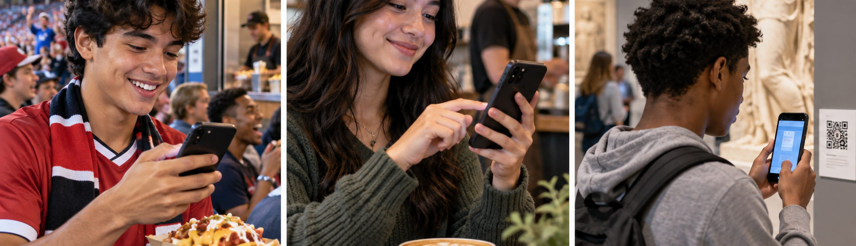
PARTNER CHOICE
3 / 8 1 min
Choose one company or customer experience
STADIUM
order or report
CAFÉ
rate or request
MUSEUM
scan or explore
Choose one of these or another school-appropriate example. Speak, point, or write your choice.
Decide in 30 seconds. If you disagree, use the first option that gets two votes.
Notes:
UDL engagement and action: students choose a familiar context and may contribute by speaking, pointing, or writing. Keep the decision controlled and fast. No device or research required.

Slide 4
SEVEN FUNCTIONS OF MARKETING
Pick exactly TWO functions
1
Information management
5
Promotion
collect and use customer information
communicate and build awareness
2
Product/service management
6
Selling
develop or improve the offer
help customers decide and purchase
3
Pricing
7
Financing
set what customers pay
fund the business or help customers pay
4
Channel management
make the offer available
Best fit test
Can you explain what the company would DO for each function?
Use the words on screen, your notes, or the teacher’s read-aloud.
Notes:
UDL representation: keep definitions visible and read them aloud once. Students may use the screen, their notes, or the read-aloud. Do not reteach all seven. Emphasize exactly two and the best-fit test.

Slide 5
PARTNER PLAN
5 / 8 1 min
Two functions, two jobs, one response
Choose TWO functions
Partner jobs
Function 1: ____________________
PARTNER A
Name the phone use and customer need.
The company would ____________________
Function 2: ____________________
PARTNER B
Name the two functions and improvement.
The company would ____________________
Both partners may speak, point, write, or read from prepared notes.
Notes:
UDL action and expression: assign predictable jobs while allowing flexible contribution modes. Partners can swap jobs. Late arrivals receive a brief from the partner before becoming the designated speaker.

Slide 6
BUILD THE RESPONSE
6 / 8 3 min
Connect the customer experience to two functions
1
Phone use
Customers use a phone to ________________________________.
2
Experience, barrier, or need
This helps the company understand ________________________.
3
Two marketing functions
The company uses ____________ and ____________.
4
Specific improvement
The company could _______________________________________.
Success check: two functions named, each function connected to an action, improvement is specific.
Use the full frame, keywords, or a quick sketch with labels.
Notes:
UDL action and expression: pairs may build the answer as a full sentence, keywords, or a labeled sketch. Circulate and check for exactly two functions and a concrete action for each. Prompt: What would the company actually do?

Slide 7
REHEARSE
7 / 8 1 min
Prepare a clear 30-second explanation
“Customers use their phones to ________. The company uses ________ and ________ to ________.”
Choose your sharing support
SAY IT
READ IT
SHARE IT
Speak from memory or use keywords.
Read the prepared sentence frame.
One partner points while the other speaks.
Partner check: Can a listener identify both functions?
Notes:
UDL action and expression: students select a controlled sharing support. The academic target stays constant. Late arrivals become speakers only after partner briefing and may read the prepared frame.

Slide 8
SHARE AND IDENTIFY
8 / 8 3–4 min
30 seconds per pair
SPEAKER
LISTENERS
1. Company or experience
2. Phone use or feedback
3. Exactly two functions
4. One specific improvement
Show what you heard
Say one function
Hold up its number
Point to it on the function list
If time ends, share with a neighboring pair so every pair participates.
Return to notes slides 12–13 and reading pages 13–14.
Notes:
UDL engagement and expression: listeners can respond orally, with a number, or by pointing. Keep a visible 30-second limit. Optional closing only if time remains: Which function begins the response, and which function supports it? Then return to notes slides 12–13 and reading pp. 13–14.

