Slide 1
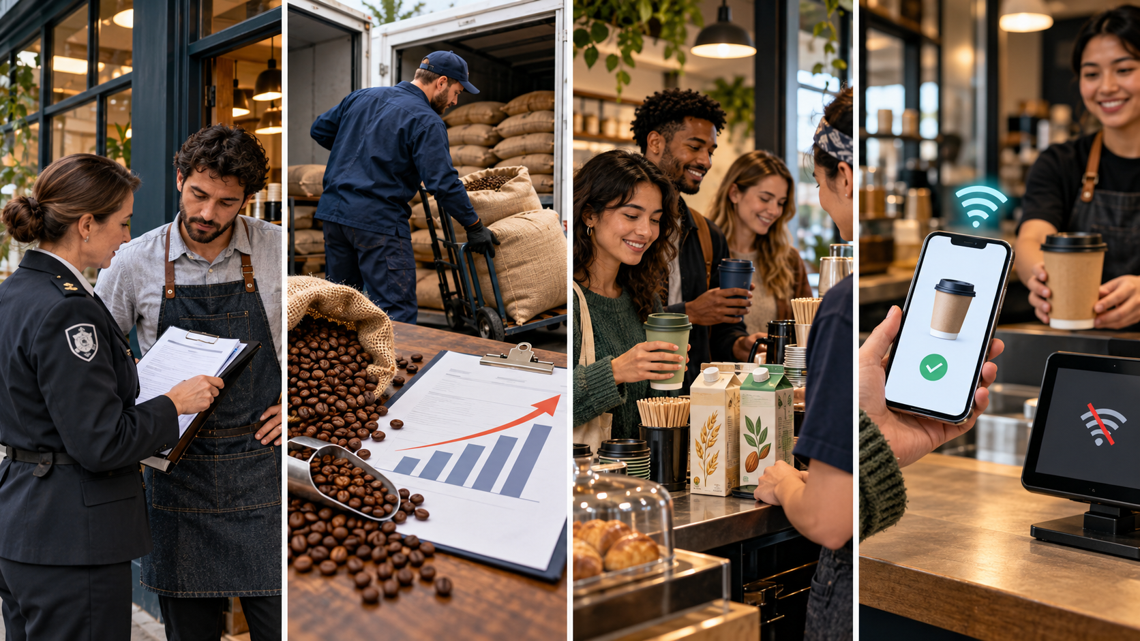
PEST analysis for your business
How could outside changes help or hurt your business?
Choose one business. Explain its opportunities and risks.
30 minutes
Notes:
SAY: “Today you will use PEST to explain how outside changes affect a business you choose.”
DO: Display the agenda, distribute the sheet, and identify the target.
CHECK: Students know that PEST concerns external influences, not the four Ps.
Source: Principles of Marketing, Chapter 2, printed pp.19–20, Figure2.1. Activity/timing: Piter reconstructed October13 notes and whiteboard reference. Grading descriptors: proposed for SBTE approval, not established school scoring policy. Images: generated hypothetical coffee-shop scenarios, not actual events.

Slide 2
Activity sequence
Instructions and grading: 3–5 min
Business and target market: 2 min
P / E / S / T: 3 min each = 12 min
Business summary: 5 min
Buffer and Terms to Know: 6–8 min
A 30-minute planning window
Notes:
SAY: “We will complete one PEST section at a time. I will tell you when to move.”
DO: Keep the introduction within five minutes, including the short model.
NOTE: 3–5 + 2 + 12 + 5 =22–24, leaving6–8minutes. If discussion runs longer, reduce buffer rather than claiming work finished.
Source: Principles of Marketing, Chapter 2, printed pp.19–20, Figure2.1. Activity/timing: Piter reconstructed October13 notes and whiteboard reference. Grading descriptors: proposed for SBTE approval, not established school scoring policy. Images: generated hypothetical coffee-shop scenarios, not actual events.

Slide 3
Proficiency and deeper reasoning
3 Proficient
Accurate PEST categories, relevant examples, + and − impacts explained in complete thoughts, and a clear business response.
4 Exceeds
Meets level 3 and independently explains a justified priority, trade-off, or connection between factors.
Proposed grading for SBTE review
Notes:
SAY: “A 3 shows complete, accurate application. A 4 explains a deeper decision and why it makes sense. More words alone do not earn a 4.”
CHECK WITH PAT: Confirm these descriptors and whether this is formative or graded before announcing them as final. No automatic averaging, bonuses, or conversion rules.
Source: Principles of Marketing, Chapter 2, printed pp.19–20, Figure2.1. Activity/timing: Piter reconstructed October13 notes and whiteboard reference. Grading descriptors: proposed for SBTE approval, not established school scoring policy. Images: generated hypothetical coffee-shop scenarios, not actual events.

Slide 4
Developing understanding
2 Developing
Some relevant ideas, but impacts or business connections are incomplete or unclear.
1 Initial
Limited relevant evidence so far; substantial support needed to explain the effects.
Use your textbook and notes. Ask for clarification.
Explain the impact, not just a keyword
Notes:
SAY: “Use business terms and explain because. A list of words does not yet show why a business is affected.”
DO: Read directions aloud and accept a spoken rehearsal before writing.
ASSESS: Understanding, not spelling, handwriting, accent, speed, or decorative work. Access support alone never reduces a level. Insufficient evidence is separate from level1; confirm IE and overall-score handling with Pat.
Source: Principles of Marketing, Chapter 2, printed pp.19–20, Figure2.1. Activity/timing: Piter reconstructed October13 notes and whiteboard reference. Grading descriptors: proposed for SBTE approval, not established school scoring policy. Images: generated hypothetical coffee-shop scenarios, not actual events.

Slide 5
One hypothetical example
A coffee shop faces stricter food-safety rules.
Which PEST category fits?
What could help the business?
What could create a difficulty?
Think first; answers appear on the next clicks
Notes:
SAY: “What changed outside the business? Which letter fits? What could be positive and negative for this shop?”
DO: Wait5–10seconds; invite a spoken or written response. Do not pre-answer students’ own chosen businesses.
Source: Principles of Marketing, Chapter 2, printed pp.19–20, Figure2.1. Activity/timing: Piter reconstructed October13 notes and whiteboard reference. Grading descriptors: proposed for SBTE approval, not established school scoring policy. Images: generated hypothetical coffee-shop scenarios, not actual events.

Slide 6
Political influence
Stricter food-safety rules
+ Customers may trust a shop that demonstrates compliance.
− What possible cost could the shop face?
First reveal: category and positive impact
Notes:
SAY: “The factor is government regulation. One possible positive impact is customer trust. What might the cost be?”
DO: Pause before the next click. Explain these are possible consequences, not guarantees.
Source: Principles of Marketing, Chapter 2, printed pp.19–20, Figure2.1. Activity/timing: Piter reconstructed October13 notes and whiteboard reference. Grading descriptors: proposed for SBTE approval, not established school scoring policy. Images: generated hypothetical coffee-shop scenarios, not actual events.

Slide 7
Political influence
Stricter food-safety rules
+ Compliance may strengthen customer trust.
− Training and equipment may increase operating costs.
Second reveal: negative impact
Notes:
SAY: “The same external change can create an opportunity and a cost. Your example must explain why.”
DO: Model only this one factor, then let students apply the other categories.
RESPONSE: The shop could train staff and plan for compliance costs. This is an internal response to an external factor.
Source: Principles of Marketing, Chapter 2, printed pp.19–20, Figure2.1. Activity/timing: Piter reconstructed October13 notes and whiteboard reference. Grading descriptors: proposed for SBTE approval, not established school scoring policy. Images: generated hypothetical coffee-shop scenarios, not actual events.

Slide 8
Business and target market
Write your business name.
Who is the business trying to serve?
Use a real or realistic business you can explain.
2 minutes
Notes:
SAY: “Choose a business you understand and name its target market. Who buys from it, and what do they want?”
DO: Start2min timer. If stuck, offer a familiar business category such as a cafe, shoe shop, or digital-book service.
CHECK: Business and target market both recorded.
Source: Principles of Marketing, Chapter 2, printed pp.19–20, Figure2.1. Activity/timing: Piter reconstructed October13 notes and whiteboard reference. Grading descriptors: proposed for SBTE approval, not established school scoring policy. Images: generated hypothetical coffee-shop scenarios, not actual events.

Slide 9
P Political
Government policies, laws, or intervention
What outside rule or policy could affect this business?
Example/factor
+ Positive impact and why
− Negative impact and why
3 minutes
Notes:
SAY: “What outside rule or policy could affect this business? Give a connected example and explain both possible impacts.”
DO: Read the category cue, start3min, stand at a deliberate scan point.
LISTEN FOR: External factor, category fit, effect on this business or target market, because reasoning.
IF WEAK: Ask “What changed outside the business? What happens to costs, customers, or access?” Model a question, not their answer.
IF STRONG: Ask which impact matters most and why.
CHECK: Do not classify the business’s own ad, discount, or new app decision as the external factor.
Source: Principles of Marketing, Chapter 2, printed pp.19–20, Figure2.1. Activity/timing: Piter reconstructed October13 notes and whiteboard reference. Grading descriptors: proposed for SBTE approval, not established school scoring policy. Images: generated hypothetical coffee-shop scenarios, not actual events.

Slide 10
E Economic
Inflation, consumer income, exchange rates, or credit
What outside economic change could affect costs or demand?
Example/factor
+ Positive impact and why
− Negative impact and why
3 minutes
Notes:
SAY: “What outside economic change could affect costs or demand? Give a connected example and explain both possible impacts.”
DO: Read the category cue, start3min, stand at a deliberate scan point.
LISTEN FOR: External factor, category fit, effect on this business or target market, because reasoning.
IF WEAK: Ask “What changed outside the business? What happens to costs, customers, or access?” Model a question, not their answer.
IF STRONG: Ask which impact matters most and why.
CHECK: Do not classify the business’s own ad, discount, or new app decision as the external factor.
Source: Principles of Marketing, Chapter 2, printed pp.19–20, Figure2.1. Activity/timing: Piter reconstructed October13 notes and whiteboard reference. Grading descriptors: proposed for SBTE approval, not established school scoring policy. Images: generated hypothetical coffee-shop scenarios, not actual events.

Slide 11
S Social
Population, education, social patterns, or preferences
What change in the customers or community could affect demand?
Example/factor
+ Positive impact and why
− Negative impact and why
3 minutes
Notes:
SAY: “What change in the customers or community could affect demand? Give a connected example and explain both possible impacts.”
DO: Read the category cue, start3min, stand at a deliberate scan point.
LISTEN FOR: External factor, category fit, effect on this business or target market, because reasoning.
IF WEAK: Ask “What changed outside the business? What happens to costs, customers, or access?” Model a question, not their answer.
IF STRONG: Ask which impact matters most and why.
CHECK: Do not classify the business’s own ad, discount, or new app decision as the external factor.
Source: Principles of Marketing, Chapter 2, printed pp.19–20, Figure2.1. Activity/timing: Piter reconstructed October13 notes and whiteboard reference. Grading descriptors: proposed for SBTE approval, not established school scoring policy. Images: generated hypothetical coffee-shop scenarios, not actual events.

Slide 12
T Technological
Access to technology or the rate of technological change
What outside technology change could affect access, service, or competition?
Example/factor
+ Positive impact and why
− Negative impact and why
3 minutes
Notes:
SAY: “What outside technology change could affect access, service, or competition? Give a connected example and explain both possible impacts.”
DO: Read the category cue, start3min, stand at a deliberate scan point.
LISTEN FOR: External factor, category fit, effect on this business or target market, because reasoning.
IF WEAK: Ask “What changed outside the business? What happens to costs, customers, or access?” Model a question, not their answer.
IF STRONG: Ask which impact matters most and why.
CHECK: Do not classify the business’s own ad, discount, or new app decision as the external factor.
Source: Principles of Marketing, Chapter 2, printed pp.19–20, Figure2.1. Activity/timing: Piter reconstructed October13 notes and whiteboard reference. Grading descriptors: proposed for SBTE approval, not established school scoring policy. Images: generated hypothetical coffee-shop scenarios, not actual events.

Slide 13
Business summary
How could your PEST findings affect the business’s potential success?
How would the business use a positive impact?
How would it respond to a negative impact?
Explain the reason for each response.
5 minutes
Notes:
SAY: “Connect the analysis to a business decision. Which opportunity would you use? Which risk would you address? Why?”
DO: Invite2–4complete sentences as a planning guide, not a scored word count. Students may orally rehearse first.
CHECK: Responses follow from their own factors, not generic advice.
EXTEND: Compare priorities or two interacting factors and justify a trade-off.
Source: Principles of Marketing, Chapter 2, printed pp.19–20, Figure2.1. Activity/timing: Piter reconstructed October13 notes and whiteboard reference. Grading descriptors: proposed for SBTE approval, not established school scoring policy. Images: generated hypothetical coffee-shop scenarios, not actual events.

Slide 14
Completion check and Terms to Know
Business and target market
All four PEST sections
Connected examples and explained + / − impacts
Summary with business responses
Then practise Terms to Know for Thursday’s quiz.
Remaining 6–8 minutes
Notes:
SAY: “Check each section. Circle a place where you explained why. Use remaining time to practise the approved Terms to Know.”
DO: Record separate Block1 and Block5 stops.
OPEN: Confirm quiz scope, collection route, individual/pair arrangement, and grading with Pat. Do not invent a deadline.
RECORD: Block1 stop/support needed __ ; Block5 stop/support needed __.
Source: Principles of Marketing, Chapter 2, printed pp.19–20, Figure2.1. Activity/timing: Piter reconstructed October13 notes and whiteboard reference. Grading descriptors: proposed for SBTE approval, not established school scoring policy. Images: generated hypothetical coffee-shop scenarios, not actual events.

