Slide 1
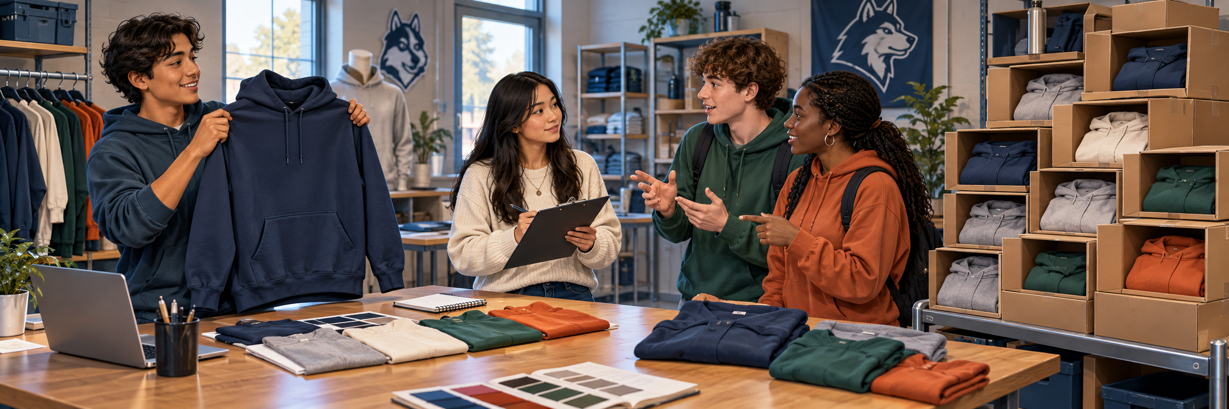
MONDAY · NOTICE
3:00 TOTAL
Would this hoodie work for everyone?
A fictional school-spirit shop is choosing its next hoodie.
What should the shop do first? Think before choosing.
Chapter 1 pp. 10–11; SBTE 9 LOOK QUIETLY · 20 seconds 1
Notes:
MONDAY. Chapter 1 pp. 10–11; SBTE 9. THREE-MINUTE MAXIMUM.
SEQUENCE: slide 1: whole scene, 20 seconds quiet noticing; slide 2: the same scene cropped into three details, 40 seconds choosing; slide 3: reveal after responses, 50 seconds checking and 50 seconds connecting to reading, 20 seconds buffer. No automatic countdown. Click-controlled appear/disappear effects.
SAY ON NOTICE: A fictional school-spirit shop is choosing its next hoodie. What should the shop do first? Think before choosing.
SAY ON CHOOSE: What should the shop do FIRST? Read the three short labels once. Do not show the reveal before students respond.
ANSWER AND EXPLANATION: B. Ask likely buyers about their wants and needs before selecting the next hoodie. The scene illustrates possible decisions; it does not mean all three have already happened.
CLOSE: Customer evidence helps a business choose.
READING TRANSITION: Open p. 10: “The Purpose of Marketing”. Resume the actual section stopping point, not the calendar alone.
ACCESS: Describe the scene without telling students the answer. Accept pointing, fingers, writing or a quiet response. No personal purchases, visits or financial disclosures required. SBTE takes attendance, scans responses and adds at most one clarification.
VISUAL SOURCE: Built-in image generation; fictional people and settings, not actual Eastridge students or facilities. Whole image first, exact source crops second, focused crop at reveal. Assets: ../assets/2026-09-21-to-25-visual-v3/whole-scenes/monday.png.
FOLLOW-UP 1 (optional, choose at most one): What could the shop ask about the hoodie?
FOLLOW-UP 2: How could that answer change what it sells?
CLICK CUES: The whole scene and main question appear immediately. Give students a few seconds to notice. Click once for the supporting scenario text, then advance when ready.

Slide 2
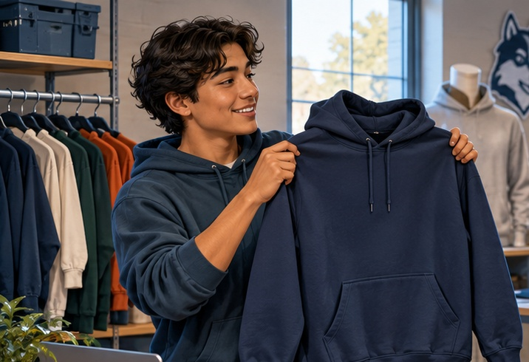
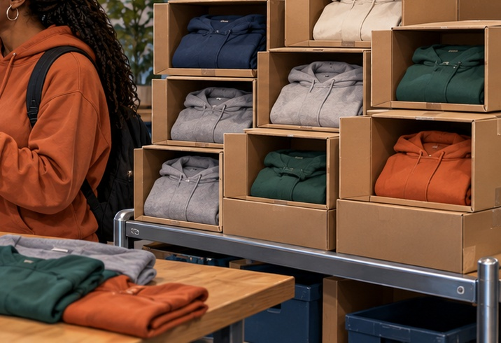
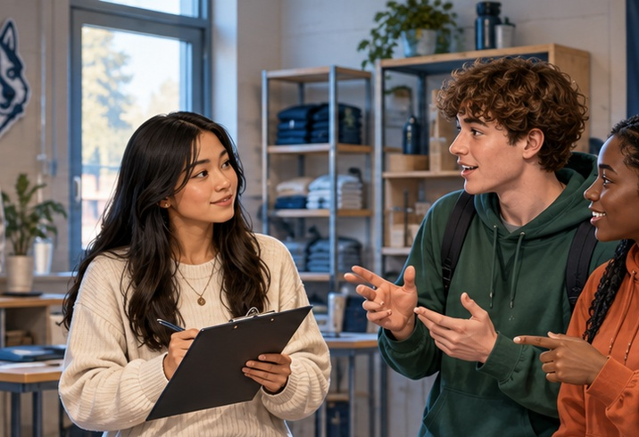
MONDAY · CHOOSE
CHOOSE · 0:40
What should the shop do FIRST?
Choose one. Point, show fingers, write, or answer quietly.
A Pick our favorite
C Order a huge batch
B Ask likely buyers
Choose first. Be ready to give one reason.
pp. 10–11 · SBTE 9 Point to the clue that supports your answer. 2
Notes:
MONDAY. Chapter 1 pp. 10–11; SBTE 9. THREE-MINUTE MAXIMUM.
SEQUENCE: slide 1: whole scene, 20 seconds quiet noticing; slide 2: the same scene cropped into three details, 40 seconds choosing; slide 3: reveal after responses, 50 seconds checking and 50 seconds connecting to reading, 20 seconds buffer. No automatic countdown. Click-controlled appear/disappear effects.
SAY ON NOTICE: A fictional school-spirit shop is choosing its next hoodie. What should the shop do first? Think before choosing.
SAY ON CHOOSE: What should the shop do FIRST? Read the three short labels once. Do not show the reveal before students respond.
ANSWER AND EXPLANATION: B. Ask likely buyers about their wants and needs before selecting the next hoodie. The scene illustrates possible decisions; it does not mean all three have already happened.
CLOSE: Customer evidence helps a business choose.
READING TRANSITION: Open p. 10: “The Purpose of Marketing”. Resume the actual section stopping point, not the calendar alone.
ACCESS: Describe the scene without telling students the answer. Accept pointing, fingers, writing or a quiet response. No personal purchases, visits or financial disclosures required. SBTE takes attendance, scans responses and adds at most one clarification.
VISUAL SOURCE: Built-in image generation; fictional people and settings, not actual Eastridge students or facilities. Whole image first, exact source crops second, focused crop at reveal. Assets: ../assets/2026-09-21-to-25-visual-v3/whole-scenes/monday.png.
FOLLOW-UP 1 (optional, choose at most one): What could the shop ask about the hoodie?
FOLLOW-UP 2: How could that answer change what it sells?
CLICK CUES: Six clicks: picture 1, its label, replace with picture 2, its label, replace with picture 3, its label. Pause briefly on each picture. Invite a tentative choice as each appears; students may revise it. Read each label aloud. Use Back to revisit an earlier picture if needed. The next click advances to CHECK + CONNECT; do not advance until responses are collected.

Slide 3
MONDAY · CHECK + CONNECT
REVEAL · 1:40
B Ask likely buyers
MARKETING CONCEPT
Open p. 10: “The Purpose of Marketing”
Customer needs guide company goals and profit decisions.
Customer evidence helps a business choose.
pp. 10–11 · SBTE 9 Stop at 3:00 total. 3
Notes:
MONDAY. Chapter 1 pp. 10–11; SBTE 9. THREE-MINUTE MAXIMUM.
SEQUENCE: slide 1: whole scene, 20 seconds quiet noticing; slide 2: the same scene cropped into three details, 40 seconds choosing; slide 3: reveal after responses, 50 seconds checking and 50 seconds connecting to reading, 20 seconds buffer. No automatic countdown. Click-controlled appear/disappear effects.
SAY ON NOTICE: A fictional school-spirit shop is choosing its next hoodie. What should the shop do first? Think before choosing.
SAY ON CHOOSE: What should the shop do FIRST? Read the three short labels once. Do not show the reveal before students respond.
ANSWER AND EXPLANATION: B. Ask likely buyers about their wants and needs before selecting the next hoodie. The scene illustrates possible decisions; it does not mean all three have already happened.
CLOSE: Customer evidence helps a business choose.
READING TRANSITION: Open p. 10: “The Purpose of Marketing”. Resume the actual section stopping point, not the calendar alone.
ACCESS: Describe the scene without telling students the answer. Accept pointing, fingers, writing or a quiet response. No personal purchases, visits or financial disclosures required. SBTE takes attendance, scans responses and adds at most one clarification.
VISUAL SOURCE: Built-in image generation; fictional people and settings, not actual Eastridge students or facilities. Whole image first, exact source crops second, focused crop at reveal. Assets: ../assets/2026-09-21-to-25-visual-v3/whole-scenes/monday.png.
FOLLOW-UP 1 (optional, choose at most one): What could the shop ask about the hoodie?
FOLLOW-UP 2: How could that answer change what it sells?
CLICK CUES: The focused image appears first. Click 1 reveals the answer and academic term. Click 2 reveals the reading cue and explanation. Click 3 reveals the one-line closer. Keep the full opener within three minutes.

