Slide 1
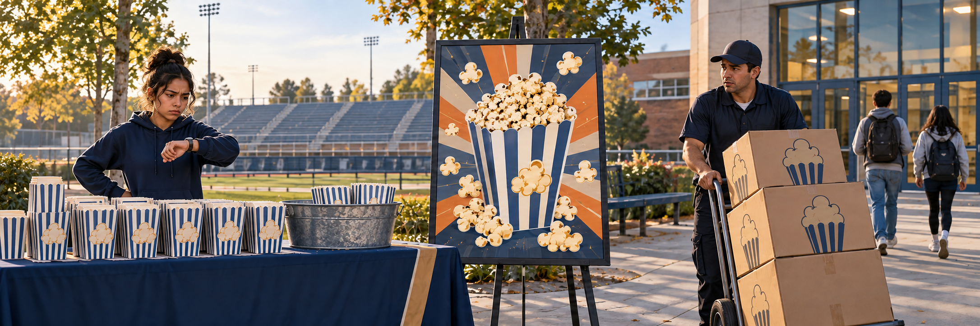
TUESDAY · NOTICE
3:00 TOTAL
Ordered ahead. Delivered too late.
The club ordered popcorn early. It arrived after the game.
What should the seller fix for the next game?
Chapter 1 pp. 11–12; SBTE 10 LOOK QUIETLY · 20 seconds 4
Notes:
TUESDAY. Chapter 1 pp. 11–12; SBTE 10. THREE-MINUTE MAXIMUM.
SEQUENCE: slide 4: whole scene, 20 seconds quiet noticing; slide 5: the same scene cropped into three details, 40 seconds choosing; slide 6: reveal after responses, 50 seconds checking and 50 seconds connecting to reading, 20 seconds buffer. No automatic countdown. Click-controlled appear/disappear effects.
SAY ON NOTICE: The club ordered popcorn early. It arrived after the game. What should the seller fix for the next game?
SAY ON CHOOSE: Which change solves the late-delivery problem? Read the three short labels once. Do not show the reveal before students respond.
ANSWER AND EXPLANATION: C. Fix delivery timing. Point to the empty cups, disappointed seller, concerned driver, departing customers and empty seats. The popcorn in the center is a picture on an unused advertisement, not food already sold. The right crop shows the problem to fix, not successful delivery.
CLOSE: A product must reach customers at the right time.
READING TRANSITION: Open pp. 11–12: “Marketing Mix”. Resume the actual section stopping point, not the calendar alone.
ACCESS: Describe the scene without telling students the answer. Accept pointing, fingers, writing or a quiet response. No personal purchases, visits or financial disclosures required. SBTE takes attendance, scans responses and adds at most one clarification.
VISUAL SOURCE: Built-in image generation; fictional people and settings, not actual Eastridge students or facilities. Whole image first, exact source crops second, focused crop at reveal. Assets: ../assets/2026-09-21-to-25-visual-v3/whole-scenes/tuesday.png.
CLICK CUES: The whole scene and main question appear immediately. Give students a few seconds to notice. Click once for the supporting scenario text, then advance when ready.

Slide 2
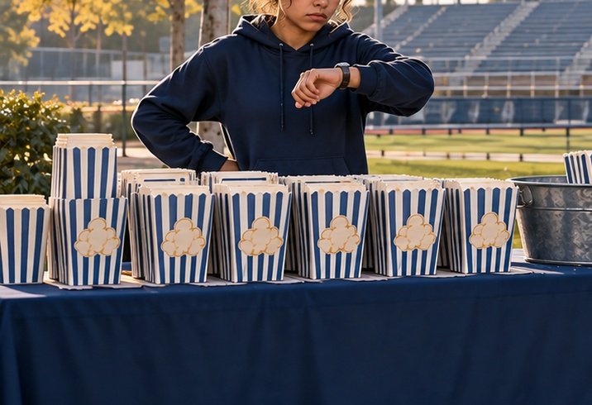

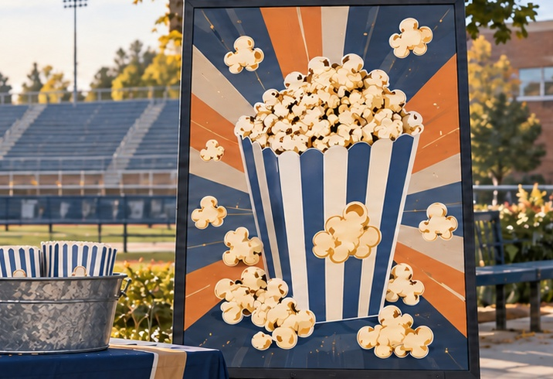
TUESDAY · CHOOSE
CHOOSE · 0:40
Which change solves the late-delivery problem?
Choose one. Point, show fingers, write, or answer quietly.
A Change the packaging
C Change delivery timing
B Make a bigger ad
Choose first. Be ready to give one reason.
pp. 11–12 · SBTE 10 Point to the clue that supports your answer. 5
Notes:
TUESDAY. Chapter 1 pp. 11–12; SBTE 10. THREE-MINUTE MAXIMUM.
SEQUENCE: slide 4: whole scene, 20 seconds quiet noticing; slide 5: the same scene cropped into three details, 40 seconds choosing; slide 6: reveal after responses, 50 seconds checking and 50 seconds connecting to reading, 20 seconds buffer. No automatic countdown. Click-controlled appear/disappear effects.
SAY ON NOTICE: The club ordered popcorn early. It arrived after the game. What should the seller fix for the next game?
SAY ON CHOOSE: Which change solves the late-delivery problem? Read the three short labels once. Do not show the reveal before students respond.
ANSWER AND EXPLANATION: C. Fix delivery timing. Point to the empty cups, disappointed seller, concerned driver, departing customers and empty seats. The popcorn in the center is a picture on an unused advertisement, not food already sold. The right crop shows the problem to fix, not successful delivery.
CLOSE: A product must reach customers at the right time.
READING TRANSITION: Open pp. 11–12: “Marketing Mix”. Resume the actual section stopping point, not the calendar alone.
ACCESS: Describe the scene without telling students the answer. Accept pointing, fingers, writing or a quiet response. No personal purchases, visits or financial disclosures required. SBTE takes attendance, scans responses and adds at most one clarification.
VISUAL SOURCE: Built-in image generation; fictional people and settings, not actual Eastridge students or facilities. Whole image first, exact source crops second, focused crop at reveal. Assets: ../assets/2026-09-21-to-25-visual-v3/whole-scenes/tuesday.png.
CLICK CUES: Six clicks: picture 1, its label, replace with picture 2, its label, replace with picture 3, its label. Pause briefly on each picture. Invite a tentative choice as each appears; students may revise it. Read each label aloud. Use Back to revisit an earlier picture if needed. The next click advances to CHECK + CONNECT; do not advance until responses are collected.

Slide 3
TUESDAY · CHECK + CONNECT
REVEAL · 1:40
C Deliver before the game
PLACE IN THE MARKETING MIX
Open pp. 11–12: “Marketing Mix”
Place includes how, where, and when a product reaches customers.
A product must reach customers at the right time.
pp. 11–12 · SBTE 10 Stop at 3:00 total. 6
Notes:
TUESDAY. Chapter 1 pp. 11–12; SBTE 10. THREE-MINUTE MAXIMUM.
SEQUENCE: slide 4: whole scene, 20 seconds quiet noticing; slide 5: the same scene cropped into three details, 40 seconds choosing; slide 6: reveal after responses, 50 seconds checking and 50 seconds connecting to reading, 20 seconds buffer. No automatic countdown. Click-controlled appear/disappear effects.
SAY ON NOTICE: The club ordered popcorn early. It arrived after the game. What should the seller fix for the next game?
SAY ON CHOOSE: Which change solves the late-delivery problem? Read the three short labels once. Do not show the reveal before students respond.
ANSWER AND EXPLANATION: C. Fix delivery timing. Point to the empty cups, disappointed seller, concerned driver, departing customers and empty seats. The popcorn in the center is a picture on an unused advertisement, not food already sold. The right crop shows the problem to fix, not successful delivery.
CLOSE: A product must reach customers at the right time.
READING TRANSITION: Open pp. 11–12: “Marketing Mix”. Resume the actual section stopping point, not the calendar alone.
ACCESS: Describe the scene without telling students the answer. Accept pointing, fingers, writing or a quiet response. No personal purchases, visits or financial disclosures required. SBTE takes attendance, scans responses and adds at most one clarification.
VISUAL SOURCE: Built-in image generation; fictional people and settings, not actual Eastridge students or facilities. Whole image first, exact source crops second, focused crop at reveal. Assets: ../assets/2026-09-21-to-25-visual-v3/whole-scenes/tuesday.png.
CLICK CUES: The focused image appears first. Click 1 reveals the answer and academic term. Click 2 reveals the reading cue and explanation. Click 3 reveals the one-line closer. Keep the full opener within three minutes.

