Slide 1

NOTICE
LOOK QUIETLY · 0:20
A phone turns a snack purchase into feedback
At the game, a student buys popcorn and rates the experience on her phone.
What could the business learn from that rating?
Think quietly. You may point, jot, whisper, or share.
Phone feedback → customer information
Notes:
Source context: September 23 marketing transcript, phone feedback/customer experience discussion. UDL: image establishes the scenario; students have a low-pressure independent entry and four response modes. Generated image prompt: photorealistic school concession, student holding phone with rating icons, no text.

Slide 2

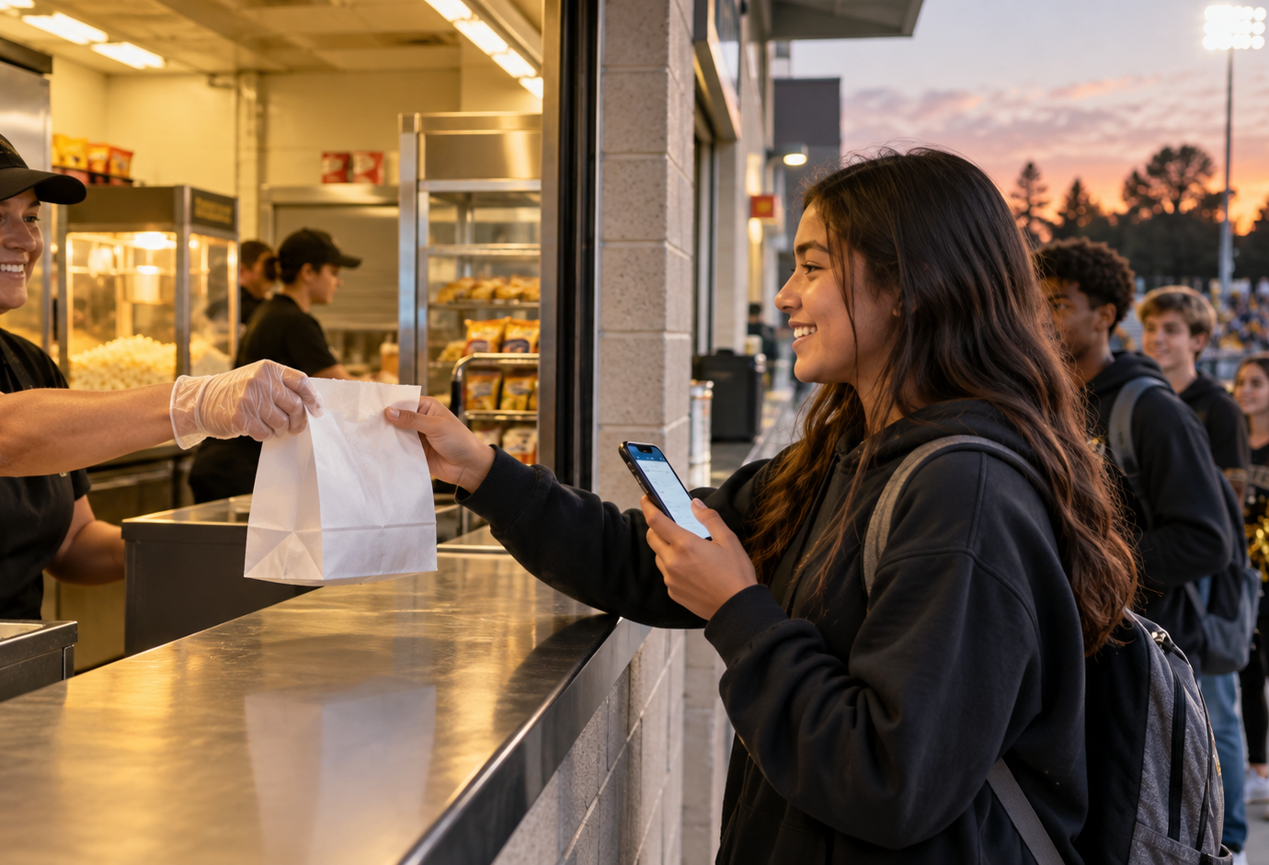

CHOOSE
CHOOSE · 0:40
What could help the next customer?
Choose one example. What customer need or want could it help?
A Use ratings to learn what customers liked
B Make pickup quicker or easier
C Show visitors what they may like
Choose first. Then give one reason. There can be more than one good idea.
Point · jot · partner-share · share aloud
Notes:
Source context: September 23 transcript. SBTE feedback applied: let students generate their ideas before teacher examples. UDL: three concrete visual routes, choice without a single forced answer, and multiple response modes. Generated images depict mobile pickup and concession staff reviewing icon-only feedback. Museum phone-feedback image reuses the established class example.

Slide 3

CHECK + CONNECT
CONNECT · 1:40
One customer need or want. One marketing function.
Pick one exact term
Marketing information management
Gather customer wants, needs, or feedback
Product/service management
Improve the product or service
Promotion
Send messages that influence purchases
Selling
Help the customer buy
Channel management
Make the product available
“The customer needs or wants ____. ____ helps because the company can ____.”
Rehearse quietly, then point, jot, partner-share, or share aloud. Stop at 5:00 total.
Marketing concept: satisfy customer needs and wants while making money.
Notes:
Source context: September 23 transcript, definitions of marketing information management, product/service management, promotion, selling, and channel management; marketing concept. UDL: visual example plus exact vocabulary and a plain-language clue, sentence frame, private rehearsal, and flexible expression. Teacher move: scan from a planted position; ask “What would the company actually do?” before clarifying. Generated image prompt: two students quietly connecting a concession phone photo to a paper with colored choices, no text.

