Slide 1
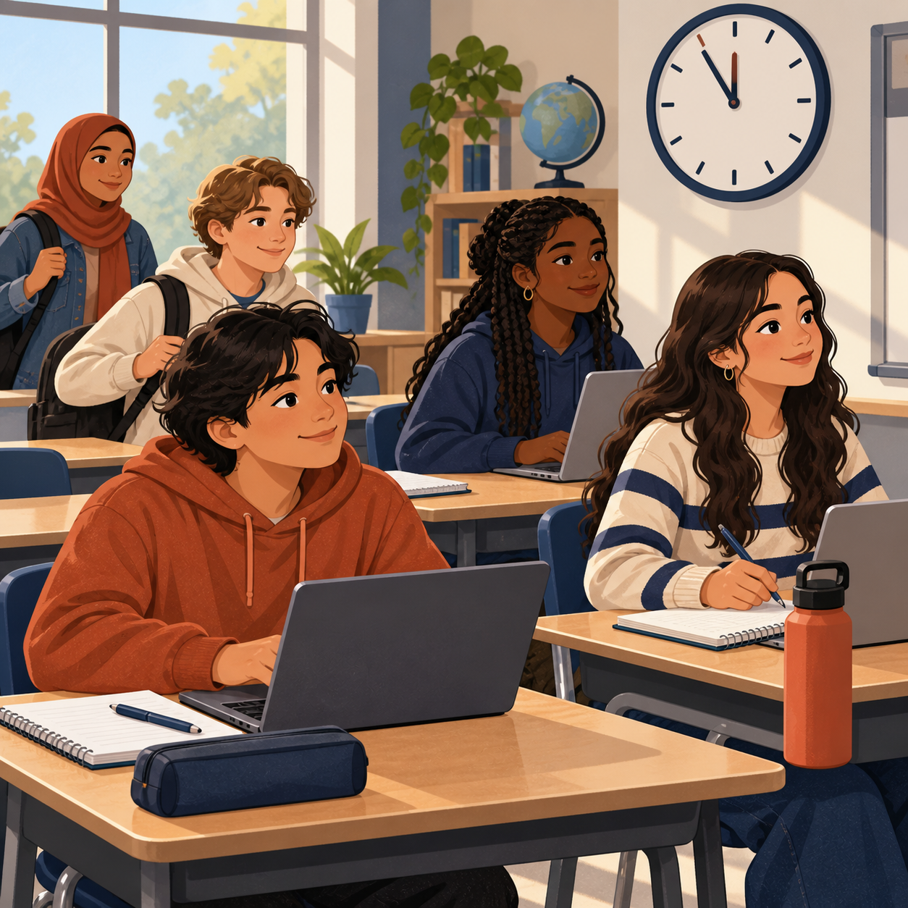
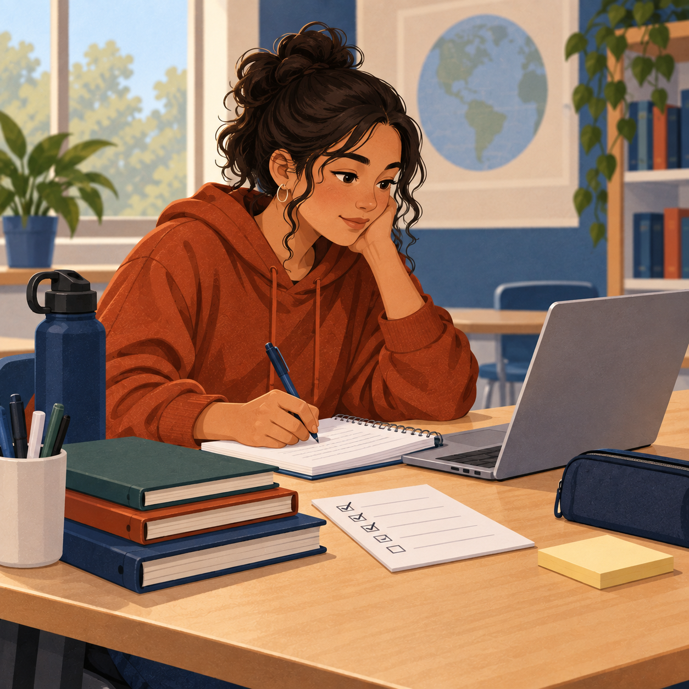
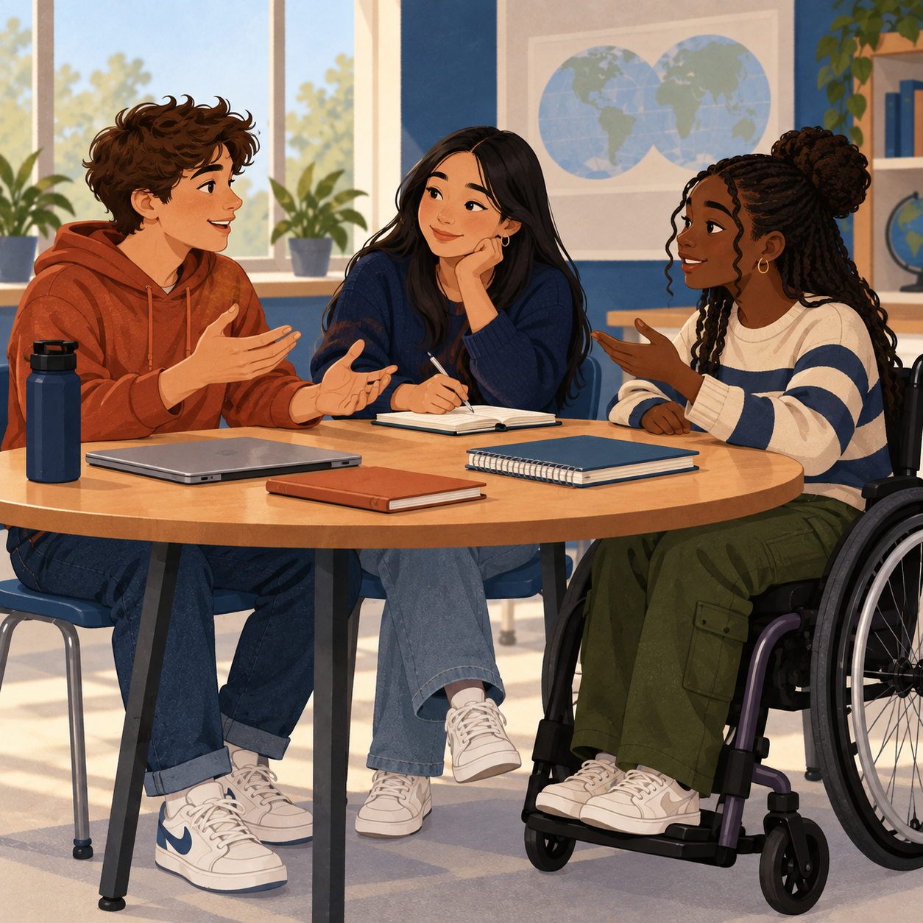
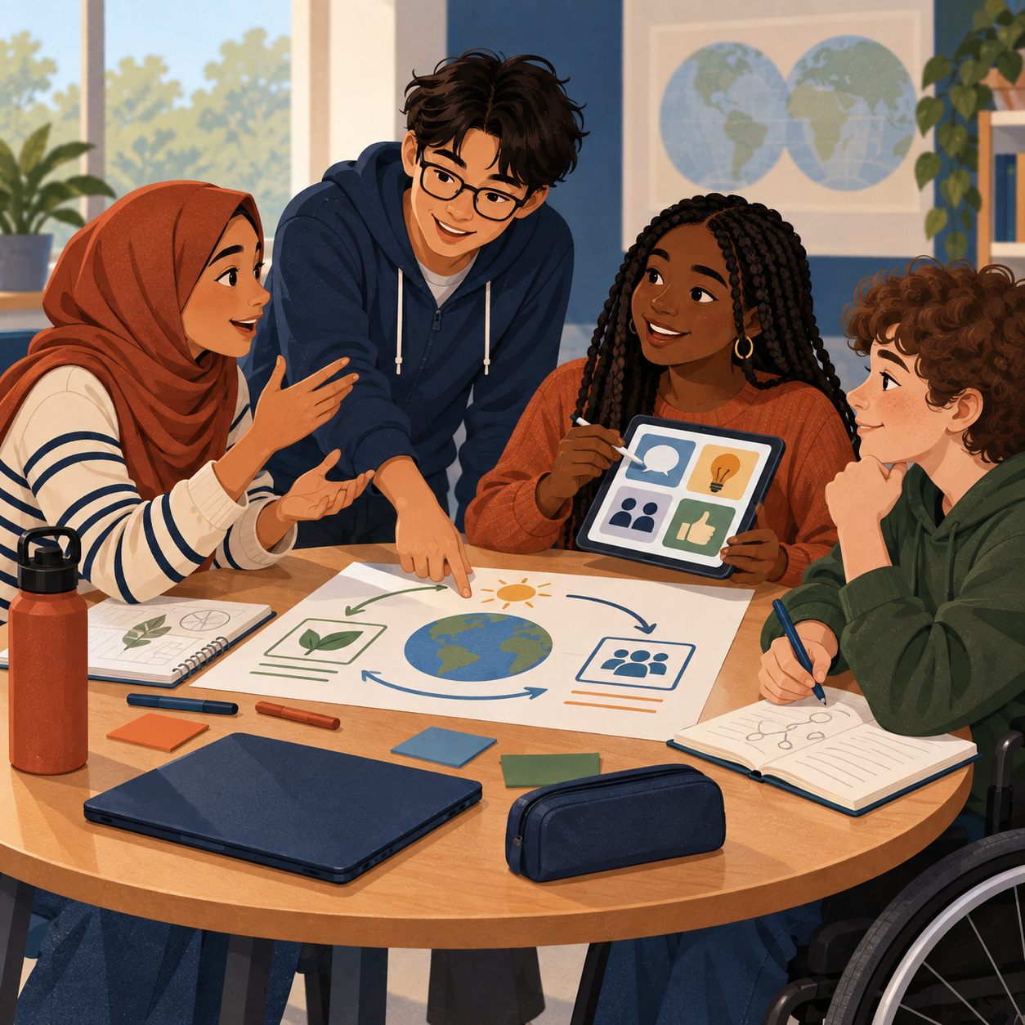
OUR SHARED COMMITMENT
BLOCK 7 CLASS NORMS
We created these norms together. Each picture and example shows what they can look like in class.
1
RESPECT
Treat people, ideas, and our classroom with care.
Student ideas: Caring, kindness, open-minded, positive work ethic.
2
ADVOCATE
Speak up respectfully for your needs and support others.
Student ideas: Communication, participation, confidence, bilingual.
3
PREPARED
Arrive organized, dependable, and ready to begin.
Student ideas: On time, responsible, available, time management.
4
PRODUCTIVE
Stay focused, adapt to challenges, and complete your work.
Student ideas: Hard worker, committed, cooperative, problem-solver.
Chosen by the students of Block 7
Words, examples, and pictures offer different ways to understand our agreement.
Notes:
Sources: 09-11 Lecture_ Classroom Professionalism and Course Management transcript; Planning_ Course Scheduling and Curriculum Outline transcript; Block 4 brainstorm photograph supplied 2026-09-11. The four norm labels and supporting student-idea words come from the class discussion and photographed brainstorm, polished only for length and readability. UDL design choices: each norm appears as a word, a plain-language action example, a student-generated keyword line, and an inclusive visual vignette. The poster uses high contrast, large sans-serif type, consistent order, and descriptive image alt text. The handwritten source photo informed the content but is intentionally not displayed.

