Slide 1

MON 28 SEP / MARKETING / DISPLAY
Goods, services, ideas
Left → middle → right: what does each customer get?
LOOK → SAY → EXPLAIN
Notes:
Withhold the vocabulary. Give quiet think time, then sample across the room.

Slide 2
MON 28 SEP / MARKETING / REVEAL
Goods, services, ideas
GOOD SERVICE IDEA
Shoes = good. Car wash = service. Recycling campaign = idea.
Notes:
Reveal only after students give a term and evidence. This staged slide is the click-controlled answer state.

Slide 3
MON 28 SEP / WORD / DISPLAY
Before the 2.x assessment
Open Word. Find one command from 2.1–2.4 using Search. Then return to your assessment instructions.
READ THE TASK → FIND THE COMMAND → CHECK THE RESULT
Notes:
If a menu looks different, search the command name. Check the result before submitting. Keep this brief; follow the SBTE’s current Word sequence.

Slide 4
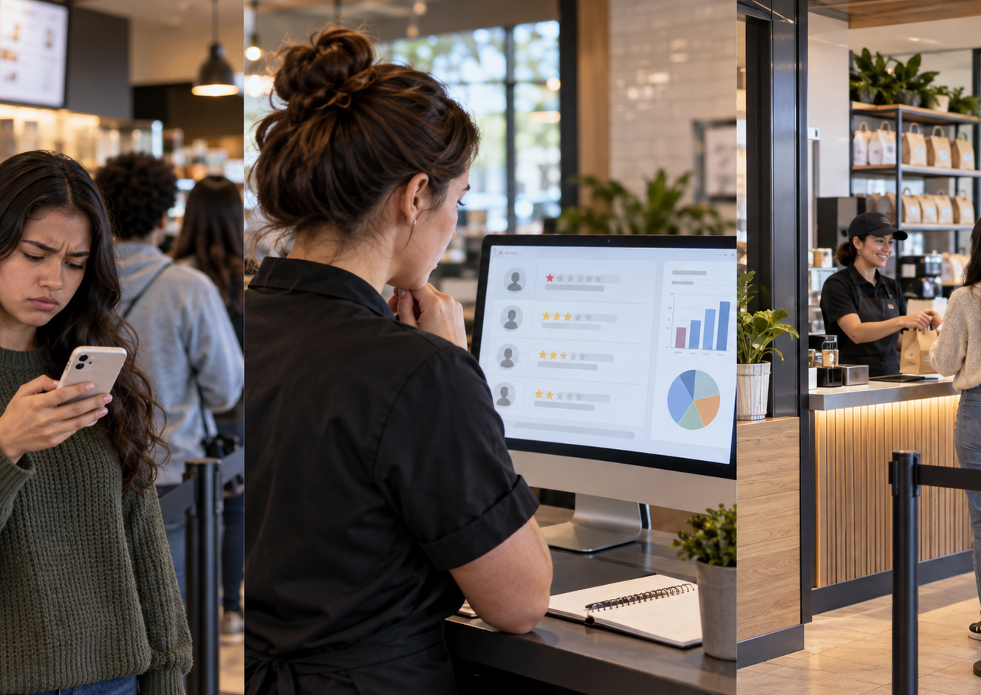
TUE 29 SEP / MARKETING / DISPLAY
One function, one purpose
Which marketing function is happening here? What job does it do?
LOOK → SAY → EXPLAIN
Notes:
Withhold the vocabulary. Give quiet think time, then sample across the room.

Slide 5
TUE 29 SEP / MARKETING / REVEAL
One function, one purpose
MARKETING-INFORMATION MANAGEMENT
Feedback gives the business evidence for a decision.
Notes:
Reveal only after students give a term and evidence. This staged slide is the click-controlled answer state.

Slide 6
TUE 29 SEP / WORD / DISPLAY
Start Word 3.x
Read the instruction first. Highlight the action verb. Find that command in Word before changing the document.
READ THE TASK → FIND THE COMMAND → CHECK THE RESULT
Notes:
Say the action; locate the control; check the result. Keep this brief; follow the SBTE’s current Word sequence.

Slide 7

WED 30 SEP / MARKETING / DISPLAY
Function and marketing concept
How could this choice satisfy a customer want and help the business earn a profit?
LOOK → SAY → EXPLAIN
Notes:
Withhold the vocabulary. Give quiet think time, then sample across the room.

Slide 8
WED 30 SEP / MARKETING / REVEAL
Function and marketing concept
MARKETING CONCEPT
Connect a relevant customer need or want to company goals and profit.
Notes:
Reveal only after students give a term and evidence. This staged slide is the click-controlled answer state.

Slide 9
WED 30 SEP / WORD / DISPLAY
Word 3.x: spot the target
What must the finished document look like? Point to the instruction that tells you.
READ THE TASK → FIND THE COMMAND → CHECK THE RESULT
Notes:
Compare your document with the stated target before moving on. Keep this brief; follow the SBTE’s current Word sequence.

Slide 10
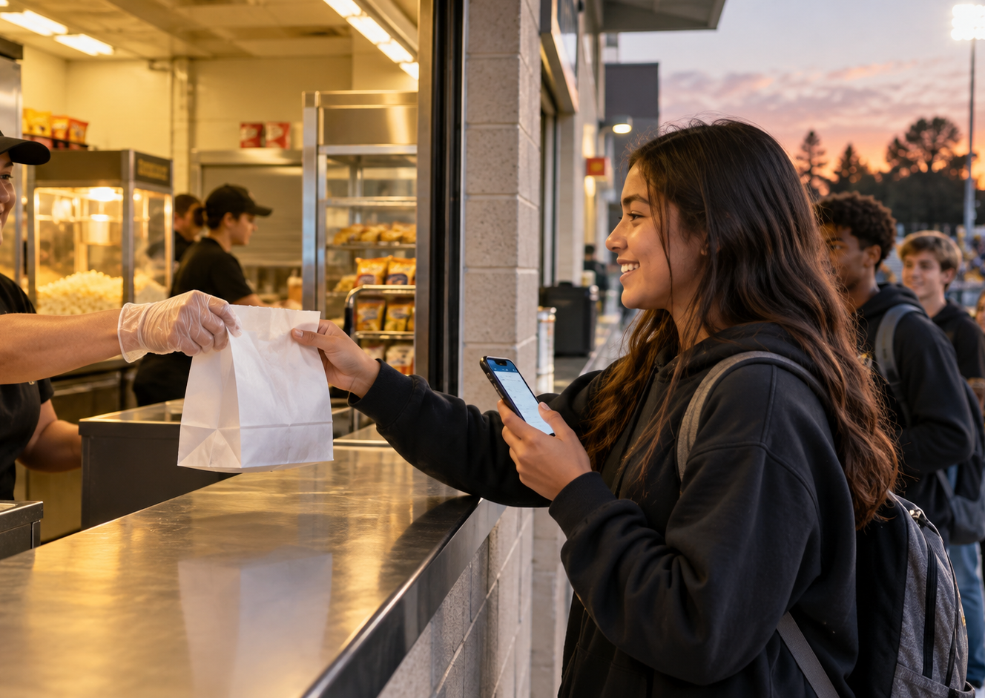
THU 1 OCT / MARKETING / DISPLAY
A specific example
Name one action this business could take. How does that show the function?
LOOK → SAY → EXPLAIN
Notes:
Withhold the vocabulary. Give quiet think time, then sample across the room.

Slide 11
THU 1 OCT / MARKETING / REVEAL
A specific example
EXAMPLE + WHY
A concrete action is stronger than only naming a function.
Notes:
Reveal only after students give a term and evidence. This staged slide is the click-controlled answer state.

Slide 12
THU 1 OCT / WORD / DISPLAY
Word 3.x: troubleshoot
A command is missing from the pictured menu. What will you search for?
READ THE TASK → FIND THE COMMAND → CHECK THE RESULT
Notes:
Search by task name, inspect the result, then ask if the output still differs. Keep this brief; follow the SBTE’s current Word sequence.

Slide 13

FRI 2 OCT / MARKETING / DISPLAY
Explain it in one minute
Function → purpose → marketing concept → example. Which link needs more work?
LOOK → SAY → EXPLAIN
Notes:
Withhold the vocabulary. Give quiet think time, then sample across the room.

Slide 14
FRI 2 OCT / MARKETING / REVEAL
Explain it in one minute
PURPOSE / CONNECTION / EXAMPLE
Review the three textbook requirements before any presentation.
Notes:
Reveal only after students give a term and evidence. This staged slide is the click-controlled answer state.

Slide 15
FRI 2 OCT / WORD / DISPLAY
Word 3.x: check and continue
Find one result you are confident in and one step you want to verify.
READ THE TASK → FIND THE COMMAND → CHECK THE RESULT
Notes:
Show evidence of both; use Search or ask a precise question. Keep this brief; follow the SBTE’s current Word sequence.

