Slide 1
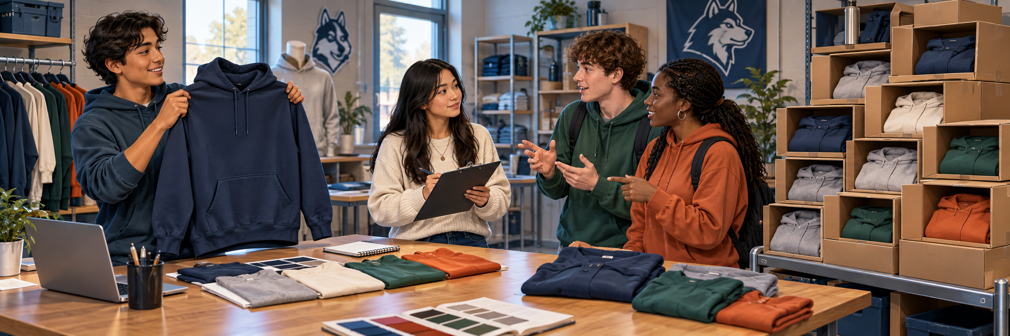
MONDAY · NOTICE
3:00 TOTAL
Would this hoodie work for everyone?
A fictional school-spirit shop is choosing its next hoodie.
What should the shop do first? Think before choosing.
Chapter 1 pp. 10–11; SBTE 9 LOOK QUIETLY · 20 seconds 1
Notes:
MONDAY. Chapter 1 pp. 10–11; SBTE 9. THREE-MINUTE MAXIMUM.
SEQUENCE: slide 1: whole scene, 20 seconds quiet noticing; slide 2: the same scene cropped into three details, 40 seconds choosing; slide 3: reveal after responses, 50 seconds checking and 50 seconds connecting to reading, 20 seconds buffer. No automatic countdown or animation.
SAY ON NOTICE: A fictional school-spirit shop is choosing its next hoodie. What should the shop do first? Think before choosing.
SAY ON CHOOSE: What should the shop do FIRST? Read the three short labels once. Do not show the reveal before students respond.
ANSWER AND EXPLANATION: B. Ask likely buyers about their wants and needs before selecting the next hoodie. The scene illustrates possible decisions; it does not mean all three have already happened.
CLOSE: Customer evidence helps a business choose.
READING TRANSITION: Open p. 10: “The Purpose of Marketing”. Resume the actual section stopping point, not the calendar alone.
ACCESS: Describe the scene without telling students the answer. Accept pointing, fingers, writing or a quiet response. No personal purchases, visits or financial disclosures required. SBTE takes attendance, scans responses and adds at most one clarification.
VISUAL SOURCE: Built-in image generation; fictional people and settings, not actual Eastridge students or facilities. Whole image first, exact source crops second, focused crop at reveal. Assets: ../assets/2026-09-21-to-25-visual-v3/whole-scenes/monday.png.
FOLLOW-UP 1 (optional, choose at most one): What could the shop ask about the hoodie?
FOLLOW-UP 2: How could that answer change what it sells?

Slide 2
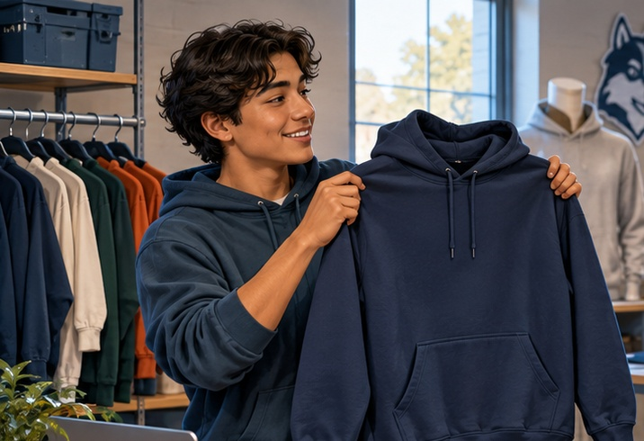
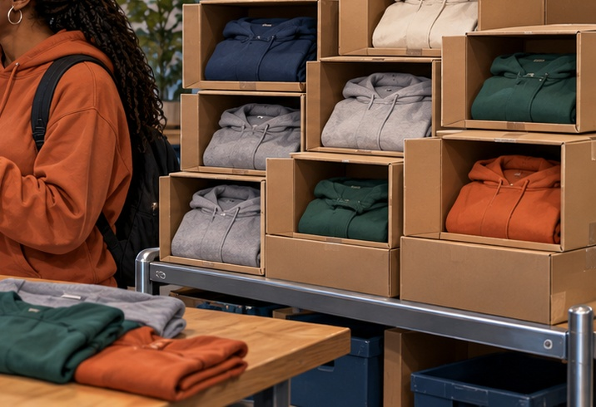

MONDAY · CHOOSE
CHOOSE · 0:40
What should the shop do FIRST?
Choose one. Point, show fingers, write, or answer quietly.
A Pick our favorite
C Order a huge batch
B Ask likely buyers
Choose first. Be ready to give one reason.
pp. 10–11 · SBTE 9 Point to the clue that supports your answer. 2
Notes:
MONDAY. Chapter 1 pp. 10–11; SBTE 9. THREE-MINUTE MAXIMUM.
SEQUENCE: slide 1: whole scene, 20 seconds quiet noticing; slide 2: the same scene cropped into three details, 40 seconds choosing; slide 3: reveal after responses, 50 seconds checking and 50 seconds connecting to reading, 20 seconds buffer. No automatic countdown or animation.
SAY ON NOTICE: A fictional school-spirit shop is choosing its next hoodie. What should the shop do first? Think before choosing.
SAY ON CHOOSE: What should the shop do FIRST? Read the three short labels once. Do not show the reveal before students respond.
ANSWER AND EXPLANATION: B. Ask likely buyers about their wants and needs before selecting the next hoodie. The scene illustrates possible decisions; it does not mean all three have already happened.
CLOSE: Customer evidence helps a business choose.
READING TRANSITION: Open p. 10: “The Purpose of Marketing”. Resume the actual section stopping point, not the calendar alone.
ACCESS: Describe the scene without telling students the answer. Accept pointing, fingers, writing or a quiet response. No personal purchases, visits or financial disclosures required. SBTE takes attendance, scans responses and adds at most one clarification.
VISUAL SOURCE: Built-in image generation; fictional people and settings, not actual Eastridge students or facilities. Whole image first, exact source crops second, focused crop at reveal. Assets: ../assets/2026-09-21-to-25-visual-v3/whole-scenes/monday.png.
FOLLOW-UP 1 (optional, choose at most one): What could the shop ask about the hoodie?
FOLLOW-UP 2: How could that answer change what it sells?

Slide 3
MONDAY · CHECK + CONNECT
REVEAL · 1:40
B Ask likely buyers
MARKETING CONCEPT
Open p. 10: “The Purpose of Marketing”
Customer needs guide company goals and profit decisions.
Customer evidence helps a business choose.
pp. 10–11 · SBTE 9 Stop at 3:00 total. 3
Notes:
MONDAY. Chapter 1 pp. 10–11; SBTE 9. THREE-MINUTE MAXIMUM.
SEQUENCE: slide 1: whole scene, 20 seconds quiet noticing; slide 2: the same scene cropped into three details, 40 seconds choosing; slide 3: reveal after responses, 50 seconds checking and 50 seconds connecting to reading, 20 seconds buffer. No automatic countdown or animation.
SAY ON NOTICE: A fictional school-spirit shop is choosing its next hoodie. What should the shop do first? Think before choosing.
SAY ON CHOOSE: What should the shop do FIRST? Read the three short labels once. Do not show the reveal before students respond.
ANSWER AND EXPLANATION: B. Ask likely buyers about their wants and needs before selecting the next hoodie. The scene illustrates possible decisions; it does not mean all three have already happened.
CLOSE: Customer evidence helps a business choose.
READING TRANSITION: Open p. 10: “The Purpose of Marketing”. Resume the actual section stopping point, not the calendar alone.
ACCESS: Describe the scene without telling students the answer. Accept pointing, fingers, writing or a quiet response. No personal purchases, visits or financial disclosures required. SBTE takes attendance, scans responses and adds at most one clarification.
VISUAL SOURCE: Built-in image generation; fictional people and settings, not actual Eastridge students or facilities. Whole image first, exact source crops second, focused crop at reveal. Assets: ../assets/2026-09-21-to-25-visual-v3/whole-scenes/monday.png.
FOLLOW-UP 1 (optional, choose at most one): What could the shop ask about the hoodie?
FOLLOW-UP 2: How could that answer change what it sells?

Slide 4
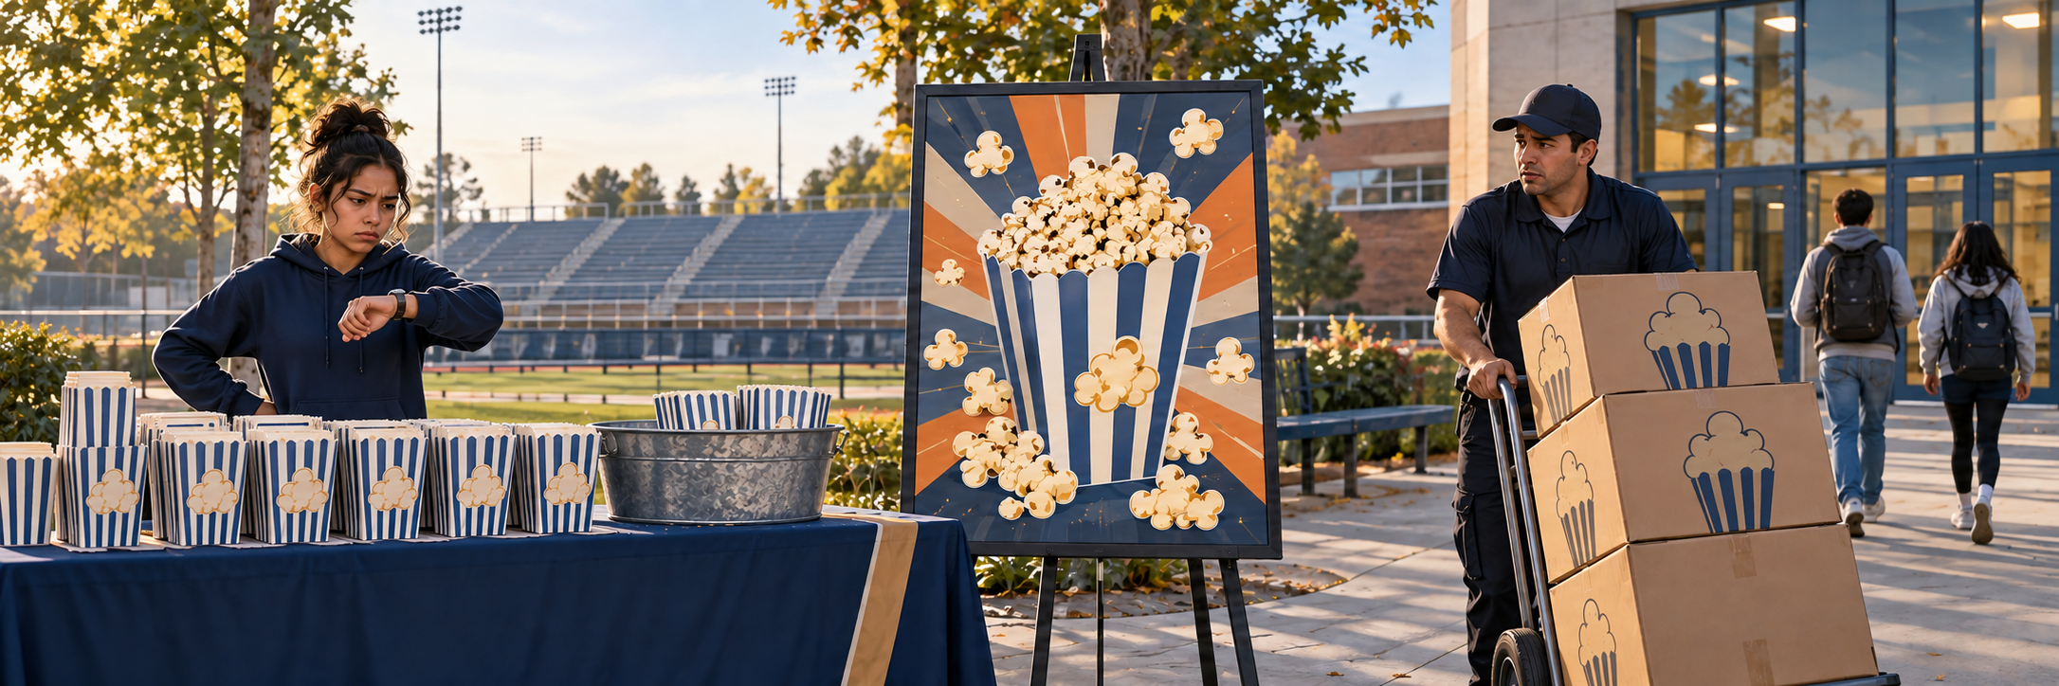
TUESDAY · NOTICE
3:00 TOTAL
Ordered ahead. Delivered too late.
The club ordered popcorn early. It arrived after the game.
What should the seller fix for the next game?
Chapter 1 pp. 11–12; SBTE 10 LOOK QUIETLY · 20 seconds 4
Notes:
TUESDAY. Chapter 1 pp. 11–12; SBTE 10. THREE-MINUTE MAXIMUM.
SEQUENCE: slide 4: whole scene, 20 seconds quiet noticing; slide 5: the same scene cropped into three details, 40 seconds choosing; slide 6: reveal after responses, 50 seconds checking and 50 seconds connecting to reading, 20 seconds buffer. No automatic countdown or animation.
SAY ON NOTICE: The club ordered popcorn early. It arrived after the game. What should the seller fix for the next game?
SAY ON CHOOSE: Which change solves the late-delivery problem? Read the three short labels once. Do not show the reveal before students respond.
ANSWER AND EXPLANATION: C. Fix delivery timing. Point to the empty cups, disappointed seller, concerned driver, departing customers and empty seats. The popcorn in the center is a picture on an unused advertisement, not food already sold. The right crop shows the problem to fix, not successful delivery.
CLOSE: A product must reach customers at the right time.
READING TRANSITION: Open pp. 11–12: “Marketing Mix”. Resume the actual section stopping point, not the calendar alone.
ACCESS: Describe the scene without telling students the answer. Accept pointing, fingers, writing or a quiet response. No personal purchases, visits or financial disclosures required. SBTE takes attendance, scans responses and adds at most one clarification.
VISUAL SOURCE: Built-in image generation; fictional people and settings, not actual Eastridge students or facilities. Whole image first, exact source crops second, focused crop at reveal. Assets: ../assets/2026-09-21-to-25-visual-v3/whole-scenes/tuesday.png.

Slide 5
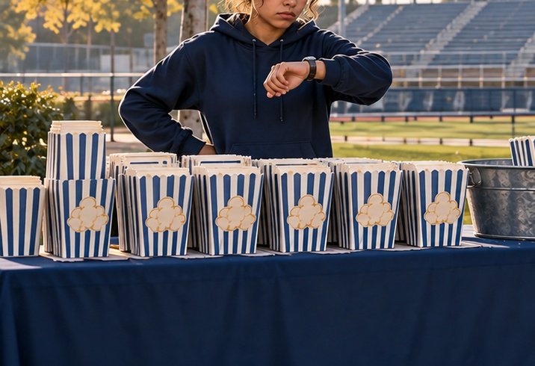
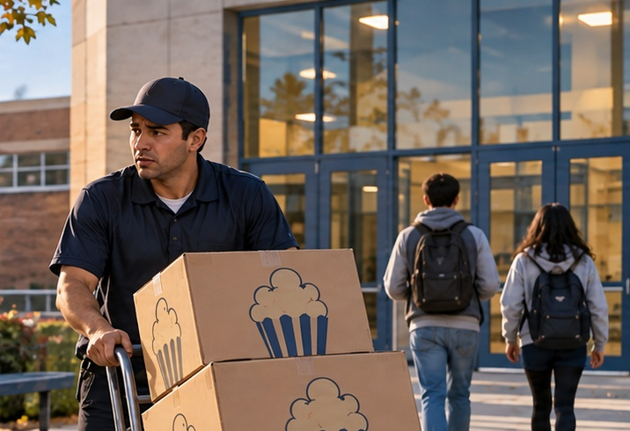

TUESDAY · CHOOSE
CHOOSE · 0:40
Which change solves the late-delivery problem?
Choose one. Point, show fingers, write, or answer quietly.
A Change the packaging
C Change delivery timing
B Make a bigger ad
Choose first. Be ready to give one reason.
pp. 11–12 · SBTE 10 Point to the clue that supports your answer. 5
Notes:
TUESDAY. Chapter 1 pp. 11–12; SBTE 10. THREE-MINUTE MAXIMUM.
SEQUENCE: slide 4: whole scene, 20 seconds quiet noticing; slide 5: the same scene cropped into three details, 40 seconds choosing; slide 6: reveal after responses, 50 seconds checking and 50 seconds connecting to reading, 20 seconds buffer. No automatic countdown or animation.
SAY ON NOTICE: The club ordered popcorn early. It arrived after the game. What should the seller fix for the next game?
SAY ON CHOOSE: Which change solves the late-delivery problem? Read the three short labels once. Do not show the reveal before students respond.
ANSWER AND EXPLANATION: C. Fix delivery timing. Point to the empty cups, disappointed seller, concerned driver, departing customers and empty seats. The popcorn in the center is a picture on an unused advertisement, not food already sold. The right crop shows the problem to fix, not successful delivery.
CLOSE: A product must reach customers at the right time.
READING TRANSITION: Open pp. 11–12: “Marketing Mix”. Resume the actual section stopping point, not the calendar alone.
ACCESS: Describe the scene without telling students the answer. Accept pointing, fingers, writing or a quiet response. No personal purchases, visits or financial disclosures required. SBTE takes attendance, scans responses and adds at most one clarification.
VISUAL SOURCE: Built-in image generation; fictional people and settings, not actual Eastridge students or facilities. Whole image first, exact source crops second, focused crop at reveal. Assets: ../assets/2026-09-21-to-25-visual-v3/whole-scenes/tuesday.png.

Slide 6
TUESDAY · CHECK + CONNECT
REVEAL · 1:40
C Deliver before the game
PLACE IN THE MARKETING MIX
Open pp. 11–12: “Marketing Mix”
Place includes how, where, and when a product reaches customers.
A product must reach customers at the right time.
pp. 11–12 · SBTE 10 Stop at 3:00 total. 6
Notes:
TUESDAY. Chapter 1 pp. 11–12; SBTE 10. THREE-MINUTE MAXIMUM.
SEQUENCE: slide 4: whole scene, 20 seconds quiet noticing; slide 5: the same scene cropped into three details, 40 seconds choosing; slide 6: reveal after responses, 50 seconds checking and 50 seconds connecting to reading, 20 seconds buffer. No automatic countdown or animation.
SAY ON NOTICE: The club ordered popcorn early. It arrived after the game. What should the seller fix for the next game?
SAY ON CHOOSE: Which change solves the late-delivery problem? Read the three short labels once. Do not show the reveal before students respond.
ANSWER AND EXPLANATION: C. Fix delivery timing. Point to the empty cups, disappointed seller, concerned driver, departing customers and empty seats. The popcorn in the center is a picture on an unused advertisement, not food already sold. The right crop shows the problem to fix, not successful delivery.
CLOSE: A product must reach customers at the right time.
READING TRANSITION: Open pp. 11–12: “Marketing Mix”. Resume the actual section stopping point, not the calendar alone.
ACCESS: Describe the scene without telling students the answer. Accept pointing, fingers, writing or a quiet response. No personal purchases, visits or financial disclosures required. SBTE takes attendance, scans responses and adds at most one clarification.
VISUAL SOURCE: Built-in image generation; fictional people and settings, not actual Eastridge students or facilities. Whole image first, exact source crops second, focused crop at reveal. Assets: ../assets/2026-09-21-to-25-visual-v3/whole-scenes/tuesday.png.

Slide 7
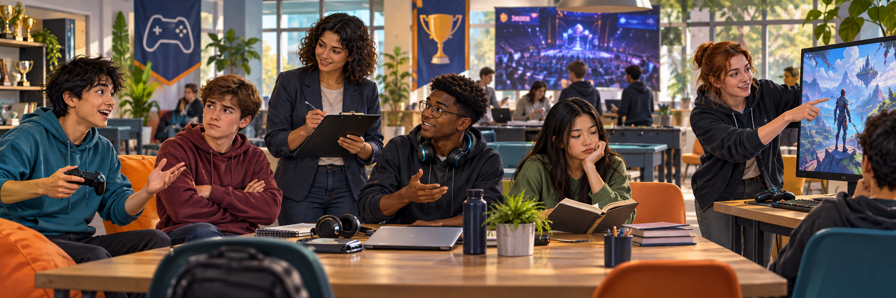
WEDNESDAY · NOTICE
3:00 TOTAL
Would people actually come?
A fictional esports event wants players AND spectators.
What could we ask to learn who is interested?
Chapter 1 pp. 13–15; SBTE 11–13 LOOK QUIETLY · 20 seconds 7
Notes:
WEDNESDAY. Chapter 1 pp. 13–15; SBTE 11–13. THREE-MINUTE MAXIMUM.
SEQUENCE: slide 7: whole scene, 20 seconds quiet noticing; slide 8: the same scene cropped into three details, 40 seconds choosing; slide 9: reveal after responses, 50 seconds checking and 50 seconds connecting to reading, 20 seconds buffer. No automatic countdown or animation.
SAY ON NOTICE: A fictional esports event wants players AND spectators. What could we ask to learn who is interested?
SAY ON CHOOSE: Which question gives useful evidence? Read the three short labels once. Do not show the reveal before students respond.
ANSWER AND EXPLANATION: B permits different answers. A pushes agreement; C substitutes the organizer’s preference. Not being interested is a valid answer. Do not equate visible quietness with lack of learning.
CLOSE: Useful questions leave room for honest answers.
READING TRANSITION: Open p. 13: “Marketing Functions”. Resume the actual section stopping point, not the calendar alone.
ACCESS: Describe the scene without telling students the answer. Accept pointing, fingers, writing or a quiet response. No personal purchases, visits or financial disclosures required. SBTE takes attendance, scans responses and adds at most one clarification.
VISUAL SOURCE: Built-in image generation; fictional people and settings, not actual Eastridge students or facilities. Whole image first, exact source crops second, focused crop at reveal. Assets: ../assets/2026-09-21-to-25-visual-v3/whole-scenes/wednesday.png.
FOLLOW-UP 1 (optional, choose at most one): Why is “neither” a useful option?
FOLLOW-UP 2: How could the answer change the event?

Slide 8



WEDNESDAY · CHOOSE
CHOOSE · 0:40
Which question gives useful evidence?
Choose one. Point, show fingers, write, or answer quietly.
A “Gaming is great, right?”
C “My favorite game wins?”
B “Play, watch, or neither?”
Choose first. Be ready to give one reason.
pp. 13–15 · SBTE 11–13 Point to the clue that supports your answer. 8
Notes:
WEDNESDAY. Chapter 1 pp. 13–15; SBTE 11–13. THREE-MINUTE MAXIMUM.
SEQUENCE: slide 7: whole scene, 20 seconds quiet noticing; slide 8: the same scene cropped into three details, 40 seconds choosing; slide 9: reveal after responses, 50 seconds checking and 50 seconds connecting to reading, 20 seconds buffer. No automatic countdown or animation.
SAY ON NOTICE: A fictional esports event wants players AND spectators. What could we ask to learn who is interested?
SAY ON CHOOSE: Which question gives useful evidence? Read the three short labels once. Do not show the reveal before students respond.
ANSWER AND EXPLANATION: B permits different answers. A pushes agreement; C substitutes the organizer’s preference. Not being interested is a valid answer. Do not equate visible quietness with lack of learning.
CLOSE: Useful questions leave room for honest answers.
READING TRANSITION: Open p. 13: “Marketing Functions”. Resume the actual section stopping point, not the calendar alone.
ACCESS: Describe the scene without telling students the answer. Accept pointing, fingers, writing or a quiet response. No personal purchases, visits or financial disclosures required. SBTE takes attendance, scans responses and adds at most one clarification.
VISUAL SOURCE: Built-in image generation; fictional people and settings, not actual Eastridge students or facilities. Whole image first, exact source crops second, focused crop at reveal. Assets: ../assets/2026-09-21-to-25-visual-v3/whole-scenes/wednesday.png.
FOLLOW-UP 1 (optional, choose at most one): Why is “neither” a useful option?
FOLLOW-UP 2: How could the answer change the event?

Slide 9
WEDNESDAY · CHECK + CONNECT
REVEAL · 1:40
B Play, watch, or neither?
MARKETING INFORMATION MANAGEMENT
Open p. 13: “Marketing Functions”
Different preferences, including no interest, give useful evidence.
Useful questions leave room for honest answers.
pp. 13–15 · SBTE 11–13 Stop at 3:00 total. 9
Notes:
WEDNESDAY. Chapter 1 pp. 13–15; SBTE 11–13. THREE-MINUTE MAXIMUM.
SEQUENCE: slide 7: whole scene, 20 seconds quiet noticing; slide 8: the same scene cropped into three details, 40 seconds choosing; slide 9: reveal after responses, 50 seconds checking and 50 seconds connecting to reading, 20 seconds buffer. No automatic countdown or animation.
SAY ON NOTICE: A fictional esports event wants players AND spectators. What could we ask to learn who is interested?
SAY ON CHOOSE: Which question gives useful evidence? Read the three short labels once. Do not show the reveal before students respond.
ANSWER AND EXPLANATION: B permits different answers. A pushes agreement; C substitutes the organizer’s preference. Not being interested is a valid answer. Do not equate visible quietness with lack of learning.
CLOSE: Useful questions leave room for honest answers.
READING TRANSITION: Open p. 13: “Marketing Functions”. Resume the actual section stopping point, not the calendar alone.
ACCESS: Describe the scene without telling students the answer. Accept pointing, fingers, writing or a quiet response. No personal purchases, visits or financial disclosures required. SBTE takes attendance, scans responses and adds at most one clarification.
VISUAL SOURCE: Built-in image generation; fictional people and settings, not actual Eastridge students or facilities. Whole image first, exact source crops second, focused crop at reveal. Assets: ../assets/2026-09-21-to-25-visual-v3/whole-scenes/wednesday.png.
FOLLOW-UP 1 (optional, choose at most one): Why is “neither” a useful option?
FOLLOW-UP 2: How could the answer change the event?

Slide 10
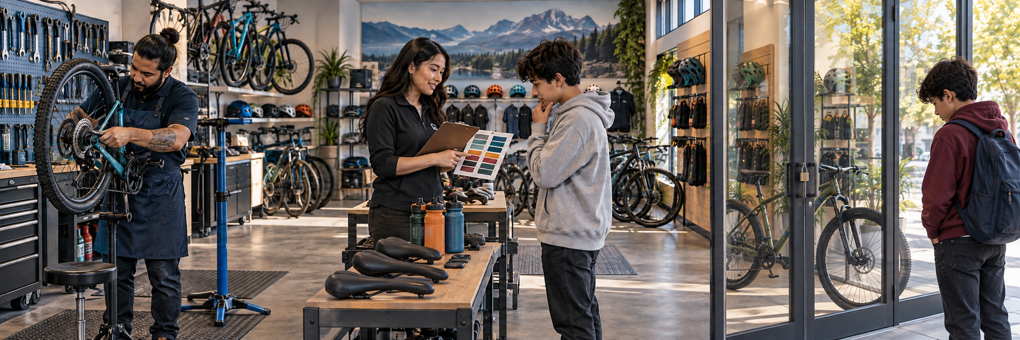
THURSDAY · NOTICE
3:00 TOTAL
Bike ready. Pickup closes too early.
The shop closes before school ends. The student cannot collect it.
What could the shop change so pickup works?
Chapter 1 pp. 13–15, Figure 1.4; SBTE 12–13 LOOK QUIETLY · 20 seconds 10
Notes:
THURSDAY. Chapter 1 pp. 13–15, Figure 1.4; SBTE 12–13. THREE-MINUTE MAXIMUM.
SEQUENCE: slide 10: whole scene, 20 seconds quiet noticing; slide 11: the same scene cropped into three details, 40 seconds choosing; slide 12: reveal after responses, 50 seconds checking and 50 seconds connecting to reading, 20 seconds buffer. No automatic countdown or animation.
SAY ON NOTICE: The shop closes before school ends. The student cannot collect it. What could the shop change so pickup works?
SAY ON CHOOSE: Which change helps the student collect the bike? Read the three short labels once. Do not show the reveal before students respond.
ANSWER AND EXPLANATION: C fixes access. The right image shows a disappointed student outside the closed shop with a ready bike behind glass. The other shop activities do not solve this pickup barrier. The repaired bike does not need a second repair. This is a fictional application of arranging customer access, not a new textbook definition.
CLOSE: A finished repair still needs a workable pickup.
READING TRANSITION: Open p. 13: “Channel Management”. Resume the actual section stopping point, not the calendar alone.
ACCESS: Describe the scene without telling students the answer. Accept pointing, fingers, writing or a quiet response. No personal purchases, visits or financial disclosures required. SBTE takes attendance, scans responses and adds at most one clarification.
VISUAL SOURCE: Built-in image generation; fictional people and settings, not actual Eastridge students or facilities. Whole image first, exact source crops second, focused crop at reveal. Assets: ../assets/2026-09-21-to-25-visual-v3/whole-scenes/thursday.png.

Slide 11
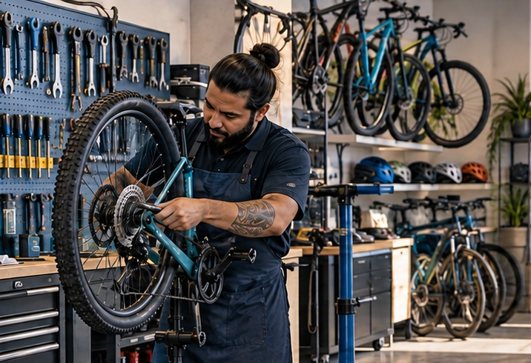
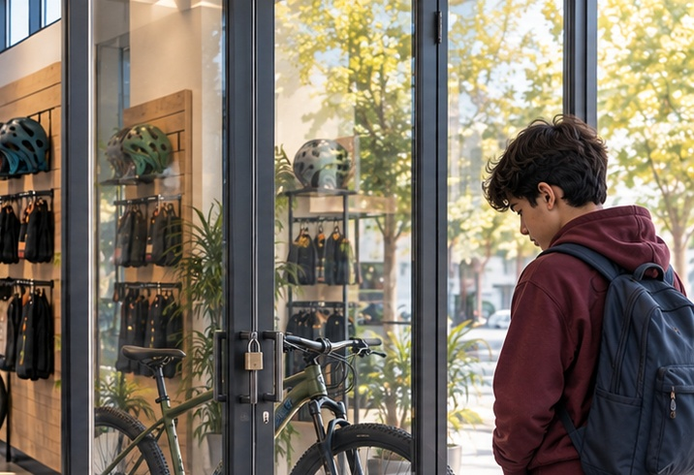
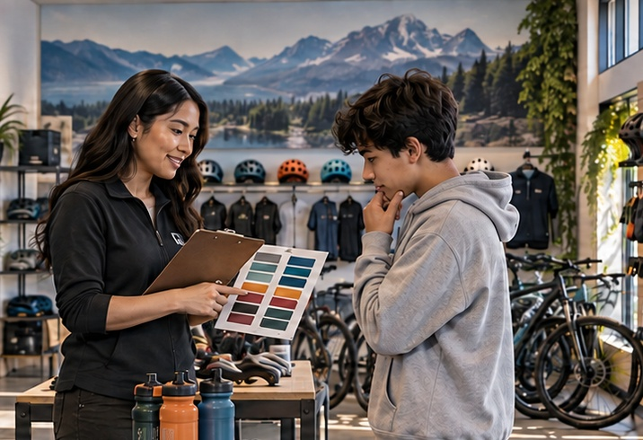
THURSDAY · CHOOSE
CHOOSE · 0:40
Which change helps the student collect the bike?
Choose one. Point, show fingers, write, or answer quietly.
A Repair the bike again
C Change pickup hours
B Ask about bike colors
Choose first. Be ready to give one reason.
pp. 13–15 · SBTE 12–13 Point to the clue that supports your answer. 11
Notes:
THURSDAY. Chapter 1 pp. 13–15, Figure 1.4; SBTE 12–13. THREE-MINUTE MAXIMUM.
SEQUENCE: slide 10: whole scene, 20 seconds quiet noticing; slide 11: the same scene cropped into three details, 40 seconds choosing; slide 12: reveal after responses, 50 seconds checking and 50 seconds connecting to reading, 20 seconds buffer. No automatic countdown or animation.
SAY ON NOTICE: The shop closes before school ends. The student cannot collect it. What could the shop change so pickup works?
SAY ON CHOOSE: Which change helps the student collect the bike? Read the three short labels once. Do not show the reveal before students respond.
ANSWER AND EXPLANATION: C fixes access. The right image shows a disappointed student outside the closed shop with a ready bike behind glass. The other shop activities do not solve this pickup barrier. The repaired bike does not need a second repair. This is a fictional application of arranging customer access, not a new textbook definition.
CLOSE: A finished repair still needs a workable pickup.
READING TRANSITION: Open p. 13: “Channel Management”. Resume the actual section stopping point, not the calendar alone.
ACCESS: Describe the scene without telling students the answer. Accept pointing, fingers, writing or a quiet response. No personal purchases, visits or financial disclosures required. SBTE takes attendance, scans responses and adds at most one clarification.
VISUAL SOURCE: Built-in image generation; fictional people and settings, not actual Eastridge students or facilities. Whole image first, exact source crops second, focused crop at reveal. Assets: ../assets/2026-09-21-to-25-visual-v3/whole-scenes/thursday.png.

Slide 12
THURSDAY · CHECK + CONNECT
REVEAL · 1:40
C Offer after-school pickup
CHANNEL MANAGEMENT
Open p. 13: “Channel Management”
Plan how, when, and where customers receive products.
A finished repair still needs a workable pickup.
pp. 13–15 · SBTE 12–13 Stop at 3:00 total. 12
Notes:
THURSDAY. Chapter 1 pp. 13–15, Figure 1.4; SBTE 12–13. THREE-MINUTE MAXIMUM.
SEQUENCE: slide 10: whole scene, 20 seconds quiet noticing; slide 11: the same scene cropped into three details, 40 seconds choosing; slide 12: reveal after responses, 50 seconds checking and 50 seconds connecting to reading, 20 seconds buffer. No automatic countdown or animation.
SAY ON NOTICE: The shop closes before school ends. The student cannot collect it. What could the shop change so pickup works?
SAY ON CHOOSE: Which change helps the student collect the bike? Read the three short labels once. Do not show the reveal before students respond.
ANSWER AND EXPLANATION: C fixes access. The right image shows a disappointed student outside the closed shop with a ready bike behind glass. The other shop activities do not solve this pickup barrier. The repaired bike does not need a second repair. This is a fictional application of arranging customer access, not a new textbook definition.
CLOSE: A finished repair still needs a workable pickup.
READING TRANSITION: Open p. 13: “Channel Management”. Resume the actual section stopping point, not the calendar alone.
ACCESS: Describe the scene without telling students the answer. Accept pointing, fingers, writing or a quiet response. No personal purchases, visits or financial disclosures required. SBTE takes attendance, scans responses and adds at most one clarification.
VISUAL SOURCE: Built-in image generation; fictional people and settings, not actual Eastridge students or facilities. Whole image first, exact source crops second, focused crop at reveal. Assets: ../assets/2026-09-21-to-25-visual-v3/whole-scenes/thursday.png.

Slide 13
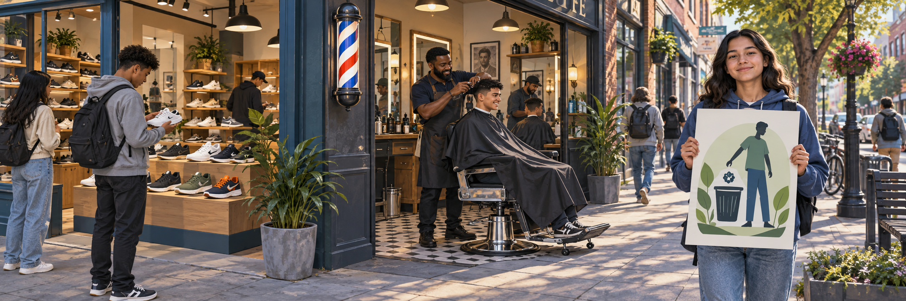
FRIDAY · NOTICE
3:00 TOTAL
What is being offered here?
A fictional neighborhood street. Look for three different offerings.
Notice the shoes, the haircut, and the message.
Chapter 1 p. 4; SBTE 4 LOOK QUIETLY · 20 seconds 13
Notes:
FRIDAY. Chapter 1 p. 4; SBTE 4. THREE-MINUTE MAXIMUM.
SEQUENCE: slide 13: whole scene, 20 seconds quiet noticing; slide 14: the same scene cropped into three details, 40 seconds choosing; slide 15: reveal after responses, 50 seconds checking and 50 seconds connecting to reading, 20 seconds buffer. No automatic countdown or animation.
SAY ON NOTICE: A fictional neighborhood street. Look for three different offerings. Notice the shoes, the haircut, and the message.
SAY ON CHOOSE: Which picture shows a GOOD? Read the three short labels once. Do not show the reveal before students respond.
ANSWER AND EXPLANATION: Ask ONE category at a time: Which picture shows a good? Pause. Which shows a service? Pause. Which shows an idea? Pause. Students point, show fingers, write a number or answer quietly. Answers 1, 2, 3. Classify the environmental message, not its paper. Confirm assessment plans; omit the opener if it would coach assessed answers.
CLOSE: Different offerings. Different ways to meet a need.
READING TRANSITION: Check p. 4, then follow today’s class agenda. Resume the actual section stopping point, not the calendar alone.
ACCESS: Describe the scene without telling students the answer. Accept pointing, fingers, writing or a quiet response. No personal purchases, visits or financial disclosures required. SBTE takes attendance, scans responses and adds at most one clarification.
VISUAL SOURCE: Built-in image generation; fictional people and settings, not actual Eastridge students or facilities. Whole image first, exact source crops second, focused crop at reveal. Assets: ../assets/2026-09-21-to-25-visual-v3/whole-scenes/friday.png.

Slide 14
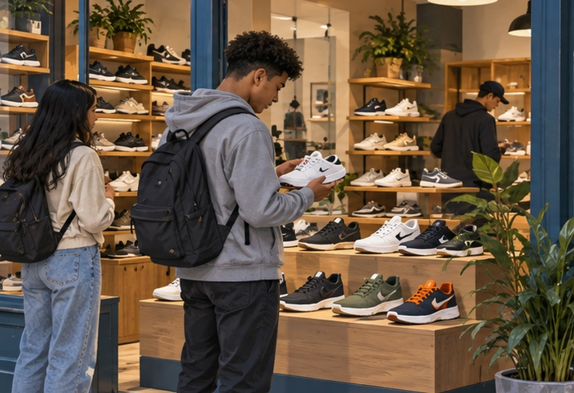
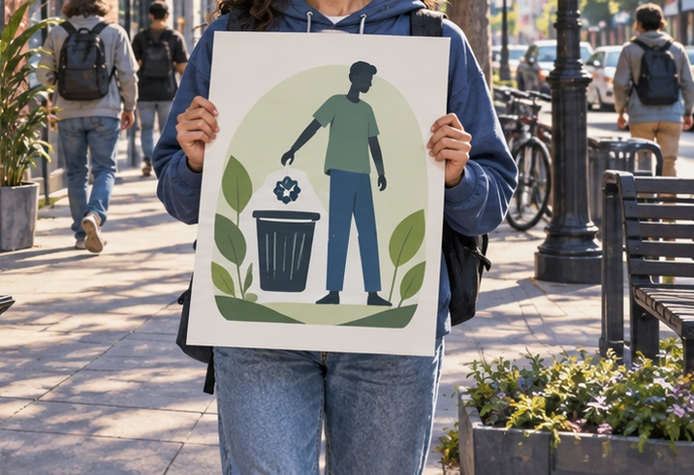
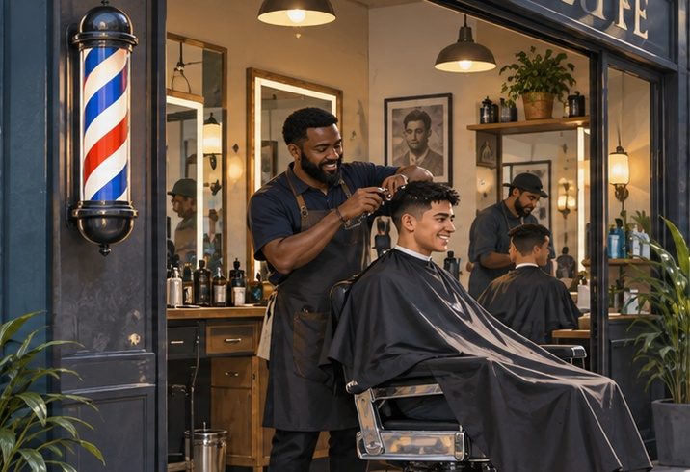
FRIDAY · CHOOSE
CHOOSE · 0:40
Which picture shows a GOOD?
Show its number. Then listen for the next category.
1 Sneakers for sale
3 “Keep our community clean”
2 A paid haircut
One question at a time. Point, show fingers, or write a number.
p. 4; revisit pp. 10–15 · SBTE 4, 9–13 Point to the clue that supports your answer. 14
Notes:
FRIDAY. Chapter 1 p. 4; SBTE 4. THREE-MINUTE MAXIMUM.
SEQUENCE: slide 13: whole scene, 20 seconds quiet noticing; slide 14: the same scene cropped into three details, 40 seconds choosing; slide 15: reveal after responses, 50 seconds checking and 50 seconds connecting to reading, 20 seconds buffer. No automatic countdown or animation.
SAY ON NOTICE: A fictional neighborhood street. Look for three different offerings. Notice the shoes, the haircut, and the message.
SAY ON CHOOSE: Which picture shows a GOOD? Read the three short labels once. Do not show the reveal before students respond.
ANSWER AND EXPLANATION: Ask ONE category at a time: Which picture shows a good? Pause. Which shows a service? Pause. Which shows an idea? Pause. Students point, show fingers, write a number or answer quietly. Answers 1, 2, 3. Classify the environmental message, not its paper. Confirm assessment plans; omit the opener if it would coach assessed answers.
CLOSE: Different offerings. Different ways to meet a need.
READING TRANSITION: Check p. 4, then follow today’s class agenda. Resume the actual section stopping point, not the calendar alone.
ACCESS: Describe the scene without telling students the answer. Accept pointing, fingers, writing or a quiet response. No personal purchases, visits or financial disclosures required. SBTE takes attendance, scans responses and adds at most one clarification.
VISUAL SOURCE: Built-in image generation; fictional people and settings, not actual Eastridge students or facilities. Whole image first, exact source crops second, focused crop at reveal. Assets: ../assets/2026-09-21-to-25-visual-v3/whole-scenes/friday.png.

Slide 15
FRIDAY · CHECK + CONNECT
REVEAL · 1:40
1 Good 2 Service 3 Idea
GOODS, SERVICES, AND IDEAS
Check p. 4, then follow today’s class agenda
Good: tangible item. Service: paid task. Idea: thought or opinion.
Different offerings. Different ways to meet a need.
p. 4; revisit pp. 10–15 · SBTE 4, 9–13 Stop at 3:00 total. 15
Notes:
FRIDAY. Chapter 1 p. 4; SBTE 4. THREE-MINUTE MAXIMUM.
SEQUENCE: slide 13: whole scene, 20 seconds quiet noticing; slide 14: the same scene cropped into three details, 40 seconds choosing; slide 15: reveal after responses, 50 seconds checking and 50 seconds connecting to reading, 20 seconds buffer. No automatic countdown or animation.
SAY ON NOTICE: A fictional neighborhood street. Look for three different offerings. Notice the shoes, the haircut, and the message.
SAY ON CHOOSE: Which picture shows a GOOD? Read the three short labels once. Do not show the reveal before students respond.
ANSWER AND EXPLANATION: Ask ONE category at a time: Which picture shows a good? Pause. Which shows a service? Pause. Which shows an idea? Pause. Students point, show fingers, write a number or answer quietly. Answers 1, 2, 3. Classify the environmental message, not its paper. Confirm assessment plans; omit the opener if it would coach assessed answers.
CLOSE: Different offerings. Different ways to meet a need.
READING TRANSITION: Check p. 4, then follow today’s class agenda. Resume the actual section stopping point, not the calendar alone.
ACCESS: Describe the scene without telling students the answer. Accept pointing, fingers, writing or a quiet response. No personal purchases, visits or financial disclosures required. SBTE takes attendance, scans responses and adds at most one clarification.
VISUAL SOURCE: Built-in image generation; fictional people and settings, not actual Eastridge students or facilities. Whole image first, exact source crops second, focused crop at reveal. Assets: ../assets/2026-09-21-to-25-visual-v3/whole-scenes/friday.png.

Slide 16
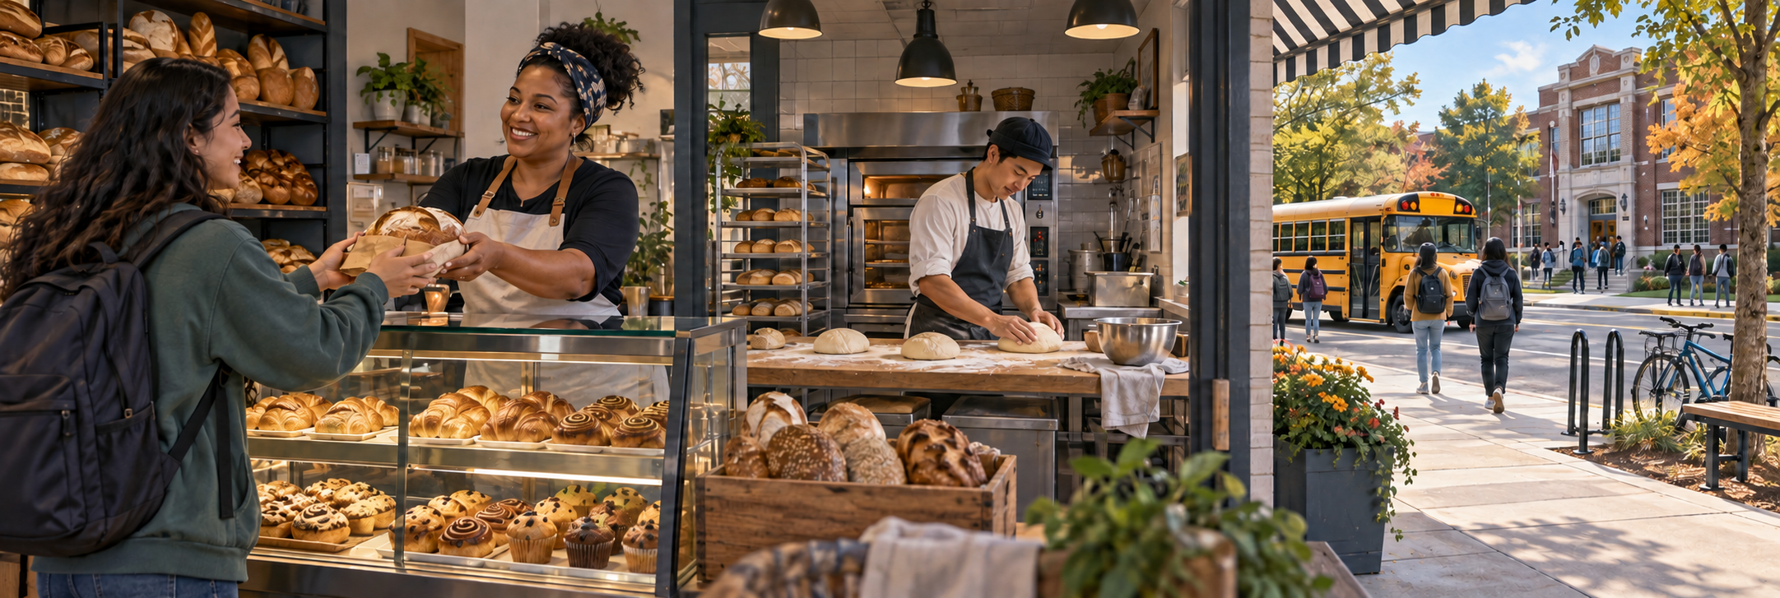
OPTIONAL MONDAY CATCH-UP · NOTICE
3:00 TOTAL
A loaf is sold. What happens beyond the sale?
Look beyond the person buying the bread.
Who else might benefit, and how? Think of one possibility.
Chapter 1 pp. 7–9; SBTE 7–8 LOOK QUIETLY · 20 seconds 16
Notes:
OPTIONAL MONDAY CATCH-UP. Chapter 1 pp. 7–9; SBTE 7–8. THREE-MINUTE MAXIMUM.
SEQUENCE: slide 16: whole scene, 20 seconds quiet noticing; slide 17: the same scene cropped into three details, 40 seconds choosing; slide 18: reveal after responses, 50 seconds checking and 50 seconds connecting to reading, 20 seconds buffer. No automatic countdown or animation.
SAY ON NOTICE: Look beyond the person buying the bread. Who else might benefit, and how? Think of one possibility.
SAY ON CHOOSE: How could the sale affect someone else? Read the three short labels once. Do not show the reveal before students respond.
ANSWER AND EXPLANATION: Use slides 16–18 INSTEAD OF 1–3 only if this section still owes pp. 7–9. First let students predict how someone benefits. Slide 17 has neutral labels only; accept a plausible prediction for baker or community. Reveal on slide 18: employment and wages, taxes supporting public services. The street scene does not show or claim a direct donation to a school. Resume Financial Activities p. 7, then Ways Businesses Contribute to Society pp. 8–9.
CLOSE: Businesses affect more than their customers.
READING TRANSITION: Resume p. 7; then read “Ways Businesses…” on pp. 8–9. Resume the actual section stopping point, not the calendar alone.
ACCESS: Describe the scene without telling students the answer. Accept pointing, fingers, writing or a quiet response. No personal purchases, visits or financial disclosures required. SBTE takes attendance, scans responses and adds at most one clarification.
VISUAL SOURCE: Built-in image generation; fictional people and settings, not actual Eastridge students or facilities. Whole image first, exact source crops second, focused crop at reveal. Assets: ../assets/2026-09-21-to-25-visual-v3/whole-scenes/catchup.png.

Slide 17
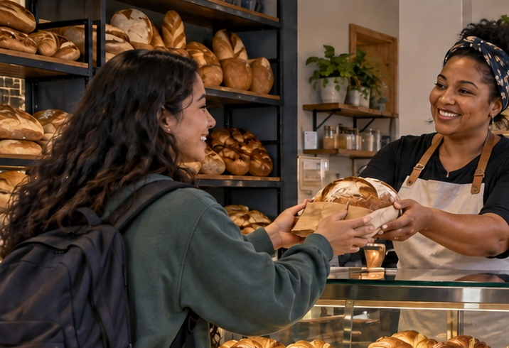
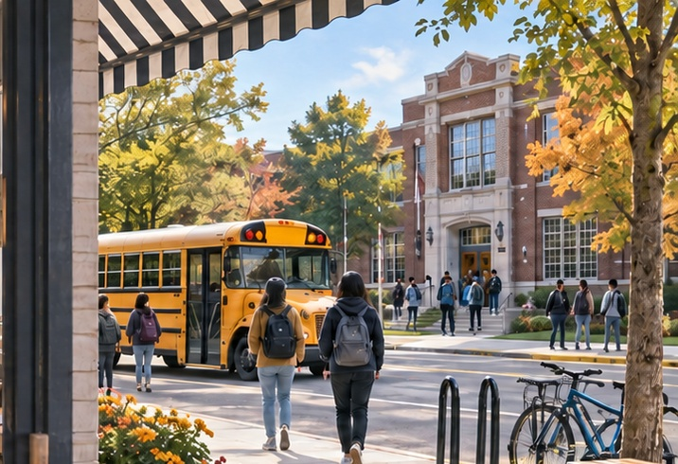
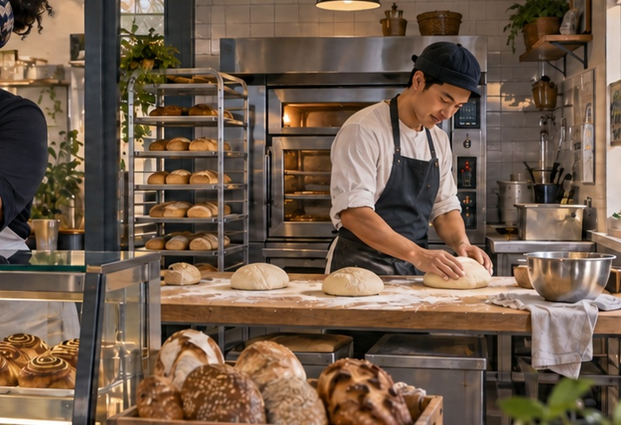
OPTIONAL MONDAY CATCH-UP · CHOOSE
CHOOSE · 0:40
How could the sale affect someone else?
Choose someone beyond the customer. Predict one effect.
1 Customer
3 Community
2 Baker
Say or write: “They might benefit because ___.”
pp. 7–9 · SBTE 7–8 Point to the clue that supports your answer. 17
Notes:
OPTIONAL MONDAY CATCH-UP. Chapter 1 pp. 7–9; SBTE 7–8. THREE-MINUTE MAXIMUM.
SEQUENCE: slide 16: whole scene, 20 seconds quiet noticing; slide 17: the same scene cropped into three details, 40 seconds choosing; slide 18: reveal after responses, 50 seconds checking and 50 seconds connecting to reading, 20 seconds buffer. No automatic countdown or animation.
SAY ON NOTICE: Look beyond the person buying the bread. Who else might benefit, and how? Think of one possibility.
SAY ON CHOOSE: How could the sale affect someone else? Read the three short labels once. Do not show the reveal before students respond.
ANSWER AND EXPLANATION: Use slides 16–18 INSTEAD OF 1–3 only if this section still owes pp. 7–9. First let students predict how someone benefits. Slide 17 has neutral labels only; accept a plausible prediction for baker or community. Reveal on slide 18: employment and wages, taxes supporting public services. The street scene does not show or claim a direct donation to a school. Resume Financial Activities p. 7, then Ways Businesses Contribute to Society pp. 8–9.
CLOSE: Businesses affect more than their customers.
READING TRANSITION: Resume p. 7; then read “Ways Businesses…” on pp. 8–9. Resume the actual section stopping point, not the calendar alone.
ACCESS: Describe the scene without telling students the answer. Accept pointing, fingers, writing or a quiet response. No personal purchases, visits or financial disclosures required. SBTE takes attendance, scans responses and adds at most one clarification.
VISUAL SOURCE: Built-in image generation; fictional people and settings, not actual Eastridge students or facilities. Whole image first, exact source crops second, focused crop at reveal. Assets: ../assets/2026-09-21-to-25-visual-v3/whole-scenes/catchup.png.

Slide 18
OPTIONAL MONDAY CATCH-UP · CHECK + CONNECT
REVEAL · 1:40
Jobs and public services
BUSINESSES AND SOCIETY
Resume p. 7; then read “Ways Businesses…” on pp. 8–9
Employees can earn wages. Business taxes can help fund public services.
Businesses affect more than their customers.
pp. 7–9 · SBTE 7–8 Stop at 3:00 total. 18
Notes:
OPTIONAL MONDAY CATCH-UP. Chapter 1 pp. 7–9; SBTE 7–8. THREE-MINUTE MAXIMUM.
SEQUENCE: slide 16: whole scene, 20 seconds quiet noticing; slide 17: the same scene cropped into three details, 40 seconds choosing; slide 18: reveal after responses, 50 seconds checking and 50 seconds connecting to reading, 20 seconds buffer. No automatic countdown or animation.
SAY ON NOTICE: Look beyond the person buying the bread. Who else might benefit, and how? Think of one possibility.
SAY ON CHOOSE: How could the sale affect someone else? Read the three short labels once. Do not show the reveal before students respond.
ANSWER AND EXPLANATION: Use slides 16–18 INSTEAD OF 1–3 only if this section still owes pp. 7–9. First let students predict how someone benefits. Slide 17 has neutral labels only; accept a plausible prediction for baker or community. Reveal on slide 18: employment and wages, taxes supporting public services. The street scene does not show or claim a direct donation to a school. Resume Financial Activities p. 7, then Ways Businesses Contribute to Society pp. 8–9.
CLOSE: Businesses affect more than their customers.
READING TRANSITION: Resume p. 7; then read “Ways Businesses…” on pp. 8–9. Resume the actual section stopping point, not the calendar alone.
ACCESS: Describe the scene without telling students the answer. Accept pointing, fingers, writing or a quiet response. No personal purchases, visits or financial disclosures required. SBTE takes attendance, scans responses and adds at most one clarification.
VISUAL SOURCE: Built-in image generation; fictional people and settings, not actual Eastridge students or facilities. Whole image first, exact source crops second, focused crop at reveal. Assets: ../assets/2026-09-21-to-25-visual-v3/whole-scenes/catchup.png.

