Slide 1

ICEBREAKER 1/4
⏱ 3 MIN MAX
One pizza shop, three kinds of work
Use what you notice. The reading will give us the official terms.
LOOK QUIETLY FOR 10 SECONDS FIND THREE DIFFERENT KINDS OF WORK
1/4
Notes:
0:00–0:15 | Say: ‘Look for three different kinds of work. You do not need the business words yet. The reading will give us those.’
Source: Chapter 1, Introduction to Business and Marketing, B.E. Publishing, pp. 4–7. Local source: /Users/pitergarcia/DataScience/Semester5/Semester3(UofR)/TeachingPlacement/second-placement/Chapter 1 Introduction to Business and Marketing.pdf

Slide 2
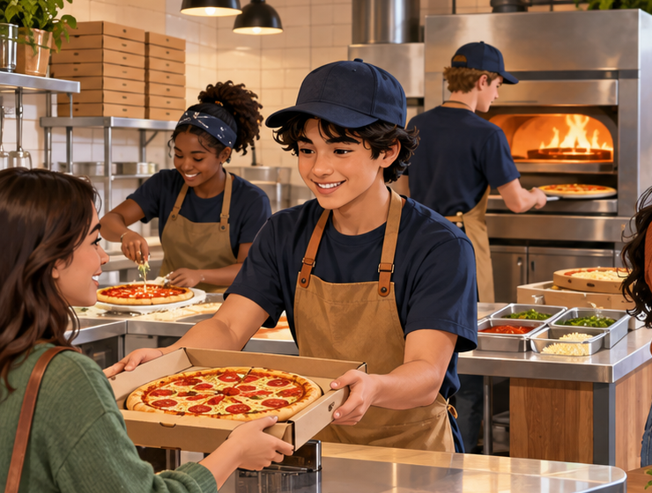


ICEBREAKER 2/4
⏱ 3 MIN MAX
Where do O, I, and F belong?
Use each clue once. Place one letter under each picture.
O = daily work I = builds value over time F = money moves in or out
1
3
2
POINT, WRITE, OR SAY: 1 = ? 2 = ? 3 = ?
2/4
Notes:
0:15–1:05 | Keep the first image visible in three parts. Read the clues once. Give students 15 silent seconds, then say: ‘Place O, I, and F under pictures 1, 2, and 3.’ Students may point, write, or say the three-letter order. Do not reveal the answer yet.
Source: Chapter 1, Introduction to Business and Marketing, B.E. Publishing, pp. 4–7. Local source: /Users/pitergarcia/DataScience/Semester5/Semester3(UofR)/TeachingPlacement/second-placement/Chapter 1 Introduction to Business and Marketing.pdf

Slide 3
ICEBREAKER 3/4
⏱ 3 MIN MAX
Check the three pictures
Use the visual clue to explain each match.
1
OPERATIONAL
Employees make pizzas and serve customers
2
INVESTING
The owners plan an upgrade that can build future value
3
FINANCIAL
The business records sales and pays for supplies
1 = O 2 = I 3 = F
3/4
Notes:
1:05–1:50 | Reveal the order. Say only: ‘Picture 1 shows daily operations. Picture 2 shows an investment for future value. Picture 3 shows money moving through the business.’
Source: Chapter 1, Introduction to Business and Marketing, B.E. Publishing, pp. 4–7. Local source: /Users/pitergarcia/DataScience/Semester5/Semester3(UofR)/TeachingPlacement/second-placement/Chapter 1 Introduction to Business and Marketing.pdf

Slide 4

ICEBREAKER 4/4
⏱ 3 MIN MAX
Reading map for pages 4–7
The icebreaker gives us clues. The text gives us the full explanation.
4
Business, marketing, products, goods, services, and ideas
5–6
Operational activities and investing activities
7
Financial activities and the money flowing through a business
Business activities include daily operations, investments, and money moving through the company.
NEXT: Read pages 4–7 and use the three clues to check your predictions.
4/4
Notes:
1:50–3:00 | Say the closer exactly. Then say: ‘Open to page 4. As you read, look for the three clues and correct any prediction that needs changing.’ Hard stop by 7:38.
Source: Chapter 1, Introduction to Business and Marketing, B.E. Publishing, pp. 4–7. Local source: /Users/pitergarcia/DataScience/Semester5/Semester3(UofR)/TeachingPlacement/second-placement/Chapter 1 Introduction to Business and Marketing.pdf

