Slide 1
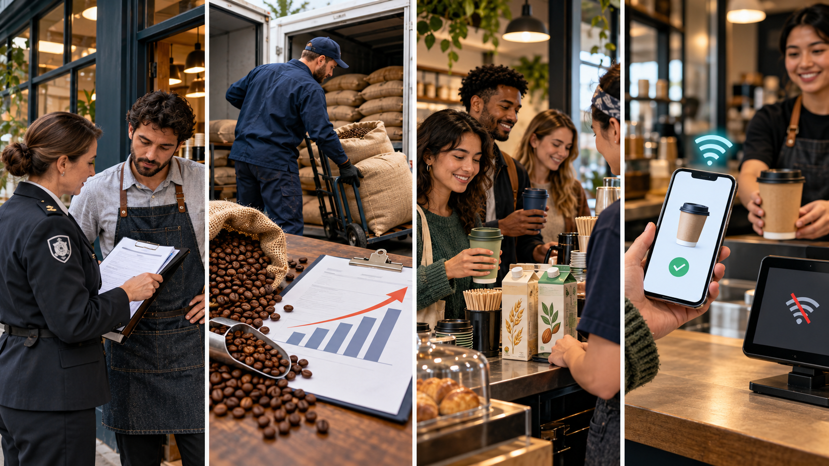
PEST analysis for your business
Work with a partner.
Choose one business together. Explain how outside changes could help or hurt it.
30 minutes
Notes:
SAY: “Today you will use PEST to explain how outside changes affect a business you choose.”
DO: Display the agenda, distribute the sheet, and identify the target.
CHECK: Students know that PEST concerns external influences, not the four Ps.
Source: Principles of Marketing, Chapter 2, printed pp.19–20, Figure2.1. Activity/timing: Piter reconstructed October13 notes and whiteboard reference. Grading descriptors: proposed for SBTE approval, not established school scoring policy. Images: generated hypothetical coffee-shop scenarios, not actual events.
Pair structure: Piter explicitly confirmed October13.

Slide 2
Activity sequence
Instructions and grading: 3–5 min
Business and target market: 2 min
P / E / S / T: 3 min each = 12 min
Business summary: 5 min
Buffer and Terms to Know: 6–8 min
A 30-minute planning window
Notes:
SAY: “We will complete one PEST section at a time. I will tell you when to move.”
DO: Keep the introduction within five minutes, including the short model.
NOTE: 3–5 + 2 + 12 + 5 =22–24, leaving 6–8 minutes. If discussion runs longer, reduce buffer rather than claiming work finished.
Source: Principles of Marketing, Chapter 2, printed pp.19–20, Figure2.1. Activity/timing: Piter reconstructed October13 notes and whiteboard reference. Grading descriptors: proposed for SBTE approval, not established school scoring policy. Images: generated hypothetical coffee-shop scenarios, not actual events.
Pair structure: Piter explicitly confirmed October13.

Slide 3
Your PEST work
Accurate external factors
Examples connected to your business
Positive and negative impacts with reasons
A summary explaining business responses
Success criteria
Notes:
IF PAT APPROVES THE NUMERICAL RUBRIC: SAY: “A 3 shows complete, accurate application. A 4 explains a deeper decision and why it makes sense. More words alone do not earn a 4.”
CHECK WITH PAT: Confirm these descriptors and whether this is formative or graded before announcing them as final. No automatic averaging, bonuses, or conversion rules.
Source: Principles of Marketing, Chapter 2, printed pp.19–20, Figure2.1. Activity/timing: Piter reconstructed October13 notes and whiteboard reference. Grading descriptors: proposed for SBTE approval, not established school scoring policy. Images: generated hypothetical coffee-shop scenarios, not actual events.
Pair structure: Piter explicitly confirmed October13.

Slide 4
Clear business explanations
Use business terms and complete thoughts.
“This could affect our business because…”
“Our business could respond by… because…”
Use your textbook and notes. Rehearse your explanation with your partner.
Both partners explain why
Notes:
IF PAT APPROVES THE NUMERICAL RUBRIC: SAY: “Use business terms and explain because. A list of words does not yet show why a business is affected.”
DO: Read directions aloud and accept a spoken rehearsal before writing.
ASSESS: Understanding, not spelling, handwriting, accent, speed, or decorative work. Access support alone never reduces a level. Insufficient evidence is separate from level 1; confirm IE and overall-score handling with Pat.
Source: Principles of Marketing, Chapter 2, printed pp.19–20, Figure2.1. Activity/timing: Piter reconstructed October13 notes and whiteboard reference. Grading descriptors: proposed for SBTE approval, not established school scoring policy. Images: generated hypothetical coffee-shop scenarios, not actual events.
Pair structure: Piter explicitly confirmed October13.

Slide 5
One hypothetical example
A coffee shop faces stricter food-safety rules.
Which PEST category fits?
What could help the business?
What could create a difficulty?
Think first; answers appear on the next clicks
Notes:
SAY: “What changed outside the business? Which letter fits? What could be positive and negative for this shop?”
DO: Wait5–10seconds; invite a spoken or written response. Do not pre-answer students’ own chosen businesses.
Source: Principles of Marketing, Chapter 2, printed pp.19–20, Figure2.1. Activity/timing: Piter reconstructed October13 notes and whiteboard reference. Grading descriptors: proposed for SBTE approval, not established school scoring policy. Images: generated hypothetical coffee-shop scenarios, not actual events.
Pair structure: Piter explicitly confirmed October13.

Slide 6
Political influence
Stricter food-safety rules
+ Customers may trust a shop that demonstrates compliance.
− What possible cost could the shop face?
First reveal: category and positive impact
Notes:
SAY: “The factor is government regulation. One possible positive impact is customer trust. What might the cost be?”
DO: Pause before the next click. Explain these are possible consequences, not guarantees.
Source: Principles of Marketing, Chapter 2, printed pp.19–20, Figure2.1. Activity/timing: Piter reconstructed October13 notes and whiteboard reference. Grading descriptors: proposed for SBTE approval, not established school scoring policy. Images: generated hypothetical coffee-shop scenarios, not actual events.
Pair structure: Piter explicitly confirmed October13.

Slide 7
Political influence
Stricter food-safety rules
+ Compliance may strengthen customer trust.
− Training and equipment may increase operating costs.
Second reveal: negative impact
Notes:
SAY: “The same external change can create an opportunity and a cost. Your example must explain why.”
DO: Model only this one factor, then let students apply the other categories.
RESPONSE: The shop could train staff and plan for compliance costs. This is an internal response to an external factor.
Source: Principles of Marketing, Chapter 2, printed pp.19–20, Figure2.1. Activity/timing: Piter reconstructed October13 notes and whiteboard reference. Grading descriptors: proposed for SBTE approval, not established school scoring policy. Images: generated hypothetical coffee-shop scenarios, not actual events.
Pair structure: Piter explicitly confirmed October13.

Slide 8
Business and target market
Choose one business together.
Write both names and the target market.
One partner explains; the other records.
Switch roles for each PEST category.
Both partners contribute reasoning.
More room: use the back (page 2). Label P, E, S, or T.
2 minutes
Notes:
SAY: “Choose a business you understand and name its target market. Who buys from it, and what do they want?”
DO: Start a 2-minute timer. If stuck, offer a familiar business category such as a cafe, shoe shop, or digital-book service.
CHECK: Business and target market both recorded.
Source: Principles of Marketing, Chapter 2, printed pp.19–20, Figure2.1. Activity/timing: Piter reconstructed October13 notes and whiteboard reference. Grading descriptors: proposed for SBTE approval, not established school scoring policy. Images: generated hypothetical coffee-shop scenarios, not actual events.
Pair structure: Piter explicitly confirmed October13.
Worksheet: two pages printed front/back (long-edge duplex). Students may continue any answer on page 2, labeled P/E/S/T. The business summary is on page 2. Check both sides.

Slide 9
P Political
Government policies, laws, or intervention
What outside rule or policy could affect this business?
Together: factor/example, + and − impacts.
Explain why. Switch explainer/recorder.
3 minutes
Notes:
SAY: “What outside rule or policy could affect this business? Give a connected example and explain both possible impacts.”
DO: Read the category cue, start a 3-minute timer, stand at a deliberate scan point.
LISTEN FOR: External factor, category fit, effect on this business or target market, because reasoning.
IF WEAK: Ask “What changed outside the business? What happens to costs, customers, or access?” Model a question, not their answer.
IF STRONG: Ask which impact matters most and why.
CHECK: Do not classify the business’s own ad, discount, or new app decision as the external factor.
PAIR MOVE: Give each partner a brief turn to explain an impact before recording the shared answer. Rotate roles at the next category.
Source: Principles of Marketing, Chapter 2, printed pp.19–20, Figure2.1. Activity/timing: Piter reconstructed October13 notes and whiteboard reference. Grading descriptors: proposed for SBTE approval, not established school scoring policy. Images: generated hypothetical coffee-shop scenarios, not actual events.
Pair structure: Piter explicitly confirmed October13.

Slide 10
E Economic
Inflation, consumer income, exchange rates, or credit
What outside economic change could affect costs or demand?
Together: factor/example, + and − impacts.
Explain why. Switch explainer/recorder.
3 minutes
Notes:
SAY: “What outside economic change could affect costs or demand? Give a connected example and explain both possible impacts.”
DO: Read the category cue, start a 3-minute timer, stand at a deliberate scan point.
LISTEN FOR: External factor, category fit, effect on this business or target market, because reasoning.
IF WEAK: Ask “What changed outside the business? What happens to costs, customers, or access?” Model a question, not their answer.
IF STRONG: Ask which impact matters most and why.
CHECK: Do not classify the business’s own ad, discount, or new app decision as the external factor.
PAIR MOVE: Give each partner a brief turn to explain an impact before recording the shared answer. Rotate roles at the next category.
Source: Principles of Marketing, Chapter 2, printed pp.19–20, Figure2.1. Activity/timing: Piter reconstructed October13 notes and whiteboard reference. Grading descriptors: proposed for SBTE approval, not established school scoring policy. Images: generated hypothetical coffee-shop scenarios, not actual events.
Pair structure: Piter explicitly confirmed October13.

Slide 11
S Social
Population, education, social patterns, or preferences
What change in the customers or community could affect demand?
Together: factor/example, + and − impacts.
Explain why. Switch explainer/recorder.
3 minutes
Notes:
SAY: “What change in the customers or community could affect demand? Give a connected example and explain both possible impacts.”
DO: Read the category cue, start a 3-minute timer, stand at a deliberate scan point.
LISTEN FOR: External factor, category fit, effect on this business or target market, because reasoning.
IF WEAK: Ask “What changed outside the business? What happens to costs, customers, or access?” Model a question, not their answer.
IF STRONG: Ask which impact matters most and why.
CHECK: Do not classify the business’s own ad, discount, or new app decision as the external factor.
PAIR MOVE: Give each partner a brief turn to explain an impact before recording the shared answer. Rotate roles at the next category.
Source: Principles of Marketing, Chapter 2, printed pp.19–20, Figure2.1. Activity/timing: Piter reconstructed October13 notes and whiteboard reference. Grading descriptors: proposed for SBTE approval, not established school scoring policy. Images: generated hypothetical coffee-shop scenarios, not actual events.
Pair structure: Piter explicitly confirmed October13.

Slide 12
T Technological
Access to technology or the rate of technological change
What outside technology change could affect access, service, or competition?
Together: factor/example, + and − impacts.
Explain why. Switch explainer/recorder.
3 minutes
Notes:
SAY: “What outside technology change could affect access, service, or competition? Give a connected example and explain both possible impacts.”
DO: Read the category cue, start a 3-minute timer, stand at a deliberate scan point.
LISTEN FOR: External factor, category fit, effect on this business or target market, because reasoning.
IF WEAK: Ask “What changed outside the business? What happens to costs, customers, or access?” Model a question, not their answer.
IF STRONG: Ask which impact matters most and why.
CHECK: Do not classify the business’s own ad, discount, or new app decision as the external factor.
PAIR MOVE: Give each partner a brief turn to explain an impact before recording the shared answer. Rotate roles at the next category.
Source: Principles of Marketing, Chapter 2, printed pp.19–20, Figure2.1. Activity/timing: Piter reconstructed October13 notes and whiteboard reference. Grading descriptors: proposed for SBTE approval, not established school scoring policy. Images: generated hypothetical coffee-shop scenarios, not actual events.
Pair structure: Piter explicitly confirmed October13.

Slide 13
Business summary
How could your PEST findings affect the business’s potential success?
How would the business use a positive impact?
How would it respond to a negative impact?
Explain the reason for each response.
Agree on your response together.
Write the summary on the back (page 2).
5 minutes
Notes:
SAY: “Connect the analysis to a business decision. Which opportunity would you use? Which risk would you address? Why?”
DO: Invite2–4 complete sentences as a planning guide, not a scored word count. Students may orally rehearse first.
CHECK: Responses follow from their own factors, not generic advice.
EXTEND: Compare priorities or two interacting factors and justify a trade-off.
PAIR CHECK: Both partners can explain the agreed business response.
Source: Principles of Marketing, Chapter 2, printed pp.19–20, Figure2.1. Activity/timing: Piter reconstructed October13 notes and whiteboard reference. Grading descriptors: proposed for SBTE approval, not established school scoring policy. Images: generated hypothetical coffee-shop scenarios, not actual events.
Pair structure: Piter explicitly confirmed October13.
Worksheet: two pages printed front/back (long-edge duplex). Students may continue any answer on page 2, labeled P/E/S/T. The business summary is on page 2. Check both sides.

Slide 14
Completion check and Terms to Know
Business and target market
All four PEST sections
Connected examples and explained + / − impacts
Summary on the back with business responses
Then practise Terms to Know for Thursday’s quiz.
Remaining 6–8 minutes
Notes:
SAY: “Check each section. Circle a place where you explained why. Use remaining time to practise the approved Terms to Know.”
DO: Record separate Block 1 and Block 5 stops.
OPEN: Confirm quiz scope, collection route, how pair evidence will be assessed, and grading with Pat. Do not invent a deadline.
RECORD: Block 1 stop/support needed __ ; Block 5 stop/support needed __.
Source: Principles of Marketing, Chapter 2, printed pp.19–20, Figure2.1. Activity/timing: Piter reconstructed October13 notes and whiteboard reference. Grading descriptors: proposed for SBTE approval, not established school scoring policy. Images: generated hypothetical coffee-shop scenarios, not actual events.
Pair structure: Piter explicitly confirmed October13.
Worksheet: two pages printed front/back (long-edge duplex). Students may continue any answer on page 2, labeled P/E/S/T. The business summary is on page 2. Check both sides.

