Slide 1
British Airways
Web scraping to gain company insights

Slide 2
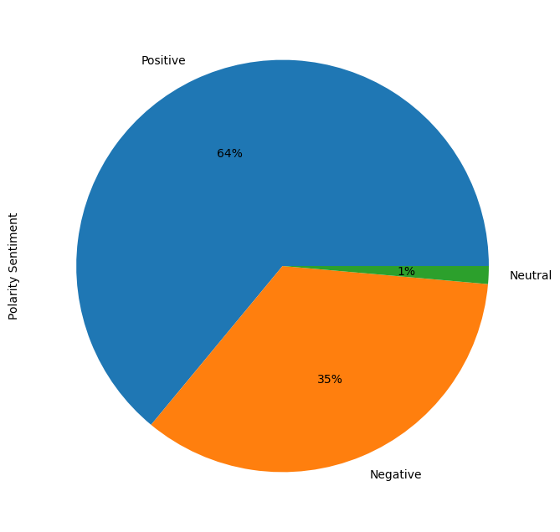
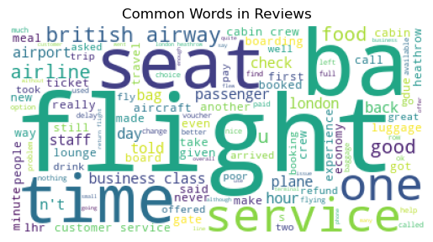
Insights from Sentiment Analysis and Key Word Analysis
After cleaning a sample of 1000 British Airways reviews, it’s revealed that 64% of them are positive, 35% are negative, and 1% is neutral.

