Slide 1
MAGeCK tutorial
Morning Lab: CRISPR Screening Workshop 2026

Slide 2
MAGeCK produces effect sizes given NGS data
Model-based Analysis of Genome-wide CRISPR/Cas9 Knockout
How are statistically significant genes/sgRNAs identified from CRISPR screen data?
Notes:
MAGeCK is a computational tool used to analyze CRISPR screen data and has been in use since 2014. It is very widely used in the CRISPR screening field.
It seeks to address the following question: How are statistically significant genes/sgRNAs identified from CRISPR screen data?
This is not such an easy task.
The fundamental issue:
How to normalize raw data (to account for differences in read depth) Some gRNAs work better than others.
How do we identify key genes if there are multiple sgRNAs per gene?
If guides for one gene are skewed to the left, or skewed to the right, that indicates that that gene is probably a real hit
Kolmogorov-Smirnov test can be used for sgRNA analysis (just like in GSEA)

Slide 3
MAGeCK produces effect sizes given NGS data
Model-based Analysis of Genome-wide CRISPR/Cas9 Knockout
How are statistically significant genes/sgRNAs identified from CRISPR screen data?
CRISPR screen data analysis challenges:
sgRNA sequencing reads substantially vary between biological replicates
How to aggregate information from multiple sgRNAs targeting the same gene?
Notes:
From replicate to replicate in an experiment, sgRNA sequencing reads can vary. How do you account for these differences in sequencing depth such that you can make reliable statistical comparisons between replicates?
One sgRNA when it “knocks out” a gene, is mechanistically inducing a specific double-stranded break with a specific repair outcome and off-target profile. Thus, using one sgRNA to edit a gene is a proxy for measuring true gene effects. That’s why it would be nice to use multiple sgRNAs and somehow average their effects together.

Slide 4
MAGeCK produces effect sizes given NGS data
Model-based Analysis of Genome-wide CRISPR/Cas9 Knockout
How are statistically significant genes/sgRNAs identified from CRISPR screen data?
CRISPR screen data analysis challenges:
sgRNA sequencing reads substantially vary between biological replicates
How to aggregate information from multiple sgRNAs targeting the same gene?
Idea: Statistical testing to identify essential sgRNAs, genes, and pathways from CRISPR screens
Notes:
Shirley Liu’s lab came up with a framework to statistically test for essential sgRNAs, genes, and pathways in CRISPR screens.
How to normalize raw data (to account for differences in read depth) Some gRNAs work better than others.
How do we identify key genes if there are multiple sgRNAs per gene?
If guides for one gene are skewed to the left, or skewed to the right, that indicates that that gene is probably a real hit
Kolmogorov-Smirnov test can be used for sgRNA analysis (just like in GSEA)

Slide 5
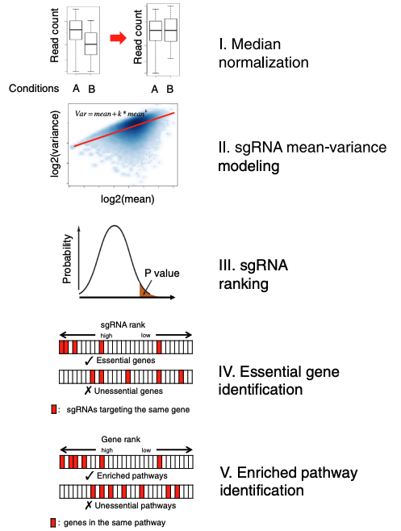
How MAGeCK works
Median normalization
sgRNA mean-variance modeling
sgRNA ranking
Essential gene identification
Enriched pathway identification
Notes:
I’m briefly going to touch on some of the steps of MAGeCK and why they are done.

Slide 6
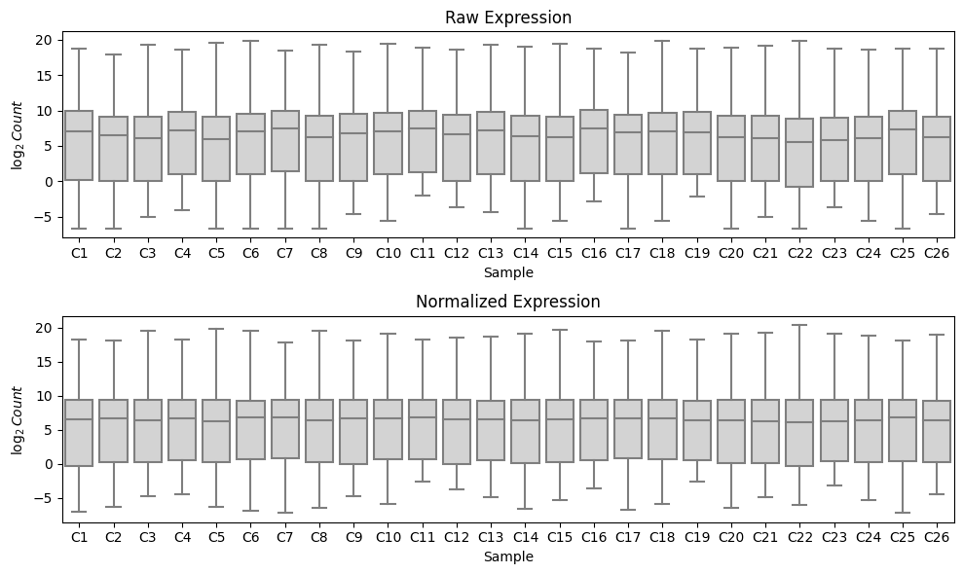
How MAGeCK works
Why use median normalization?
https://mbernste.github.io/posts/median_ratio_norm/
Notes:
Normalization is essential to remove systematic variation across replicates. Median normalization is used to make read count distributions have the same medians and rescale all other values accordingly.
Say your control and treatment samples have the same distribution shape of sgRNAs, but there are twice as many reads in the treatment. That would mean every sgRNA is enriched. The biology didn’t change in this case, it’s just that the sequencing depth was higher. The median is not influenced by outliers, which is why it is picked for normalization purposes
Each sample has a distribution that is slightly stretched or shrunk. Median-ratio normalization rescales the distribution so that the middle of the distribution lines up with the reference.
This assumes that most genes do not change biologically, so the center of the distribution (a ”typical gene” tells you how much your sample is scaled relative to the others
In other words, normalization asks: What is the multiplicative factor that best aligns the unchanged majority of genes across samples?
https://mbernste.github.io/posts/median_ratio_norm/

Slide 7
How MAGeCK works
Why use median normalization?
To eliminate global technical effects (e.g. read depth)
https://mbernste.github.io/posts/median_ratio_norm/
Notes:
Normalization is essential to remove systematic variation across replicates. Median normalization is used to make read count distributions have the same medians and rescale all other values accordingly.
Say your control and treatment samples have the same distribution shape of sgRNAs, but there are twice as many reads in the treatment. That would mean every sgRNA is enriched. The biology didn’t change in this case, it’s just that the sequencing depth was higher. The median is not influenced by outliers, which is why it is picked for normalization purposes
Each sample has a distribution that is slightly stretched or shrunk. Median-ratio normalization rescales the distribution so that the middle of the distribution lines up with the reference.
This assumes that most genes do not change biologically, so the center of the distribution (a ”typical gene” tells you how much your sample is scaled relative to the others
In other words, normalization asks: What is the multiplicative factor that best aligns the unchanged majority of genes across samples?
https://mbernste.github.io/posts/median_ratio_norm/

Slide 8
How MAGeCK works
Median normalization
sgRNA mean-variance modeling
sgRNA ranking
Essential gene identification
Enriched pathway identification
Notes:
Doing differential expression with Poisson distribution:
How much could the read counts for an sgRNA differ due to random sampling of a Poisson distribution? If observed difference is too large to plausibly come from random sampling, we can call the sgRNA significant
The Poisson distribution has a single parameter lambda, where its variance and all other properties follow from it. The variance is equal to the mean.
In practice, there is “overdispersion,” i.e. counts from biological replicates tend to have variance exceeding the mean, so Poisson predicts smaller variations than what is observed in data.
Negative binomial distribution is used to model count data: determined by mean mu and variance sigma
Very standard for DESeq, etc.
Why use negative binomial?
It's primarily because the negative binomial is A) a count distribution and B) let's you model a variance that is greater than the mean.
Poisson is count based but you're stuck with mean=var which is clearly an underestimate of variance when you look at real data.
Binomial is count based and let's you model variance separately but the way it's parameterized the variance is always less than or equal to the mean.
Negative Binomial is the opposite - variance is always greater than or equal to the mean.
it’s often the case that variance is greater than the mean, which violates the assumptions of a Poisson model. So you need a new model, negative binomial, which allows for more freedom in terms of the relationship between mean and variance.

Slide 9
How MAGeCK works
Median normalization
sgRNA mean-variance modeling
sgRNA ranking
Essential gene identification
Enriched pathway identification
Notes:
P-values derived from NB model testing are used to rank sgRNAs
Positive rank: Do gene’s gRNAs consistently appear near the top of the ranked list? Negative rank:
Do gene’s gRNAs consistently appear near the bottom of the ranked list?

Slide 10
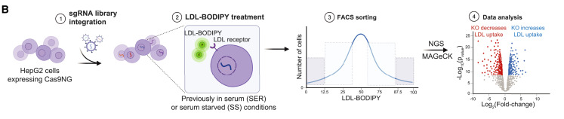
LDL uptake screen workflow
Figure 1B, Hamilton et al. 2020
Infect HepG2s (SER vs. SS) with lentiviruses containing sgRNA library
Notes:
4 gRNAs per gene
In the first screen, we did not do genome wide CRISPR screening, but a large screen that encompassed genes anywhere near a GWAS hit for LDLR level, and gRNAs that target every collection of SNPs. A set of 3000 guides (which were the top candidates from the initial screen) were used

Slide 11
LDL uptake screen workflow
Figure 1B, Hamilton et al. 2020
Infect HepG2s (SER vs. SS) with lentiviruses containing sgRNA library
Feed HepG2s with fluorescent cholesterol and sort via FACS

Slide 12
LDL uptake screen workflow
Figure 1B, Hamilton et al. 2020
Infect HepG2s (SER vs. SS) with lentiviruses containing sgRNA library
Feed HepG2s with fluorescent cholesterol and sort via FACS
Collect gDNA, PCR out sgRNAs, send for NGS

Slide 13
LDL uptake screen workflow
Figure 1B, Hamilton et al. 2020
Infect HepG2s (SER vs. SS) with lentiviruses containing sgRNA library
Feed HepG2s with fluorescent cholesterol and sort via FACS
Collect gDNA, PCR out sgRNAs, send for NGS
Analyze sgRNA counts with MAGeCK

Slide 14
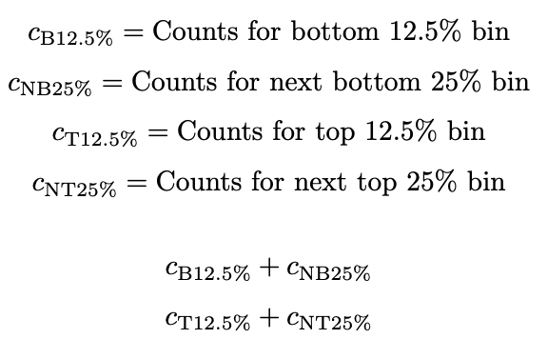
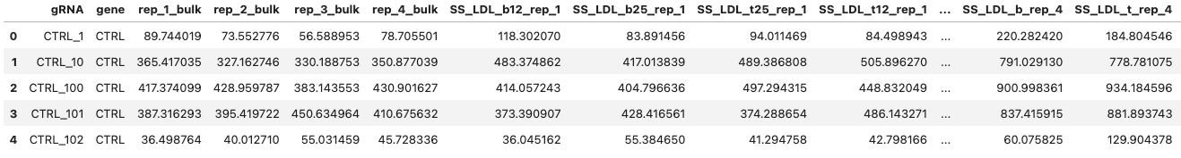
Running MAGeCK on screen data
Consult the Colab notebook: https://colab.research.google.com/github/pzhou1729/2026_CRISPRscreen_GeneticsBootcamp/blob/main/mageck_tutorial.ipynb
Let’s take a look at the counts data from the CRISPR screen.
Serum starved, bottom 12.5% bin
Serum starved, sum of bins
Unsorted sample
Notes:
Making a weighted sum gives you one number per sgRNA per replicate summarizing “how top-heavy vs bottom-heavy” it is, instead of juggling multiple bins.

Slide 15
Running MAGeCK on screen data
Referencing the tutorial on 20200417_mageck_tutorial:
1. Download Anaconda: https://www.anaconda.com/distribution/
2. Install MAGeCK from Anaconda
In your terminal, conda install -c bioconda mageck
3. Verify installation
conda list OR
mageck –v
4. Clone the repository:
git clone https://github.com/pzhou1729/2026_CRISPRscreen_GeneticsBootcamp.git
Notes:
If you try conda list, mageck should pop up in the list of packages
Mageck version should be 0.5.9.5 as of January 13, 2026

Slide 16
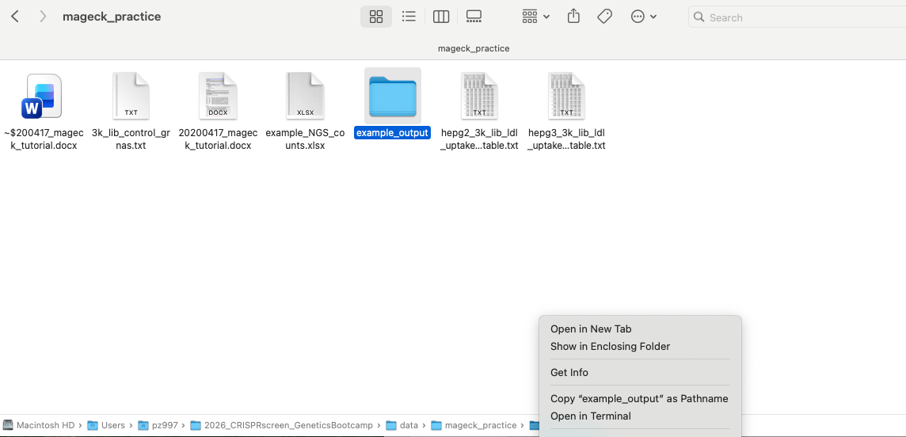
Running MAGeCK on screen data
5. Navigate to the cloned repository. You should be able to find it with Finder > Go > Go to Folder and searching up 2026_CRISPRscreen_GeneticsBootcamp
6. Navigate to data > mageck_practice
7. Right click on the folder and select “Open in Terminal”

Slide 17
Running MAGeCK on screen data
8. Now what you’ve all been waiting for: Copy and paste this command into your terminal and hit enter.
mageck test \
-k hepg2_3k_lib_ldl_uptake_read_count_table.txt \
-t ser_LDL_b_rep_1,ser_LDL_b_rep_2,ser_LDL_b_rep_3,ser_LDL_b_rep_4 \
-c ser_LDL_t_rep_1,ser_LDL_t_rep_2,ser_LDL_t_rep_3,ser_LDL_t_rep_4 \
-n ser_bottom_top \
--paired \
--sort-criteria pos \
--norm-method control \
--control-sgrna 3k_lib_control_grnas.txt \
--pdf-report

Slide 18
What flags are we using?
mageck test \
-k hepg2_3k_lib_ldl_uptake_read_count_table.txt \
-t ser_LDL_b_rep_1,ser_LDL_b_rep_2,ser_LDL_b_rep_3,ser_LDL_b_rep_4 \
-c ser_LDL_t_rep_1,ser_LDL_t_rep_2,ser_LDL_t_rep_3,ser_LDL_t_rep_4 \
-n ser_bottom_top \
--paired \
--sort-criteria pos \
--norm-method control \
--control-sgrna 3k_lib_control_grnas.txt \
--pdf-report
Read count table file
Treatment samples (bottom bin replicates)
Control samples (top bin replicates)
Output file prefix (every file starts with “ser_bottom_top”)
Perform paired analysis (treatment vs. controls)
Sorts output by positively selected gRNAs
Normalizes based on control gRNAs
Input list of control gRNAs
Generate PDF report of results
Notes:
How do the sgRNA enrichments in the top fluorescent bins differ from the least fluorescent bins?

Slide 19
MAGeCK output
ser_bottom_top.log
ser_bottom_top.negcntl_ids.txt
ser_bottom_top.gene_summary.txt
ser_bottom_top.pdf
ser_bottom_top.R
ser_bottom_top_sgrna_summary.txt

Slide 20
Highlights from MAGeCK output
Take a few minutes to look at the data and think about it.
Focus on the following datasets:
ser_bottom_top.gene_summary.txt
ser_bottom_top_sgrna_summary.txt
You can open txt files in Excel
Feel free to look genes up!

Slide 21
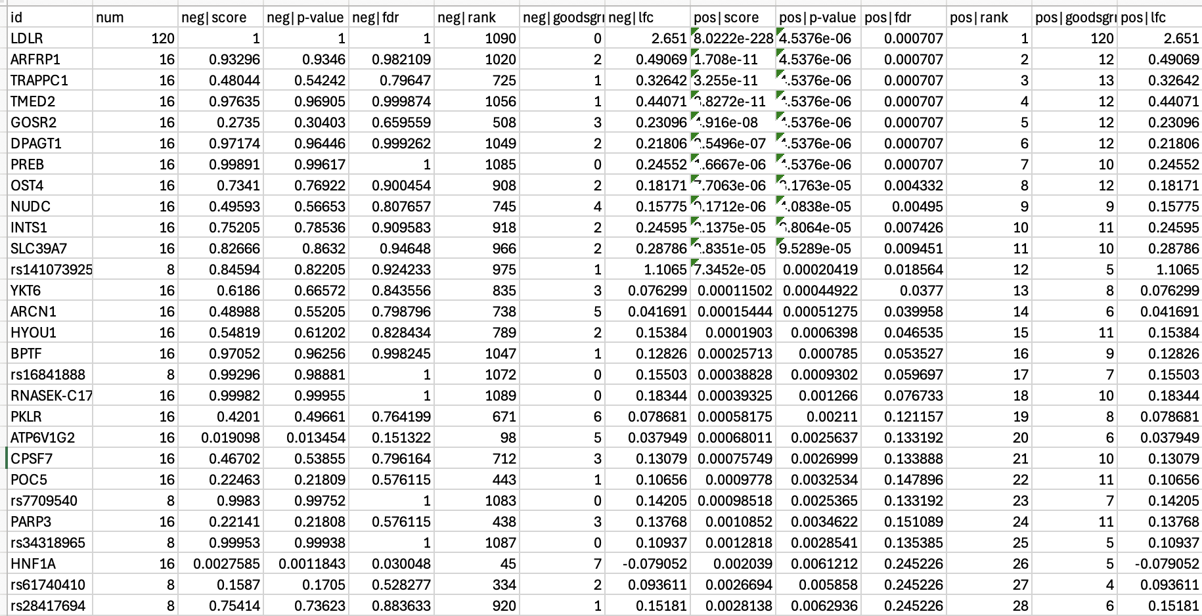
Genes: LDLR is strongest positive hit
Notes:
When LDLR is knocked out, LDL uptake decreases
You might want to use the p-values and LFCs in volcano plots down the line

Slide 22
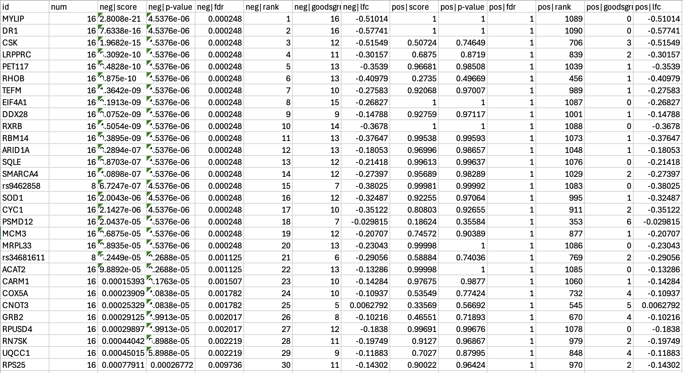
Genes: MYLIP is strongest negative hit
Notes:
When MYLIP is knocked out, LDL uptake increases

Slide 23
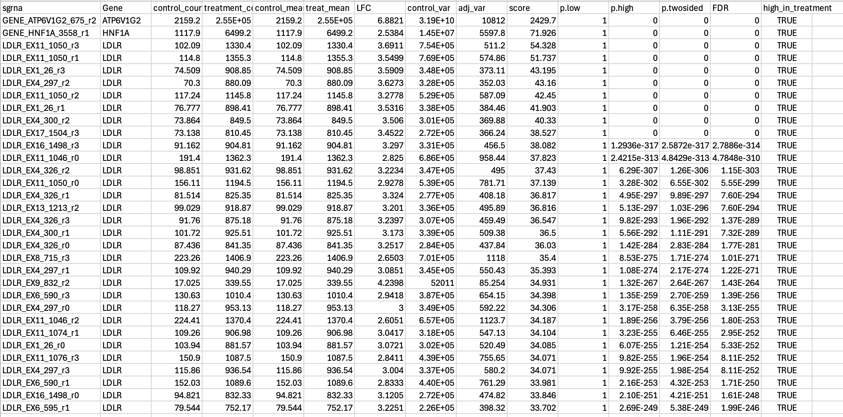
sgRNAs: What are the top hits?
Notes:
The #1 gRNA that decreases LDL uptake is targeting ATP6V1G2
At the gene level, that’s up there. It’s the 20th ranked gene.
The #2 gRNA targets HNF1A. It’s 26th on the gene list. Why is the top gRNA hit not in the top gene hit?
The answer: Clearly, the the other 3 gRNAs did not share the same level of enrichment for ATP6V1G2.
Either the gRNA was spuriously effective, or maybe the gRNA somehow had off target effects on LDLR.
Activity normalization is a way to deal with this: Can we drill down and say: This is the only one that caused frameshifts
That’s why we put multiple gRNAs in a screen, so that we can take the average result of them.
Don’t do a whole screen, look at the gene level output, and think that there’s nothing beyond that.
For instance, if ATP6V1G2 is of interest, maybe it’s worth thinking about why that one gRNA is so effective while the others aren’t.
There are a lot of counts for the top hits in ser_bottom_top.sgrna_library: ATP6V1G2 and HNF1A

Slide 24
How could we follow up on our CRISPR screen?

Slide 25
How could we follow up on our CRISPR screen?
Orthogonal validations of top hits in screen
Doing individual Cas9 KO
CRISPRi
ORF overexpression
CRISPRa
Data exploration:
Violin plot
Gene set enrichment analysis
Further screening:
Gene targeting CRISPR screens
Variant scanning screens (BE/PE)

Slide 26
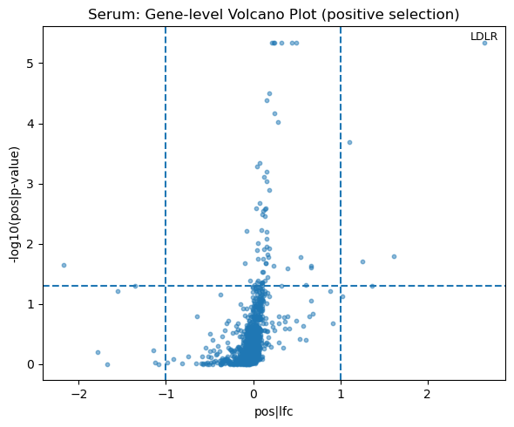
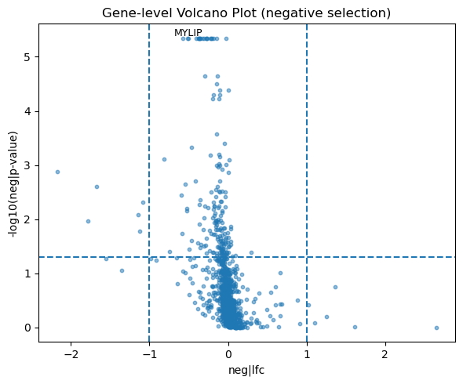
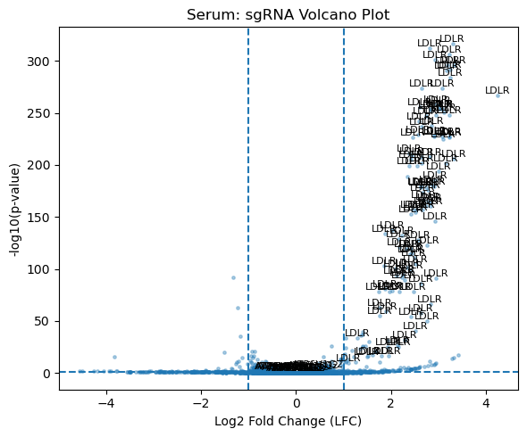
Volcano plots

Slide 27
Co-essential GSEA
Inputs: Gene sets (i.e. sharing a GO category, part of a metabolic pathway), gene expression data, ranking metric (ex. LFC)
Outputs: A list of modules, each of which has:
Enrichment score (es), Normalized enrichment score (nes), False discovery rate (FDR), p-value (p)
es: How overrepresented members of gene list are at top or bottom of ranked list of all genes
nes: es/mean of es against all permutations of the dataset
FDR: est. probability that gene set with given nes is a false positive
P-value: Not adjusted for gene set size, multiple hypothesis testing
Notes:
Why use co-essentiality analysis instead of GO?
https://docs.google.com/document/d/14OclHMEKGYMUb_qqjsXl7PfR4tr5YduYH8awrytaKJs/edit?tab=t.0
Statistical method to create a genome wide set of functional modules
Previously been shown to recapitulate diverse pathways and protein complexes
Co-essential GSEA is based on generalized least squares
Co-essential GSEA was benchmarked against CORUM (manually curated protein complex database), h.MAP: MS based PPI database, STRING: gene-gene interaction database integrating experimental evidence, co-expression, literature text mining, genomic colocalization, co-occurrence, etc.
Co-essentiality modules and enrichment Modules were generated using DepMap 21Q2 Project Achilles data43. This data was altered to account for gene proximity effects using the method described by FIREWORKS47. The proximity corrected data was then converted to modules using an existing method48. Module enrichments for gene subsets were calculated from the hypergeometric distribution implemented in scipy v1.6.3102. Gene Ontology103 (GO) terms were generated from PANTHER version 14 along with the tool’s implementations of term enrichment and FDR control104. All GSEA analysis was performed with gseapy v.0.10.469 with 10,000-100,000 iterations as negative control. Networks were constructed for all modules with a hypergeometric test FDR less than 0.01. t-Distributed Stochastic Neighbor Embedding (t-SNE)105 algorithm was used to reduce the dimensionality of the Achillies proximity corrected data, and the first and second principal components were used as the X and Y coordinates of the genes, respectively.

Slide 28
Summary
MAGeCK provides a broadly applicable and accessible platform for analyzing CRISPR screen data
MAGeCK can be used to discover genes and pathways relevant to a biological process of interest
MAGeCK derived scores can fuel downstream discovery
Notes:
When we come back for lunch, we’ll be able to see a case study in how to explore a CRISPR screening dataset with newer methods and experimental tools.

Slide 29
Further MAGeCK resources:
Shirley Liu’s lecture on MAGeCK:
https://www.youtube.com/watch?v=7V-Sjv-uQbk&t=1027s
MAGeCK github repository:
https://github.com/liulab-dfci/MAGeCK

Slide 30
References:
https://link.springer.com/article/10.1186/gb-2010-11-10-r106#Sec1
https://pubmed.ncbi.nlm.nih.gov/25476604/

