Slide 1
Computer Science 165 C++ Final Project
Picture Modification Program

Slide 2
Importance
To learn how to use additional library OpenCV to deal with image and video.
It is an open source library.
It can play an important role in artificial intelligence which I believe it is important for my career.

Slide 3
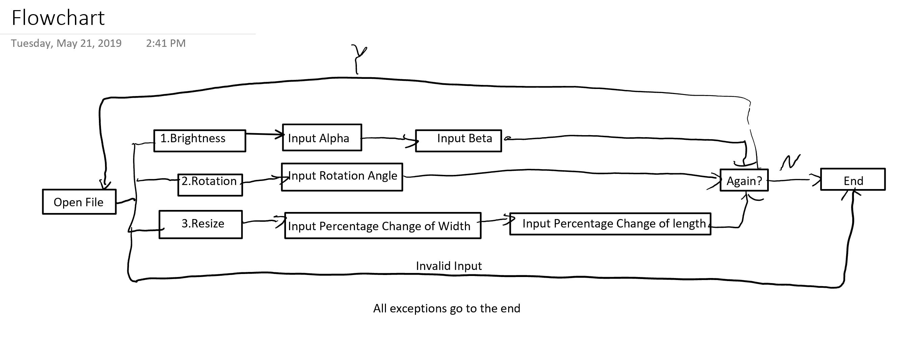

Slide 4


Brightness
Change the brightness by alpha and beta
Alpha gain parameter
Beta bias parameter

Slide 5
Rotation
Input the angle(For example 90 degrees)

Slide 6
Resize
By passing the percentage change of the width and length of the image.

