Slide 1
Z-RECOGNITION License Plate Recognition
Patrick Ziajski pziajski@myseneca.ca Zarak Khattak zkhattak@myseneca.ca
Notes:
Both of us

Slide 2
AGENDA
INTRODUCTION
FUNCTIONAL FEATURES
BLOCK DIAGRAM
SOFTWARE FLOWCHART
MAJOR COMPONENTS
INFOGRAPHICS
CONCLUSION
Notes:
zarak

Slide 3
INTRODUCTION
License Plate recognition system
Authenticate License Plates
Python programming language
Notes:
zarak

Slide 4
FUNCTIONAL FEATURES
Digital Image processing
Optical Character Recognition (OCR) using Computer Vision Services (CVS)
Image Binarization
Motor and Sound control
Raspberry Pi 3 MCU
Modular execution
Manual or Timed Capturing
GUI
User friendly system interaction
Notes:
zarak

Slide 5
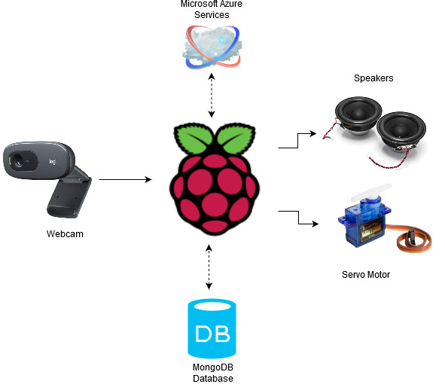
BLOCK DIAGRAM
Notes:
zarak

Slide 6
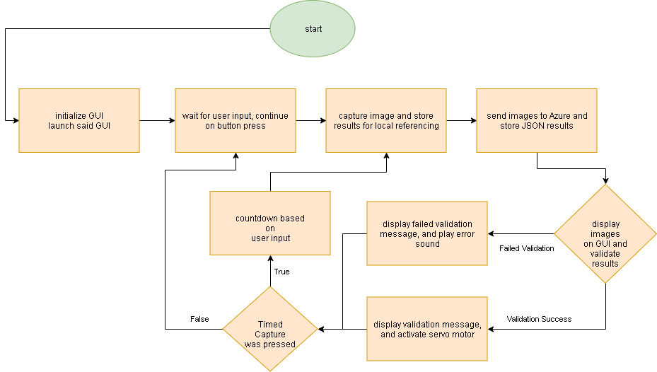
SOFTWARE FLOWCHART
Notes:
pat

Slide 7
MAJOR COMPONENTS
Hardware
Raspberry Pi 3 Model B
1.2GHz Broadcom 64 Bit CPU
1GB RAM
40 PIN extended GPIO
Camera
720 /30 FPS w/ Fixed Focus
Servo Motor
Operating Voltage: 3.0V ~ 7.2V
Software
Python Program
Operates the whole system
Microsoft Azure
Cognitive Services Resources
Mongo DB
JSON data
Image Binarization
Notes:
pat

Slide 8

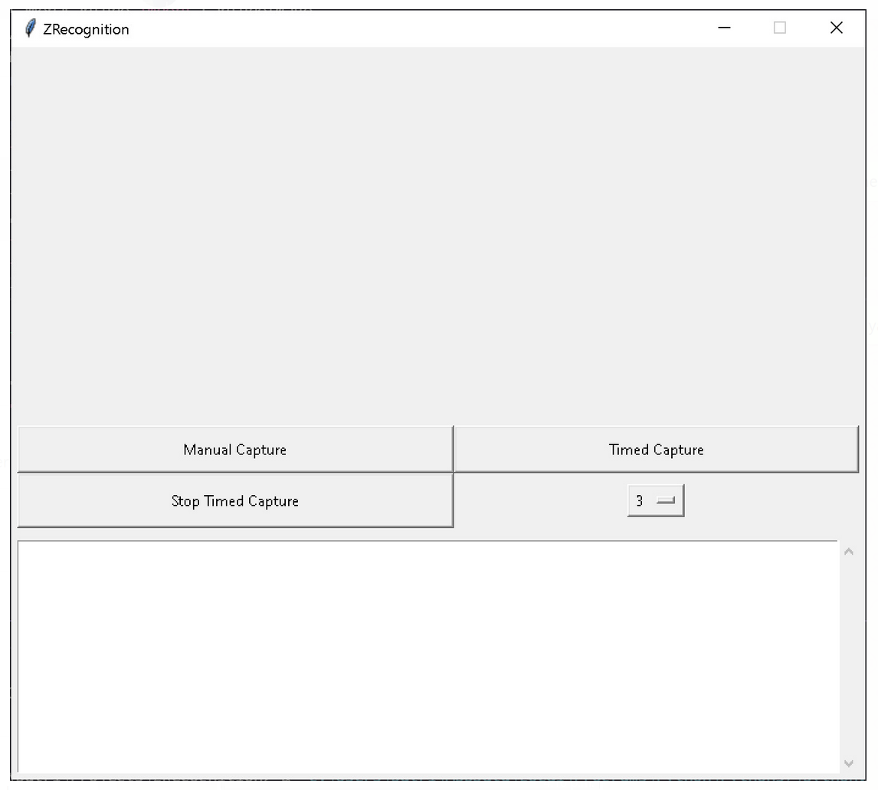
GRAPHICAL USER INTERFACE
Notes:
pat

Slide 9
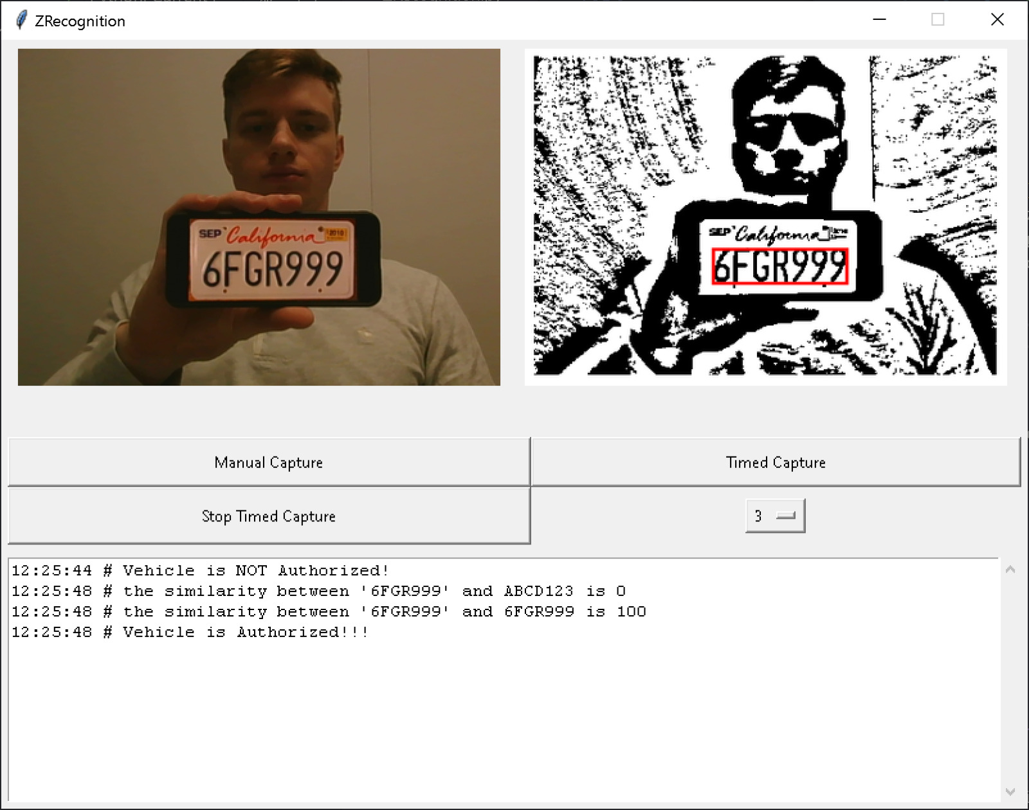
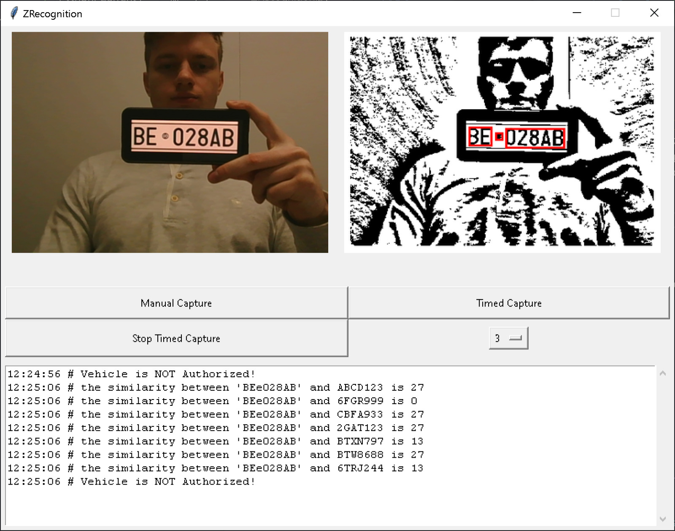
Example Results
Validated Result
Non-Validated Result
Notes:
pat

Slide 10
CONCLUSION
Project Difficulties
OCR not dealing with corners
Fixed using the binarization of images with a Gaussian model
Matching Results
Partial matching with mathematical algorithms (ratio)
Outcome
Overall Successful
Learning experience
Python language; Image processing; API requests; JSON databases; Cloud services; Raspberry Pi
Questions?
Notes:
pat

Slide 11
CONTACT INFORMATION
Patrick Ziajski
pziajski@myseneca.ca
Zarak Khattak zkhattak@myseneca.ca
Notes:
finito

