Slide 1
Z-RECOGNITION License Plate Recognition
Patrick Ziajski pziajski@myseneca.ca Zarak Khattak zkhattak@myseneca.ca

Slide 2
AGENDA
INTRODUCTION
FUNCTIONAL FEATURES
BLOCK DIAGRAM
FLOWCHART
MAJOR COMPONENTS
CONCLUSION

Slide 3
INTRODUCTION
License Plate recognition system
Authenticate License Plates
Python programming language

Slide 4
FUNCTIONAL FEATURES
Digital Image processing
Optical Character Recognition (OCR) using Computer vision services (CVS)
Image Digitization using Gaussian Algorithms
Motor and Sound control
Raspberry Pi 3 MCU
Scheduled script execution
Python script to tie everything together

Slide 5
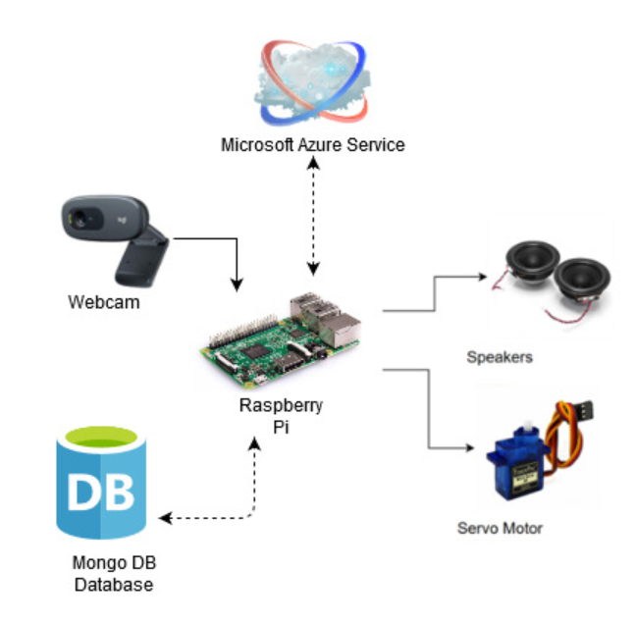
BLOCK DIAGRAM
Notes:
Update this

Slide 6
SYSTEM FLOW-CHART
Notes:
We need to update this

Slide 7
MAJOR COMPONENTS
Hardware
Raspberry Pi 3 Model B
1.2GHz Broadcom 64 Bit CPU
1GV RAM
40 PIN extended GPIO
Camera
720 /30 FPS w/ Fixed Focus
Servo Motor
Operating Voltage: 3.0V ~ 7.2V
Software
Python Program
Operates the whole system
Microsoft Azure
Cognitive Services Resources
Mongo DB
JSON data
Image Digitalization

Slide 8

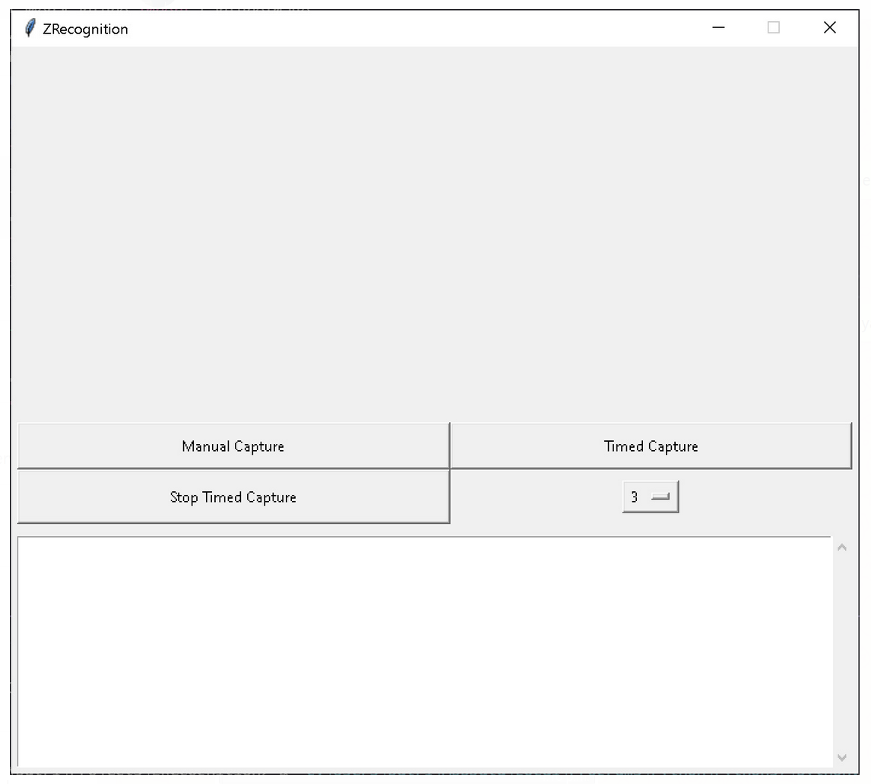
GRAPHICAL USER INTERFACE
Notes:
The blue box around the window?

Slide 9
Example Results
Notes:
Put in both images of results side by side

Slide 10
CONCLUSION
Project Difficulties
OCR not dealing with corners
fixed using the digitalization of images with a Gaussian model
Matching Results
Partial matching with mathematical algorithms (ratio)
Outcome
Overall Successful
Learning experience
Python language; Image processing; API requests; JSON databases; Cloud services; Raspberry Pi
Questions?

Slide 11
CONTACT INFORMATION
Patrick Ziajski
pziajski@myseneca.ca
Zarak Khattak zkhattak@myseneca.ca

