Slide 1
Writing poems Shakespeare-style using a language model with limited depth

Slide 2
The problem : building a language model without exploding/vanishing gradients
Unlike the forward pass which includes non-linearities, the backward propagation of gradients is purely linear.
With each layer, gradients get multiplied by the weight matrix of the layer. With recurrent networks, the recurrent weight matrix is the same as gradients get backpropagated in time.
This means gradients are multiplied by the same matrix raised to an infinite power. If a diagonal element is above 1, it leads to gradient explosion. If it is below 1, it leads to vanishing gradients

Slide 3
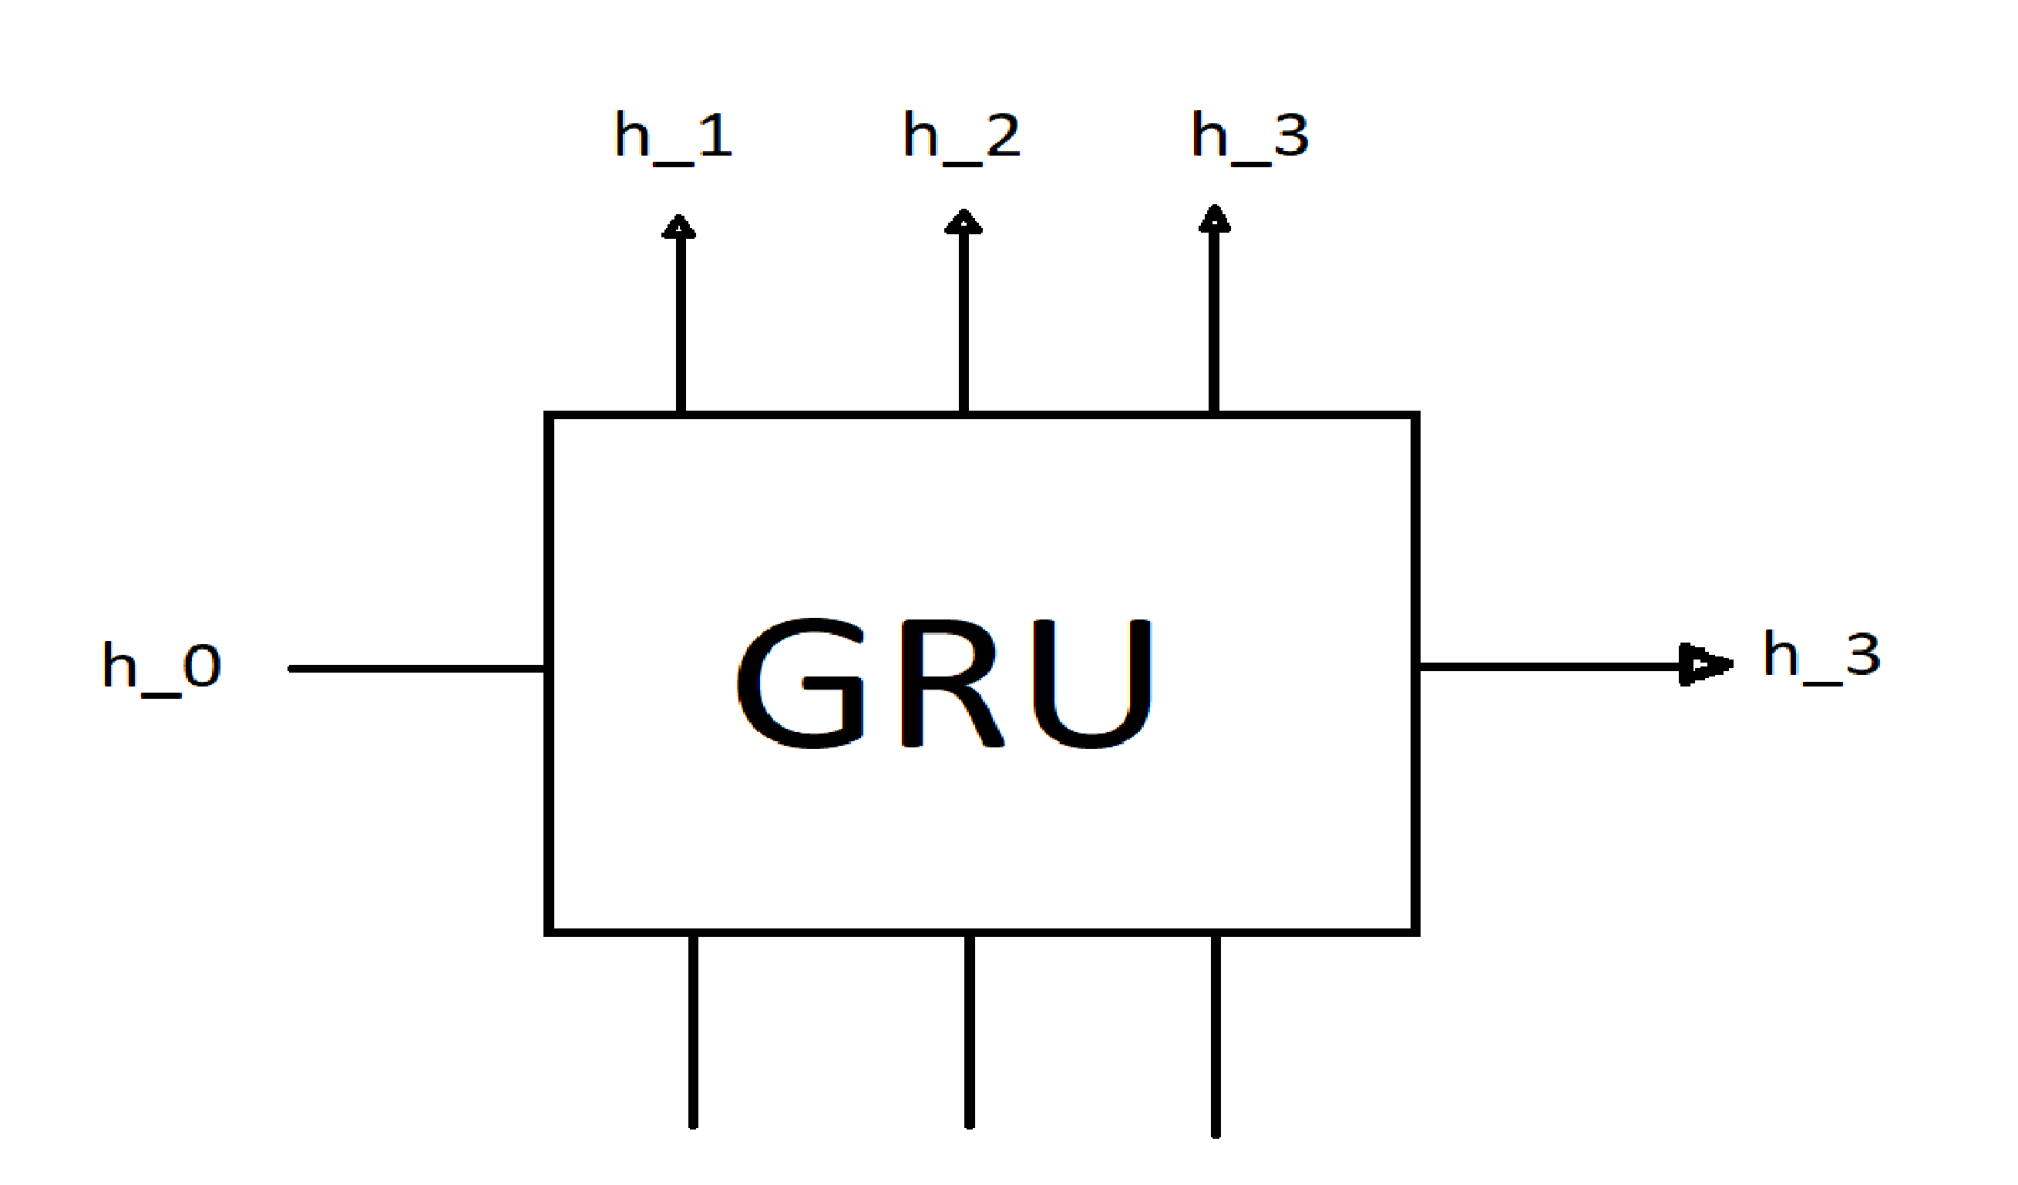
Gated Recurrent Unit (Cho et al., 2014)

Slide 4
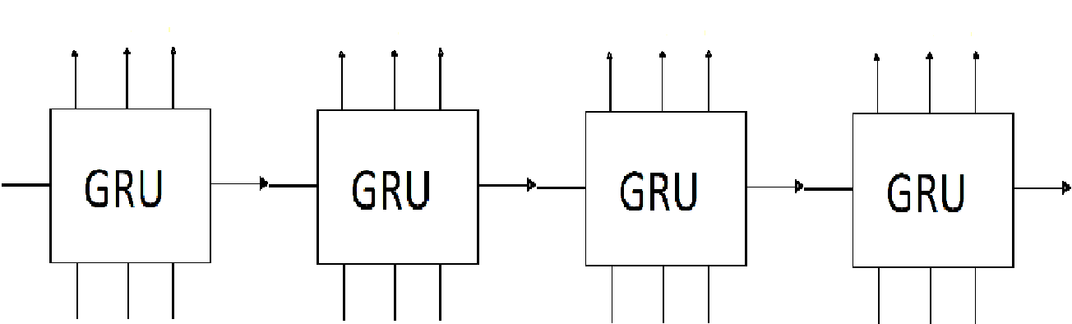
Generating text with a single GRU Tensorflow authors. Text generation with an RNN. Tensorflow tutorial
Text generation using a single GRU leads to infinite gradient back-propagation. Gradient clipping is needed

Slide 5
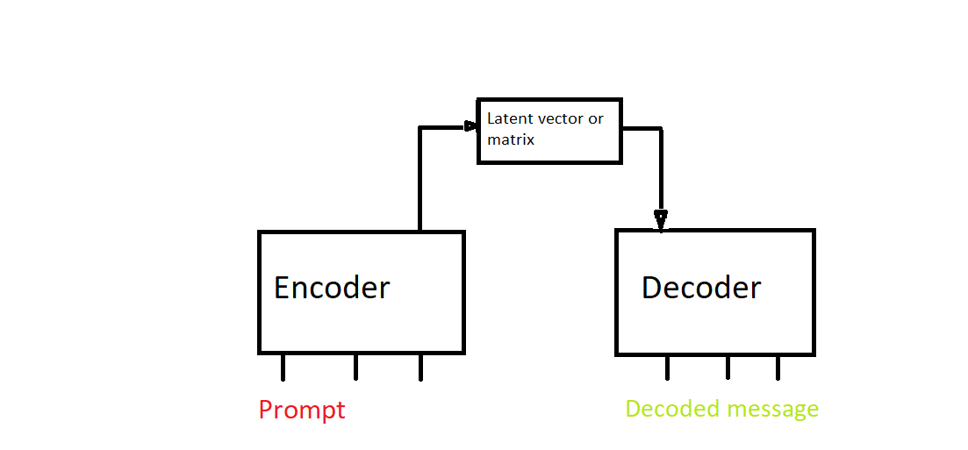
Encoder-Decoder architecture

Slide 6
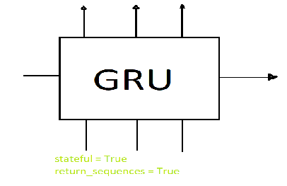
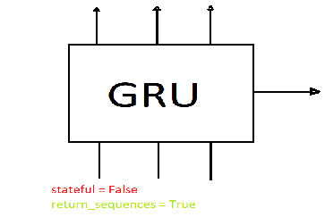
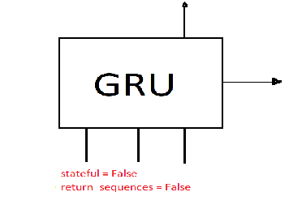
Three kinds of GRUs
Classic: inputs initial state,
outputs every time step
Zero initial state,
outputs every time step
Zero initial state,
returns last state only

Slide 7
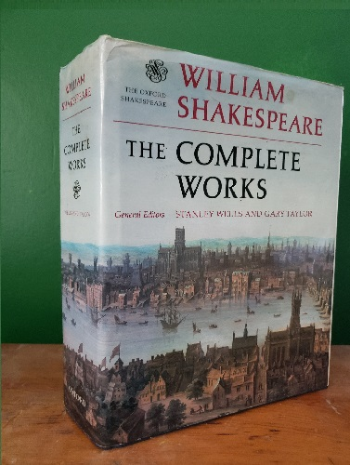
Methods : the data Andrej Karpathy (2015). The Unreasonable Effectiveness of Recurrent Neural Networks. Andrej Karpathy blog
The complete works of Shakespeare

Slide 8
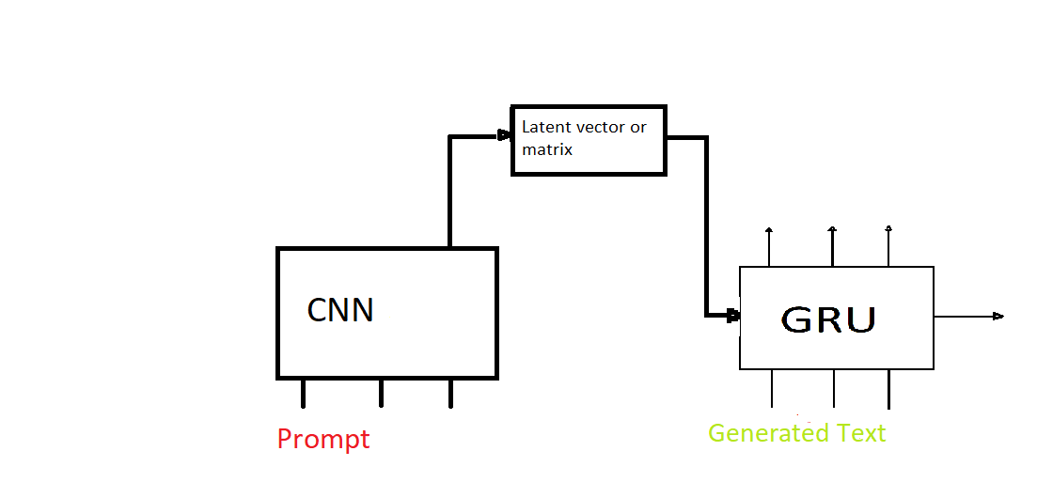
Iteration 1 : CNN encoder, GRU decoder
Did not output English

Slide 9
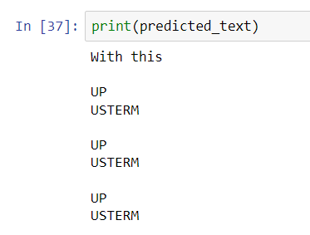
Iteration 1 : result

Slide 10
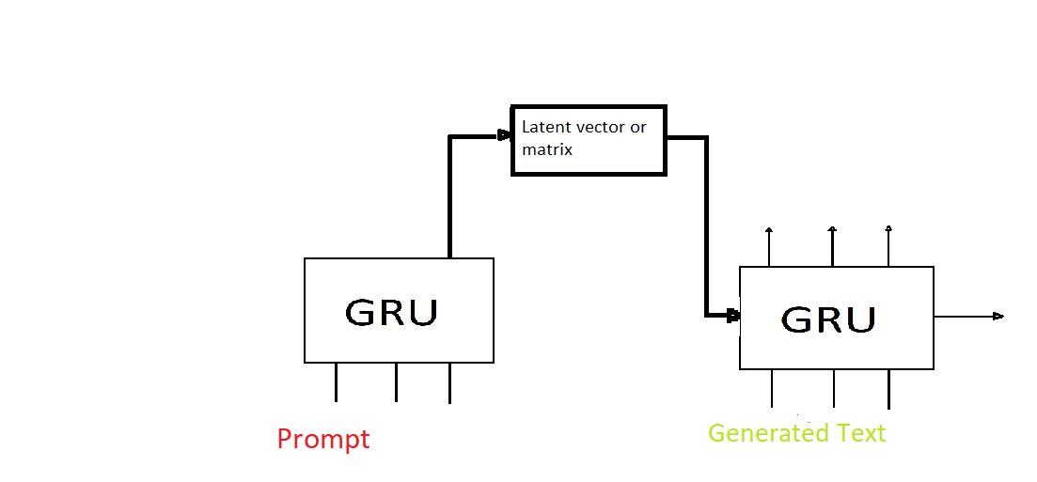
Iteration 2 : encoder: GRU, last output only decoder GRU
Output is English, prompt has to be small

Slide 11
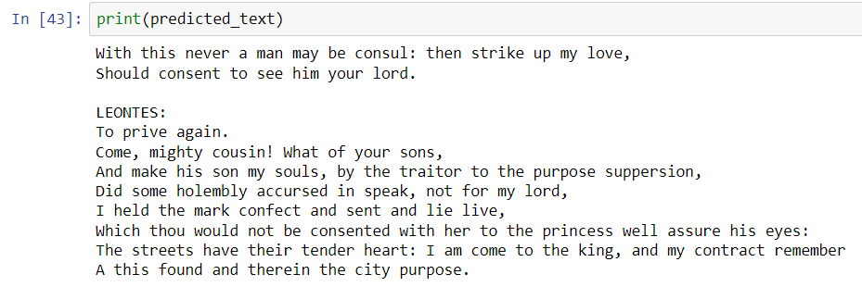
Iteration 2 : result

Slide 12

Iteration 3 : encoder : full sequence GRU, decoder : GRU

Slide 13
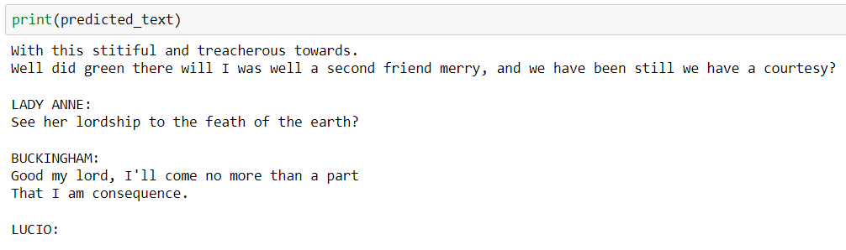
Iteration 3 : result

Slide 14
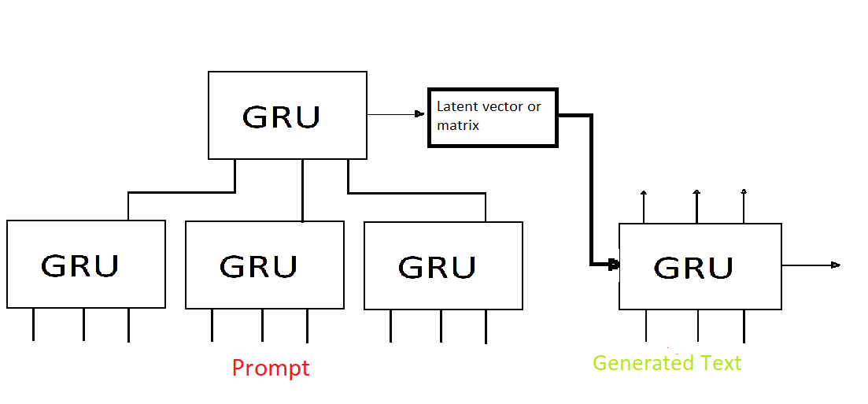
Iteration 4 : encoder : stacked GRUs, decoder : GRU

Slide 15
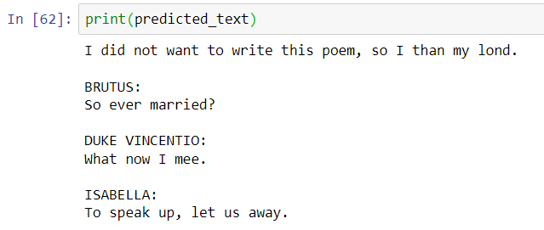
Iteration 4 : result

Slide 16
Conclusions
A CNN does not work as an encoder because it ignores syllable order
Both full sequence and last output only GRUs work as encoders but prompt is small: “With this ”
A GRU stack works too and makes it possible to have a longer prompt: “I did not want to write this poem, so I ”
All encoders start with a vector of zeros for their initial state so the gradients cannot back-propagate further.

