Slide 1
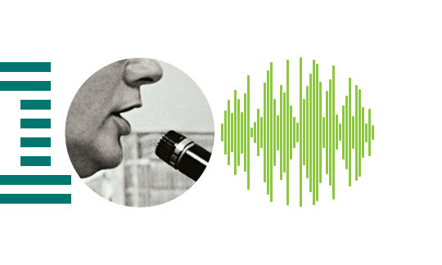
Voice Gender Recognition

Slide 2

Backstory
Have you noticed that voice/speech recognition became part of our life?
This branch spreads very fast and now it is almost everywhere – military, education, telephony, in-car systems, security or usual life. The simplest example is our smartphones, almost all smartphones support such thing as speech recognition. I wouldn’t say that it is the most important thing and that it is necessary for everyone, I would rather say that it takes place in future technologies, such as full-value AI and security. But this technology is simple only in words. Actually it is difficult enough.

Slide 3

Aim
Generally, speech recognition is wide branch and difficult on the one hand but although very interesting on the another hand. So in this presentation I’d like to show the way we can recognize gender of person’s voice.

Slide 4

Plan
Explore the Dataset
Visualization
Make predictions
Conclusion

Slide 5
Dataset
Make a long story short sound is a pressure wave which is created by a vibrating object. Humans can hear sound waves with frequencies between about 20 Hz and 20 kHz. Analyzed frequency range of 0hz-280hz.
The dataset consists of 3168 recorded voice samples, collected from male and female speakers.

Slide 6
The following acoustic properties of each voice:
meanfreq: mean frequency (in kHz)
sd: standard deviation of frequency
median: median frequency (in kHz)
Q25: first quantile (in kHz)
Q75: third quantile (in kHz)
IQR: interquantile range (in kHz)
skew: skewness (see note in specprop description)
kurt: kurtosis (see note in specprop description)
sp.ent: spectral entropy
sfm: spectral flatness
mode: mode frequency
centroid: frequency centroid (see specprop)
peakf: peak frequency (frequency with highest energy)
meanfun: average of fundamental frequency measured across acoustic signal
minfun: minimum fundamental frequency measured across acoustic signal
maxfun: maximum fundamental frequency measured across acoustic signal
meandom: average of dominant frequency measured across acoustic signal
mindom: minimum of dominant frequency measured across acoustic signal
maxdom: maximum of dominant frequency measured across acoustic signal
dfrange: range of dominant frequency measured across acoustic signal
modindx: modulation index. Calculated as the accumulated absolute difference between adjacent measurements of fundamental frequencies divided by the frequency range
label: male or female

Slide 7
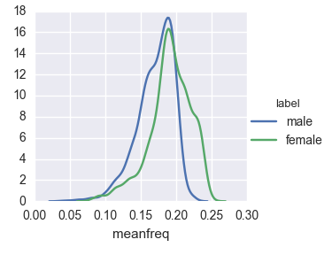
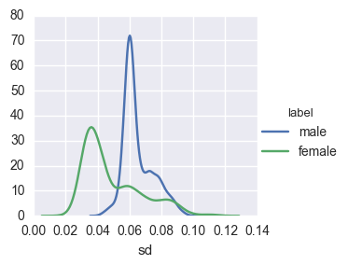
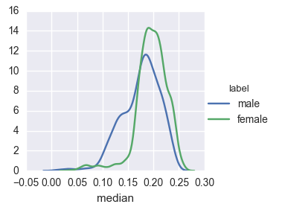
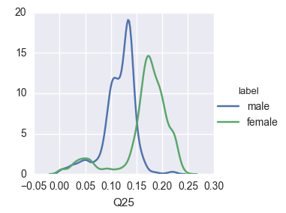
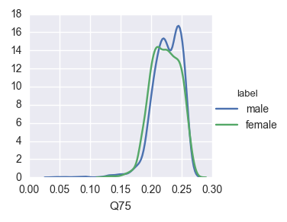
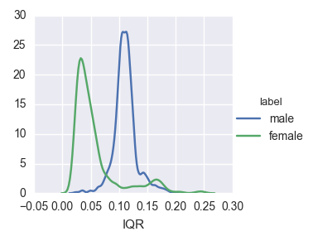
Visualization of each feature

Slide 8
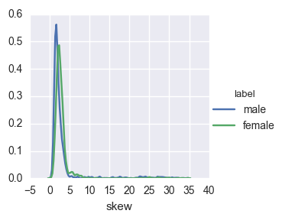
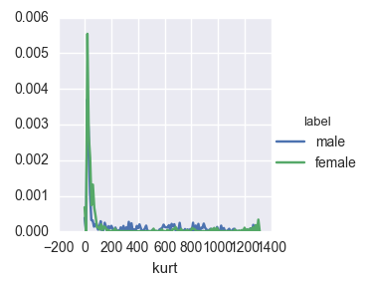
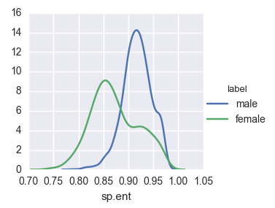
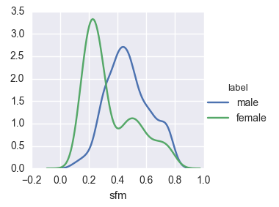
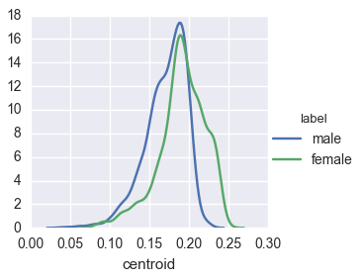
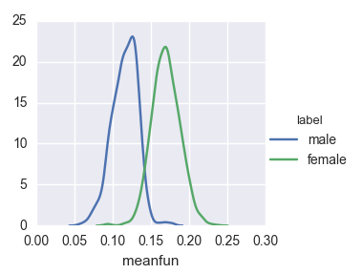

Slide 9
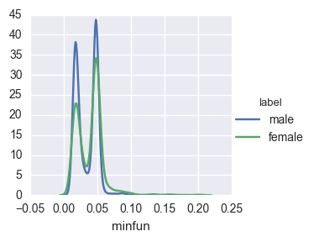
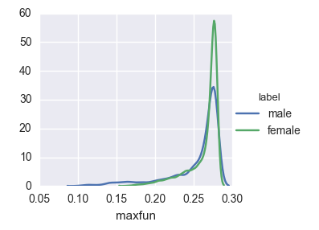
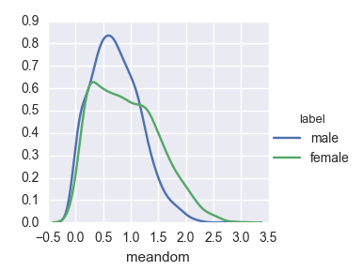
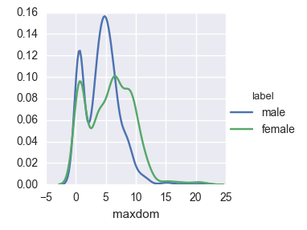
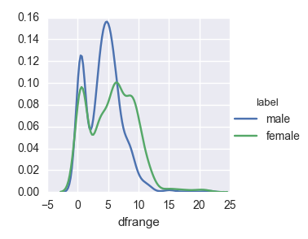
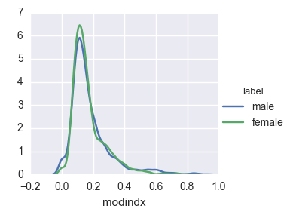

Slide 10
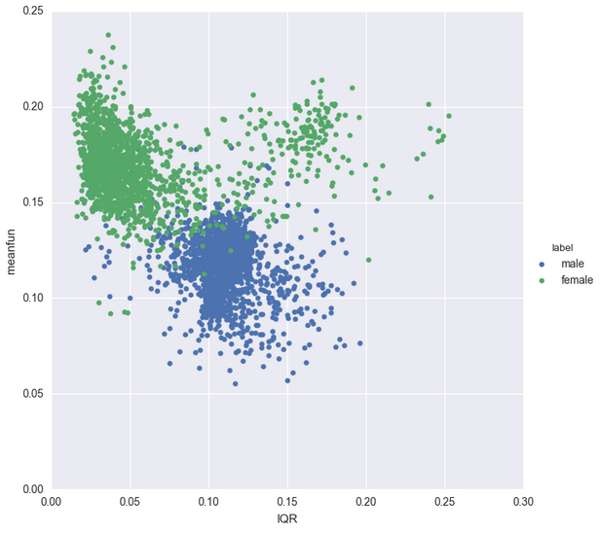
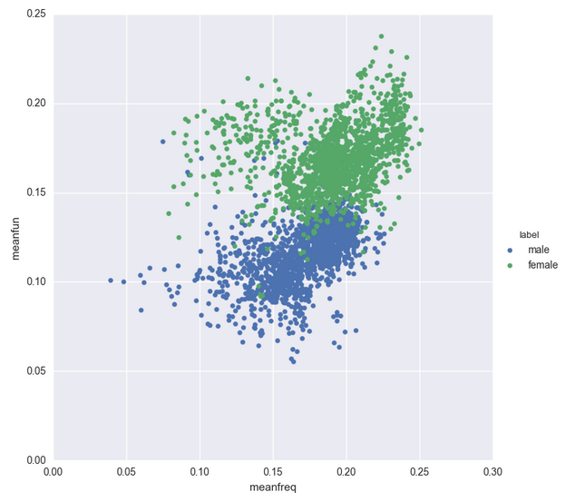
The most significant features: meanfun and IQR
From all 21 features we can separate “meanfun” and “IQR”. Is it enough of these two features to make predictions? We will see later.

Slide 11
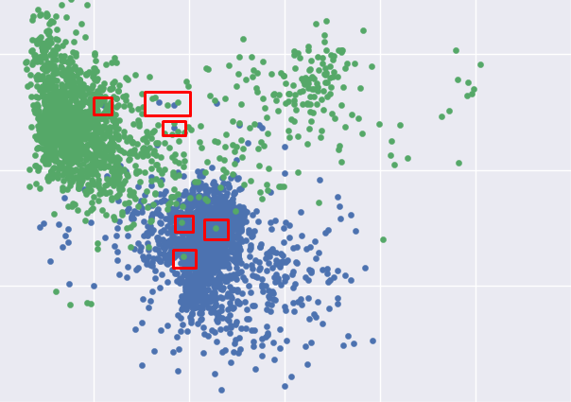
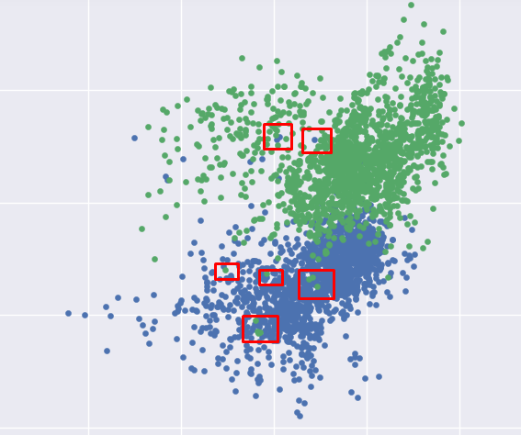
As we could see, there are some samples that belong to male but graph tells us that it is female. And vice versa.
It is possible because of next reasons:
particular qualities
accuracy of equipment not enough
interference during recording
speech defects

Slide 12
Prediction results
For making prediction I’ve used 4 algorithms: Logistic Regression, K-means, Naive Bayes and SVM. Also, I found that feature scaling improves results, except K-means.
Below you can see results of each algorithm with 2534 train samples and 634 test samples with all features and with 2 features separately.
Features | Feature scaling | K-means | Logistic Regression | Naive Bayes | SVM
All | Without | 54.416 % clusters: 2 | 88.17 % | 85.48 % | 71.766 %
All | With | 53.31 % clusters: 1 | 97.003 % | 86.27 % | 97.47 %
‘meanfun’, ‘IQR’ | Without | 88.96 % clusters: 2 | 90.22 % | 95.89% | 90.06 %
‘meanfun’, ‘IQR’ | With | 53.31 % clusters: 1 | 95.58 % | 95.89 % | 95.74 %

Slide 13
Conclusion
So, best result results we have in SVM, then logistic regression, Naive Bayes and K-means.
But in case with only 2 features(‘meanfun’, ‘IQR’) without feature scaling results are more precise. Naive Bayers, for example, gives 95 % against 85-85% with all features. That is because algorithm is based on suggestion of independence. The most significant improvement is in K-means without feature scaling, it grows up from ~54% to 88%. The reason is the same, less quantity of features.
Generally, results of partial dataset don’t lose to full, but sometimes gives even better results. Hence, in some cases we can use only 2 features, instead of all 21.

Slide 14

To improve results I’ve used feature scaling. Also, there are a few other ways:
- get more accurate records of voices. It would minimize incorrect predictions;
remove some useless features and add another features, as in real world there are often much larger variety of data;
intonation, as I suppose, also influences results, so there should be right chosen environment and conditions of recording.

Slide 15
As I said before with given dataset you shouldn’t expect 100 % result, and that’s why:
First of all speech defects. Percent of these people is quite minor, but we should consider it.
Models provide us so high results with special dataset, I mean conditions of recording. In real life we should take into account many other features.
So, from my point of view, removing useless features and adding other one is the most effective way of improving our results with selected models.
But now, with given dataset, we can predict gender with possibility in 97.47 % with SVM model.

Slide 16
Thank you for your attention.

