Slide 1

BOF 37
Impala Framework
Skills Matter, London
May 20, 2008

Slide 2
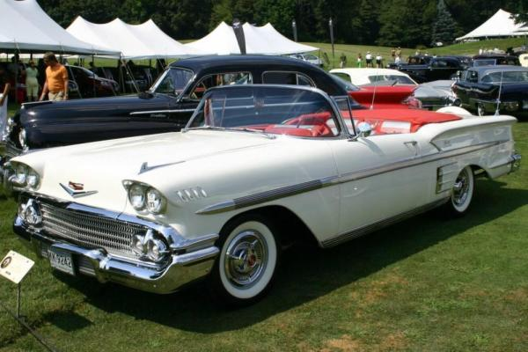
What is Impala?
  A car made by General Motors, first produced in 1958
Source: http://en.wikipedia.org/wiki/Image:1958-chevy-impala-chevrolet-archives.jpg

Slide 3

What is Impala?
  A graceful antelope found in Southern Africa
Source: http://en.wikipedia.org/wiki/Image:Impalajump.jpg

Slide 4
What is Impala?
Impala is a dynamic module framework
for enterprise application development.
It builds on the Spring Framework to
provide a genuinely modular, highly productive
environment for web-based applications.
  Where Rails-like productivity meets open source Java.

Slide 5
Why create Impala?
Spring Framework: a massive contribution to Enterprise Java:
  lightweight replacement for EJB
  dependency injection and AOP
  third party library integration
BUT only part of the solution
  no first class concept of modularity
  difficult to stay productive as code base grows

Slide 6
An example: Toys for Boys Inc
Simple online ordering system for gizmos and gadgets
Some requirements
  products loaded from XML from file system
  integration with single payment gateway
  fulfilment by single supplier
  end user portal GUI
  order confirmation by email

Slide 7
Demo – “Toys For Boys” skeleton

Slide 8
Toys for Boys Inc, 2 years later
Real world system with:
  products loaded electronically from multiple suppliers
  own and outsourced stock, indexed and searchable
  multiple payment gateways
  fulfilment based on geographic location
  ordering via SMS
  business account holders with scheduled invoicing
  ordering via web service interface
  administration portal

Slide 9
Scaling without modularity
Same architecture as initial system
Separate XML config file per functional area
Conceptually, doesn't scale well
  integration tests difficult to construct and slow to run
  low signal to noise ratio in integration tests
  increased use of bean definition files with null overrides
  cross dependencies creep in, fuelling complexity
  progress slows, developers get frustrated
  ditch Java for RoR and others!

Slide 10
What is modularity
  "Programs that have many direct interrelationships between any two random parts of the program code are less modular (more tightly coupled) than programs where those relationships occur mainly at well-defined interfaces between modules.
  Modules provide a separation between interface and implementation. A module interface expresses the elements that are provided and required by the module. The elements defined in the interface are visible to other modules. The implementation contains the working code that corresponds to the elements declared in the interface."
http://en.wikipedia.org/wiki/Modular_programming

Slide 11
Scaling with modules
Higher level application config easier to manage
  Each functional area gets own module, with clear, enforced boundaries
  Application specified at high level via module configuration
  No need to fiddle with combinations of Spring configuration files

Slide 12
Scaling with dynamic modules (Impala)‏
Modules are incrementally loaded
  when running through a suite of integration tests
Modules are dynamically reloadable
  when running a web application or interactive test runner
  no need to reload anything if only test changes
Modules can even autoreload

Slide 13
Demo – Petclinic

Slide 14
Architecture
Impala
Service
Registry
Beans contributed to
service registry
App/web class loader
Beans consumed
from service registry
main
root
root class loader
hibernate
application
services
application
web
servlet
Module class loader
Module class loader
Module class loader

Slide 15
Implementation
Everything in Impala is pluggable
Impala itself simply set of Spring bean defs
Class loaders correspond with module hierarchy
Application context corresponds with module hierarchy
Service implementations shared across modules via service registry (as with OSGi)‏

Slide 16
Web integration
Tomcat and Jetty supported out the box
Native integration with Spring MVC
Integration via regular Spring web integration mechanisms
Many leading web frameworks feature native Spring integration (e.g. Strut2, JSF)‏
Generic web integration mechanism planned
Specific solution were appropriate

Slide 17
Build support
Writing and running applications requires no build – can all be done in IDE
Built-in build support based on ANT
Project structure conventions overridable (for use with Maven)‏
Simple non-transitive dependency management features:
main from commons-logging:commons-logging:1.1 source=false
main from log4j:log4j:1.2.13 source=false
main from org.springframework:spring:2.0.6

Slide 18
Demo – Quick Start

Slide 19
What about OSGi?
Spring DM and Spring AP use OSGi
Impala not implemented in OSGi
  enterprise library compatibility
  complexity and learning
  requires extra runtime, build and tooling support
Questions about OSGi
  is it productive?
  is it TDD friendly?
  will developers take to it?
Impala opts for OSGi convergence

Slide 20
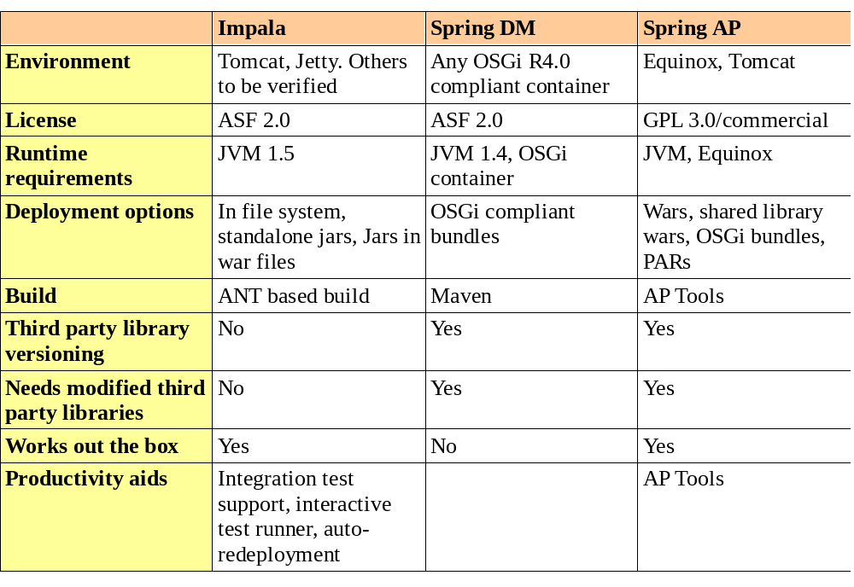
Comparison Matrix

Slide 21
Next Steps
Move toward 1.0 release
Staged release of 1.0 milestones:
http://code.google.com/p/impala/wiki/Roadmap
Looking for contributors!!! – can you help??
Take the next leap in your development, and go modular with Impala

Slide 22
Resources
Home: http://impala.googlecode.com/
Blog: http://impalablog.blogspot.com/

Slide 23
Q & A

