Slide 1
A Measurement Study of RDMA Performance In Multi-Tenant Environment - VMs and Containers
Student: Zhuangdi Zhu
Mentors: Salman A Baset, Michael R Hines
Supervisor: Alex Liu, Chen Tian
Feb 24th, 2015

Slide 2
Proposed Experiment Paths
 | sender | receiver | protocol | test
1 | host | host | TCP | 1 and 4 transfers
2 | host | host | RDMA | 1 and 4 transfers
3 | VM | VM | TCP | 1 and 4 transfers
4 | VM | VM | RDMA | 1 and 4 transfers
5 | LXC | LXC | TCP | 1 and 4 transfers
6 | LXC | LXC | RDMA | 1 and 4 transfers
7 | 4 VMs | 4 VMs | TCP | 1 transfer
8 | 4 VMs | 4 VMs | RDMA | 1 transfer
9 | 4 LXCs | 4 LXCs | TCP | 1 transfer
10 | 4 LXCs | 4 LXCs | RDMA | 1 transfer

Slide 3
Experimental Methods
qperf qperf is a Linux utility to measure bandwidth and latency between two nodes. It can work over TCP/IP as well as RDMA transports. Hence it is a convenient tool for performance testing in our experiments.
rdma_cm server/client program rdma_cm server/client program is adjusted form a sample code for the transfer of large messages between hosts using the InfiniBand verbs library. The inner basic flow-control protocol breaks messages into segments and then uses the RDMA-write-with-immediate-data (IBV_WR_RDMA_WRITE_WITH_IMM) operation to transfer these segments. And I may evaluate/consider whether this is useful for future tests.
MPI send/receive program in C MPI programming provides a high-level communication interface for operating multiple hosts/VMs to transfer messages concurrently. As the proposed experiments are finally carried out for multi- tenants, it is convenient to have tests using MPI libraries. Basic MPI send/receive codes are used in the earlier tests. And I may valuate/consider whether this is useful for future tests as well.

Slide 4
Proposed Experiment Paths
 | sender | receiver | protocol | test | status
1 | host | host | TCP | 1 and 4 transfers | 1 transfer qperf done but very poor bandwidth 4 transfers to do
2 | host | host | RDMA | 1 and 4 transfers | 1 transfer qperf done 1 transfer rdma_cm done 4 transfers to do
3 | VM | VM | TCP | 1 and 4 transfers | -to do
4 | VM | VM | RDMA | 1 and 4 transfers | - to do
5 | LXC | LXC | TCP | 1 and 4 transfers | 1 transfer qperf done 4 tranfers to do
6 | LXC | LXC | RDMA | 1 and 4 transfers | 1 transfer qperf done 4 transfers to do

Slide 5
7 | 4 VMs | 4 VMs | TCP | 1 transfer | - to do
8 | 4 VMs | 4 VMs | RDMA | 1 transfer | - to do
9 | 4 LXCs | 4 LXCs | TCP | 1 transfer | - to do
10 | 4 LXCs | 4 LXCs | RDMA | 1 transfer | - to do

Slide 6
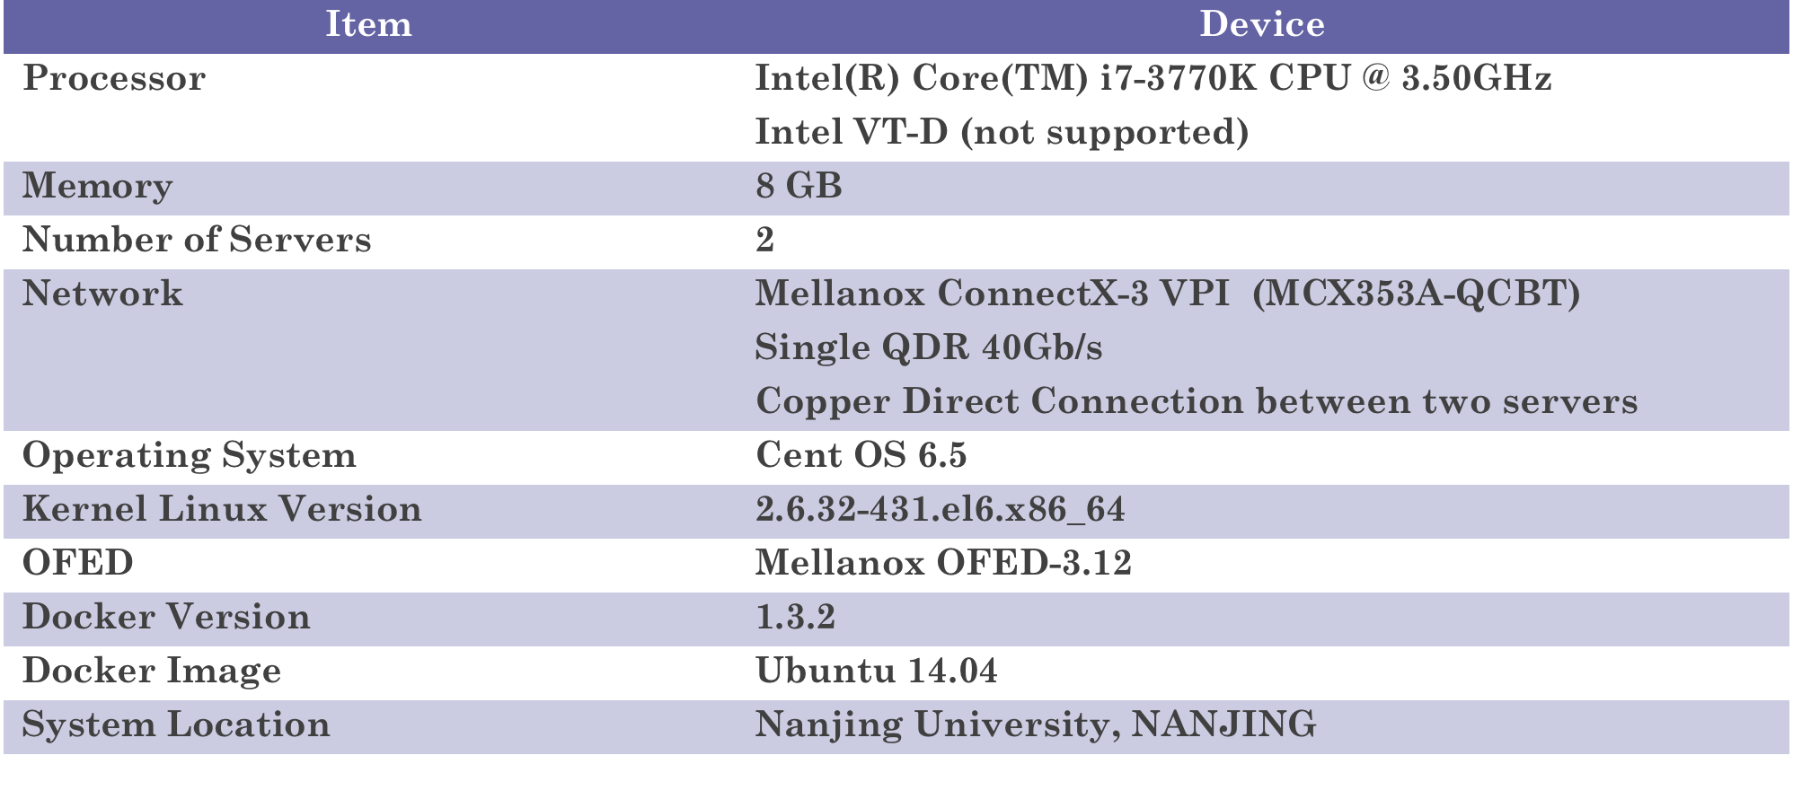
Current Testing Platform
Problems:
CPU i7-3770K does not support Intel VT-d (IOMMU) that IB sharing by multi-VMs through SR-IOV is not supported;
Current testing result of Ethernet bandwidth is much lower than IB, Salman suggested that dedicated Ethernet cards (10G) should be used.

Slide 7
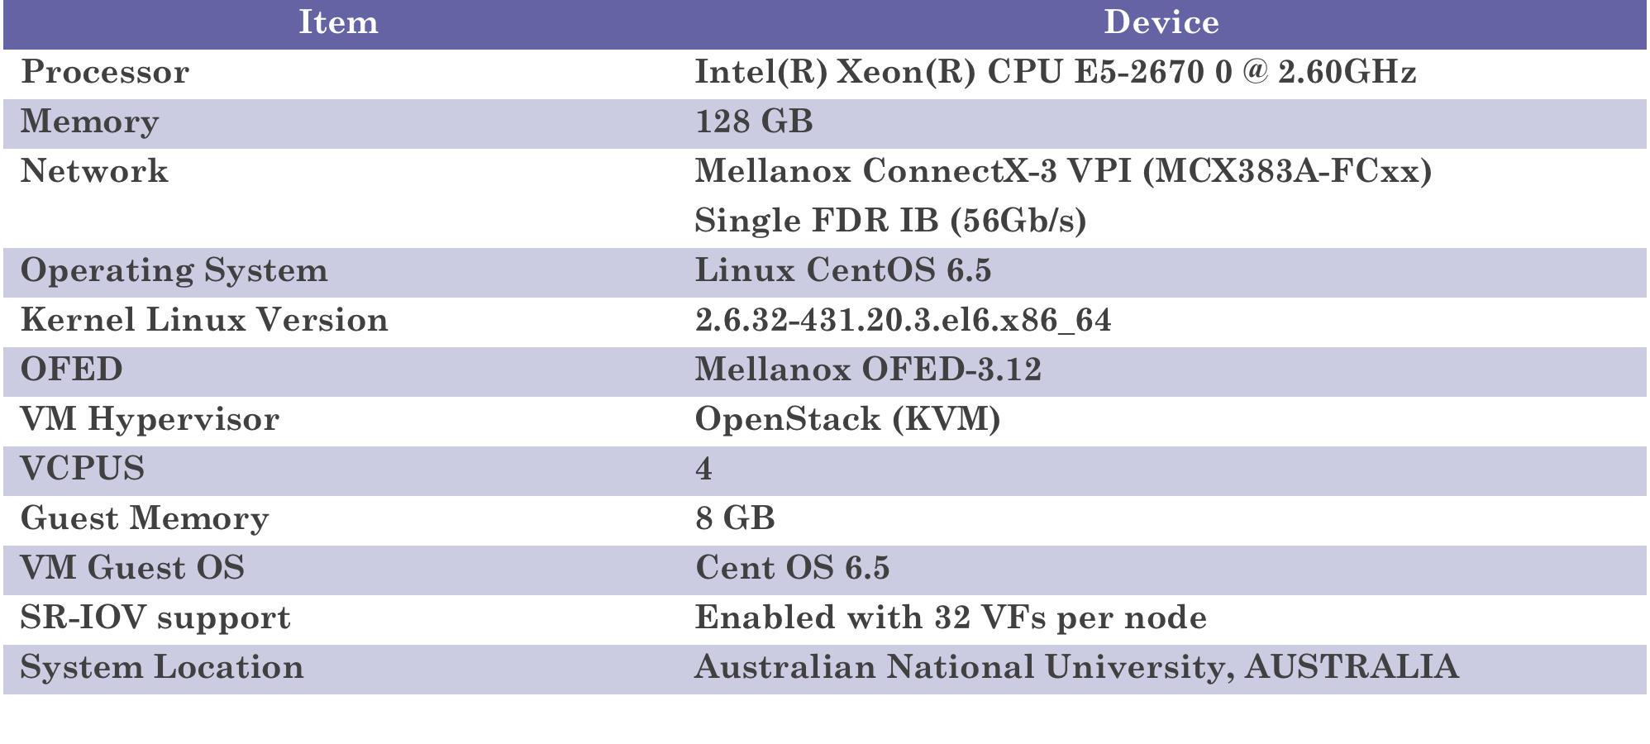
Previous ANU cloud system

Slide 8

Proposed Test Environment
Device | Info
Processor | Intel Processor supporting Intel VT-d e.g., Xeon E5 or i7 series
Motherboard | Compatible motherboard (ASUS or Gigatech) with Intel Chipset (e.g., Z77)
Memory | 16GB or 32 GB 1600 MHz DDR3
Ethernet | 10G dedicated Ethernet NICs
Infiniband | Mellanox QDR (available now)
Cable | Compatible Ethernet and IB cables
Reference:
1. The list of processors supporting Intel VT-d (IOMMU)
http://ark.intel.com/search/advanced?VTD=true
2. The list of motherboards, compatible with Intel Xeon E5-2670 http://www.cpu-upgrade.com/CPUs/Intel/Xeon/E5-2670_motherboards.html

Slide 9
Work I Have Done
Host-Host RDMA and TCP using qperf
Results | 1 | 2 | 3 | 4 | 5 | 6 | 7 | 8 | 9 | 10 | Avg
Rdma_read-lantency(us) | 3.98 | 4.08 | 4.03 | 4.04 | 4.05 | 4.06 | 3.91 | 4.07 | 4.04 | 4.04 | 4.03
Rdma_read-bandwidth(GB/sec) | 3.82 | 3.81 | 3.82 | 3.82 | 3.82 | 3.82 | 3.82 | 3.82 | 3.82 | 3.82 | 3.819
Rdma_write-lantency(us) | 10.7 | 10.8 | 10.8 | 10.8 | 10.7 | 10.6 | 10.8 | 10.8 | 10.8 | 10.8 | 10.76
Rdma_write-bandwidth (GB/sec) | 3.74 | 3.75 | 3.74 | 3.75 | 3.75 | 3.76 | 3.75 | 3.75 | 3.75 | 3.75 | 3.749
Tcp_bandwidth(MB/sec) | 11.9 | 11.9 | 11.9 | 11.9 | 11.9 | 11.9 | 11.9 | 11.9 | 11.9 | 11.9 | 11.90
Tcp_latency (us) | 36.8 | 36.8 | 36.8 | 36.8 | 36.9 | 36.8 | 36.8 | 36.8 | 36.8 | 36.8 | 36.81

Slide 10
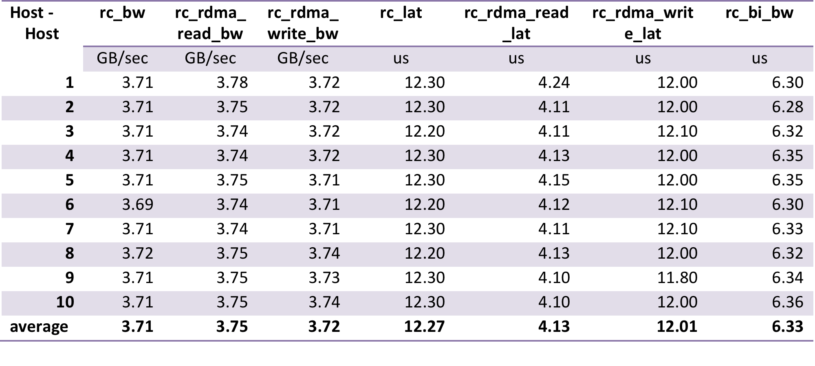
Host-Host RDMA test using qperf

Slide 11
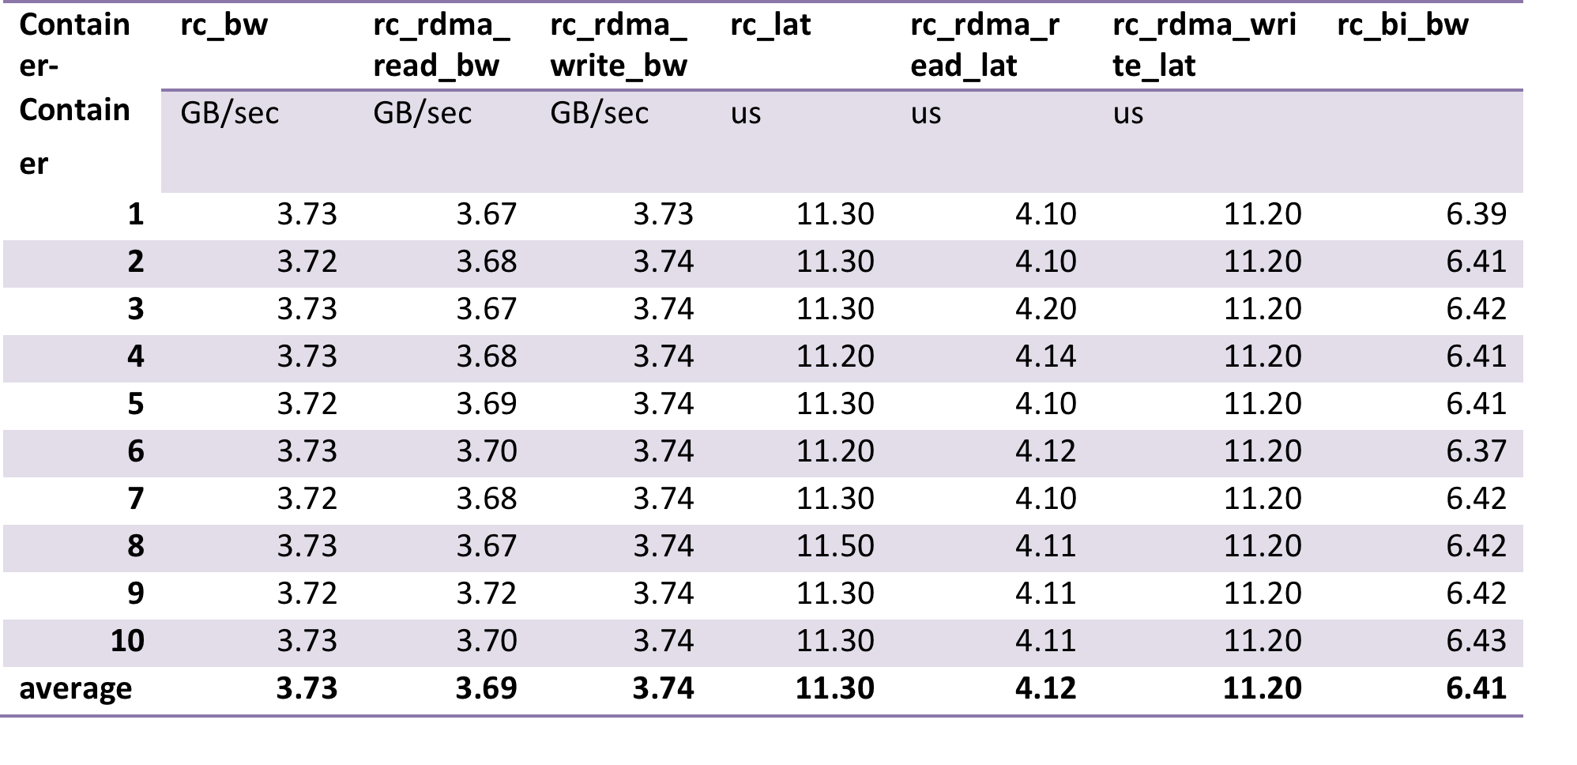
Container-Container RDMA test using qperf

Slide 12
Work I Have Done
Preliminary Conclusion: Performance of Host and Container is very similar

Slide 13
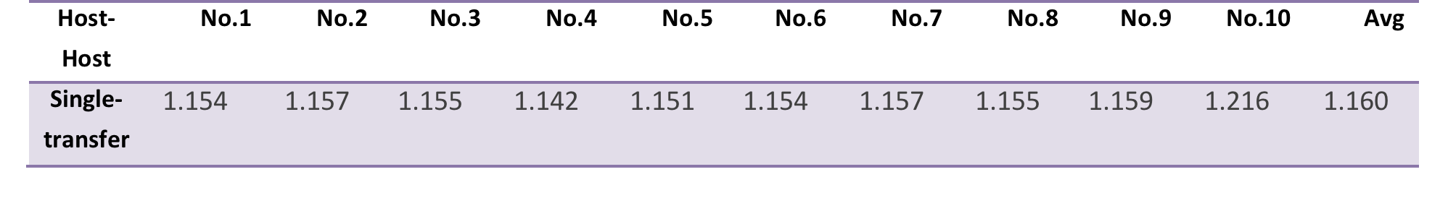
rdma_cm test on host-host
rdma_cm Server/Client Program Testing Results on Host to Host transferring 1GB file

Slide 14
Previous Results with MPI on ANU’s cloud and HPC

Slide 15
Future Work
Performance testing methods
SR-IOV and IOMMU Support
Comparison of TCP and RDMA tests

