Slide 1
A Measurement Study of RDMA Performance In Multi-Tenant Environment - VMs and Containers
Student: Zhuangdi Zhu
Mentors: Salman A Baset, Michael R Hines
Supervisor: Alex Liu, Chen Tian
Feb 24th, 2015

Slide 2
Proposed Experiment Paths
 | sender | receiver | protocol | test
1 | host | host | TCP | 1 and 4 transfers
2 | host | host | RDMA | 1 and 4 transfers
3 | VM | VM | TCP | 1 and 4 transfers
4 | VM | VM | RDMA | 1 and 4 transfers
5 | LXC | LXC | TCP | 1 and 4 transfers
6 | LXC | LXC | RDMA | 1 and 4 transfers
7 | 4 VMs | 4 VMs | TCP | 1 transfer
8 | 4 VMs | 4 VMs | RDMA | 1 transfer
9 | 4 LXCs | 4 LXCs | TCP | 1 transfer
10 | 4 LXCs | 4 LXCs | RDMA | 1 transfer

Slide 3
Proposed Experiment Paths
 | sender | receiver | protocol | test | status
1 | host | host | TCP | 1 and 4 transfers | 1 transfer qperf done but very poor bandwidth 4 transfers to do
2 | host | host | RDMA | 1 and 4 transfers | 1 transfer qperf done 1 transfer rdma_cm done 4 transfers to do
3 | VM | VM | TCP | 1 and 4 transfers | -to do
4 | VM | VM | RDMA | 1 and 4 transfers | - to do
5 | LXC | LXC | TCP | 1 and 4 transfers | 1 transfer qperf done 4 tranfers to do
6 | LXC | LXC | RDMA | 1 and 4 transfers | 1 transfer qperf done 4 transfers to do

Slide 4
7 | 4 VMs | 4 VMs | TCP | 1 transfer | - to do
8 | 4 VMs | 4 VMs | RDMA | 1 transfer | - to do
9 | 4 LXCs | 4 LXCs | TCP | 1 transfer | - to do
10 | 4 LXCs | 4 LXCs | RDMA | 1 transfer | - to do

Slide 5
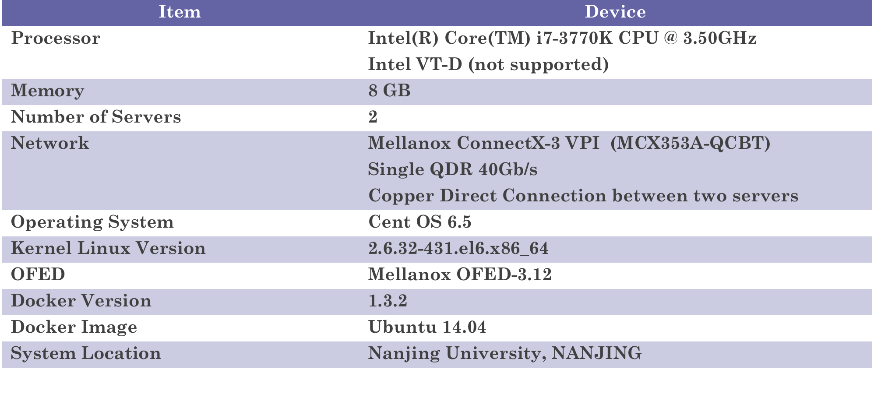
Current Testing Platform
Problems:
CPU i7-3770K does not support Intel VT-d (IOMMU) that IB sharing by multi-VMs through SR-IOV is not supported;
Current testing result of Ethernet bandwidth is much lower than IB, Salman suggested that dedicated Ethernet cards (10G) should be used.

Slide 6
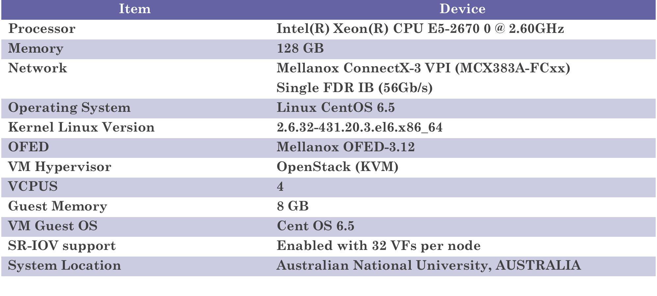
Previous ANU cloud system

Slide 7
Proposed Test Environment
Device | Info
Processor | Intel(R) Xeon(R) CPU E5-2670 @ 2.60GHz Sandy Bridge Architecture [1] （CNY 8800.0）
Motherboard | Compatible motherboard with Intel Chipset [2]
Memory | 32 GB 1600 MHz DDR3
Ethernet | 10G dedicated Ethernet NICs
Infiniband | Mellanox QDR (available now)
Cable | Compatible Ethernet and IB cables
Reference:
1. The list of processors supporting Intel VT-d (IOMMU)
http://ark.intel.com/search/advanced?VTD=true
2. The list of motherboards, compatible with Intel Xeon E5-2670 http://www.cpu-upgrade.com/CPUs/Intel/Xeon/E5-2670_motherboards.html

Slide 8
Proposed Test Environment
Device | Info
Processor | Intel® Core™ i7-3770 [2] (CNY 1894.0)
Motherboard | P8H77-M PRO [1] (CNY 1049.0)
Memory | 32 GB 1600 MHz DDR3
Ethernet | 10G dedicated Ethernet NICs
Infiniband | Mellanox QDR (available now)
Cable | Compatible Ethernet and IB cables
Reference:
1. P8H77-M PRO Motherboardhttp://www.asus.com/us/Motherboards/P8H77M_PRO/
2. The list of chipsets supporting i7-3770
http://ark.intel.com/products/65719/Intel-Core-i7-3770-Processor-8M-Cache-up-to-3_90-GHz#@compatibility
3 Asus motherboard homepage
http://www.asus.com/us/Motherboards/

Slide 9
Future Work
Performance testing methods
SR-IOV and IOMMU Support
Comparison of TCP and RDMA tests

