Slide 1
Capstone1
E-Commerce five endpoints

Slide 2
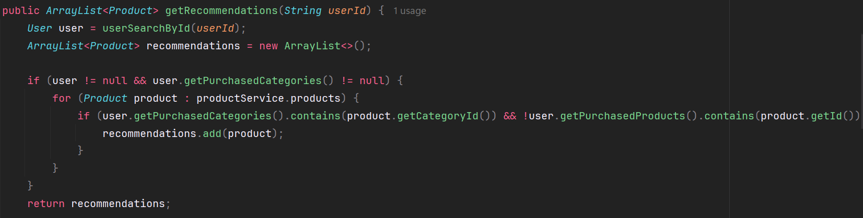
Endpoint 1
A method that return recommendation products based on category

Slide 3
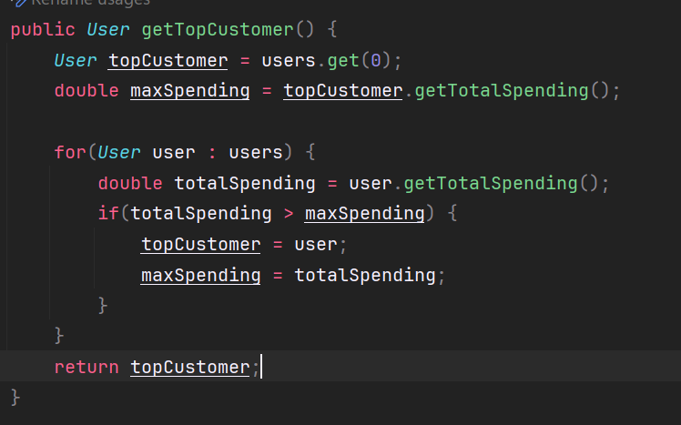
Endpoint 2- (getTopCustomer)
A Method that return top customer based on their total spending on the website

Slide 4
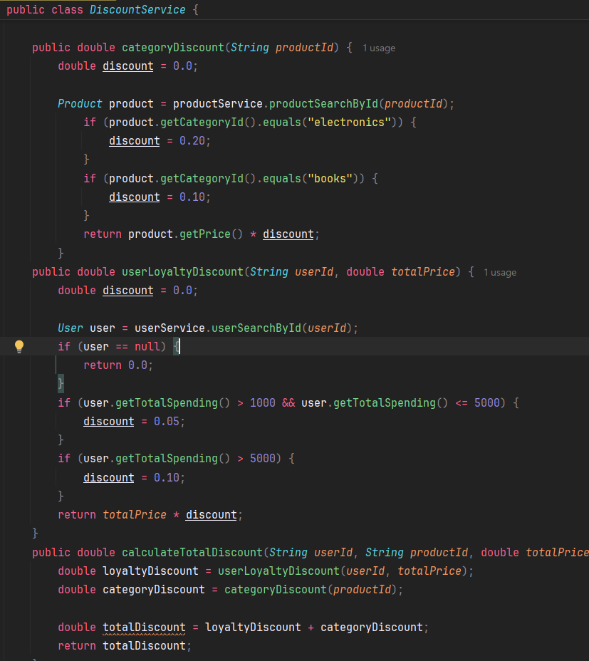
Endpoints 3,4,5 (DiscountService)
DiscountService contain three methods (categoryDiscount, userLoyaltyDiscount, calculateTotalDiscount)

Slide 5
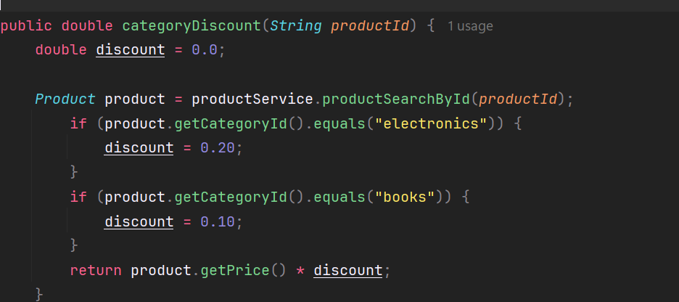
1. categoryDiscount
Apply discount based on category, I add a 20% discount on electronics and 10% on books

Slide 6
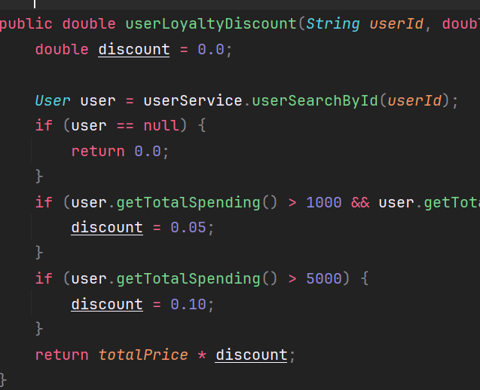
2. userLoyaltyDiscount
This method apply a discount based on user total spending on the website

Slide 7
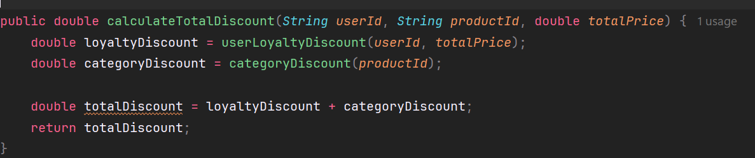
3. calculateTotalDiscount

