Slide 1
AI Shield Intelligence
How I keep myself up to date on the latest threats and attack techniques

Slide 2
AI Shield Intelligence In One Sentence
A local-first AI threat intelligence platform for collecting, classifying, enriching, and serving AI/ML security threats.
It turns raw external signals into structured records that engineers and downstream systems can query.

Slide 3
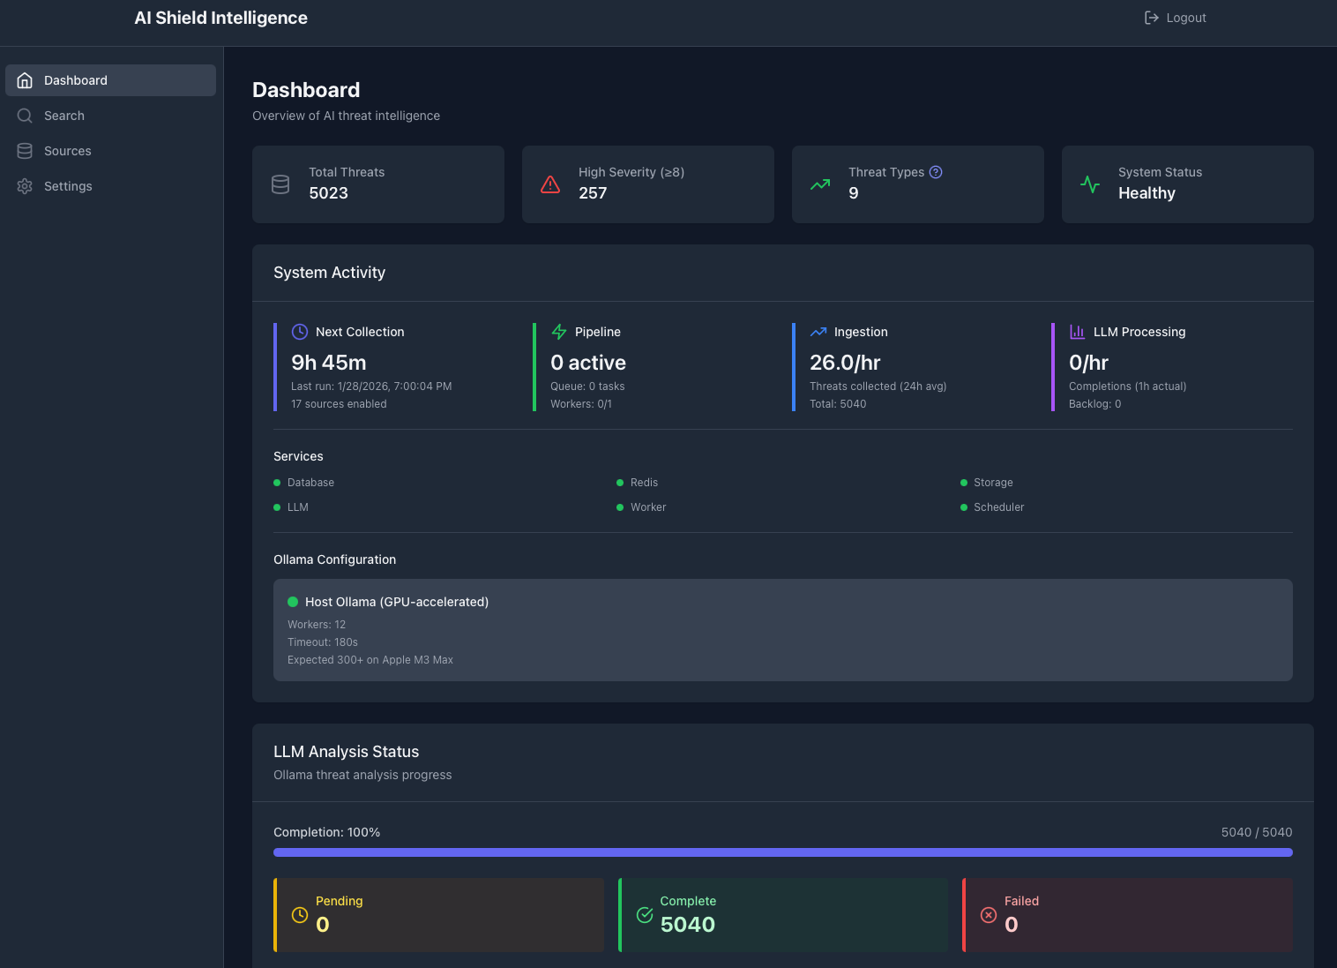
What The System Actually Does
Pulls from research, advisories, GitHub, CVE feeds, and community channels.
Normalizes and deduplicates incoming documents into threat records.
Classifies threat type and extracts entities, MITRE mappings, and severity.
Stores raw artifacts plus structured metadata for search and analytics.
Serves the output through FastAPI, React, scheduled jobs, and alert hooks.

Slide 4
Why This Matters
AI attack techniques change faster than most hand-written security test suites.
Raw papers and repos are hard to operationalize under normal engineering time pressure.
This system compresses the path from “new attack published” to “searchable, scored, testable threat.”
Structured metadata makes the output automatable by other tools instead of analyst-only.

Slide 5
Architecture: Data Flow
Sources: arXiv, security blogs, NVD/CVEs, GitHub, Reddit, Hacker News, other feeds.
Ingestion: scheduled RSS/API/scraping collectors plus manual or event-driven inputs.
Processing: normalization, deduplication, classification, entity extraction, MITRE ATLAS mapping.
Analysis: optional Ollama-based LLM summaries, attack vectors, and mitigations.
Delivery: search APIs, threat detail APIs, analytics UI, and alert notifications.

Slide 6
Runtime Architecture: Data And Infrastructure
PostgreSQL is the system of record for threats, entities, MITRE mappings, and LLM output.
Redis is the queue broker and cache for asynchronous processing.
MinIO stores raw threat payloads and collected artifacts.
Ollama provides local model inference in the minimal deployment profile.
Docker Compose ties the services together for a single-node pilot environment.

Slide 7
Runtime Architecture: Application Services
FastAPI exposes auth, search, threat retrieval, analytics, and system status endpoints.
Celery Worker runs collection, enrichment, and LLM analysis tasks.
Celery Beat triggers recurring collection on a schedule.
React provides dashboard, search, threat detail, and settings views.
Net effect: a complete analyst-facing platform, not just a background crawler.

Slide 8
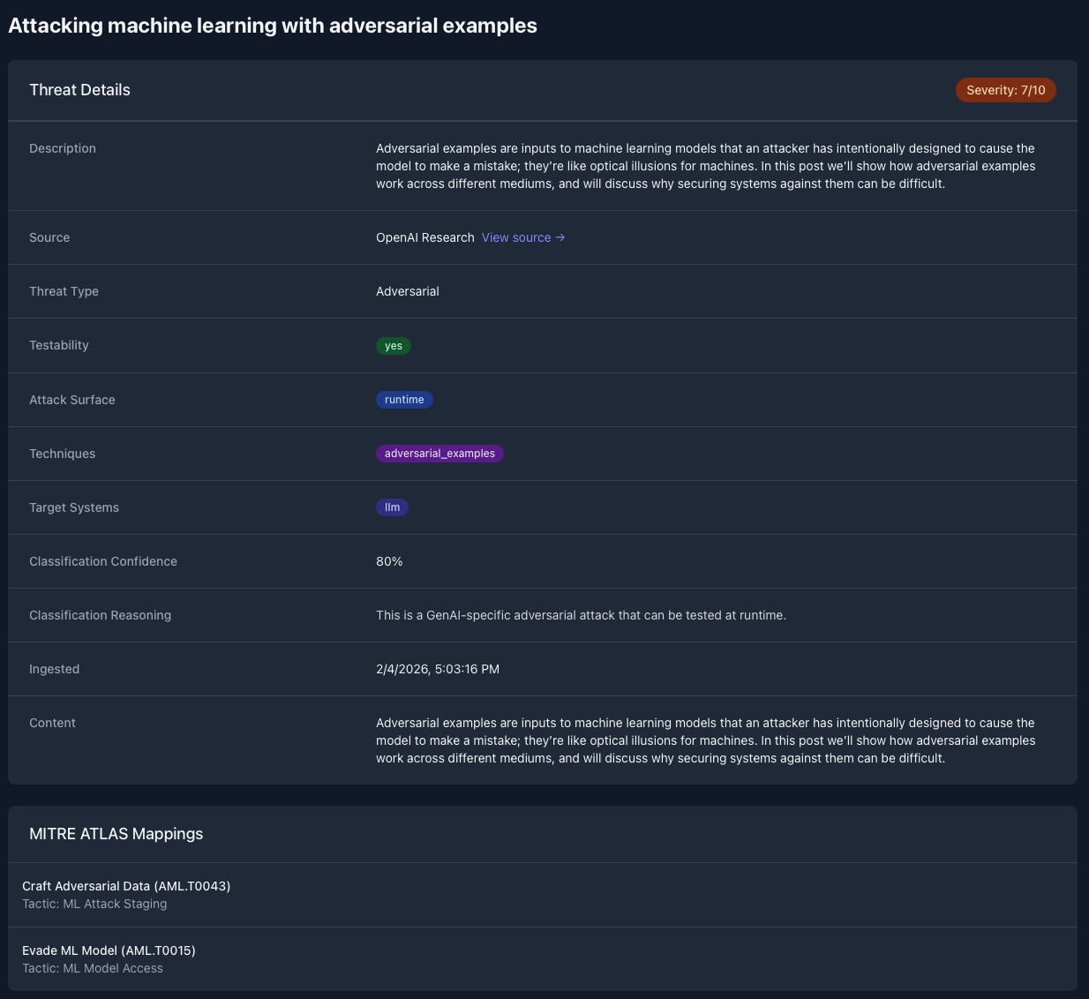
Why The Data Model Matters
Threats carry structured classification metadata rather than only free text.
Important fields include attack surface, testability, and target systems.
Those fields let clients filter for runtime-testable threats and relevant system classes.
This is the key design choice that makes the intelligence feed usable by automation.

Slide 9
How Eval Kit Uses The Feed
Selects threats from AI Shield Intelligence using search, recent, and severity-based pulls.
Deduplicates already-processed threats before spending enrichment or LLM time.
Enriches source content to extract payloads, trigger phrases, and attack details.
Filters for runtime-testable cases such as prompt injection, jailbreak, extraction, and adversarial flows.
Generates validated YAML seeds for GenAI and agentic system evaluation.
fetch threats -> filter and enrich -> generate seeds -> write catalog.

Slide 10
Why The Two Repos Belong Together
AI Shield Intelligence answers: what new attack patterns exist right now?
AI Shield Eval Kit answers: can our model or agent handle those attacks today?
The eval kit is the execution layer that converts intelligence into tests.
Combined, they form a pipeline from external threat discovery to repeatable validation.
That pipeline keeps the test catalog current as the threat landscape changes.

