Slide 1


Operational Efficiency for Document Centric Businesses

Slide 2

Documents still drive fundamental business processes
Background Verification
Finance & Accounting
Insurance Claims & Processing
Government
Know your customer KYC
Trade Finance
Contract Administration
Loan
Processing
Grading for Education
Real
Estate
Logistics

Slide 3

Background Verification companies manage complex and variable documents
Forms
Payslips
W2
Driver’s license
Passport
Previous employer letters
W4
Tax
….
Educational certificates
….
Health reports
….
Structured
Semi-structured
Unstructured

Slide 4
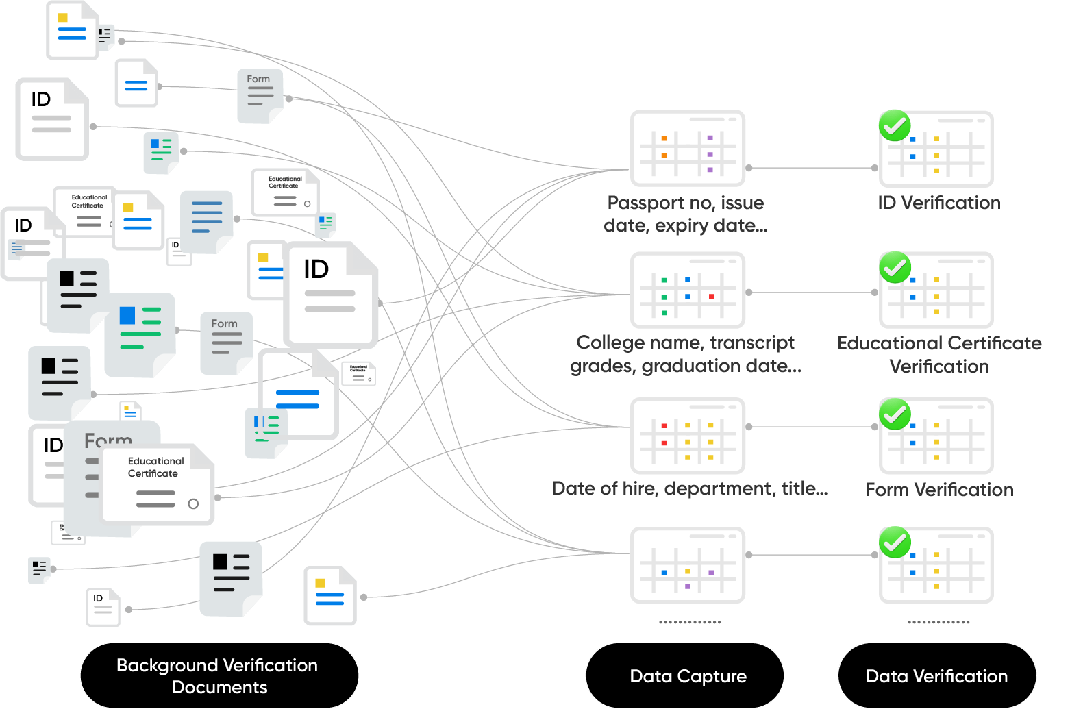

30%-40% of manpower is dedicated to data capture and document management
Major Challenges
Difficult and Expensive to Scale
Limited Data Capture
Error Prone
Time Consuming

Slide 5


Automated Data Capture and Processing

Slide 6


TruCap+ Feature Highlights
AI-enabled document processing for a greater degree of automation & accuracy
Seamless integration with downstream systems and RPA for end-to-end automation
Template-Free approach for rapid setup, deployment & future flexibility
Cloud-based platform with enterprise-grade security
Intuitive Human-in-the-loop (HITL) for quality control
Flexible, tiered pricing based on page volume

Slide 7
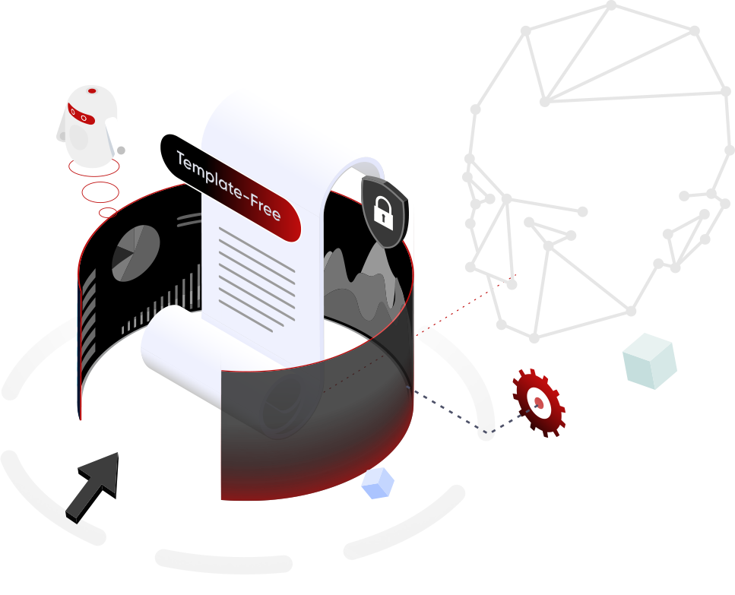
TruCap+ improves core business efficiency, enabling non-linear growth
Manual data capture
Data capture with TruCap+
Typical efficiency gains
Headcount
100
15-30
70-85% headcount reduction
Speed
2-10 mins/document
10-60 secs/document
10X+ increase in speed
Error
8-10%
1-3%
70%+ error reduction
Volume of data collected
20-30%
100%
Complete data capture for better decision making

Slide 8
Key benefits
Improved operational performance, digital readiness and end-customer-value
v
Faster case processing
Analytics-ready digital data
Faster onboarding of employees
Reduced human dependency
Increased volume with no additional investment
Lower total cost of data processing

Slide 9
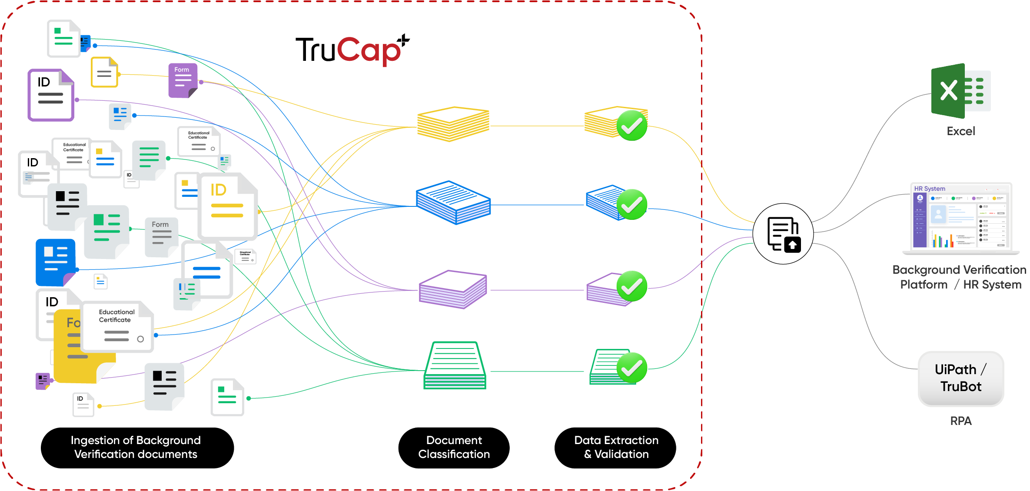
Automating data capture for Background Verification

Slide 10
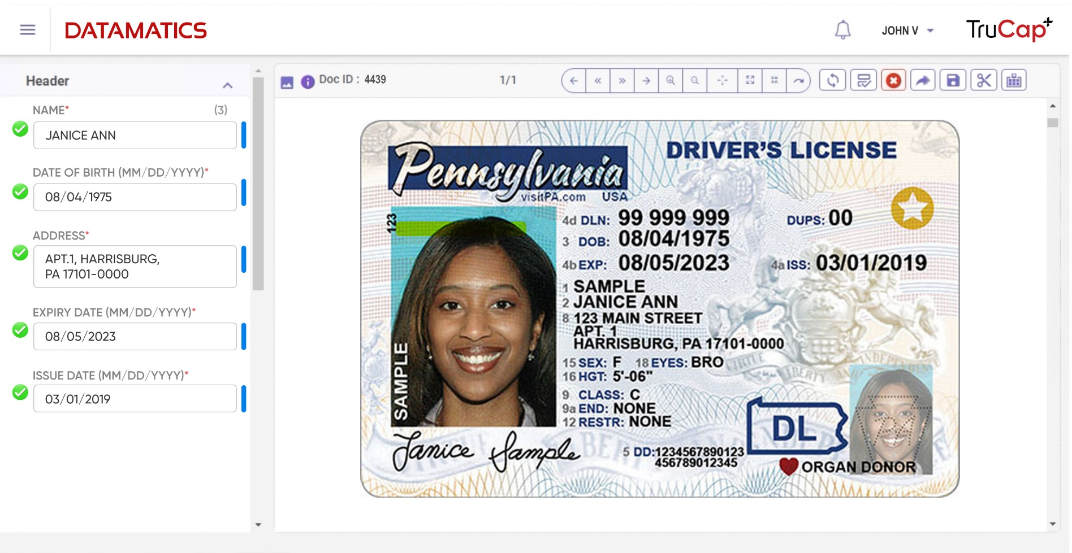
Automated data extraction from employee documents

Slide 11
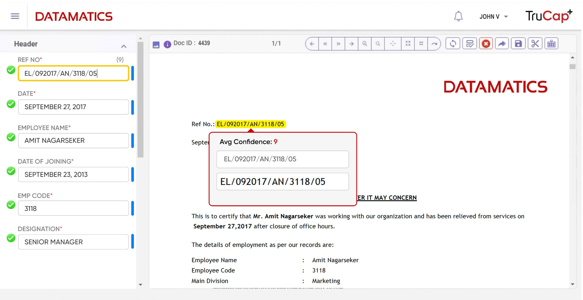
Automated data extraction from employee documents

Slide 12








TruCap+ is highly regarded by Industry Analysts
Competitive Landscape: Intelligent Document Processing Platform Providers
Technology Leaders
SPARK Matrix™: Intelligent Document Processing (IDP), 2021
Emerging Technologies and Trends Impact Radar: Enterprise Software
Major Contender
Intelligent Document Processing (IDP) Products PEAK Matrix – 2022
Market Prospects
Omdia Universe: Selecting an RPA & Intelligent Automation Solution, 2021–22
Major Player
IDC MarketScape Asia/Pacific Intelligent Automation Services 2021 Vendor Assessment
Market Guide for Artificial Intelligence Service Providers 2021
Technology Leaders
SPARK Matrix: Intelligent Process Automation Solutions and Services (IPA), 2021
Datamatics' RPA-powered intelligent document processing approach
Market Landscape: Intelligent Document Processing 2021
Breakout Zone
Zinnov Zones – Hyper Intelligent Automation – H1 2022
Market Guide for Intelligent Document Processing Solutions

Slide 13
Datamatics is an expert in Enterprise Data Management and Intelligent Document Processing
80+
TruCap+ customers
1B+ Pages processed by TruCap+
52%
Business from document centric processes
Key Industries
Key Geographies
Banking and capital markets
Travel and Logistics
UK & Western Europe
Healthcare
Manufacturing
Business Services
North America
Middle East
Insurance
Government and public sector
LATAM
India

Slide 14

Who we are

Slide 15

Application Modernisation
Finance & Accounting
Cloud & DevOps
Banking Process Management
Digital
Technologies
Insurance Process Management
Big Data & Analytics
Digital Content Management
Artificial Intelligence & Cognitive Services
Digital
Operations
BPaaS
Intelligent Automation
Mobility & Portals
Digital
Experiences
Customer Management & Experience
Business Solutions & Platforms
Consumer Research & Analytics
Automatic Fare Collection
Digital Proctoring

Slide 16
Thank You
automation.datamatics.com

