Slide 1
Treaty Bio Progress report 1
Ben trey, Sishir Yeety, diana LIU, Gurleen bath, Brendan keegan

Slide 2
Quick overview of our project
We are creating a wearable device that gives suggestions to a basketball player to increase their shooting percentages

Slide 3
Our Current progress
Rough Architectural Visual (next slide)
UI: initial layout complete in skeletal form
Speech recognition, using SpeechRecognition library in Python, skeletal layout complete as part of main program
Text-to-speech is completed and integrated into UI on GitHub. This will be used for audio generated coach feedback
Main programming/UI portion of README.md completed with further updates as we integrate

Slide 4
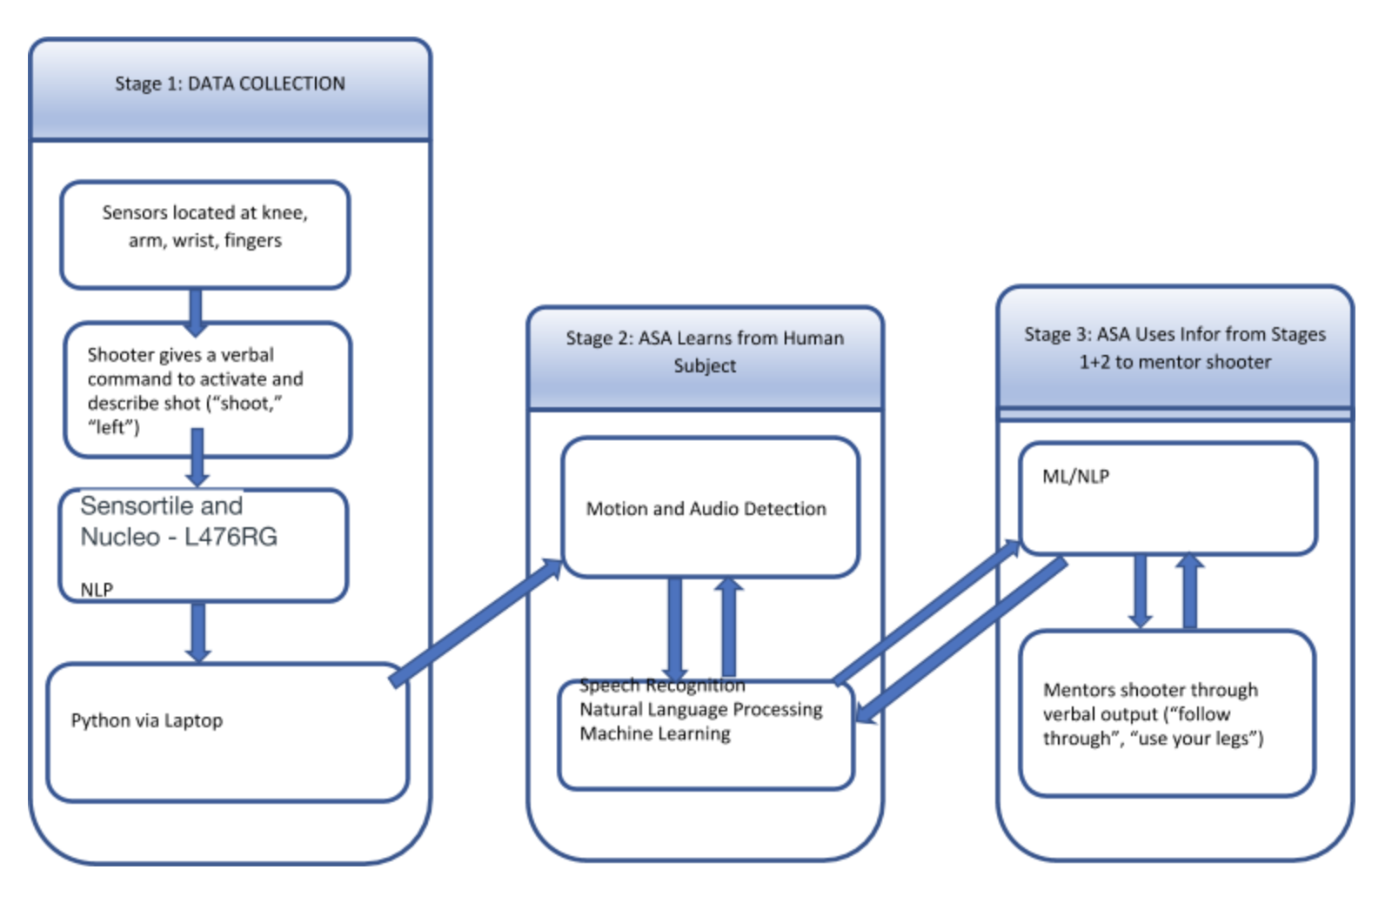
Device architecture

Slide 5
Next steps
SpeechRecognition Library programming
UI: layout complete, but needs further integration
Main programming/UI portion of README.md ongoing updates as we update
Getting Data from the Sensor Tile with Python - Using the blue_st_sdk library to get sound, acceleration, and gyro data from the tile.
Start collecting actual shot data to put through sklearn

