Slide 1
Price-Drop Master
PDEng Mini-project
Hang LIU

Slide 2
Outline
Introduction
Use Case
Design Choice
Technology Choice
Realization
Demo

Slide 3

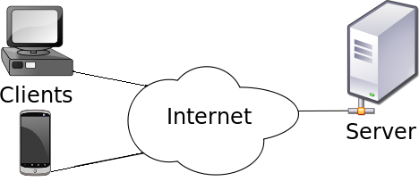

Introduction
To learn new technologies
To develop a client-server application
To provide automatic price tracking for
online shopping

Slide 4

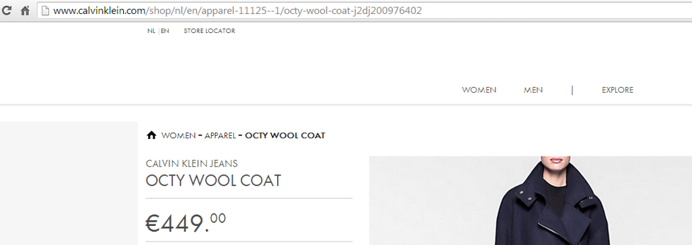
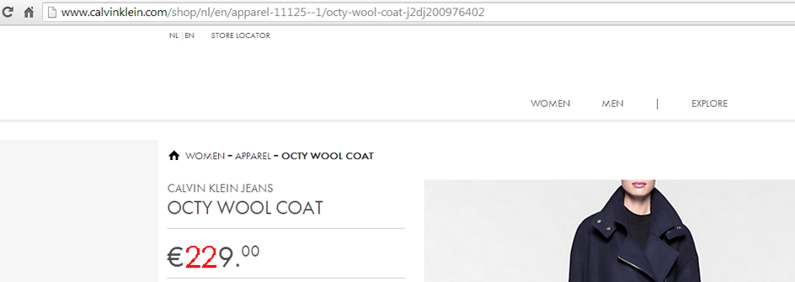

Use Case

Slide 5
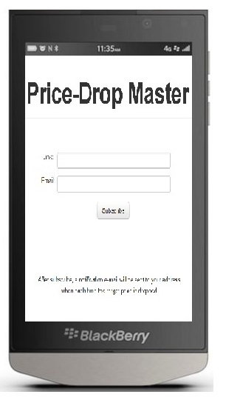
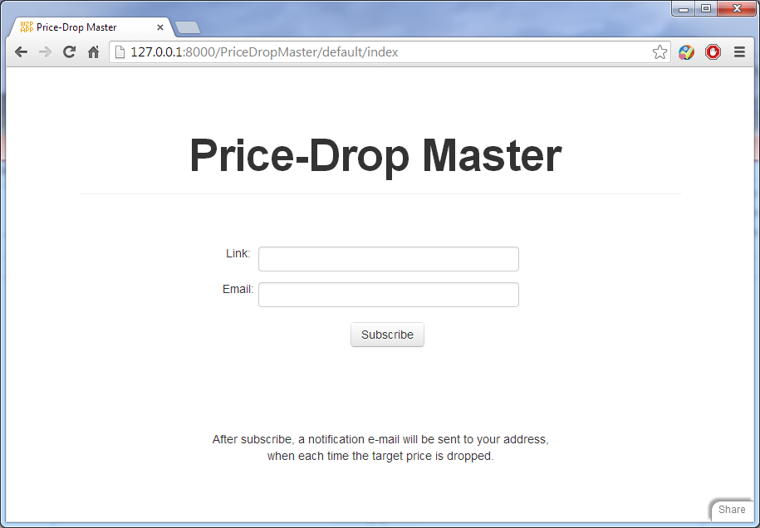
Design Choice
More people using computer for online shopping
Web-based application also can be accessed from
Smart devices
HTML 5 is a new knowledge for me

Slide 6
Technology Choice
Web Framework
Web2py vs. Django
Scraping Technique
Scrapy vs. LXML

Slide 7
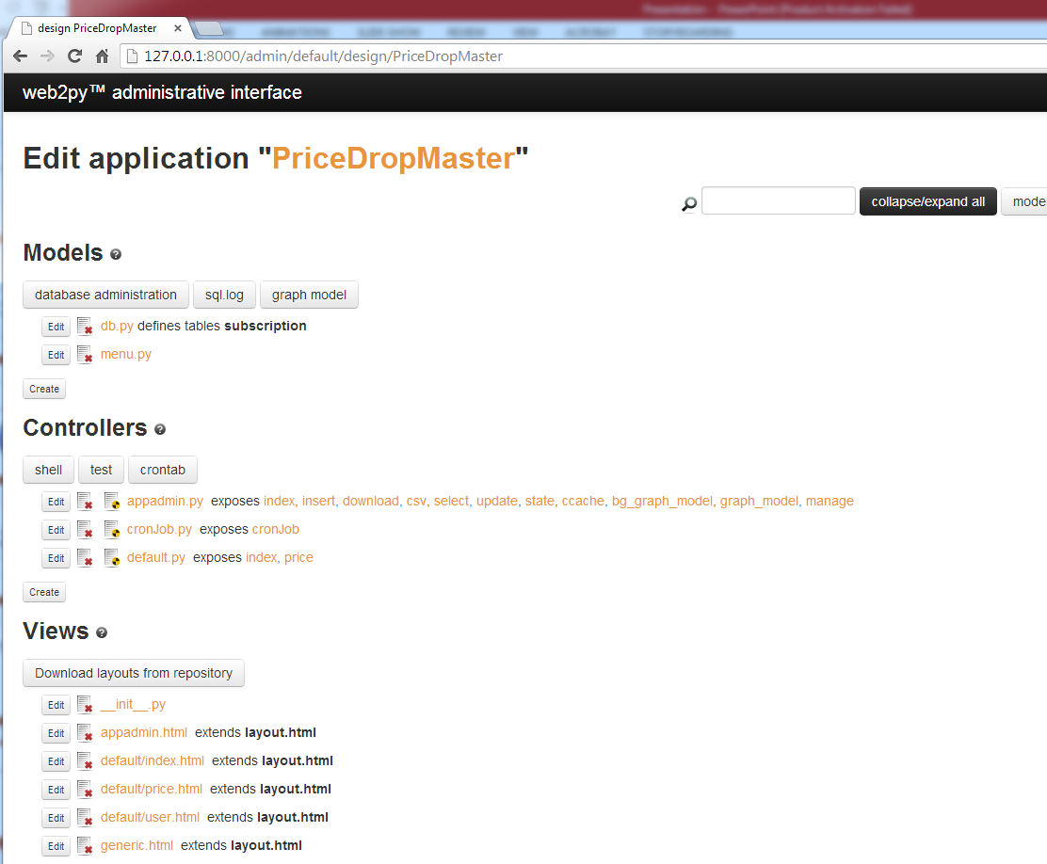
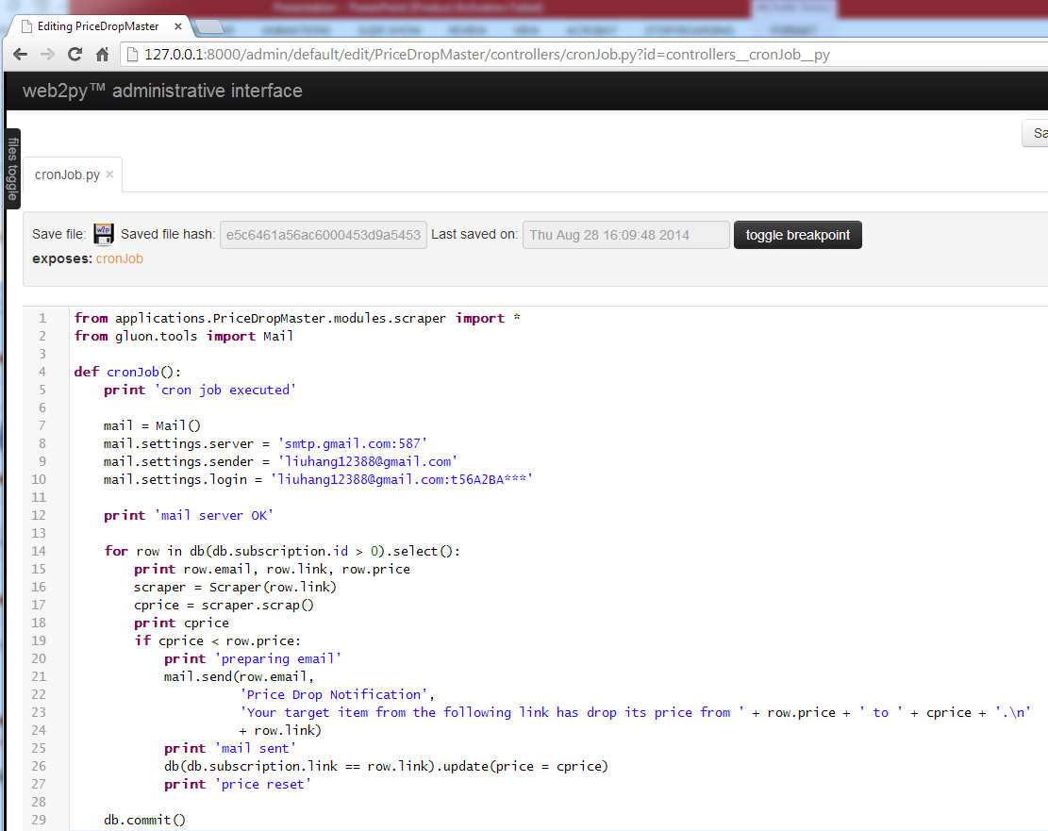
Realization

Slide 8
Demo
http://127.0.0.1:8000/PriceDropMaster

