Slide 1
ACADEMIC CYBERSECURITY PROJECT
GRC Risk Register
Cybersecurity Risk Management System
A lightweight, deterministic qualitative risk management system with interactive matrix scoring and audit trail.
Author: Tanvi Mishra | Domain: Information Security & GRC | Date: August 2026

Slide 2
Problem Statement
Why manual risk management and static spreadsheets fail in practice
Spreadsheet Chaos
• Static Excel files cause severe version conflicts and accidental overwrites.
• No multi-user access synchronization or change accountability.
• High risk of corrupted records and data loss.
Disconnected Assets
• Cybersecurity threats evaluated without linking to physical or cloud assets.
• Difficult to identify which critical database or service is exposed.
• Lack of organizational asset context.
Subjective Scoring
• Inconsistent ratings assigned by different security analysts.
• Lack of a transparent mathematical calculation model.
• Vague severity classifications create confusion in triage.
Lost Accountability
• Risks identified once and forgotten in static documents.
• No structured status lifecycle (Open -> In Progress -> Treated).
• Zero audit trail tracking who modified risk parameters.
GRC Risk Register — Cybersecurity Risk Management System | Academic Project Presentation

Slide 3
Project Objectives
What the GRC Risk Register system delivers
1. Unified Asset Inventory
• Maintain structured records of systems, databases, devices, and cloud services.
• Categorize assets into Data, System, Device, and Service.
• Assign business importance ratings (Low, Medium, High).
2. Threat Scenario Register
• Link cybersecurity risks directly to affected organizational assets.
• Capture threat titles, consequence narratives, and ownership.
• Support soft-archiving to maintain historical referential integrity.
3. Deterministic Scoring
• Compute risk severity using a reproducible formula: Score = Likelihood x Impact.
• Map scores strictly into Low (1-2), Medium (3-4), and High (6-9).
• Standardize triage using an interactive 3x3 risk matrix heatmap.
4. Lifecycle Tracking & Reports
• Track status across Open, In Progress, Treated, and Closed phases.
• Generate browser-native printable executive reports.
• Export RFC-4180 compliant CSV datasets for external auditing.
GRC Risk Register — Cybersecurity Risk Management System | Academic Project Presentation

Slide 4
Main Application Features
Core capabilities implemented in the Single-Page Application
Authentication & RBAC
• Session token authentication.
• Role separation (Admin vs Analyst).
• Instant session termination on logout.
Executive Dashboard
• Top 4 summary metric KPI cards.
• Interactive 3x3 Risk Matrix Heatmap.
• Severity breakdown progress bars.
Asset Register
• Auto ID generation (AST-001).
• Asset criticality ratings.
• Safe soft-archiving & filtering.
Risk Register
• Threat-to-asset relational linkage.
• Real-time modal calculation preview.
• 4-stage lifecycle treatment tracking.
Reports & CSV Export
• Browser-native printable summary.
• One-click CSV dataset download.
• Executive risk metrics overview.
Audit & Governance
• Immutable event logging trail.
• Admin feature control toggles.
• Zero exposed user credentials.
GRC Risk Register — Cybersecurity Risk Management System | Academic Project Presentation

Slide 5
Risk Scoring Model
Deterministic calculation and the 3x3 qualitative risk matrix
Mathematical Model
Score = Likelihood (1–3) × Impact (1–3)
Likelihood Scale (1 to 3): 1 = Low (Rare), 2 = Medium (Possible), 3 = High (Frequent)
Impact Scale (1 to 3): 1 = Low (Minor), 2 = Medium (Moderate), 3 = High (Critical)
Severity Classification: • Low Risk (Score 1–2): Routine monitoring • Medium Risk (Score 3–4): Planned remediation • High Risk (Score 6–9): Immediate mitigation
Deterministic & Transparent: Eliminates subjective guesswork during risk reviews.
The 3 × 3 Qualitative Risk Matrix
Likelihood \ Impact | Low (1) | Medium (2) | High (3)
High (3) | Score 3 (Med) | Score 6 (High) | Score 9 (High)
Medium (2) | Score 2 (Low) | Score 4 (Med) | Score 6 (High)
Low (1) | Score 1 (Low) | Score 2 (Low) | Score 3 (Med)
GRC Risk Register — Cybersecurity Risk Management System | Academic Project Presentation

Slide 6
System Architecture
Zero-dependency four-tier web architecture
Tier 1: Client Browser
Web Browser (Chrome, Firefox, Edge)
Tier 2: Frontend SPA
Vanilla HTML5 + CSS3 + ES6 JavaScript
Tier 3: Backend Server
Python Standard Library (http.server)
Tier 4: Persistence
SQLite 3 Embedded Database (sqlite3)
• Renders user interface and views.
• Captures user inputs and form submissions.
• Stores session token securely in localStorage.
• Executes client-side tab routing.
• Pure Single-Page Application (SPA).
• Asynchronous fetch API communication.
• Real-time modal calculation preview.
• Zero external JavaScript frameworks required.
• Handles REST API routing.
• Authenticates Bearer session tokens.
• Enforces server-side RBAC guards (401/403).
• Validates incoming JSON request payloads.
• ACID-compliant relational database.
• Stores users, assets, risks, controls, and logs.
• Protects passwords with PBKDF2 hashing.
• Zero external database servers required.
GRC Risk Register — Cybersecurity Risk Management System | Academic Project Presentation

Slide 7
Security Architecture
Layered defensive engineering and least-privilege access control
Password Hashing
Session Management
Role-Based Access (RBAC)
Input Validation
Immutable Audit Trail
• PBKDF2-HMAC-SHA256 algorithm.
• 100,000 hash iterations.
• Unique 16-byte random salt per user.
• Passwords never stored in plaintext.
• Cryptographically random 32-byte tokens.
• Bearer token transmission via HTTP headers.
• Server-side token validation on every request.
• Immediate token revocation on user logout.
• Server-side privilege separation.
• Administrator: Full system & audit control.
• Risk Analyst: Asset and risk operations.
• Protected routes reject unprivileged users (403).
• Strict schema and type checking on API.
• Bounds validation on Likelihood & Impact (1-3).
• Foreign key relational validation on assets.
• HTML escaping to mitigate XSS vulnerabilities.
• Server-side immutable event logger.
• Captures user ID, username, action, and time.
• Records all asset and risk modifications.
• Provides complete operational traceability.
GRC Risk Register — Cybersecurity Risk Management System | Academic Project Presentation

Slide 8
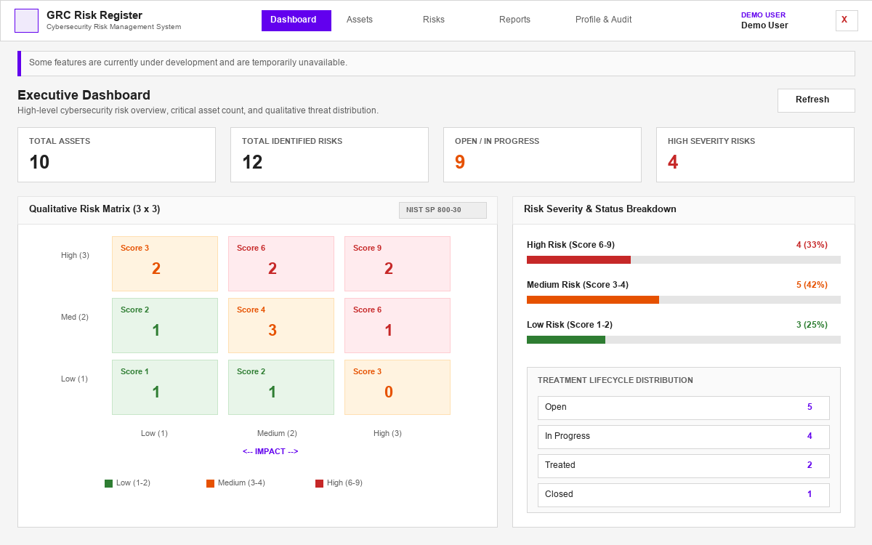
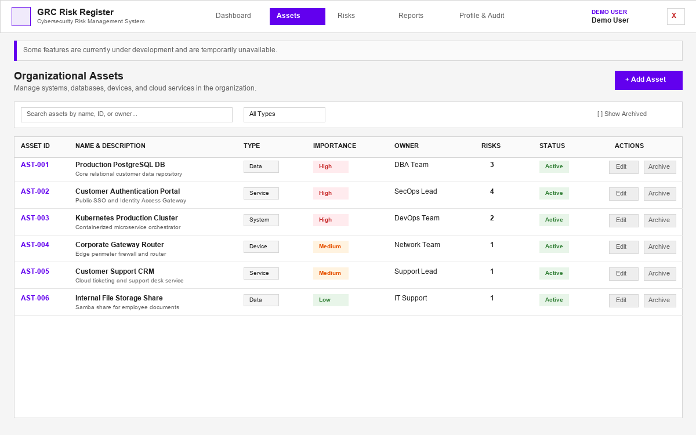
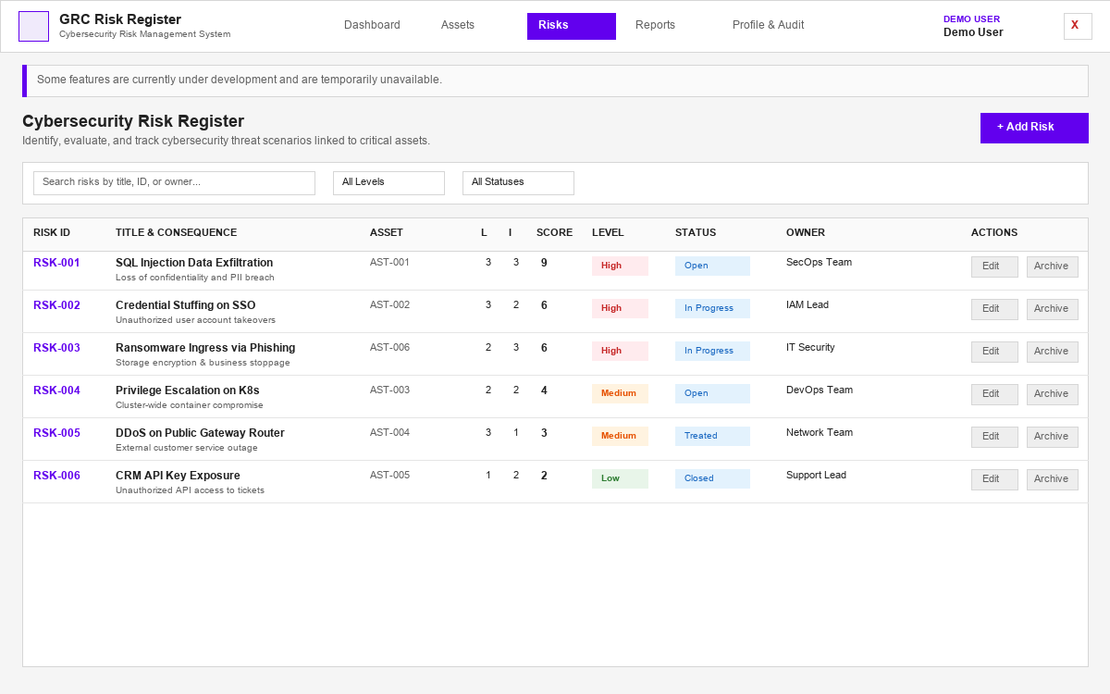
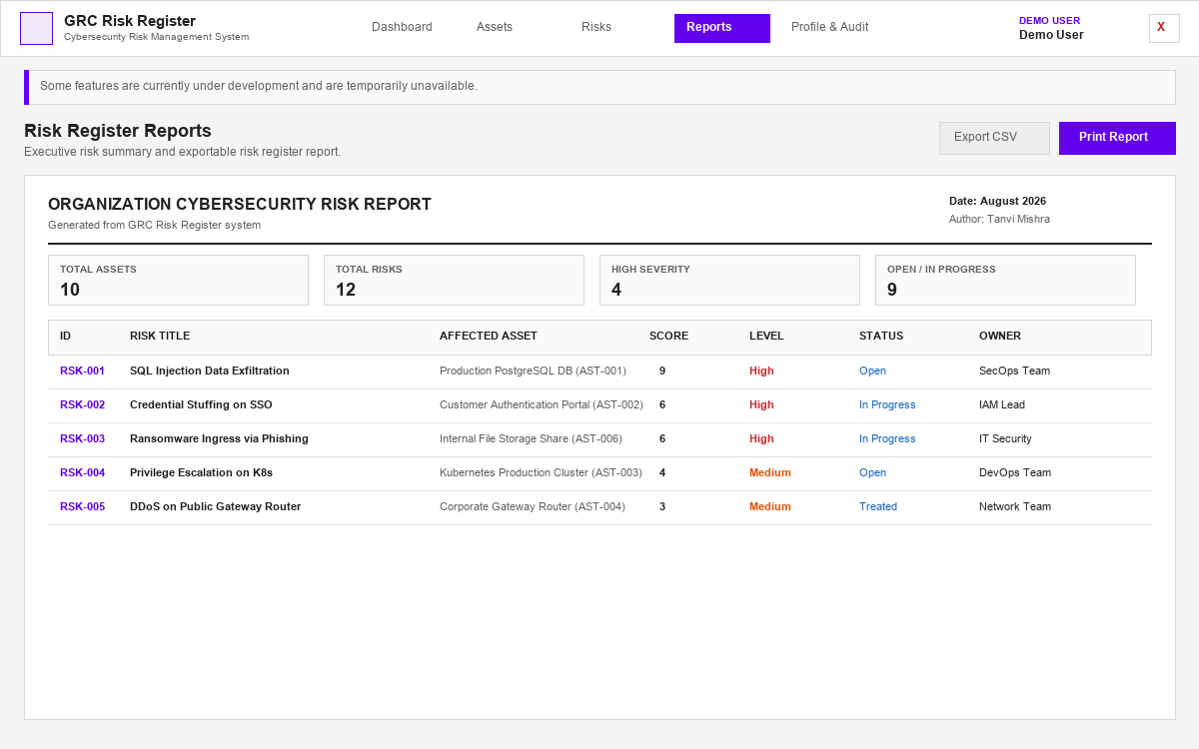
Application Screens & User Interface
Clean flat Material interface designed for risk analysts
Executive Dashboard
KPI summary cards, interactive 3x3 risk matrix heatmap, and severity bars.
Organizational Assets
Asset register with categorization, importance ratings, and soft-archiving.
Risk Register
Threat scenario evaluation with dynamic scoring preview and status tracking.
Printable Reports & CSV
Formatted risk register report ready for browser printing and CSV export.
GRC Risk Register — Cybersecurity Risk Management System | Academic Project Presentation

Slide 9
Verification & Testing Results
100% automated test coverage across all subsystems
TOTAL AUTOMATED TESTS
32
FAILURES / ERRORS
0 / 0
PASS RATE
100%
EXECUTION DURATION
< 2.5s
Calculator & Engine Tests (6/6)
• All 9 Cartesian coordinate pairs verified.
• Score range bounds and type validation.
• Matrix grid definition structure confirmed.
Authentication & RBAC Tests (7/7)
• PBKDF2 password hashing & salting.
• Session token lifecycle & expiration.
• 401 unauthenticated & 403 RBAC denial.
Asset & Risk CRUD Tests (9/9)
• Asset creation & AST-xxx auto-numbering.
• Soft-archiving & restore capabilities.
• Risk creation, scoring & status lifecycle.
Controls & Live Audits (10/10)
• 29 granular feature availability toggles.
• Demo mutation rejection guards (403).
• Live server integration checks passed.
GRC Risk Register — Cybersecurity Risk Management System | Academic Project Presentation

Slide 10
Conclusion & Key Learnings
Summary of project achievements and academic outcomes
Project Achievements
• Built a portable, self-contained Cybersecurity Risk Management System with zero external dependencies.
• Replaced error-prone spreadsheets with a structured relational database model.
• Implemented deterministic 3x3 qualitative risk calculation complying with NIST guidelines.
• Delivered real-time dashboard visibility, interactive matrix filtering, and printable reports.
Key Technical Learnings
• End-to-end Single-Page Application (SPA) design with vanilla web technologies.
• Implementation of cryptographically salted password hashing and session tokens.
• Strict server-side Role-Based Access Control (RBAC) and input validation.
• Comprehensive test-driven engineering achieving 100% automated test coverage.
Future Enhancements
• More granular threat actor and vulnerability classification criteria.
• Customizable multi-parameter PDF reporting and automated email digests.
• Enhanced bulk data import/export utilities for enterprise scalability.
• Additional authentication mechanisms such as Multi-Factor Authentication (MFA).
GRC Risk Register — Cybersecurity Risk Management System | Academic Project Presentation

